Slide 1
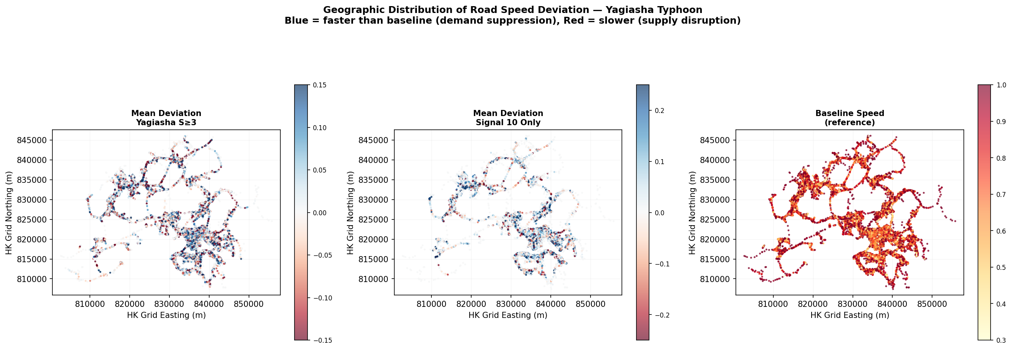
06
RQ1 · RQ2
During Event: The S8 Flip — From Congestion to Clearance
A Spatial distribution of speed deviation during typhoon (S3+, MIDDAY)
The S8 Flip
13:00 Pre-S8
Mean dev = −0.010 28.3% roads slower System-wide congestion
14:20 S8 ↑
Signal 8 raised Behavioural trigger
19:30 Post-S8
Mean dev = +0.045 <8% roads slower Network clears rapidly
Δ = +0.055 in 5 hours
largest 5-hour swing in the entire dataset
Conclusions
S8 is the single most powerful behavioural intervention — the network flips from congestion to clearance within hours
Spatial pattern confirms demand-side dominance: urban core (jobs) clears most, residential periphery mixed
Motorways and trunks are most responsive; local streets retain residual activity throughout the event
During-event phase | S8 triggers +0.055 swing | Network clears in ~2h | Urban core leads clearance

