Slide 1
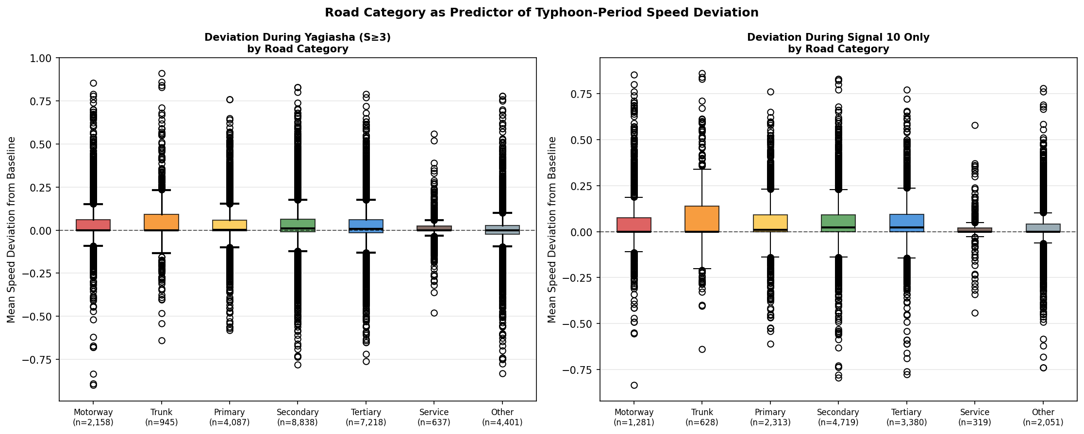
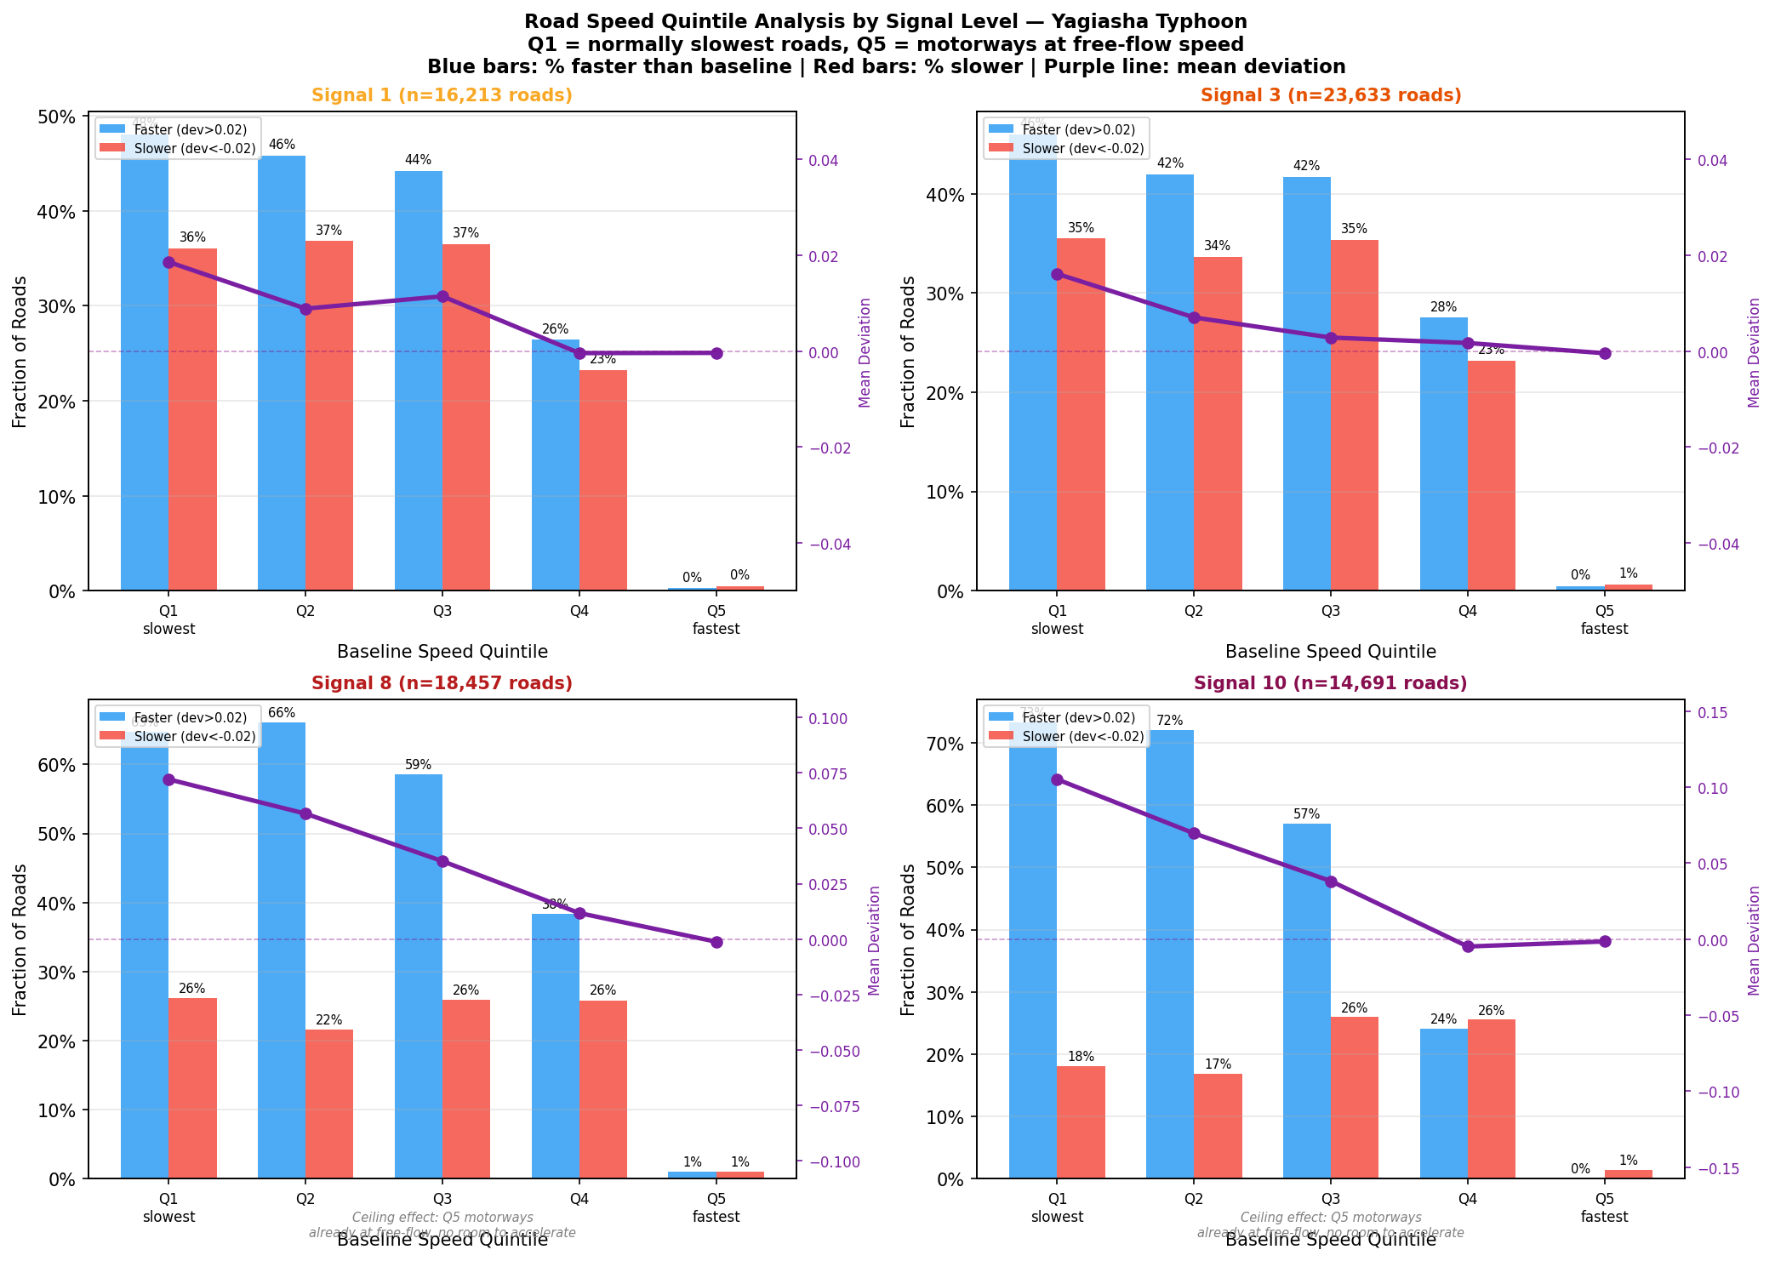
07
RQ1
During Event: Speed Polarization — Not All Roads Clear
A Speed deviation by road category: motorways shift most, local streets mixed
B Deviation quantiles by signal level: spread widens with severity
Key Findings: The Network Splits into Two Groups
Demand collapse on arterials
Signal gradient
33% of roads clearly faster (>+0.05) at S10 Motorways/trunks: strongest positive shift Fewer vehicles → higher observed speeds
IQR: 0.02 (S1) → 0.09 (S10) 4.5× spread increase from S1 to S10 Each upgrade widens the distribution
Residual activity on local streets
Bimodal, not uniform
11% clearly slower (<-0.05) at S10 Tertiary/residential streets hold activity Local trips persist despite typhoon
Roads don't shift uniformly faster Two clusters emerge: faster arterials and slower local streets
Polarization | Higher signal → wider spread | Demand collapse ≠ uniform | Bimodal distribution emerges

