Slide 1
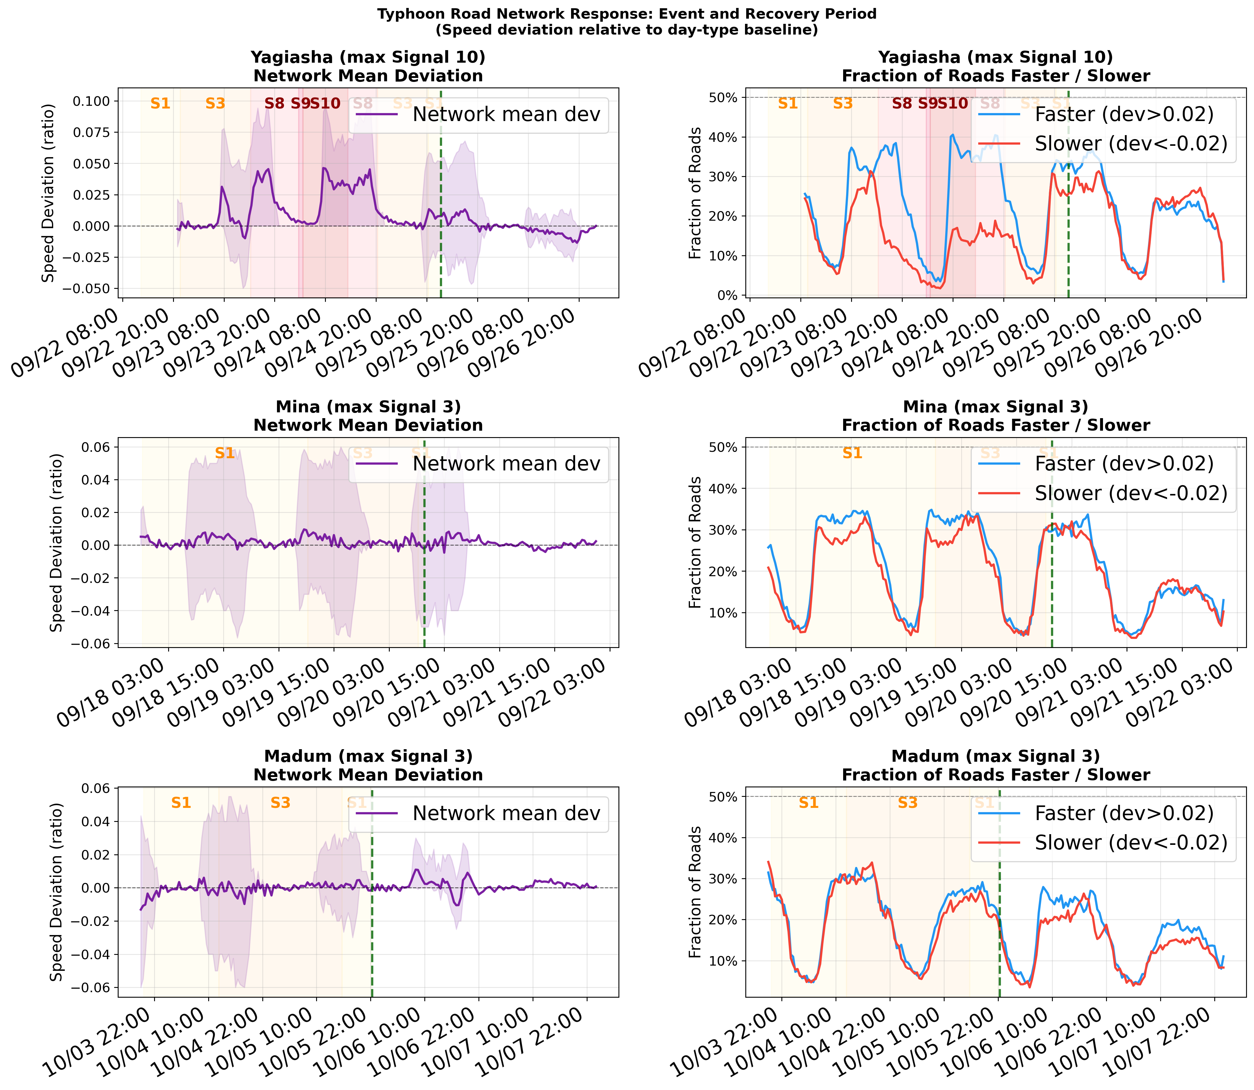
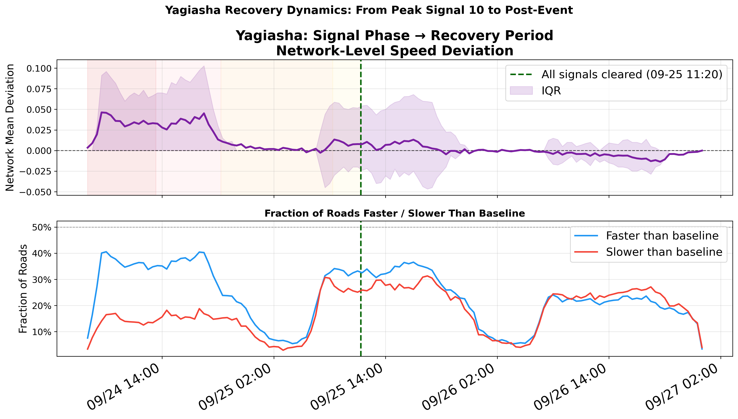
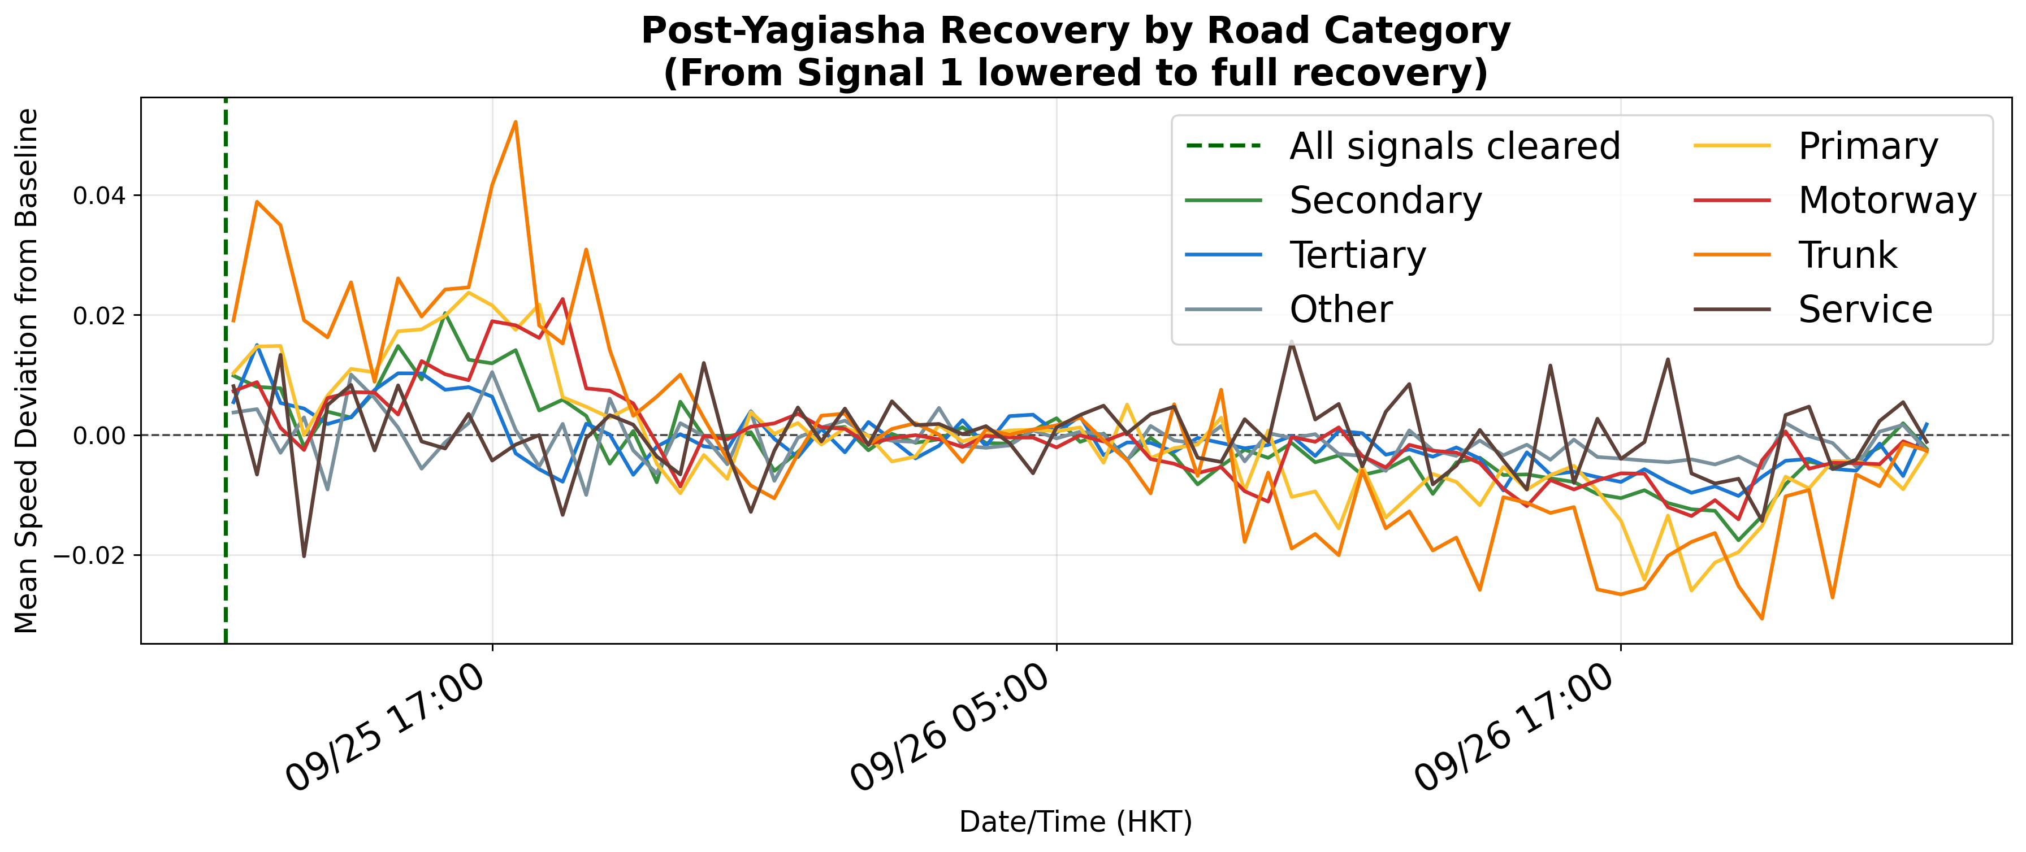
09
RQ4
Post-Event: Rapid Recovery — No Rebound
Recovery Metrics
~100 min
Return to within ±0.003 of baseline after All Clear
No rebound
No post-typhoon congestion surge — unlike hurricane lit.
All 3 typhoons
Mina, Yagiasha, Madum all show consistent rapid recovery
Demand-driven
Recovery is traffic returning, not infrastructure repair
→ Recovery speed confirms demand-side dominance: if infrastructure damage were primary, recovery would take days
Yagiasha recovery detail
Recovery by road category: motorways fastest
Post-event phase | ~100 min recovery | No rebound | Consistent across all 3 typhoons | Demand-driven

