Slide 1
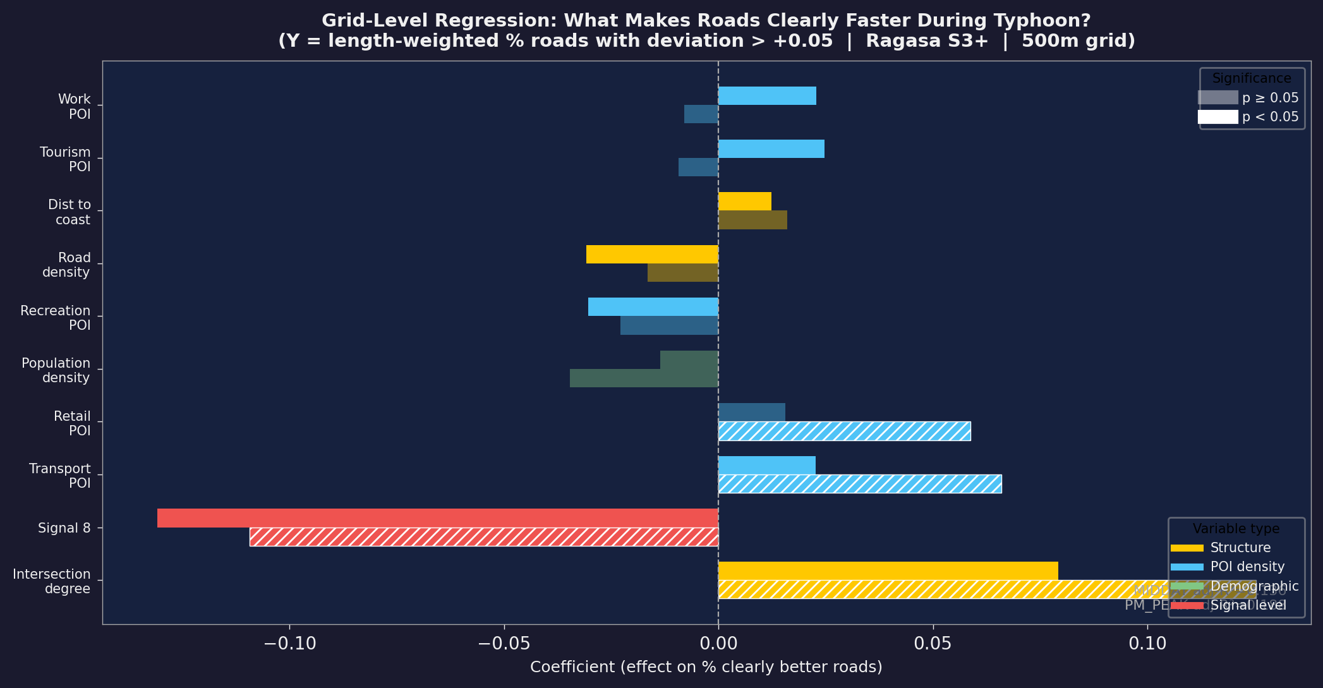
10
RQ3
Grid Regression: What Determines Speed Change?
Model Summary
Y variable
Length-weighted % of roads with deviation > +0.05 ("clearly better")
Unit
500m × 500m grid cell (≥3 roads, ≥500m total length)
X variables
10 POI log-densities + road structure + demographics + signal dummies
Best model
PM_PEAK: adj-R² = 0.188 MIDDAY: adj-R² = 0.136
Consistent Predictors
+ Intersection degree
More connected roads → more improvement
+ Transport POI
Near transit hubs → more roads get faster
− Road density
Denser network → less improvement
− Signal 8
S8 suppresses improvement (pre-S8 rush)
Interpretation: Grids with complex road networks near transit hubs clear fastest during typhoons. Dense road networks in commercial areas show less improvement — residual local activity. Demographic variables have limited explanatory power at grid scale.
Regression analysis | 500m grid | Ragasa S3+ | Length-weighted aggregation

