Slide 1
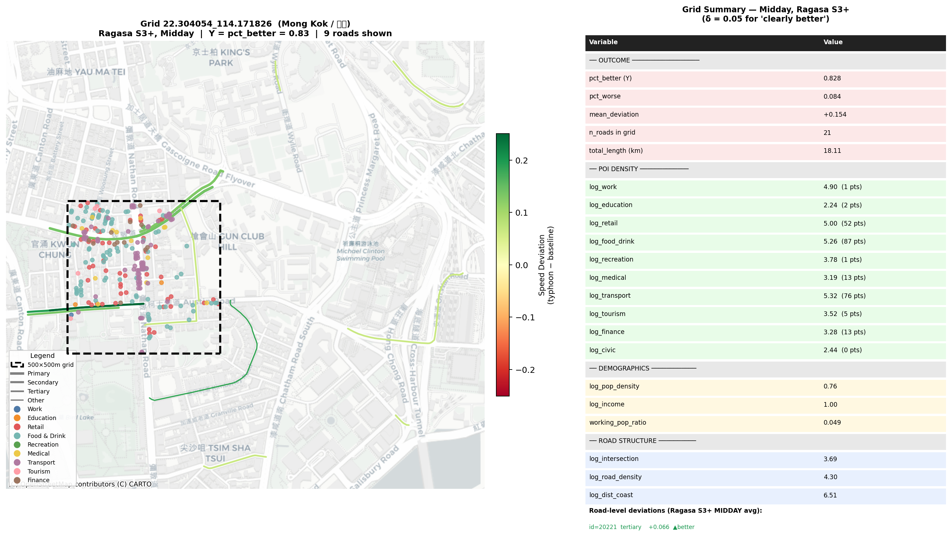
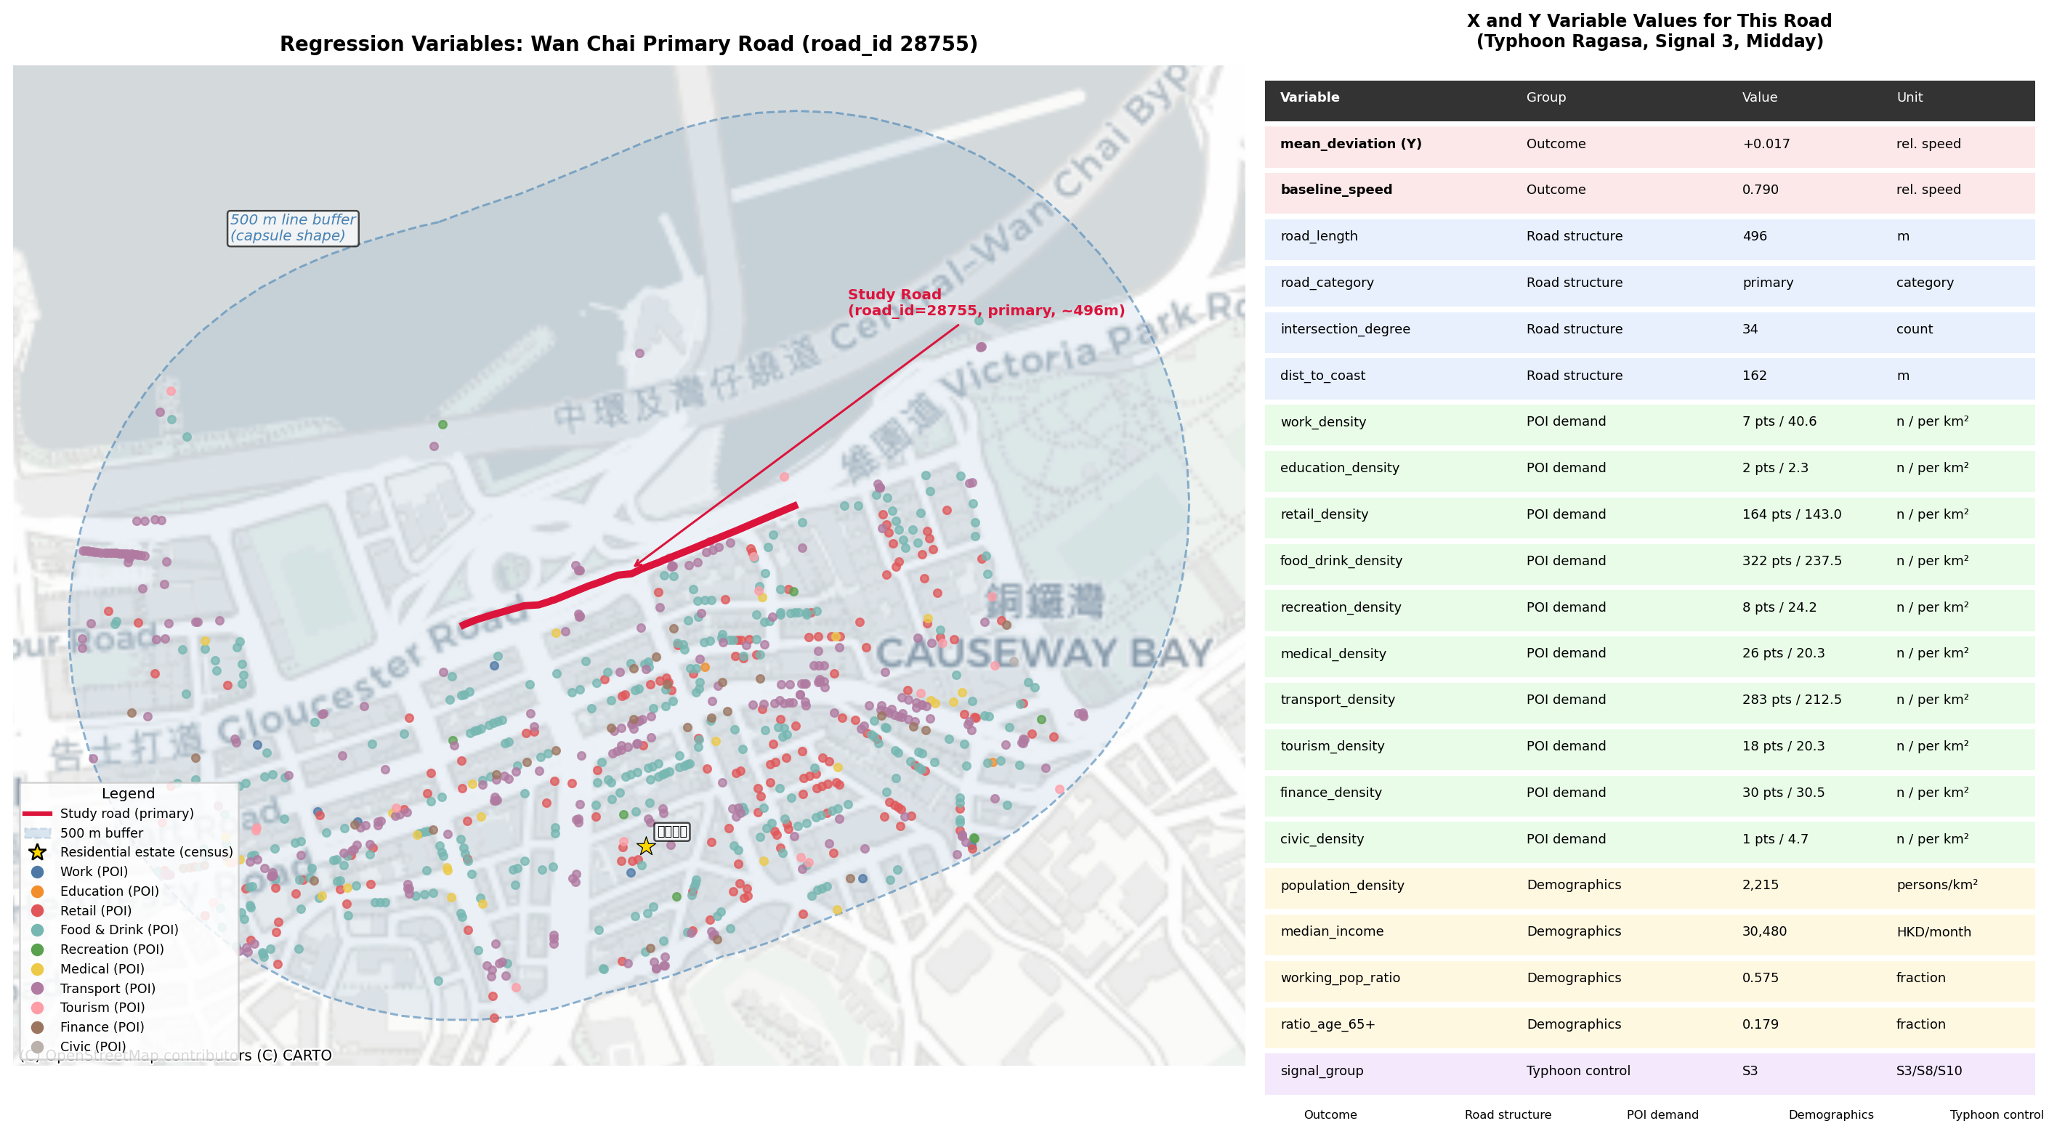
11
RQ3
Case Study: Single Grid × Regression Variables
A Mong Kok grid: 9 roads, pct_better=0.83, mean_dev=+0.154
B Wan Chai study road: 861 POIs in 500m buffer
From Road to Grid: Why Aggregation Works
Road-level R² ≈ 0.02–0.06 → Grid-level R² ≈ 0.14–0.19: spatial aggregation reduces micro-noise
500m grid captures neighborhood-scale determinants (POI, demographics) better than single roads
Length-weighting ensures long arterials contribute proportionally more to grid metrics
The Mong Kok case: high intersection density + transport POI + moderate road density → 83% roads clearly faster
Grid aggregation | 500m cells | Length-weighted | Neighborhood-scale determinants

