Slide 1
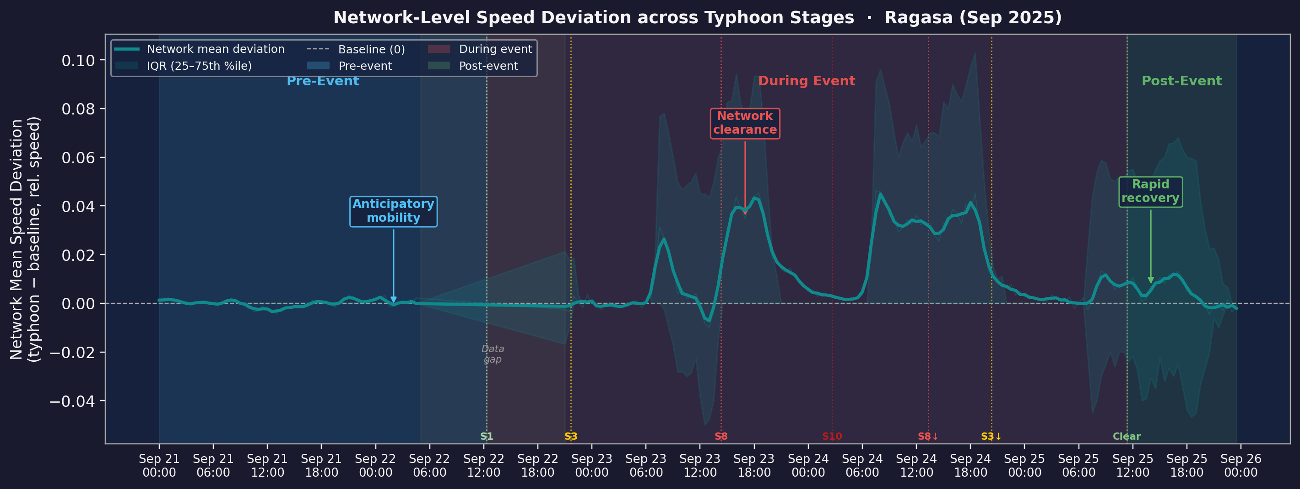
04
Overview: Network Response across All Typhoon Phases
RQ1 · RQ2 · RQ3
ALL PHASES
Pre-event:
During:
Post-event:
Anticipatory demand suppression begins hours before Signal 1
Network clears rapidly after Signal 8 — +4–5% above workday baseline
Recovery within ~2 hrs of All Clear; no rebound congestion
Ragasa (Sep 2025) | 30-min TomTom floating-car data | ~6,000–7,000 roads per slot

