Slide 1

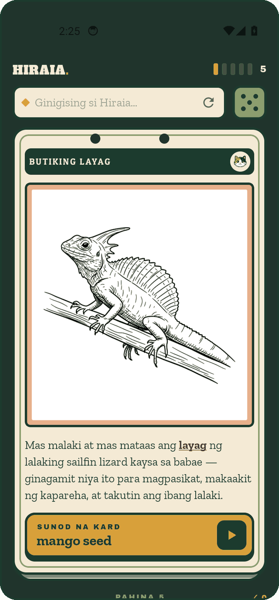
Hiraia — progress update
Early September 2026
An offline, on-device science tutor for Filipino grade-school students (Grades 3–10), aligned to the DepEd MATATAG curriculum, in Tagalog, Cebuano and English. The build targets Android 12+ phones with 6 GB or more memory, a single device tier: a 3B model with GPU offload, its Tagalog and Cebuano adapters bundled in the APK.
36,487
50,279
324
25,746
illustrated fact cards
verified trilingual facts
MATATAG competencies tracked (321 with cards)
cards with a quiz question
Evidence: repository at commit 58d358495 (branch question-cards) and its evaluation records; the published app is app v0.1 — the feed shown here ships in the next build. Sources are in the slide notes.
current build (card-ui, 26 Aug 2026)
Notes:
Sources: rag/bank/COVERAGE-ROUNDUP.md/.json (pool cards, bank facts, competencies with cards); packages/mobile/src/data/cards-questions.json (cards with an MCQ = 25,746); repository commit 58d358495 on branch question-cards; published APK: hiraia.org/models/hiraia.apk = v0.1.0 (June 2026, Sailor2-3B tier).

Slide 2




User experience
The app teaches with a deck of flash cards drawn from the DepEd MATATAG curriculum: a child reads a card, is quizzed on what they just read, is told what they have covered, and can ask for a topic at any time.
A card carries one fact, one illustration, and the topic that comes next.
Every few cards a question interrupts the deck, on a fact just read.
A periodic recap names the topics the child actually covered.
Typing a word moves the deck to a matching card — here, “bulkan”.
Hiraia · progress update · early September 2026 · hiraia.org
2
Notes:
Screenshots captured from the current UI build (card-ui branch, 26 Aug 2026) running on an Android 34 emulator at 720x1600. The deck is drawn from 36,487 illustrated cards; 25,746 of them have a verified multiple-choice question. Search is a local lexical/semantic match over the bundled card pool — a confident hit navigates to that card with the “ang tanong mo” banner shown here; when nothing matches, the on-device model answers from retrieved facts or says it does not know.

Slide 3
Training runs on RunPod
Most of the compute went into a continued-pretrained Filipino base model; the rest into tutoring fine-tunes, a pruning experiment, and evaluation.
run | GPUs | GPU-h | cost | basis | outcome
Full continued pre-training — Qwen3.5-2B, ≈13.7B tokens | 8 × H100 80GB | 294 | $972 | cost documented; hours from pod age | Held-out perplexity: Tagalog −80%, Cebuano −82%, English −4% (improved)
CPT probe run 2 (full-parameter, ZeRO-2) | 8 × H100 | 167 | $550 | documented | Only checkpoint-125 (525M tokens) survived a cross-DC sync failure — it validated the thesis: perplexity −63% tl / −63% ceb; GGUF export de-risked
CPT probe run 1 (≈5.1B tokens, trained as LoRA by mistake) | 8 × H100 | 85 | $285 | documented | No usable artefact; the pod/volume/heartbeat pipeline was proven
Full CPT attempt 1 (aborted) | 8 × H100 | 66 | $216 | estimate | Pre-processing collapse (worker count vs cgroup quota); run held and restarted
Prune + heal 2.4B experiment (Sailor2-3B) | 8 × A100 | 56 | $86 | documented | Heal recovered fluency (ppl tl 6.7 / ceb 9.9); conservative re-SFT under-fit — not shipped
GRPO rounds 1–5 (1B/3B) | 1–4 × H100 / RTX 6000 | 55 | $74 | mostly documented | Not shippable: capability 3.30 → 2.98; English +1.4 but abstention and Bisaya regressed
SFT v1 / v2 on the CPT base (Qwen3.5-2B) | 1 × A100 80GB | 3 | $6 | documented | v1 is the ship candidate: reply-language accuracy tl 99% · ceb 99% · en 94%
Adapter iterations on Sailor2-3B / 1B and tooling (36 entries, May–June) | H100 / L40 / A100 / L4 | 60 | $128 | mostly estimated | Shipped adapters v3 → v11: grounding faithfulness, static-prompt TTFT, kitten/cat tiers; QVAC-native training path evaluated and dropped
Checkpoint-sync, eval and debug pods | various | 68 | $85 | mixed | Evaluation on a device-equivalent GGUF; pre-flight debugging of run 2
≈853 GPU-hours and ≈$2,402 on RunPod since late May 2026 (rows sum to the totals); ≈$2,000 of that from figures recorded at the time, the rest estimated at list price — no billing export yet. About 80% of the compute went into continued pre-training of the Filipino base model.
Hiraia · progress update · early September 2026 · hiraia.org
3
Notes:
Per-run sources and hour/cost bases: docs/deck/data/evidence.json (runs, 49 entries; per-entry source = repo file:line or git commit). Grouping rule over the 49 raw entries in evidence.json→runs: 'full cpt run' without 'attempt' = row 1; 'probe cpt run 2/1' (not helper) = rows 2–3; 'attempt' = row 4; prune+heal = row 5; any 'GRPO' = row 6; SFT v1/v2 on the CPT/flagship base = row 7; 'helper pod' or 'pre-flight' = row 9; everything else (adapter LoRAs, QVAC CUDA attempts, DPO, bake-off) = row 8. (1) No RunPod billing export exists in the repo; Costs marked DOCUMENTED are the project's own contemporaneous figures ('~$972', '~$550', '~$285', '~$86', '≈$55', '~$24', '~$6'), not invoices. (2) Every June LoRA run except the 1B v3 ($0.38), Track-A ($0.60), v5 (~$2), GRPO pods ($10/$24/$5) and prune+heal ($86) has NO recorded duration or cost; those GPU-hours/costs are estimates from the recipe (~15-40 min train + setup) and the rates above. The kitten v3-v7 / cat v10 group (8 runs) is the least certain (±$10). (3) GPU-hours = pod wall-clock x GPU count. For probe run 2 and the run-2 pre-flight, wall-clock is unknown, so GPU-h was derived as cost ÷ $26.32/hr x 8 (167 and 16.7 GPU-h); run 2's ~$550 includes an unknown number of hours of runaway idle billing after the ~11 h of training. (4) The full-run GPU-hours use the VPS guard-log pod age (36.8 h); train_runtime alone was 35.66 h (fullrun-logging.jsonl). (5) The two probe helper pods (36h/48h TTL) have no recorded GPU type; costed at the $0.59/hr MIG rate the launcher tries first — if either was an H100 ($3.29/hr) add up to ~$75 each. 8womicsvtj3gt0/y8ys0evywikvcv/xb7pnw9ngyu8r4 MIG ≈$0.5; expansion-xfer pods MIG minutes) — together roughly $50-60 more. Also excluded: network-volume storage (5uwc7qp731 50GB US-KS-2 ~$5/mo; 1atl7503ky, 6er6skgoyb, ump7ia07oh, 0kt4j6h85v 300GB at ~$0.07/GB/mo), the hiraiabench Qwen3.5-27B pod build that failed (cost unrecorded, small), the Vultr VPS, Fireworks/Ox synth-ceb API spend, and Claude-subscription judging. (7) The June Cebuano corpus generation (8xA100, ~$42) is generation, not training, but is inside the documented $86 prune+heal figure and is reported there rather than split out. (8) The B200 smoke ($6.79/hr scaffold) never ran; the sm90 stack smoke on H100 is inferred from deploy_probe_cpt.sh comments and costed as an estimate. (9) The VPS mission-control run log/heartbeats only begin 2026-08-23T23:52Z (deployed after the run-2 loss), so earlier pod lifetimes come from docs/logs, not telemetry; the 9 run-2 heartbeats in heartbeats.jsonl were backfilled for the loss curve. (10) RunPod's quoted rate is not the billed rate (EUR-IS-3 quoted $21.52/hr, billed $26.32/hr — commit b58357e30); all 8xH100 figures use the billed $26.32. (11) SSH to the VPS (host alias 'kamai' → 45.76.180.229, ~/.ssh/config) worked read-only; notes.jsonl matches RUN-LOG.md plus 6 later entries (HOLD, GREENLIGHT, AUTOGRAB, synth-ceb closed, SFT v2 auto-eval).

Slide 4
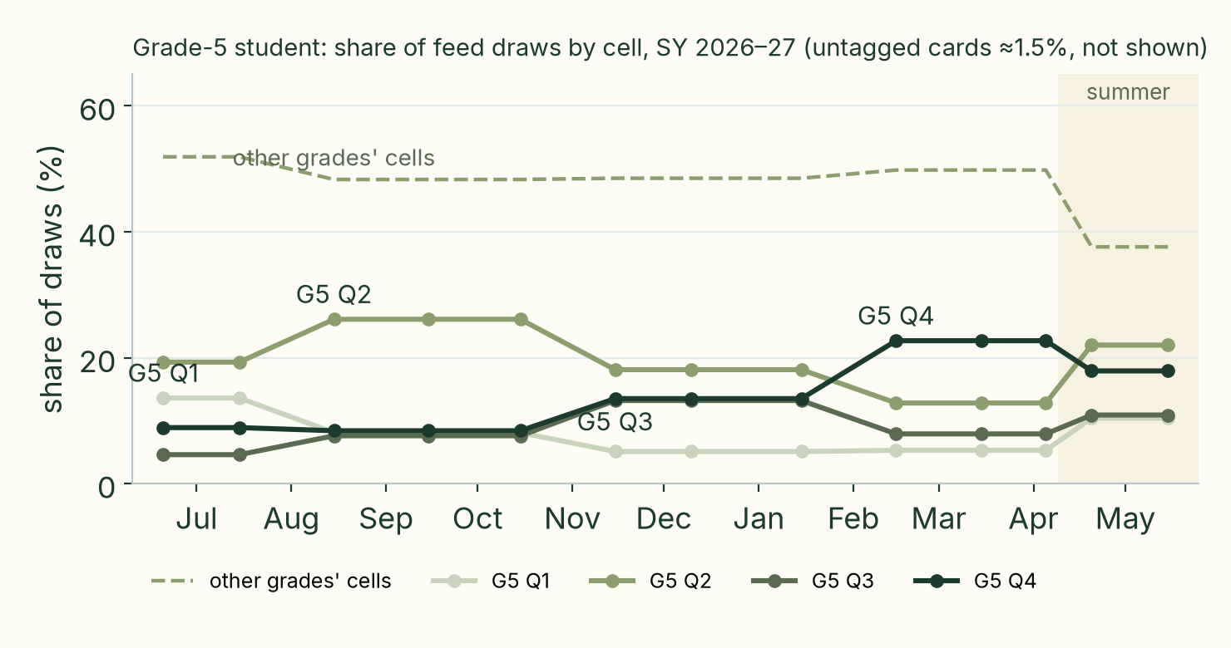
A curriculum-aware feed
Cards are weighted by the student's grade and the curriculum quarter inferred from the device date; the boost moves through the school year by itself, and flattens across the whole grade once school is out.
fact card
interject quiz card
• 36,487 illustrated cards; 34,719 facts labelled to 324 competencies (LLM labels, 83% inter-model agreement; single-model cells down-weighted)
• 25,746 cards (70%) carry a verified quiz question
• 0 elementary competencies below floor; 38 junior-high competencies below floor in the card pool (16 once DepEd module cards are counted)
current quarter, same grade | adjacent quarter | other quarter, same grade | adjacent grade, current | school out: any cell of the grade | off-curriculum
×6 | ×3 | ×1.5 | ×2 | ×6 | ×0.4
Hiraia · progress update · early September 2026 · hiraia.org
4
Notes:
Screenshots are from the current UI build (card-ui branch, 26 Aug 2026, installed on an Android 34 emulator); the curriculum weighting charted here is implemented on the question-cards branch at commit 58d358495 and the two branches are not yet merged, so the screenshots show the interface, not the weighting. Weighting: rag/pipeline/FEED-WEIGHTING.md; simulation from packages/shared/src/curriculum/feedWeighting.ts on the bundled tags (docs/deck/data/draw-share-by-month.json; the chart attributes a multi-cell card to the Grade-5 cell that won, so its Aug figure (26.1%) is not the same statistic as feed-calibration.mts's 'draws carrying a G5-Q2 cell' (25.5%) — both come from the same module and pool). Quarter weighting applies to all 324 competencies (elementary and junior high). Coverage: rag/bank/COVERAGE-ROUNDUP.md (below floor now = 38, all junior high; laggards after module cards = 16). Quiz: packages/mobile/src/data/cards-questions.json (25,746 of 36,487).

Slide 5
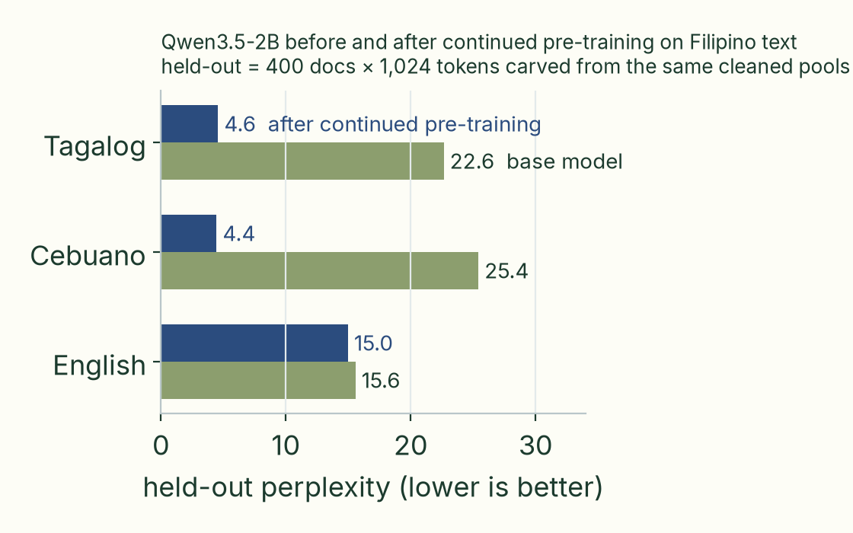
Model progress: fluency and pedagogy
From a fluent-but-cautious 3B adapter line to a continued-pretrained 2B base that reads and writes Tagalog and Cebuano: fluency is measured on held-out text, pedagogy on scripted tutoring probes.
Pedagogy (measured on scripted probes)
Scripted probes (102 in June, 143 now; 11 tiers, LLM-judged 0–5) showed the June model fluent but over-cautious: 19 of 91 answerable questions were refused. A retrieval fix plus a small data rebalance (+82 rows) lifted the score 3.32 → 3.72 (rebalance alone +0.22), and grounding faithfulness was fixed — the tutor defers to retrieved verified facts and abstains when none apply. The 2B line inherits the same harness; its capability run is the next measurement.
Known weaknesses (measured)
• Hedging: the SFT v1 2B prefixes 64% of Tagalog replies with a 'not sure' clause on grade-5 terms; about two-thirds of those then explain the term — a template-wording effect, not a knowledge gap
• English mode-lock is the 2B's fragile edge (94% vs 99% in Tagalog and Cebuano); misroutes fall to Tagalog
• Junior-high content is thinner than elementary. The 1B budget tier could not learn safety negation (DPO tested and rejected) and has been retired — the build now targets 6 GB+ devices only
Tiles: pedagogy figures are from the June 3B line; language accuracy and hedging from the August 2B (SFT v1). The 2B capability run is pending.
3.49 → 3.72
99 · 96 · 94%
64%
capability score (0–5), 102 probes — June 3B line, rebalance only
reply-language accuracy, SFT v1 2B (tl · ceb · en); Cebuano 99% corrected
of Tagalog replies open with a hedge; two-thirds still explain the term
Hiraia · progress update · early September 2026 · hiraia.org
5
Notes:
Sources: finetuning/cpt/FULLRUN-RESULTS.md (perplexity, 400 docs × 1,024 tokens); finetuning/eval/capability/ (capability score, rubric); finetuning/eval/routing/routing-sft-v1.json (reply-language accuracy, hedge rate); finetuning/cpt/SFT-V1-RESULTS.md; finetuning/eval/capability/FINDINGS.md (2×2: blob fix +0.17 for the shipping model, rebalance +0.22 faithful vs +0.41 lexical; together 3.32 → 3.72)
Held-out perplexity, Tagalog (400 docs x 1024 tok): 22.639 (Qwen3.5-2B-Base); probe base 21.299 (different carve-out) → 4.570 after full CPT (-79.8%); 7.835 at probe ckpt-125 / 525M tokens (-63.2%) — finetuning/cpt/FULLRUN-RESULTS.md:34 and finetuning/cpt/FULLRUN-EVAL-RESULT.json (base.tl.ppl=22.639, cpt.tl.ppl=4.57); probe: finetuning/cpt/PROBE-RUN-STATUS.md:101; caveat FULLRUN-RESULTS.md:64-67
Held-out perplexity, Cebuano (400 docs x 1024 tok): 25.416 (base); probe base 25.020 → 4.448 after full CPT (-82.5%); 9.249 at ckpt-125 (-63.0%) — finetuning/cpt/FULLRUN-RESULTS.md:35; FULLRUN-EVAL-RESULT.json cpt.ceb.ppl=4.448; PROBE-RUN-STATUS.md:102; mix shares finetuning/cpt/FULL-MIX-README.md table
Held-out perplexity, English (reserved FineWeb shard, never trained on): 15.568 (base); probe base 15.567 → 14.968 after full CPT (-3.9%, improved); 15.796 at ckpt-125 (+1.5%) — finetuning/cpt/FULLRUN-RESULTS.md:36,38; FULLRUN-EVAL-RESULT.json; PROBE-RUN-STATUS.md:103
Greedy generation quality, base vs CPT (45 new tokens, same prompts): Base: 'Ang araw ay ... mga puno, mga puno, mga puno' (degenerate); photosynthesis -> '___ at ___' filler; Cebuano 'Ang adlaw mao ang' answered in Tagalog and loops → CPT: 'Ang photosynthesis ay isang proseso na nangyayari sa mga halaman, algae, at ilang mga bakterya' (fluent, correct); 'Ang adlaw mao ang sentro sa atong solar nga sistema... usa ka bituon' (correct Cebuano, fixes ckpt-125's adlaw=day error) — finetuning/cpt/FULLRUN-EVAL-RESULT.json base.gen / cpt.gen; FULLRUN-RESULTS.md:42-49,53-56
Template-routing language accuracy, SFT v1 (n=1,188, T=0.7, fastText lid.176, app-composed user-turn template): No prior instrument. Raw-prompt greedy test on the same model: 0/4 Cebuano-mode language-neutral prompts answered in Cebuano (doc says do not cite 4/8, 5/8 figures: SFT-V1-ROUTING-FINDING.md:185) → Tagalog 441/446 = 99%; Cebuano 427/446 = 96% raw, 99.3% after correcting 16 lid tl/ceb confusions; English 279/296 = 94%. Wrong-language EXPLANATIONS only 14/1,188 = 1.2% (27 of 41 misroutes are hedges) — finetuning/eval/routing/README.md:34-46; reproduced with `python3 finetuning/eval/routing/score_routing.py routing-sft-v1.json` (this session): 441/446, 427/446, 279/296; misrouted 41, hedges 27, explanations 14; low-confidence lid 37/1188
SFT v1 hedge rate ('not sure' opener) by mode on grade-5 core terms: n/a (new finding on SFT v1; capability probes show the model explains these terms fluently) → Tagalog 284/446 = 64%; Cebuano 156/446 = 35%; English 64/296 = 22%; 179 of the 284 Tagalog hedges then explain anyway — finetuning/eval/routing/README.md:48-66; reproduced this session: 284/446 = 63.7% (regex HEDGE in score_routing.py); the '179 explain anyway' figure is README:58 only (not reproduced)
hiraiabench Tagalog Fluency (naturalness on tl probes, n=46; no RAG, shared neutral prompt, blind judge): Sailor2-3B untrained base: 2.39 → Hiraia-v7 (Sailor2-3B + cat v7 LoRA): 3.91. References: Qwen3.5-9B 3.17, Qwen3.5-27B 4.5, Qwen3-1.7B 0.15, Claude Opus 4.8 5.0 — finetuning/eval/hiraiabench/bench-results.json (hiraia-v7.'Tagalog Fluency'=3.91, sailor2-3b=2.39, qwen3.5-9b=3.17, qwen3.5-27b=4.5); model = finetuning/adapters/distill-sailor-3b-v7/adapter-tagalog-v7-f16.gguf per run-all-local.sh; methodology packages/web/src/components/hiraiabench-data.ts:44-49; commit 9eb1d3510 2026-06-16
hiraiabench English Fluency (n=7) / Bisaya (mean naturalness+accuracy, n=6): Sailor2-3B base: English 2.0, Bisaya 2.5 → Hiraia-v7: English 3.57, Bisaya 3.0 (Qwen3.5-9B: 5.0 / 1.75; 27B: 5.0 / 3.92) — finetuning/eval/hiraiabench/bench-results.json; footnote hiraiabench-data.ts:49
Capability benchmark naturalness dimension (Claude-judged, device-faithful, Tagalog adapter, temp 0.7, worst-of-3): 4.51 (2026-06-09 shipping ttft adapter, lexical retrieval, 102 probes) → 4.61 (Track-A rebalanced adapter); 4.60 (rebal-v2 hybrid, 88 tl probes); tl-language mean naturalness 4.58 -> 4.69 (candidate-hybrid) — finetuning/eval/capability/FINDINGS.md:24,153; recomputed this session from baselines/current-2026-06-09.json (4.51), baselines/candidate-rebal-2026-06-09.json (4.61), scores.v2-hybrid.tagalog.json (4.60), scores.candidate-hybrid.tagalog.json (4.69)
English path A/B on the 18-probe english tier (Claude-judged): Sailor2-3B BASE, no LoRA (the original on-device English path): tier 1.78, naturalness 1.00, helpfulness-on-answerable 2.87 → Same base + Tagalog adapter: tier 3.75, accuracy 4.11, h0 refusals 0/15; shipping 2026-06-13 (v2a, English routed through Tagalog adapter): english tier 3.64, naturalness 4.11 — finetuning/rl/README.md:22 ('3.75 vs 1.78'); recomputed from finetuning/eval/capability/ab/capability-scores.english-tladapter.json (3.75, n=18) and baselines/capability-baseline.2026-06-11-shipping.json english tier (1.78); baselines/capability-baseline.2026-06-13-shipping-newbank.json english 3.64
June adapter smoke: replies in target language (25 prompts, GGUF adapters on Sailor2-3B f16): tagalog-full-v2 (Qwen3-1.7B era): 24/25 lang_ok, 1 english_heavy, avg 187 words, ends_question 4/25 → sailor v5 GGUF: tagalog 25/25, cebuano 25/25, english_heavy 0, avg 111/89 words; image tags 9/25 (tl) 18/25 (ceb), malformed 0 — finetuning/eval/results-tagalog.json summary; finetuning/eval/eval-v5-gguf-tagalog.json summary; finetuning/eval/eval-v5-gguf-bisaya.json summary
Prune+heal 2.4B per-language perplexity (Sailor2-3B pruned 9352->4608 FFN, healed on 800M tokens): Tagalog 10.26 pre-prune -> 12.50 pruned; Cebuano 19.96 pruned; English 52.64 pruned → Healed: Tagalog 6.74, Cebuano 9.91, English 21.51 — finetuning/distill/ceb-heal/PRUNE-HEAL-RETROSPECTIVE.md:29-31
SFT v1 (Qwen3.5-2B) deterministic reply-language by capability tier (no LLM judge; regex language heuristic): n/a (first eval of the CPT line) → v1: all Tagalog tiers 100% Tagalog (e.g. helpfulness-floor 24/24, reasoning 14/14), bisaya tier 13/14 Cebuano, english tier 13/18 English. v2: english 6/18 (all 12 failures switched to Tagalog), bisaya 13/14 — reproduced this session with `python3 finetuning/eval/pod-eval/score_answers.py finetuning/cpt/sft-v1-eval-answers.json finetuning/cpt/sft-v2-eval-answers.json`; finetuning/cpt/SFT-V1-ROUTING-FINDING.md:120-136
Capability Score (tier-weighted 0-5, 143-probe instrument, Claude-judged, device-faithful, temp 0.7, worst-of-3), Sailor2-3B cat line: 3.32 (2026-06-09 shipping ttft adapter, lexical retrieval, 102 probes); 3.49 same adapter under true hybrid retrieval → 3.73 Track-A rebalanced adapter (+0.41 lexical / +0.22 under hybrid: 3.49->3.72); 3.95 rebal-v2 hybrid (88 tl probes, the pick); 3.81 v3 (regressed, not shipped) — finetuning/eval/capability/FINDINGS.md:17,83-90,145,68; recomputed this session with the run-capability.mts aggregation: baselines/current-2026-06-09.json 3.32, baselines/baseline-hybrid-2026-06-09.json 3.49, baselines/candidate-rebal-2026-06-09.json 3.73, baselines/candidate-hybrid-2026-06-09.json 3.72, scores.v2-hybrid.tagalog.json 3.95, scores.v3-hybrid.tagalog.json 3.81
Helpfulness on answerable probes (the over-abstention metric) and outright refusals: 2.54; 19 of 91 answerable probes refused/deflected (helpfulness 0) → 3.19 after rebalance (13 of the 19 now answer, 6 remain - all retrieval-empty hard tail); 3.37 on rebal-v2 with 1/78 refusals — FINDINGS.md:17,32,145,155,161-163,69; recomputed: current-2026-06-09.json help-answerable 2.54 (h0=19/91), candidate-rebal 3.19 (h0=9... note FINDINGS says 6/19 of the ORIGINAL 19 still refuse), scores.v2-hybrid.tagalog.json 3.37 (h0=1/78)
Abstain-correct tier (honesty on unknowables; guards against over-correcting into confabulation): 3.96 (2026-06-09 shipping) → 4.76 rebalanced (+0.80); 4.84 candidate-hybrid; 4.63-4.69 on the 2026-06-11/13 shipping snapshots — FINDINGS.md:151,99; recomputed from baselines files (4.76, 4.84, 4.63, 4.64)
Safety-myth tier (debunk myths, safe answers): 2.31 (weakest tier, 2026-06-09) → 2.61 rebalanced; 3.07 rebal-v2; 2.66-2.77 on 2026-06-11/13 shipping snapshots (still the weakest scored tier) — FINDINGS.md:21,152,68-69,74; recomputed: v2 3.07, 0613 2.66, 0611 2.70
Full-tier shipping snapshots incl. multi-turn + english (134/116 probes): 2026-06-11 'shipping' snapshot: 3.24 (help-answerable 2.77; tiers helpfulness-floor 3.79, multi-turn 2.74, english 1.78, bisaya 3.01, safety-myth 2.70, abstain-correct 4.63, pedagogy 2.93); same-judge overlay 3.30 → 2026-06-13 shipping-newbank (v2a intent adapter, tl+en only, 116 probes): 3.59 (help-answerable 3.14, h0 5/103; english 3.64, multi-turn 2.99, pedagogy 3.52, abstain-correct 4.64, safety-myth 2.66) — recomputed this session from finetuning/eval/capability/baselines/capability-baseline.2026-06-11-shipping.json (3.24, n=134), .samejudge.json (3.30), capability-baseline.2026-06-13-shipping-newbank.json (3.59, n=116); commit c4fbce1b2 2026-06-13; CPT-FLAGSHIP-PLAN.md:21,147,198
Multi-turn tier (scripted 3-turn dialogues; repetition/re-asking hard caps): mt-baseline: Tagalog 2.77 (n=10), Bisaya 1.79 (n=4) → 2.74 (2026-06-11, n=14) -> 2.99 (2026-06-13, n=10 tl) — finetuning/eval/capability/scores.mt-baseline.tagalog.json / .bisaya.json (recomputed 2.77 / 1.79); baselines 0611 (2.74) and 0613 (2.99) recomputed
Pedagogy dimension (teaches vs dumps: analogy, check-for-understanding): 3.11 (2026-06-09 shipping) → 3.59 rebalanced (+0.48); 3.75 rebal-v2; 3.66 candidate-hybrid; hiraiabench Pedagogy (n=6, no RAG): Sailor2-3B 2.0 -> Hiraia-v7 2.67 (Qwen3.5-9B 3.67, 27B 4.33) — FINDINGS.md:152; recomputed scores.v2-hybrid.tagalog.json pedagogy 3.75; finetuning/eval/hiraiabench/bench-results.json Pedagogy
hiraiabench Science Accuracy (n=20) / Safety & Honesty (n=12) / Code-switching (n=8), no RAG: Sailor2-3B base: 2.25 / 1.5 / 2.88 → Hiraia-v7: 3.05 / 3.13 / 3.25 (Qwen3.5-9B: 3.25 / 3.38 / 3.44; Qwen3.5-27B: 4.9 / 5.0 / 4.63; Qwen3-1.7B: 0 / 0.42 / 0.06) — finetuning/eval/hiraiabench/bench-results.json; category definitions finetuning/eval/hiraiabench/aggregate.mjs:12-18; 59 judged of 67 probes (8 AUP-dropped), bench-set.json meta
Regression gate (finetuning/eval/harness/run-harness.sh), device-faithful hybrid, temp 0: Pre-hybrid gate broke on the +5040 fact expansion; re-calibrated 2026-06-09 → GREEN 39/39 with the v2 adapter (2026-06-09). cases.json today: 42 cases = 30 gated + 12 pending (known-unfixed, non-blocking); modes grounded 35 / chitchat 6 / abstain 1; langs tagalog 38 / cebuano 3 / english 1; grades 4-6 only. Also gates retrieval-stress + hybrid-stress 16/16. — FINDINGS.md:49 (39/39); commit 79712b2af 2026-06-09; counts computed this session from finetuning/eval/harness/cases.json (last commit 674fa6562 2026-06-19); PROBING-FINDINGS.md:172 (16/16); finetuning/eval/harness/.server.log (2026-08-27)
Natural kid-phrasing probe (chat-tutor.mts, 3B + grounded LoRA, hybrid retrieval, temp 0.8, ~40 probes, 2026-06-07): 10 good / 7 minor / 15 major / 8 critical = ~57% major-or-critical (denied Earth is round, called math subjective, affirmed reading-in-dark myth, moon=planet) → After R1 (normalizeQuery + SEMANTIC_FLOOR 0.58->0.55) and R2 (buildContextualQuery follow-up folding): 5/5 previously-deflecting topics answer, '5 planets?' now corrects to 8, hybrid-stress gate 13/13 -> 16/16; Tier-2 prompt hardening fixed reading-dark/10%-brain/math/moon (gated in cases.json). Residuals: flat-earth, smoking, scared-lindol remain retrieval-gated (pending cases) — finetuning/eval/harness/PROBING-FINDINGS.md:21,58,82-83,153-175,190-203
Role-play edge QA (102 scripted 3-4 turn dialogues, 50 tl / 52 en, device temp 0.5, 2026-06-19): KITTEN 1B v7: fails turn 1 on TL safety/myth (affirms flat-earth/10%-brain/full-moon, says eclipse/raw chicken 'safe'), multi-turn collapse; temp-independent - greedy re-run went 8 -> 11 criticals → CAT 3B v10: single-turn mostly solid (correct safety polarity, settled science), but caves on myths by turn 2+ (flat-earth 'totoo na patag ang Earth!'), 2 English safety failures (outlet, eclipse), EN->TL leak ~5/52 EN convos (~10%) — finetuning/eval/harness/ROLEPLAY-QA-FINDINGS.md:1-9,16-17,23-37,47-56
Kitten 1B DPO safety/myth polarity (32 probes, 8 per bucket, temp 0.5; 'fail' = wrong polarity): v7 base: safety_hazardous 6/8 fail, safety_safe 6/8, myth_false 4/8, myth_true 5/8 → v8dpo2: safety_hazardous 0/8, safety_safe 1/8, myth_true 0/8 BUT myth_false 7/8 fail (affirms false myths); dpoB: 2/8, 1/8, 8/8, 1/8 — finetuning/eval/harness/dpo-eval-v7base.json .stats; dpo-eval-v8dpo2.json .stats; dpo-eval-dpoB.json .stats; semantics finetuning/eval/harness/dpo-eval.mts:1-3
GRPO rounds on the 3B (programmatic rewards, June): Same-judge shipping baseline 3.30 (2026-06-11); newbank baseline 3.59 (2026-06-13) → GRPO r2: 2.98 (bisaya 2.05 vs 3.11, abstain-correct 3.24 vs 4.69; english 3.21 vs 1.85 = only win); GRPO r4: 3.41 vs 3.59. Variant sweep (Qwen3.5-9B screening judge): baseline 3.84, all four variants 3.30-3.37 — recomputed this session from baselines/capability-grpo-r2.2026-06-12.json, capability-grpo-r4.2026-06-13.json, capability-baseline.2026-06-11-shipping.samejudge.json; finetuning/eval/capability/baselines/capability-grpo-sweep.2026-06-13.txt
Prune+heal 2.4B capability (Sailor2-3B -> 2.414B, healed, re-SFT x3; 126 probes, Claude-judged): '1B baseline' 3.24 (abstain-correct ~4.6) → 2.06 / 5 (-1.18); help-answerable 1.99; abstain-correct 1.29, bisaya 1.17, english 0.41, helpfulness-floor 2.75, safety-myth 2.74; biggest movers all confabulation on unknowables (serious illness -4.71, election winner -4.57, tomorrow's weather -4.29) — finetuning/distill/ceb-heal/PRUNE-HEAL-RETROSPECTIVE.md:12,48-52,62-63; reproduced this session from the working-tree finetuning/eval/capability/capability-scores.{tagalog,english,bisaya}.json (combined 2.06, abstain-correct 1.29, help-answerable 1.99, h0 24/113) - these files were collected against finetuning/distill/ceb-heal/gguf/sailor2-2b4-healed.Q4_K_M.gguf per capability/.server.log:11
SFT v1 (Qwen3.5-2B) deterministic behavioural gate + abstention (no LLM judge): n/a (first eval of the CPT line); v2 for comparison → v1: chitchat 5/6, abstain 1/1, grounded forbidden-term violations 0/34; abstain-correct tier refusal/deflect 8/10, safety-myth refusal 1/10, all other tiers 0 refusals; median answer ~470 chars. v2: abstain 0/1 (confabulated 'the largest star is the Supernova'), abstain-correct refusals 7/10, median +20% longer — reproduced this session: `python3 finetuning/eval/pod-eval/score_answers.py finetuning/cpt/sft-v1-eval-answers.json finetuning/cpt/sft-v2-eval-answers.json`; finetuning/cpt/SFT-V1-ROUTING-FINDING.md:118-129,141-144
Miss-card direction generation, SFT v1 (216 probes = 72 terms x 3 modes, T=0.7; bar: >=90% of cards with all 3 directions retrievable at cosine >=0.63): Pre-registered bar >=90% → v1 prose template 57/216 (26%); v2 'exactly three lines' 60/216 (28%); v3 JSON-schema constrained decoding 55/216 (25%). Mode-language compliance 211/216, 198/216, 180/216. Retrieval-only alternative: 7/27 true-miss triples sensible — finetuning/eval/misscard/README.md:25-29,51-63; finetuning/eval/retrieval/README.md:17-20
Objective presentation metrics (finetuning/eval/presentation.mts: image-tag emission/well-formed/no-repeat, emoji present/spam >4, bold, English persona-leak): 2026-06-11 english tier on the BASE model (no LoRA): emojiPresent 13/18, emojiSpam 6/18, bold 18/18, persona-leak 0/18; tagalog adapter answers: emoji 0/88, bold 0/88 → 2026-06-13 (v2a) tagalog: emojiPresent 14/88, spam 0, bold 0; bisaya bold 14/14; english persona-leak 0/18. 2.4B run (Jun 22, raw captured): image tags 4/93 all well-formed, 0 repeated images across 11 multi-turn dialogues, emoji spam 0 — computed via tsx script importing finetuning/eval/presentation.mts over baselines/answers-2026-06-11-shipping/*.json, HEAD:finetuning/eval/capability/capability-answers.*.json (commit c4fbce1b2), and working-tree capability-answers.*.json; raw-capture caveat in finetuning/eval/capability/run-capability.mts report() comment
On-device speed, Redmi (SD685/Adreno 610, CPU-only, ARMv8.0, llama-bench 4 threads, Q4_K_M): Sailor2-1B: prefill 20.13 / decode 12.73 t/s (bench; earlier 19.3/11.8); in-app 1B TTFT ~24 s, 4.4 tok/s. Sailor2-3B: ~2.6 t/s decode (unusable on this device) → Qwen3.5-2B: prefill 10.94 / decode 5.93 t/s (1.8x / 2.1x slower than the 1B; in line with a same-size transformer; hybrid SSM kernels run correctly at armv8.0) — CPT-FLAGSHIP-PLAN.md:102-105; PRUNE-HEAL-RETROSPECTIVE.md:20 (1B 11.8, 3B 2.6 t/s)
Device-equivalent latency, cat tier on M1 Pro Metal (llama-server, Sailor2-3B Q4_K_M + adapter-tagalog.gguf, temp 0.5): cold call TTFT 539 ms → warm calls ~163 ms TTFT (static system prompt KV cache reuse); avg decode 37.5 tok/s; model load 1,056 ms — AUDIT_LOG.md 'Run summary' + per-call table; generator finetuning/eval/audit/run-audit-demo.mjs
GGUF ship path for the CPT'd Qwen3.5-2B (Gate 4): Untested; open upstream hybrid-arch conversion bug ggml-org#24737 → PASS: convert_hf_to_gguf.py --no-mtp on llama.cpp b10603, qwen35.block_count=24, Q4_K_M 1,560,460,800 B (1.45 GiB, +23% vs base 1.27 GB due to 248,320 vocab), generations match safetensors; x86 16-core CPU: prefill 97.1 / decode 44.5 tok/s — finetuning/cpt/GATE4-GGUF-BRIEF.md:92-104; finetuning/cpt/FULLRUN-RESULTS.md:70-101; RUN-LOG.md 2026-08-24 02:30 UTC entry
Training run facts (for the cost/scale slide): June adapters: LoRA on Sailor2-3B, e.g. Track-A rebalance ~$0.60 on an A100 (FINDINGS.md:142-143); prune+heal total ~$86 (retrospective 'Costs') → Full CPT: 3,273 steps, ~13.7B tokens trained (mix 24.78B pool, 2.63 epochs of tl), loss 4.144 -> 1.756, 8xH100 ~35.5h, ~$972 (budget $1,000). SFT v1: 6,687 rows, 3 ep, 1,254 steps, loss 1.651 -> 0.996, 1xA100 ~47 min ~$1.40 (~$6 incl. 3 failed attempts). Probe run 2 lost 9/10 checkpoints to a cross-DC sync failure (~$278 run + drained account) — finetuning/cpt/FULLRUN-RESULTS.md:12-18; finetuning/cpt/SFT-V1-RESULTS.md:3-14; finetuning/cpt/PROBE-RUN-STATUS.md 'RUN 2 OUTCOME'

Slide 6
Next 2–3 weeks
Consolidate the model, then prove it on the device.
• More SFT and knowledge distillation on the CPT base (mode-locked buckets, teacher-generated tutoring turns)
• Extensive synthetic testing on-device: scripted student sessions on target hardware, TTFT and per-page latency budgets
• Model-as-judge quality control on every generated fact, quiz and translation (decorrelated judge, AUP-safe routing)
• APK-level optimisations: bundle size (engravings subset, indexed PNG), cold start, SQLite migrations, edge-walk cost
• Native-speaker review of the Tagalog and Cebuano copy (onboarding, settings, hedging clause)
• Junior-high gap fill: Lane B facts for the 16 remaining thin competencies; module-card supply
• Finish the quiz lane (10.7k pool cards still without a question) and per-competency Miss-Card labels
• Over-the-air fact-bank updates so content ships without an APK
• Retrieval-QA cases per new competency before each gate run
• Draft a classroom-pilot protocol (consent, offline logging, pre/post measures) to propose to DepEd schools
To report next time: the 2B capability run on the same 143 probes; on-device TTFT and per-page latency; quiz coverage after the lane completes; bundle size after optimisation.
Hiraia · progress update · early September 2026 · hiraia.org
6
Notes:
Plan items trace to: rag/pipeline/FACT-SWARM-SPEC.md (Lane B, quiz lane, module cards), rag/pipeline/FEED-WEIGHTING.md (Miss-Card labels, edge-walk cost), finetuning/eval/routing/README.md (hedge-clause wording sweep), finetuning/cpt/*.md (SFT/KD on the CPT base), on-device measurements on the Redmi SD685 (~4.4 tok/s, TTFT ~24 s) belong to the retired 1B budget tier; the project has since unified on a single 6 GB+ tier.

Slide 7
Links
Code, build and evaluation records are public; model weights follow once the release checklist is done.
Website
https://hiraia.org
APK (direct download)
https://hiraia.org/models/hiraia.apk
v0.1.0, 325 MB, sha256 708ea605…, Android 12+, 6 GB+ RAM; mirror: github.com/helloluis/hiraia/releases/tag/v0.1.0
GitHub
https://github.com/helloluis/hiraia
source, pipelines and evaluation harness (public)
Hugging Face
to be published
model weights + evaluation kit: release pending; corpus provenance will be documented, DepEd-derived text is not redistributed
Hiraia · progress update · early September 2026 · hiraia.org
7
Notes:
Website and APK verified live on 2026-08-28 (APK v0.1.0, 324.8 MB, published June 2026; Android 12+, 6 GB+ recommended). GitHub repo is public. Hugging Face: model repos under the project account are private pending a release checklist (weights + evaluation kit); DepEd-derived corpus text will not be redistributed.

