Slide 1
MVC
by Mitchell H

Slide 2
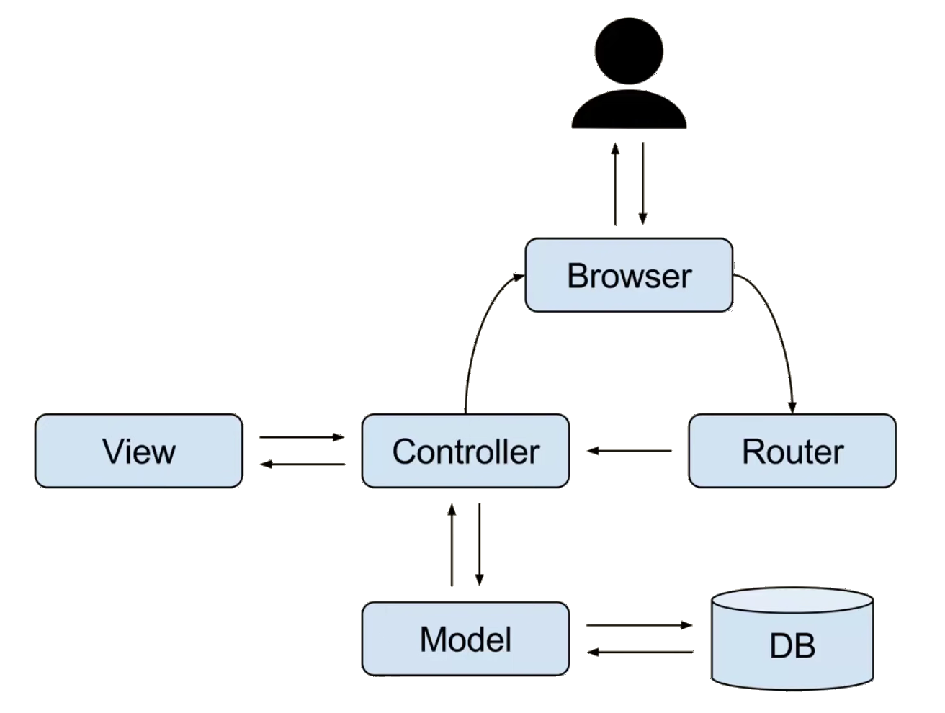
Basics - What it is
Architectural paradigm
a “style” of organizing code
not a program, framework, nothing to install, etc
so it’s not specific to a programming language
Popular
Here to stay
‘Ruby on Rails, Laravel, Zend framework, CherryPy, Symphony, etc’*
Parts
Model
View
Controller
*Router
Notes:
*https://towardsdatascience.com/everything-you-need-to-know-about-mvc-architecture-3c827930b4c1

Slide 3
Problems without MVC
Usually one big giant file of code
how do you delegate parts of code to another team-member?
even if could delegate, only one person could edit at a time
don’t have a inkling as to where to begin making changes -> have to scroll till you find it
Brittle Code
always worried it might break
one edit could break
hard to debug
Pain to swap out parts
no way to do this easily

Slide 4
How MVC solves these problems
What if… agreed upon structure / organization?
other experienced engineers already have an idea where to go/look to edit code
you can easily access code
have an idea of where to debug if broken
What if… siloed off / made hubs of code?
can be split off and other can work on it
if anything breaks, it breaks to that file, since it’s siloed off, don’t have to worry about contaminating other parts
can easily switch out pieces (b/c tech is always changing) if want to change the DB, view, etc (modularity of components)

Slide 5
Breaking it Down… pt1
House of Controller
the central brain / command center / in charge
think of as a place that houses sets of very specific instructions
tells other “silos/hubs” what to do
checks everything & sends back to browser/client
One Router
Very good at hearing what client wants & sending to the right set of instructions in controller

Slide 6
Breaking it Down… pt2
the Model only one to touch DB
in charge of storing information / dealing with DB
DB is siloed off…b/c further organizes code & makes it easier to debug & switch out
View is the thing that user sees
it’s the place where information is processed to make it presentable
but never talks to browser/client

Slide 7
So many options now & in the future (tech changes fast)
Modularity of components
aka switching out Tech
Examples….
Models / DB’s
MongoDB
MySQL
Oracle
…etc
Views
Handlebars
EJS
Pug
Nunjucks
…etc
What if your needs change?
don’t like, cheaper, better fit
before MVC vs after
siloed
brittle
organized

Slide 8
Model & DB Power Ups…pt 1
Pain to have to write code specific to one database only
Every DB is different accepts different style of information
pain to have to go back and reformat DB inputs
what if wanted to switch out from mongoDB to something else?

Slide 9

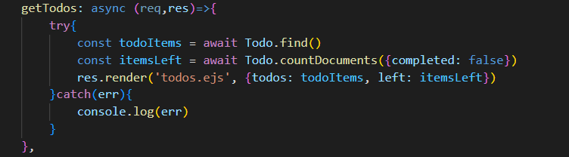
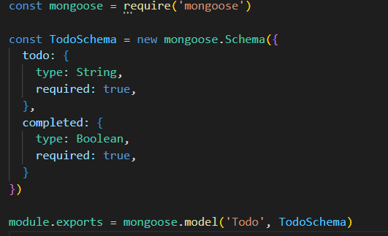
Model & DB Power Ups…pt 2
Mongoose + MongoDB
raw MongoDB vs. mongoose (smarter translator)
less coding
Schema
mongoDB doesn’t care. Put in whatever you want. Ugly
standardization of DB information… template
you don’t have to give other team members access to actual DB to understand structure of information… can interpret
ex: format of date, required fields

Slide 10

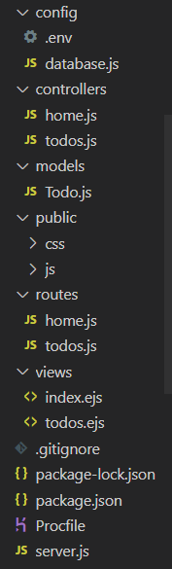
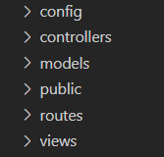
Debugging Data
DB stopped working
Models
Controller
Something not going to the right place
Routes
Controller
Something doesn’t look right for my user
Views

Slide 11
Big picture - The Lookback
Advantages
Modularity
Reusability
Organization
Group Programming
Compartmentalization
Targeted Testing
Faster Troubleshooting
Disadvantages
Takes more time to build out
Adds more complexity
Cost vs Benefit for small/simpler applications

