Slide 1

Reflection
Nirali Shah
March 12, 2018
Notes:
Hi, I’m Nirali Shah. Reflection: a mobile app focused on remembering the little moments in life

Slide 2


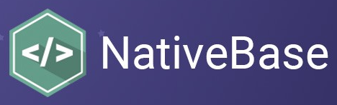

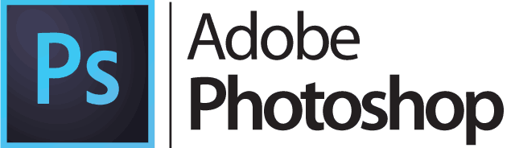
Overview
Reflection is a mobile app focused on remembering the little moments in life by privately chronicling memories and moods through short journal entries
Notes:
Reflection is a mobile app focused on remembering the little moments in life by privately chronicling memories and moods through short journal entries
Journaling can help manage anxiety, reduce stress, and help identify patterns in thoughts or behaviors, but we may not all have time to sit down and write long entries.
With Reflection, you can jot down a few words while you’re on the train, while you’re waiting for your morning coffee, while you’re waiting for dinner to finish cooking, whenever is convenient for you to capture your memories and feelings.
Think of it as a Timehop or Facebook memories, but for your private thoughts and feelings.
I utilized react native and express to create Reflection and styled with Native Base and Photoshop. Let’s get into the demo!
DEMO
Read home screen
Add entry button
The form utilizes Native Base for the floating titles
DatePicker – having to utilize a different library to get this and integrating it with the rest of the data from the form
Test form
Form clears and goes to the next page
Created a fake timeline
Read through timeline
Scroll through the timeline
Sorted posts so the most recent are on the top
Navbar goes back and forth

Slide 3
Lessons Learned
Working with React Native for the first time
React Native with NPM
Getting multiple libraries to work together
Notes:
(Started by drawing out wireframes that gave me a good sense of what I needed to build out and how to focus my time)
Learning React Native was an interesting process – there are slight differences than when working with react – CSS, libraries, simple functions like onChange and onSubmit
One important thing I learned was that react native is a work in progress and there are some current bugs they are working through. it’s been interesting debugging different error messages and learning if it’s because the app or react native is still a work in process
There are a lot of great libraries and resources that go with React Native. The benefit is that you can find a library and probably a tutorial for almost any general feature you can think of for an app, however, it did take me some time to realize which libraries worked with the latest version of NPM and which ones gave me the red screen of death
I ended up going through a handful of libraries before I landed on the ones you see. It was also fun to get them to work together seamlessly. It took a little bit to get Native Base for the UI styling, React Native Router Flux for the navbar, and React Native Modal Date Time Picker for the date picker to work all together. I tested out a lot of different layouts and options, but I do like how it ended up turning out and the flow it has

Slide 4
Version 2.0
Add authentication for multiple users
Functionality to include attachments and geo-tagging
Push notifications on the anniversary of a reflection
Include option to pick emojis to reflect mood
Aggregation mood charts
Notes:
For my version 2.0, I’d love to scale and include authentication for multiple users to sign up and use Reflection
I’d also like to add functionality to include images, sound bites, geo-tagging, and other attachments with each entry
Similar to Timehop and Facebook memories, I’d like to enable push notifications on the anniversary of a reflection
A smaller upgrade is that instead of writing moods, in order to standardize mood options and to add some whimsy to it, I’d like to include an option where you can select the emoji you’re feeling
This could also help with creating aggregated charts for mood and posts to help find trends in your entries.
Overall it’s been a challenging and fun experience. I’m glad I was able to learn react native and excited to use it again in the future. Thank you!

