Slide 1
集成原理与应用
于利军
2018年2月14日

Slide 2
偏差与方差问题
为什么集成学习
集成原理
应用

Slide 3

引入：监督学习
监督学习解决如何找到Fun及如何评估Fun的问题。监督学习同无监督学习相比是它有Label（y）。
X : 特征向量
y : 类别标签
找到一个Fun（h），使得拟合的值与真实值误差最小。
Independent
of h
The distance
from of f
Variance of the
predictions
Notes:
Supervised learning can be explained by the following example.
If we want to approximate a function, y=f(x), X is the train data point consists of a vector of features and
y is the class label. Then, we need to find a function h, called hypotheses, among a fixed subclass of functions for which the error E(h) is minimal,
The error consists of three parts, the noise, bias and variance. Noise is usually considered independent of h, so we just focus on the other two.
Error反映的是整个模型的准确度，Bias反映的是模型在样本上的输出与真实值之间的误差，即模型本身的精准度。Variance反映的是模型每一次输出结果与模型输出期望值之间的误差，即模型的稳定性。

Slide 4
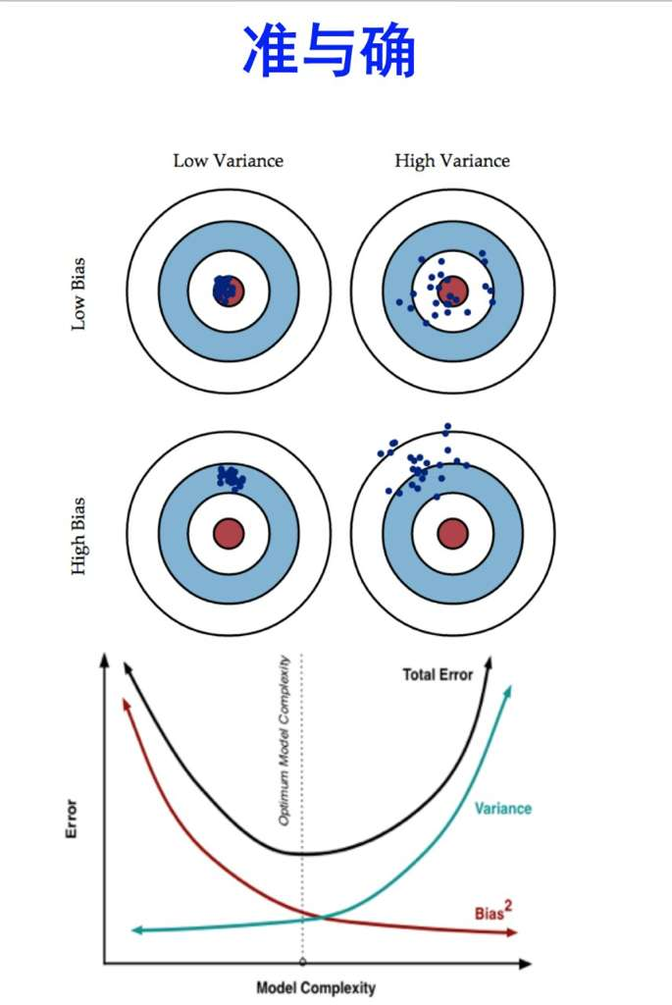
方差与误差问题
Bias Problem
The hypothesis space made available by a particular classification method does not
include sufficient hypotheses
Variance Problem
The hypothesis space made available is too large for the training data, and the selected hypothesis may not be accurate on unseen data
Notes:
方差和偏差均较小时，是最期待的结果，但是事情没有这么好，二者往往鱼与熊掌难以兼得，因此需要平衡。
高偏差（样本训练出来模型）+ 低方差，模型表现出来的是在远离靶心的地方稳定出现。注意稳定这个词。
低偏差 + 高方差，模型围绕着中心散列得比较开，因为低偏差的量化计算一般是通过估计整体的偏差期望，所以围绕着中心比较均匀分布时，可以得到较小的偏差，但是计算方差时，每一项都是正数（可以为0），那么方差就是偏离的累计。
高偏差 + 高方差，模型在远离中心的地方且散列较开，是最差的情形。
下面的线图，体现的是为何以及如何在Bias和Variance之间取得平衡。一般考虑Bias时用的是平方值。
模型越复杂，Bias越小，体现的是随着模型复杂度变高，在训练样本上效果越好，也无可避免得出现过拟合现象。也即，在测试样本上，方差就会越来越大。而总体误差是二者之和，得到的总体结果是U形线。所以，可见，最佳的解决思路是在该U形线最低点处取值。
引入过拟合的思路来看，我们通过样本上训练模型来估计真实数据。即：通过有限的训练样本来估计无限的真实数据。当我们更加相信这些样本数据的真实性的时候，会尽量保证模型在训练样本上的准确度，从而去减少了模型的Bias。这样的模型很可能就会失去一定的泛化能力，导致过拟合问题。而我们为了防止过拟合，通过降低模型在真实数据上的表现时，增加了模型的稳定性，即减小Variance。这样会使模型的Bias增大。

Slide 5
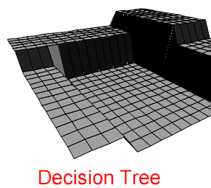
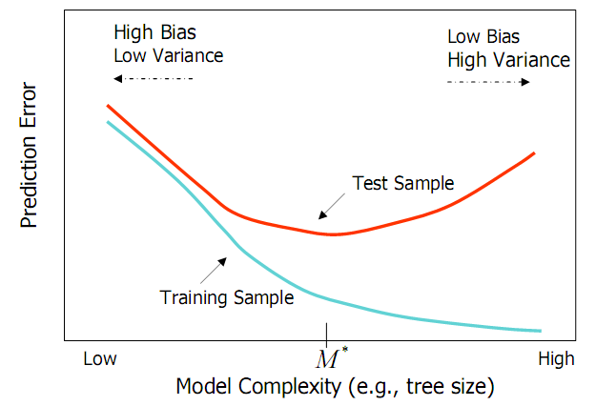
方差与误差问题
Decision Trees
Small trees have high bias.
Large trees have high variance. Why?
from Elder, John. From Trees to Forests and Rule Sets - A Unified Overview of Ensemble Methods. 2007.
Notes:
Typically, when bias is low, variance is high and vice-versa.
What do we see from the figure?
There is an optimal model complexity that gives minimum test error.
Training error is not a good estimate of the test error.
There is a bias-variance tradeoff in choosing the appropriate complexity of the model.
How to get the tradeoff. Let’s talk about the ensemble.

Slide 6
偏差与方差问题
为什么集成学习
集成原理
应用

Slide 7
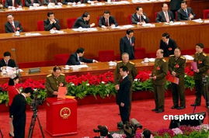

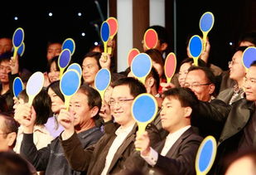
为什么集成学习
生活中大量用到了集成学习的例子
博采众长
三个臭皮匠顶个诸葛亮
集思广益
……
Notes:
one major aspect of concern is diversity. That is to say there are meaningful differences between the classifications of each classifier in the ensemble.
Utility of combining diverse, independent opinions in human decision-making
Protective Mechanism (e.g. stock portfolio diversity)
You will not spend all your money on one idea or just one company’s stock.
A man who is in the community is more unlikely to do some extreme behavior than live alone.

Slide 8
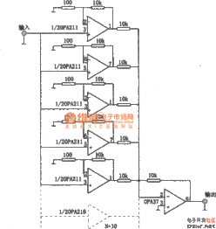
为什么集成学习
并联电路的启发：
Majority Vote Accuracy：
假设五个分类器（电路），准确率都为70%（电流正常），那么根据投票原则，
10 (.7^3)(.3^2)+5(.7^4)(.3)+(.7^5)
83.7% majority vote accuracy
如果是100 个分类器
99.9% majority vote accuracy
Notes:
Ensemble is a method like Majority vote
Suppose we have 5 completely independent classifiers…If accuracy is 70% for each, we can get 83.7% accuracy by majority vote.
If we have 101 such classifiers then we can get 99.9% majority vote accuracy

Slide 9
偏差与方差问题
为什么集成学习
集成原理
应用

Slide 10
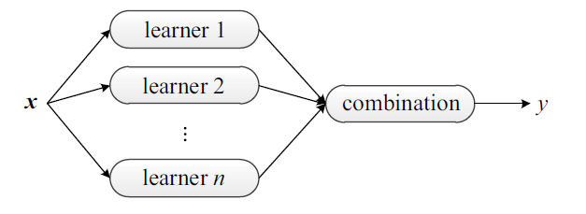
集成原理
Boosting
With each additional model, make examples currently misclassified more important (or less, in some cases)
Bagging(bootstrap aggregation )
Use different subsets of the training data for each model to generate diverse classifiers
A common ensemble architecture, Ensemble Methods Foundations and Algorithms,2012
Notes:
The two most common strategies. Boosting is incremental, and gets diversity by having each additional classifier a bit more focused than the last. Bagging—diversity comes focusing on different subsets of data.
Before we talk about the algorithm, we look at the weak learning Idea first.

Slide 11
Boosting
Make examples currently misclassified more important (or less, if lots of noise). Then combine the hypotheses given…
Types
AdaBoost
Notes:
Boosting Incrementally create models using training examples based on some distribution. The method make examples currently misclassified more important (or less, if lots of noise). Then combine the hypotheses. There are two types of boosting methods AdaBoost and BrownBoosting.

Slide 12
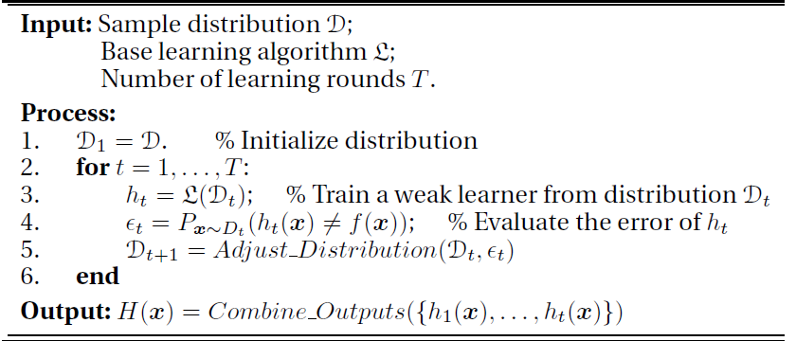
Boosting
A general boosting procedure
Notes:
Boosting Incrementally create models using training examples based on some distribution. The method make examples currently misclassified more important (or less, if lots of noise). Then combine the hypotheses. There are two types of boosting methods AdaBoost and BrownBoosting.

Slide 13
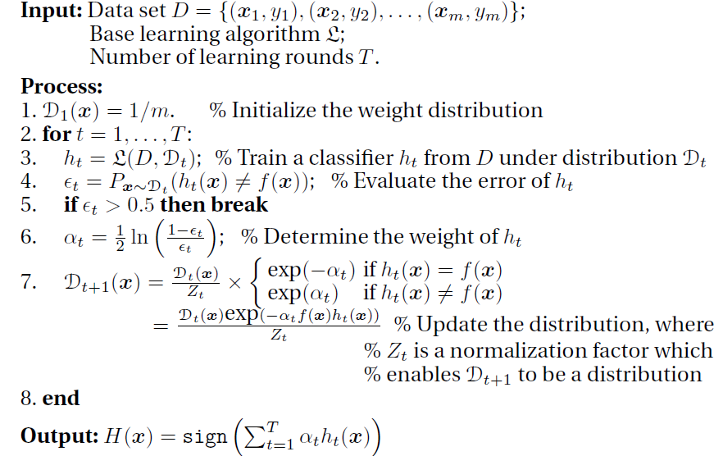
AdaBoost Algorithm
AdaBoost procedure
Notes:
Adaboost alogrithm, introduced in 1995 by Freund and Schapire solved many of the practical difficulties of the earlier boosting algorithms.
one of the main ideas of the algorithm is to maintain a distribution or set of weights over the training set. Initially, all weights are set equally, but on each round, the weights of incorrectly classified examples are increased so that the weak learner is forced to focus on the hard examples .
The weak learner’s job is to find a weak hypothesis appropriate for the distribution. In practice, the weak learner may be an algorithm that can use the weights on the training examples. Alternatively, when this is not possible, a subset of the training examples can be sampled according to the distribution, and these resampled examples can be used to train the weak learner.
Therefore, the weak learner is to be trained under Dt, and
has less than 0.5 classification error according to Dt.

Slide 14
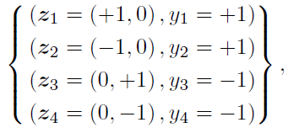
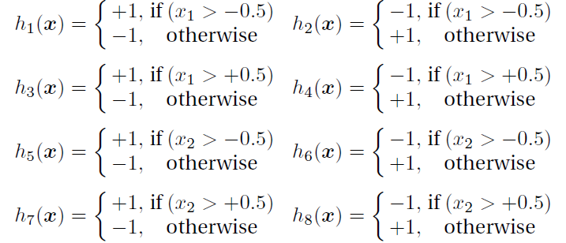
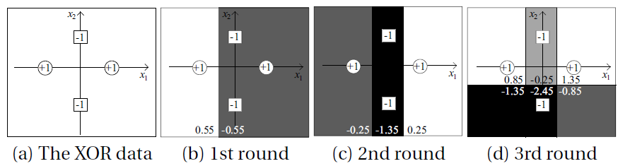
AdaBoost
AdaBoost on the XOR problem. From Trees to Forests and Rule Sets - A Unified Overview of Ensemble Methods. 2012.
Notes:
Here is the iteration steps of a single decision tree.

Slide 15
AdaBoost
Advantages
Very little code
Reduces variance
Disadvantages
Sensitive to noise and outliers. Why?
Notes:
If there is a high level of mislabeled training data points, adaboost will put very high weights on the noisy data points and learn very poor classifiers.

Slide 16
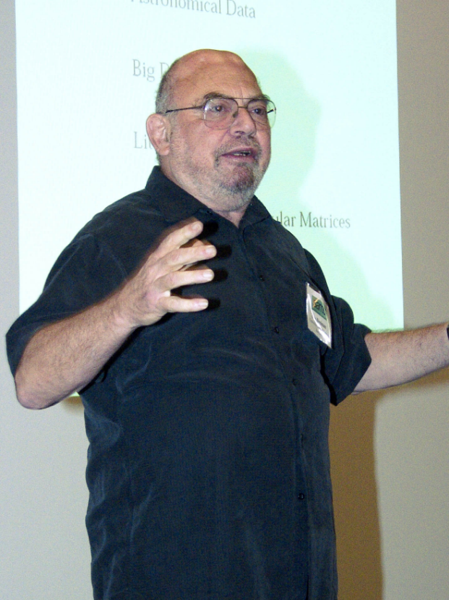
Bagging
Use random samples of the examples to construct the classifiers
Use random attribute sets to construct the classifiers
Random Decision Forests
Leo Breiman
Notes:
Something interesting is that Breiman originally submitted the paper to journal of statistics was rejected, so he went to machine learning journal in 1996 and a year or two he become the hero of the classification area.

Slide 17
Bagging Diversity
Requirement: Need unstable classifier types
Unstable means a small change to the training data may lead to major decision changes.
Is the neighbor approach unstable? No, but many other types are.
Notes:
Can also create multiple NN using different random initial weights for diversity. Another bagging technique?
17

Slide 18
Bagging Algorithm
For 1 to k,
Take a bootstrap sample of the training examples
Build a model using sample
Add model to ensemble
To make a prediction, run each model in the ensemble, and use the majority prediction.
Notes:
18

Slide 19
Some Theories on Bagging/Boosting
Error = noise + Bias + Variance
Theories:
Bagging can reduce variance part of error
Boosting can reduce variance AND bias part of
error
Bagging will hardly ever increase error
Boosting may increase error
Boosting susceptible to noise

Slide 20
偏差与方差问题
为什么集成学习
集成原理
应用

Slide 21
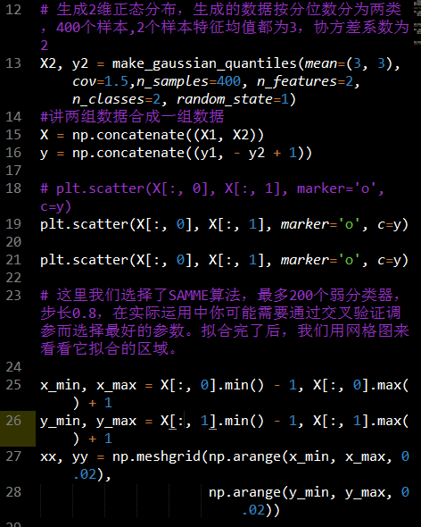
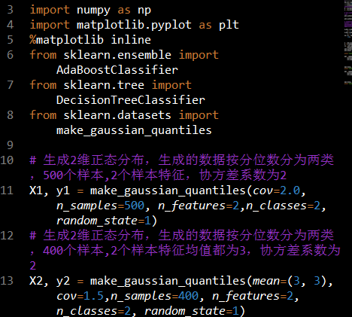
应用

Slide 22
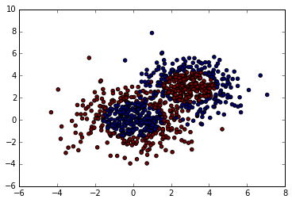
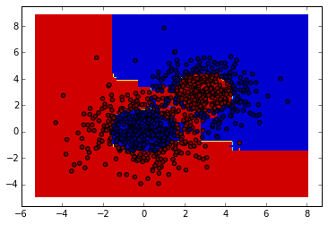
应用
推荐书籍：《Ensemble Methods Foundations and Algorithms， 周志华》

