Slide 1

COMPUTER NETWORKS
NAME – ESHAANRAJ DEBROY
CLASS – VIII
SECTION – A
ROLL NO, – 14
SUBJECT – COMPUTER SCIENCE
SESSION – 2023 – 2024
PROJECT-2

Slide 2

TABLE OF CONTENTS
01
INTRODUCTION
02
MAIN CONTENT
TYPES OF COMPUTER NETWORKS
NETWORK TOPOLOGIES
PROTOCOLS
NETWORK DEVICES
INTERNET TERMS
WHAT IS CLOUD COMPUTING
03
BIBLIOGRAPHY
04
CONCLUSION

Slide 3


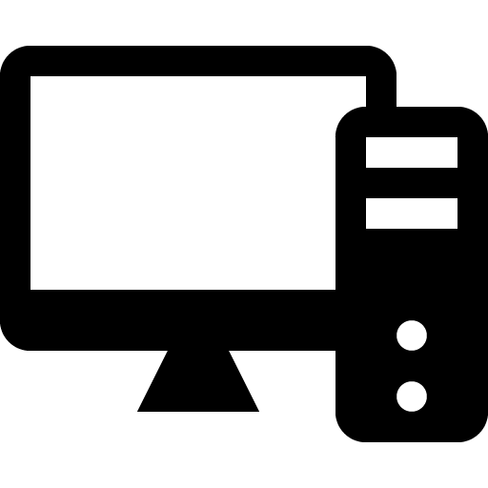
1
Introduction- What is a computer network?
A computer network is a system that connects two or more computing devices for transmitting and sharing information. Computing devices include everything from a mobile phone to a server. These devices are connected using physical wires such as fiber optics, but they can also be wireless.
Components of a computer network
SENDER
The sender sends a request for communication which may be like to access a file or access the printer
RECIEVER
The receiver receives the request by the sender and then services the request
MEDIUM
The sender and receiver are connected via a medium that is required for the transmission of data

Slide 4
2
TYPES OF COMPUTER NETWORKS
LAN: A local area network (LAN) is a collection of devices connected together in one physical location, such as a building, office, or home. A LAN can be small or large, ranging from a home network with one user to an enterprise network with thousands of users and devices in an office or school.
MAN: A metropolitan area network (MAN) is a computer network that is larger than a single building local area network (LAN) but is located in a single geographic area that is smaller than a wide area network (WAN).
WAN: A wireless local-area network (WLAN) is a group of collocated computers or other devices that form a network based on radio transmissions rather than wired connections.
PAN: A personal area network (PAN) connects electronic devices within a user's immediate area. The size of a PAN ranges from a few centimeters to a few meters.
CAN: A campus area network (CAN) is a computer network that spans a limited geographic area.

Slide 5
3
NETWORK TOPOLOGIES
BUS
RING
STAR
MESH
TREE
Bus topology is a type of network topology in which all devices are connected to a single cable called a "bus."
Ring topology is a type of network configuration where devices are connected in a circular manner, forming a closed loop.
A star topology is a topology for a Local Area Network (LAN) in which all nodes are individually connected to a central connection point
Tree Topology is a topology which is having a tree structure in which all the computers are connected like the branches which are connected with the tree.
A mesh topology is a type of computer network in which each node (computer or other device) is connected to every other node in the network.

Slide 6
4
PROTOCOLS
HTTP:The Hypertext Transfer Protocol (HTTP) is the foundation of the World Wide Web, and is used to load WebPages using hypertext links.
TCP/IP:TCP meaning Transmission Control Protocol, is a communications standard for delivering data and messages through networks.
SMTP:The Simple Mail Transfer Protocol (SMTP) is an Internet standard communication protocol for electronic mail transmission.
FTP:The term file transfer protocol (FTP) refers to a process that involves the transfer of files between devices over a network.
POP:The post office protocol (POP) is the most commonly used message request protocol in the Internet world for transferring messages from an e-mail server to an e-mail client.
IMAP:Internet Message Access Protocol, or IMAP, is a standard email retrieval (incoming) protocol. It stores email messages on a mail server and enables the recipient to view and manipulate them.

Slide 7
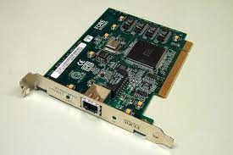
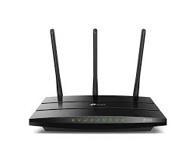
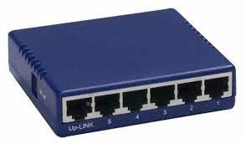
5
NETWORK DEVICES
NIC(NETWORK INTERFACE CARD): A network interface card (NIC) is a hardware component, typically a circuit board or chip, which is installed on a computer so it can connect to a network.
MODEM: A modulator-demodulator or modem is a computer hardware device that converts data from a digital format into a format suitable for an analog transmission medium such as telephone or radio. A modem transmits data by modulating one or more carrier wave signals to encode digital information, while the receiver demodulates the signal to recreate the original digital information.
HUB: A network hub is a node that broadcasts data to every computer or Ethernet-based device connected to it. A hub is less sophisticated than a switch, the latter of which can isolate data transmissions to specific devices.

Slide 8
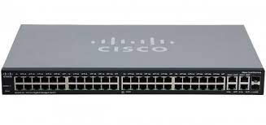
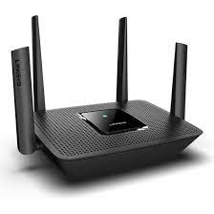
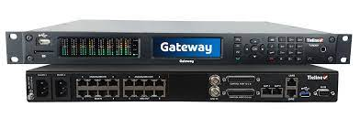
6
SWITCH: A network switch is defined as a hardware component responsible for relaying data from a computer network to the destination endpoint through packet switching, MAC address identification, and a multiport bridge system.
ROUTER: A router is a device that connects two or more packet-switched networks or sub networks. It serves two primary functions: managing traffic between these networks by forwarding data packets to their intended IP addresses, and allowing multiple devices to use the same Internet connection.
GATEWAY: A network gateway is a node in a computer network that provides a key stopping point for data that is traveling to or from other networks. Thanks to gateways, we are able to communicate online by sending data back and forth. Without a gateway, the internet would not be of any use to us! Additionally, many of the pieces of hardware and software that we use every day would be unusable and irrelevant.

Slide 9


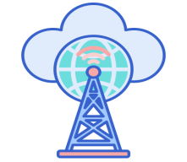
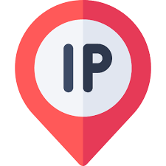
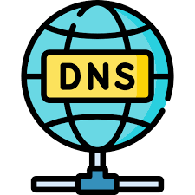
7
INTERNET TERMS
INTRANET: An intranet can be defined as a private network used by an organization. Its primary purpose is to help employees securely communicate with each other, to store information, and to help collaborate.
URL: URL stands for Uniform Resource Locator. A URL is nothing more than the address of a given unique resource on the Web. In theory, each valid URL points to a unique resource.
ISP: An ISP (internet service provider) is a company that provides individuals and organizations access to the internet and other related services.
IP Address: An Internet Protocol (IP) address is a unique numerical identifier for every device or network that connects to the internet. Typically assigned by an internet service provider (ISP), an IP address is an online device address used for communicating across the internet.
DNS: A Domain Name System (DNS) turns domain names into IP addresses, which allow browsers to get to websites and other internet resources. Every device on the internet has an IP address, which other devices can use to locate the device.

Slide 10
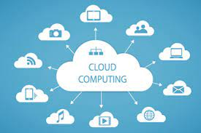
WHAT IS CLOUD COMPUTING ?
Cloud computing refers to the use of hosted services, such as data storage, servers, databases, networking, and software over the internet. The data is stored on physical servers, which are maintained by a cloud service provider. Computer system resources, especially data storage and computing power, are available on-demand, without direct management by the user in cloud computing.

