Slide 1
Step to solve run cell error

Slide 2
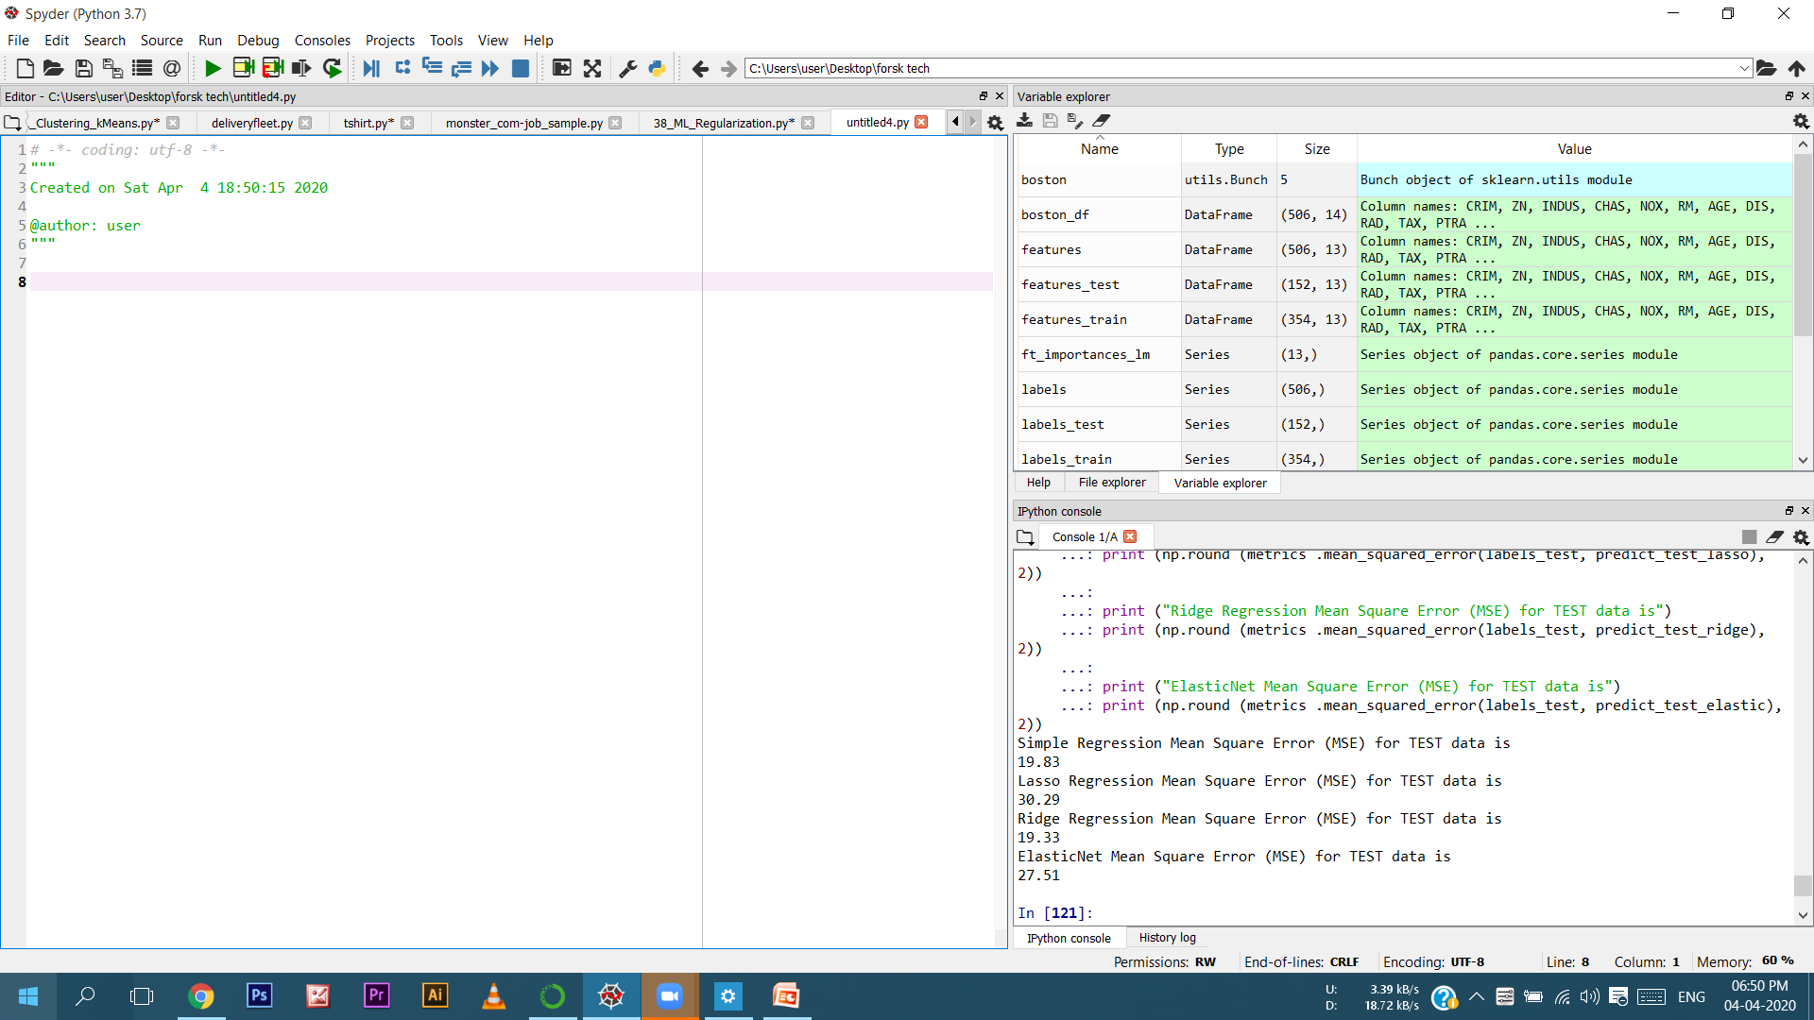
Click this preference button

Slide 3
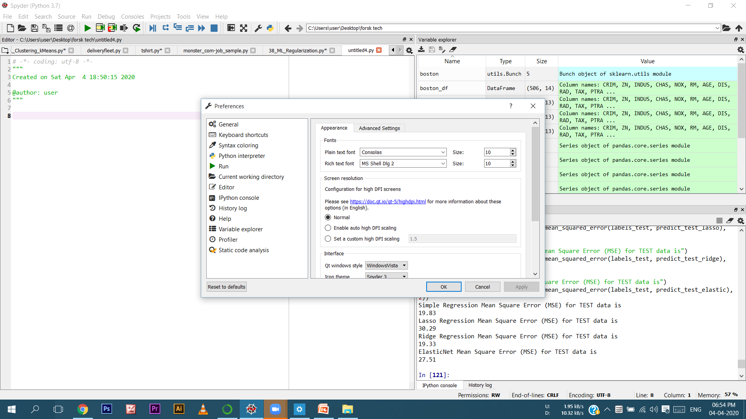
Now you will get this screen.
And than click on Keboard shortcuts
click on Keboard shortcuts

Slide 4
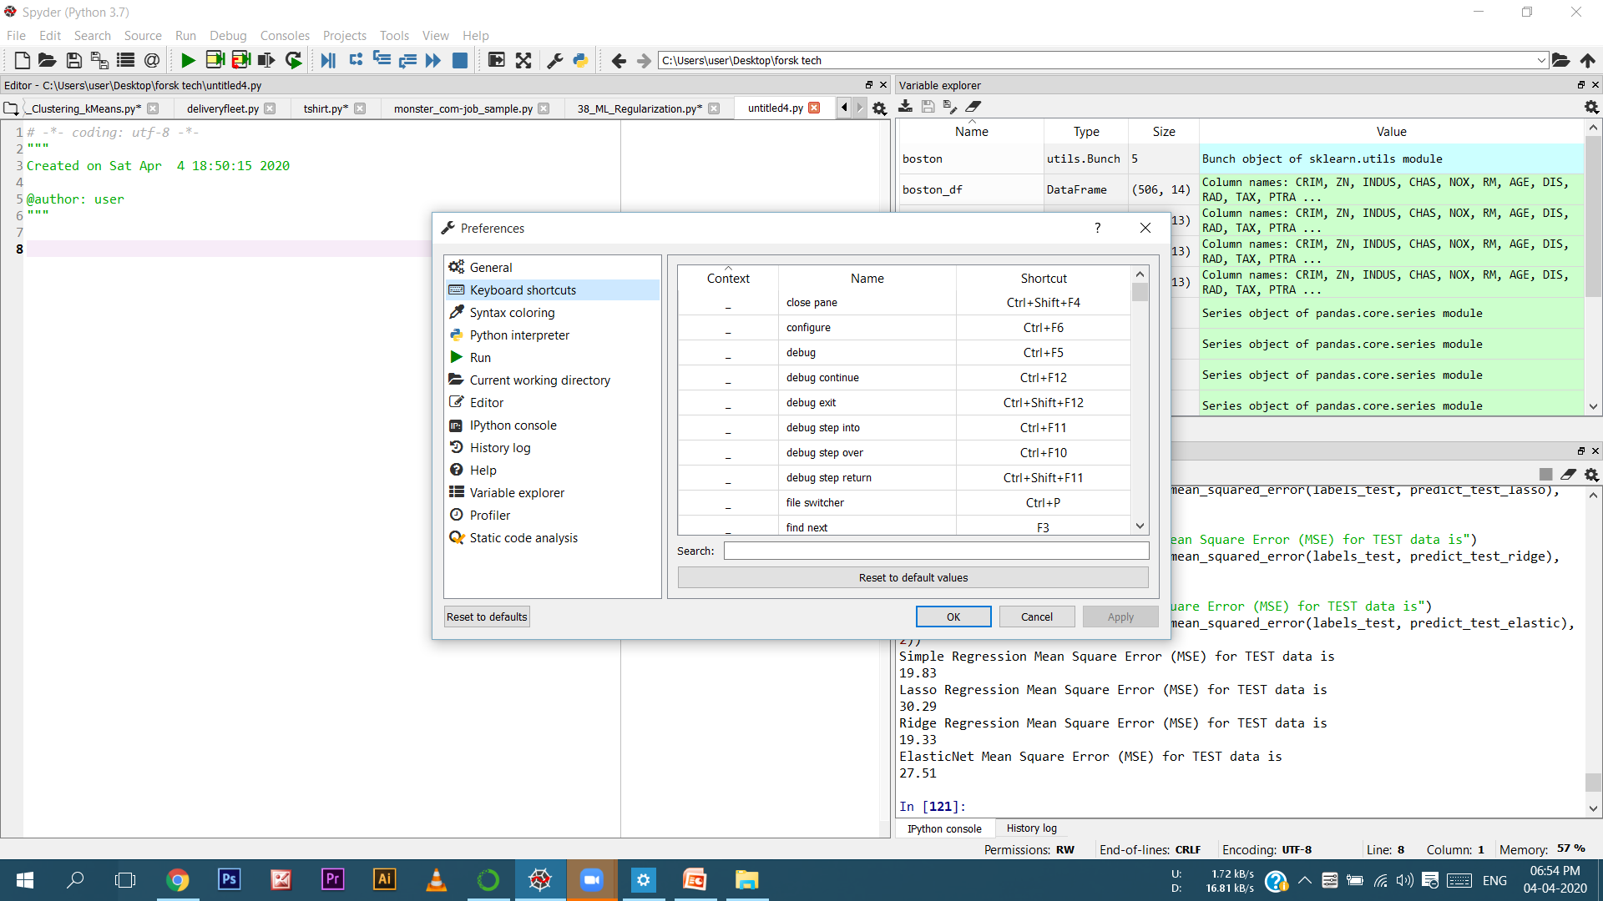
Now you will get this screen.
Look here you find a search bar.
Write here “run se”
Write here “run se”

Slide 5
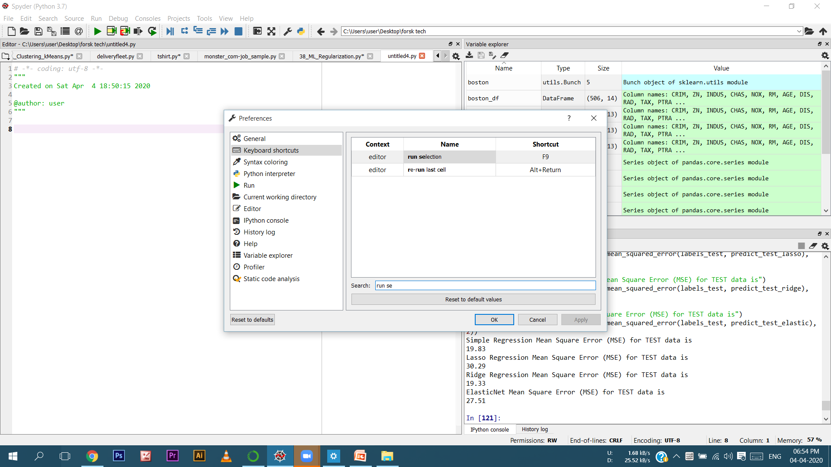
Like that :-
Like that

Slide 6
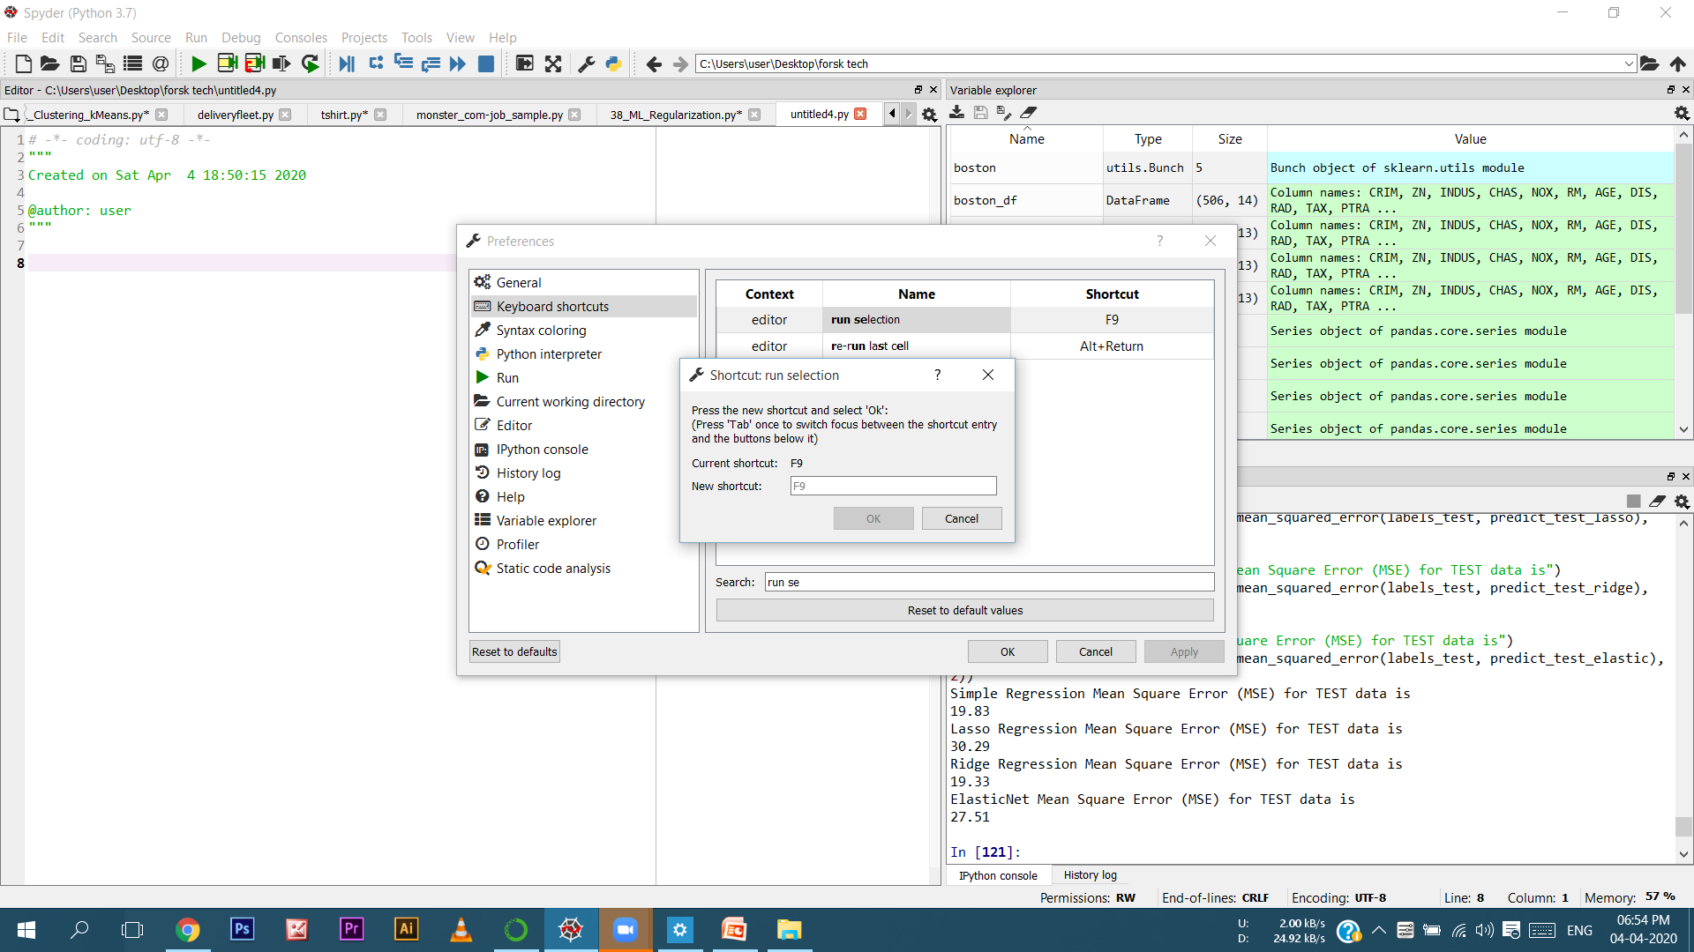
Now double click on “run selection” column
Now you find this screen than click here and press only “shift + enter”

Slide 7
After all that cilck Ok button.
Than click on Apply button.
Than click on ok button.
Note:- Using these steps you can solve the problem but if you face any issue
you can contact me on my email id .
Email : sandeepjain20178@gmail.com
Thank You!

