Slide 1
Steps For Learning Dash

Slide 2
Install some libraries
pip install dash
pip install pandas
pip install Flask
pip install dash-renderer
pip install dash-html-components
pip install dash-core-components
pip install plotly
pip install dash-bootstrap-components

Slide 3
Basic Part 1
This is a link of a blog where you can start your dash learning.
This is just a basic part. (link from Data camp website)
https://www.datacamp.com/community/tutorials/learn-build-dash-python
Remember point First run with these two lines
if __name__ == '__main__': app.run_server(debug=True)
Than remove after “debug = True” :-
if __name__ == '__main__':
app.run_server()

Slide 4
Open web browser automatically
import webbrowser
def open_browser():
webbrowser.open_new('http://127.0.0.1:8050/')
.
.
.
.
if __name__ == '__main__':
Timer(1, open_browser).start();
app.run_server()

Slide 5
Basic Part 2
Some links which will help you for more interaction with dash
Link 1:-
https://www.youtube.com/watch?v=Ma8tS4p27JI&list=PLH6mU1kedUy8fCzkTTJlwsf2EnV_UvOV-&index=1
Link 2:-
https://youtu.be/yfWJXkySfe0
Link 3:-
https://youtu.be/lu0PtsMor4E

Slide 6
Most used for dash Work: -
Most used websites for dash work
1. Official website of dash:-
https://dash.plotly.com/layout
2. You can use a website of dash community which is
https://community.plotly.com/
3. Stackoverflow also provide some solution of dash so you can also help from stackoverflow

Slide 7
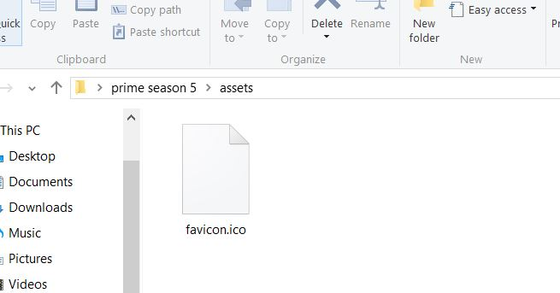
If you want to use favicon in dash
Just only make a folder name with “assets” and keep image name with ‘favicon.ico’

Slide 8
If you want to run program from command prompt use this youtube video:-
https://youtu.be/Vn4y9OiJQsc
Follow the steps of this video than you can easily run your complete python script using cmd.
Thank you!

