Slide 1

SMART PARKING SYSTEM
(IoT & Fog-Based Review)
Ignite X
Student Research Summit
Department of Computer Science
Name of Member | Roll Number | Role | Department & Section
Pratyush Kumar Srivastava | 2401330120132 | Literature Review | CS
Vedant Pandey | 2401330120211 | Documentation | CS
Piyush Diwedi | 2401330120121 | System Design | CS

Slide 2
1. Problem Statement & Motivation
Rising vehicle ownership pushes parking demand beyond supply in many cities.
Drivers search blindly for free bays, as traditional lots give no real-time availability.
Cruising wastes time and fuel, adds emissions and congests junctions, especially during large events.
Fixed pricing ignores demand, so revenue and space use are sub-optimal.
A smart system uses live sensor data to guide drivers, forecast availability and price dynamically.

Slide 3
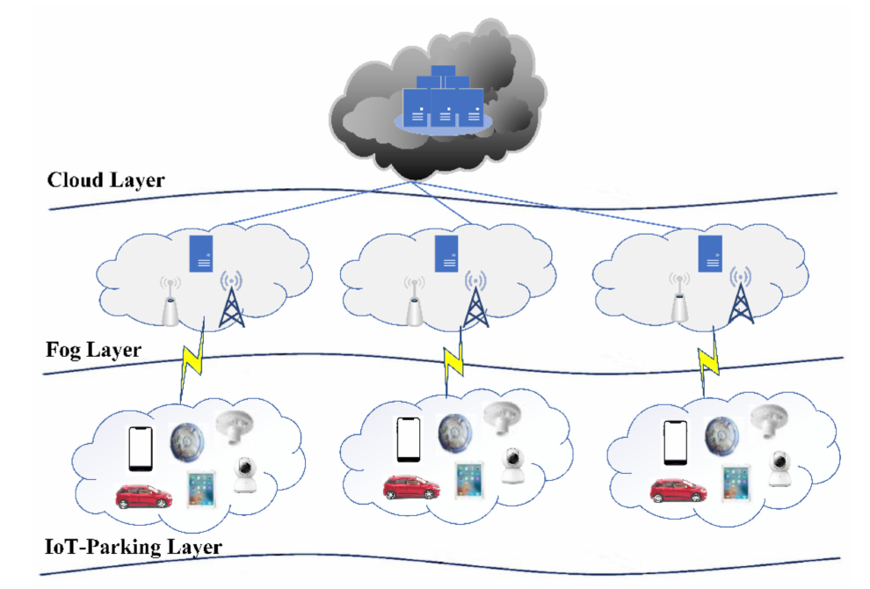
2. Aim, Objectives & Review Method
AIM →
Critically review a fog-based IoT smart parking system and propose improvements for real-world deployment.
OBJECTIVES →
Identify system components and architecture.
Review key functions: bay selection, availability and pricing.
Identify six limitations and propose a fix for each.
REVIEW METHOD →
Paper from Electronics (MDPI, Q2, SJR 0.623), read against what was built, measured and assumed.
Multi-layer architecture of the reviewed system (Balfaqih et al., 2021)

Slide 4
3. IoT System Architecture
1. SENSING
Ultrasonic • Magnetic • RFID • GPS • Camera
Bay sensors report on change; solar-powered
2. COMMUNICATION
LoRaWAN (sensors) • Wi-Fi (cameras)
Low data rate, long range, low power
3. PROCESSING
Fog node (Raspberry Pi) • Cloud • Analytics
Local decisions at the fog; history and payments in the cloud

Slide 5
4. Key Applications
PARKING-SPOT SELECTION
Dijkstra shortest path picks the bay with minimum arrival time.
AVAILABILITY ESTIMATION
Markov chain over five occupancy states; reservations accepted 3 hours or more ahead.
HYBRID PRICING
Hourly rate with discounts for short stays; bid-based subscriptions for long-term spaces.
SECURITY ALERTING
Named in the workflow but not developed in the paper.
RESERVATION & NAVIGATION
Mobile app shows status, route and e-wallet payment.
FOG PROCESSING
Local filtering, sensor-node handover and low-latency decisions.

Slide 6
5. Potential Benefits vs. Challenges
POTENTIAL BENEFITS
KEY CHALLENGES → PROPOSED FIX
16–46% shorter arrival time (simulation)
10–15% higher parking revenue
No single point of failure with fog nodes
Real-time availability and navigation
Less congestion and fewer emissions
Small prototype, 150-space simulation → Zoned fog nodes + radio planning
Camera congestion input omitted → Camera-assisted vehicle counts
Fixed-rate Markov forecast → LSTM / gradient-boosted forecasts
Validation mostly simulated → Staged field validation
Shallow security and privacy → Layered security and privacy design
Pricing tested on random bids → Demand-calibrated pricing

Slide 7
6. Flowchart
Vehicle detection
IoT sensor data collection
Fog analysis
Bay selection & pricing
Ultrasonic, magnetic, RFID, GPS
LoRaWAN to fog node
Congestion, availability forecast
Dijkstra route, hybrid price
Result sent to the cloud and shown to the driver in the mobile app (route, reservation, payment).

Slide 8
7. Conclusion & References
CONCLUSION – Fog-based IoT parking can cut search time and raise revenue, but its evidence comes from a small prototype and simulation. Each of the six limitations has a matching improvement; the next step is to test them in simulation at full lot size (about 2,500 spaces) and then in a supervised pilot.
SELECTED REFERENCES –
1. Balfaqih, M., et al. (2021). Design and development of smart parking system based on fog computing and Internet of Things. Electronics, 10(24), 3184. doi:10.3390/electronics10243184
2. Biyik, C., et al. (2021). Smart parking systems: Reviewing the literature, architecture and ways forward. Smart Cities, 4, 623–642.
3. Sarker, V. K., et al. (2020). Smart parking system with dynamic pricing, edge-cloud computing and LoRa. Sensors, 20, 4669.

Slide 9
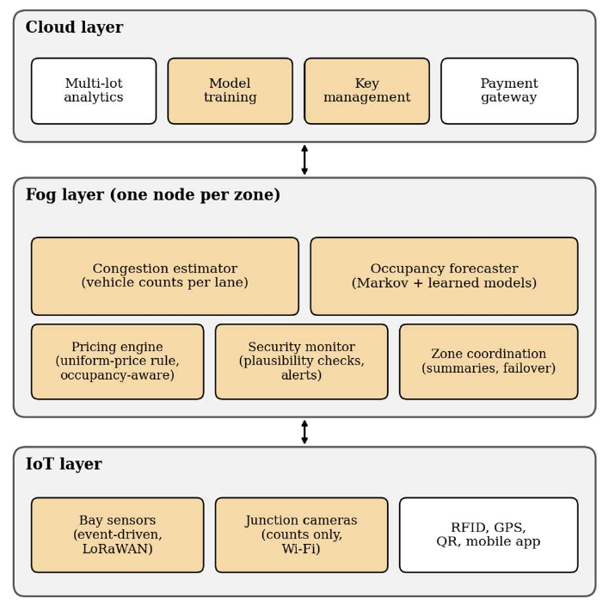
Demonstration
EVALUATION PLAN
Two lot sizes: 150 and about 2,500 spaces
Six scenarios: weekday, event surge, sensor outage, fog-node failure, degraded sensing, attacks
At least 30 random seeds, 95% confidence intervals
Baselines: blind search, nearest-free-bay, reference design
Proposed architecture (shaded blocks = added or changed)

Slide 10
THANK YOU

