Slide 1
Spark Streaming
Spark Streaming makes it easy to build scalable fault-tolerant streaming applications

Slide 2
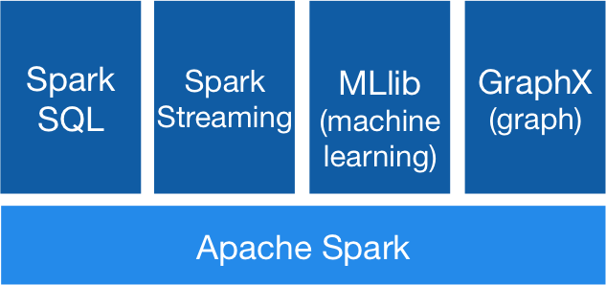
Spark Stack

Slide 3
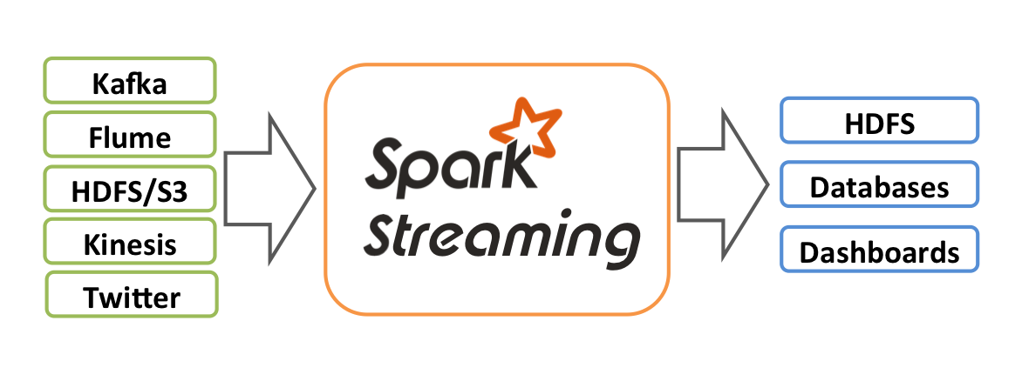
Spark Streaming概览

Slide 4
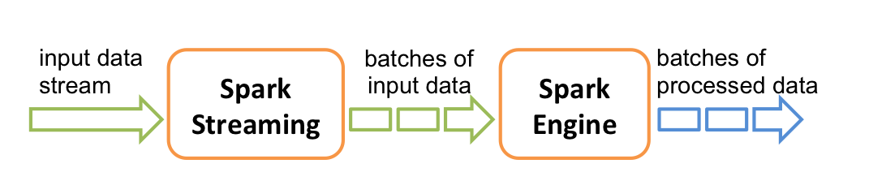
原理：将输入的数据切分成一个个批次

Slide 5
DStreams
Spark Streaming provides a high-level abstraction called discretized stream or DStream, which represents a continuous stream of data. DStreams can be created either from input data streams from sources such as Kafka, Flume, and Kinesis, or by applying high-level operations on other DStreams. Internally, a DStream is represented as a sequence of RDDs

Slide 6
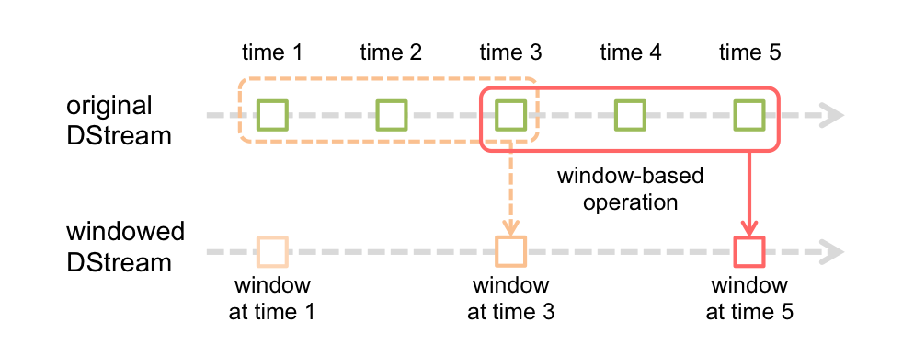
Window Operations

Slide 7
Window Operations
batch interval
window length
sliding interval
window length and sliding interval must be multiples of the batch interval of the source DStream

