Slide 1
Master Thesis Project
HALO Orbit Simulation around SEM L2 of an IRASSI Mission Satellite
Supervisors:
M.Sc. Meltem Eren Çopur (UniBw ISTA)
Prof. Dr. Urs Hugentobler (TUM IAPG)
Student:
Aleksei Petukhov (TUM ESPACE)

Slide 2
Outline
Introduction
IRASSI mission
Motivation
Theoretical Background
Circular-Restricted Three Body Problem
Libration points
Periodic orbits. Halo orbit
Precise orbit simulation
L2 environment
Force model
Numerical integration
Orbit Simulation
Results

Slide 3
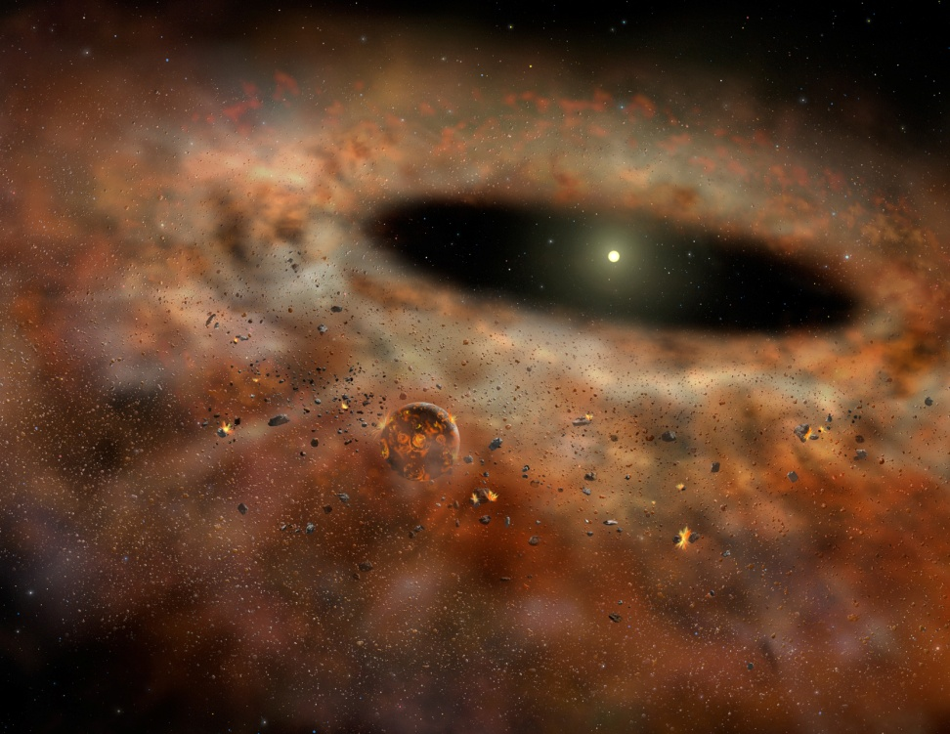
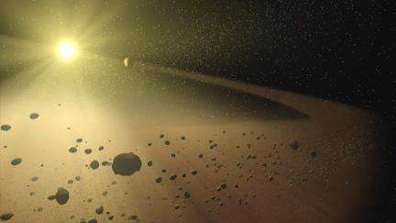
1.1 Introduction – IRASSI mission
Observation of the formation of Earth-like planets
Study physical properties and chemical properties that lead to prebiotic conditions
Earth-like planets can be originated in circumstellar disks and protoplanetary regions.
Obscured by clouds of gas and dust
Best observable in far-infrared frequencies
https://astrob ites.org (top and bottom)

Slide 4
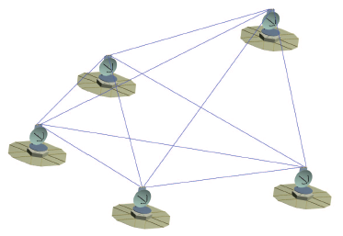





1.1 Introduction – IRASSI mission
Space-based Interferometric telescope mission
Infrared Astronomy Satellite Swarm Interferometry (IRASSI)
To resolve processes - angular resolution less than 0.1 arcsec required
Formation of 5 satellites
Interferometry in order to achieve high angular resolution
[Buinhas et al 2016]

Slide 5
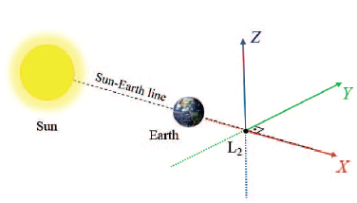
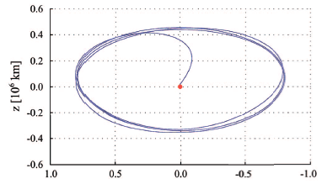
1.1 Introduction – IRASSI mission
Halo orbit around L2 libration point of Sun/Earth-Moon system
1.5 million km in anti-Sun direction
Benefits:
Spacecraft remains relatively stationary w.r.t to the Sun and Earth/Moon
Low energy expenditure for station-keeping
No thermal infrared radiation from the Earth
No eclipse zones – prevents the occurrence of temperature changes
Eclipse free observations of deep space – entire celestial sphere observed
[Buinhas et al 2016]

Slide 6
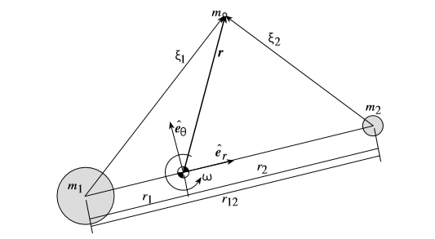





2.1 Theory – Circular-Restricted Three Body Problem
Assumptions:
Primary bodies are very massive objects compared to the third mass. Third mass has no influence on the other bodies
Primary bodies are assumed to revolve in circular orbits about their center of mass.
Equations of motion of mass m in a rotating reference frame:
Angular velocity:
Relative distances:

Slide 7





2.1 Theory – Circular-Restricted Three Body Problem
Non-dimensional equations of motion:
Mass quantities
Relative distances
Potential function:
Coordinates of
primary masses

Slide 8
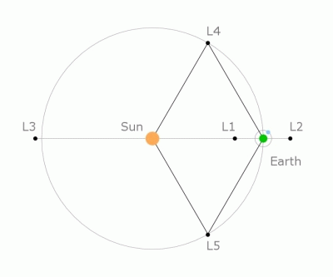
2.2 Theory – Libration Points
Libration points
Natural equilibrium solutions of the restricted three body problem, i.e. velocities and accelerations in non-dim equations of motion are zero
Net gravitational force of two primary bodies on a smaller mass m is balanced by the centrifugal force of the rotating primaries themselves.
The locations appear stationary when viewed from rotating reference frame
:
[ESA.com]

Slide 9
2.2 Theory – Libration Points
[universetoday.com]

Slide 10
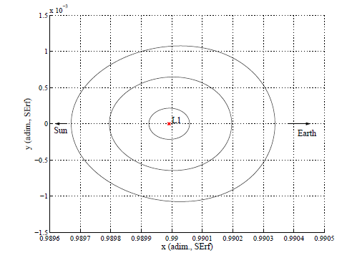
2.3 Theory – Periodic orbits around Libration points
Linearized non-dim equations of motion can be expressed as:
With frequencies only in x-y plane | Lyapunov orbit No out-of-plane motion possible
With out-of-plane frequency (not equal to that of in-plane motion) | Lissajous closed path trajectory No big out-of-plane excursions possible
[Milano paper]

Slide 11
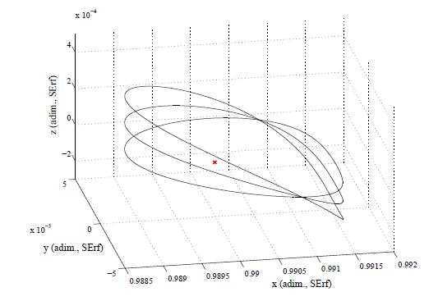
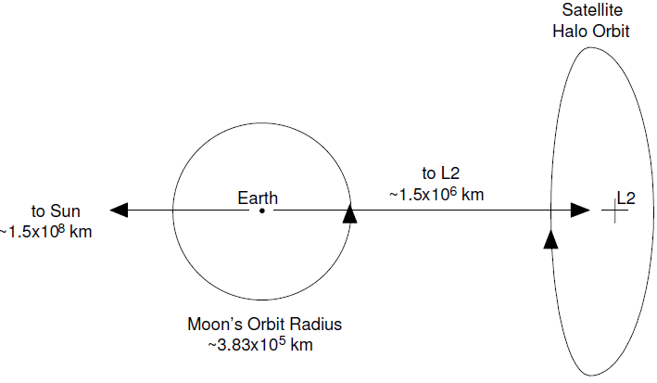
2.3 Theory – Periodic orbits around Libration points
If in-plane and out-of-plane are equal - HALO orbit
In the CR3BP model, halo orbits are both periodic and time independent.
In reality:
Quasi-periodic. Frequency in z-axis
is nearly the same as in X-Y axes frequencies.
Large amplitudes in the Y-component
Free-of-eclipse observations are possible
Quasi-free delta-V transfer maneuvers
[Milano paper]

Slide 12
3.1 Orbit simulation – L2 environment
Include as many perturbations as possible in the force model
Typical perturbations due to:
Gravitational attraction of the Sun, Earth, Moon and other celestial bodies
Atmospheric drag
Earth oblateness
Solar Radiation Pressure
Albedo
Relativistic effects
Produce accelerations ranging from 10⁻¹⁵ to 10⁻⁵ km/s²

Slide 13
3.1 Orbit simulation – L2 environment
Perturbation in the vicinity of L2
Forces producing accelerations up to 10⁻¹³ km/s² will be taken into account
Gravitational attraction of the Sun, Earth, Moon, Jupiter, Venus, Saturn and Mars
Solar Radiation Pressure
Source | Expected max. acceleration (approx), km/s2. Scalar value
Gravitational Perturbations
Sun/Earth/Moon
Jupiter
Venus
Saturn
Mars
Solar Radiation Pressure
SRP
Thrust Forces
Maneuvers

Slide 14

3.1 Orbit simulation – Force model
Gravitational perturbations
Earth-centric equation of motion
E - Earth as the primary body, sat is the satellite and j other bodies
NASA SPICE toolkit will be used to obtain relative distances
SUN_POS = cspice_spkezr ( ‘SUN’, ET_TIME, 'J2000', NONE, ‘EARTH’ );

Slide 15

3.1 Orbit simulation – Force model
Acceleration due to Solar Radiation Pressure
Simplified model used
Surface area A: 1 sq.m
Mass m: 6000 kg
Reflectivity coefficient 0.8
AU Astronomical unit 149 million km
Geocentric position vector of the Sun
Solar radiation pressure

Slide 16
3.1 Orbit simulation – Force model
Thrust Forces
Halo orbit is quasi-periodic - requires station keeping maneuvers
General idea:
Quasi-periodic can be achieved if the spacecraft crosses twice the Y-plane perpendicularly, i.e. its Vx and Vz velocity components are zero.
Targeting problem
Adjust initial conditions to end up at:
Y = 0 Vx=Vz=0
within predefined tolerance

Slide 17
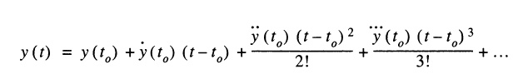
4. Integration
Equations of motion in astrodynamics cannot be solved analytically. Solution can be obtained by using numerical methods.
Single-step Runge-Kutta methods, which are particularly easy to use and may be applied to a wide range of problems
Multi-step, or often referred to as Predictor-Corrector, methods to provide high efficiency but they require a storage of past data points
Majority of integrators derive from Taylor series

Slide 18
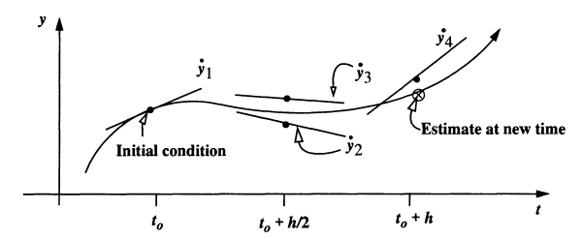
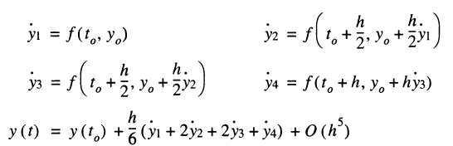
4. Integration
Runge-Kutta single step methods
Classical 4th order RK
[Vallado]

Slide 19
4. Integration
Embedded Runge-Kutta methods and step-size control
Two independent approximations of orders p and p+1 within one step, obtained using the same auxiliary functions y but with different linear combinations
Difference between two solutions represents the estimate of local truncation error of the p-th order formula
This error estimate can be used for step-size control
Step should be not too big and not too small (round-off errors)
If e(h) > tolerance – step should be repeated with a smaller h*
If the step is acceptable – it can be used for the next integration step
[Vallado]

Slide 20

4. Integration
Multi-step methods
Make use of previous steps
Require the integration of starting values
Increment function of 4th order
Most used – Adams-Bashforth-Moulton Predictor Corrector method
Initial estimate at t+1
Find corresponding function value
Find improved value (compared to initial)
Yield final updated function value
[Vallado]

Slide 21
4. Integration
Integrators used
Integrators | Features
ode45 (matlab) | Prince-Dormand pair PD5(4)7M.
ode113 (matlab) | Multistep Adams-Bashforth-Moulton PECE (orders 1 to 13)
rkv89 Embedded | Runge-Kutta-Verner 9(8)16M.
rkv89 | Runge-Kutta-Verner 9(8)16M. Fixed step
PD87 | Prince-Dormand pair PD8(7)13M
Different methods of comparison exist
Reverse check method used
Propagate until the final state is reached – propagate backwards - check how accurate the initial state is reconstructed

Slide 22
5. Simulation
Three force models
Simplified | Sun, Earth, Moon gravitational forces
Simplified + SRP | Sun, Earth, Moon + Solar radiation pressure
Full model | Sun, Earth, Moon, Jupiter, Venus, Saturn, Mars + Solar radiation pressure
Integrators are compared based on one full revolution propagated with full force model

Slide 23

5. Simulation
Maneuvers calculation
Differential corrector
Nonlinear system solver
Solves a problem specified by F(x) = 0 for x where F(x) is a function that returns a vector value.
Matlab function fsolve
V* = fsolve(function, V_initial_guess)

Slide 24
5. Simulation
Event-handling, stop condition
Transform s/c state vector to L2-centered reference frame
Check if y has changed its sign compared to that of previous step
Integrate within the range between these two adjacent states
Reduce the range applying binary search principle
When values become close to zero within tolerance – pick the closest one
Output this value as a starting point for the next orbit part integration
Integrators from Matlab ODE suite have embedded event-handling

Slide 25
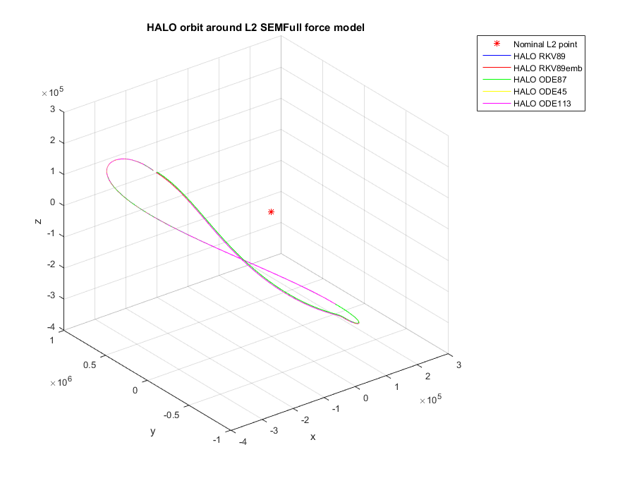
6. Results
Results of the integrators’ reverse test
Integrator | Position deviation | Velocity deviation
ODE45 | 3,1631e-06 | 1,7153e-12
ODE113 | 2,4935e-05 | 1,4124e-11
RKV89 | 1,2500e-05 | 9,5594e-12
RKV89 EMB | 4,8587e-06 | 3,6480e-12
PD87 | 1,2040e-06 | 9,5861e-13

Slide 26
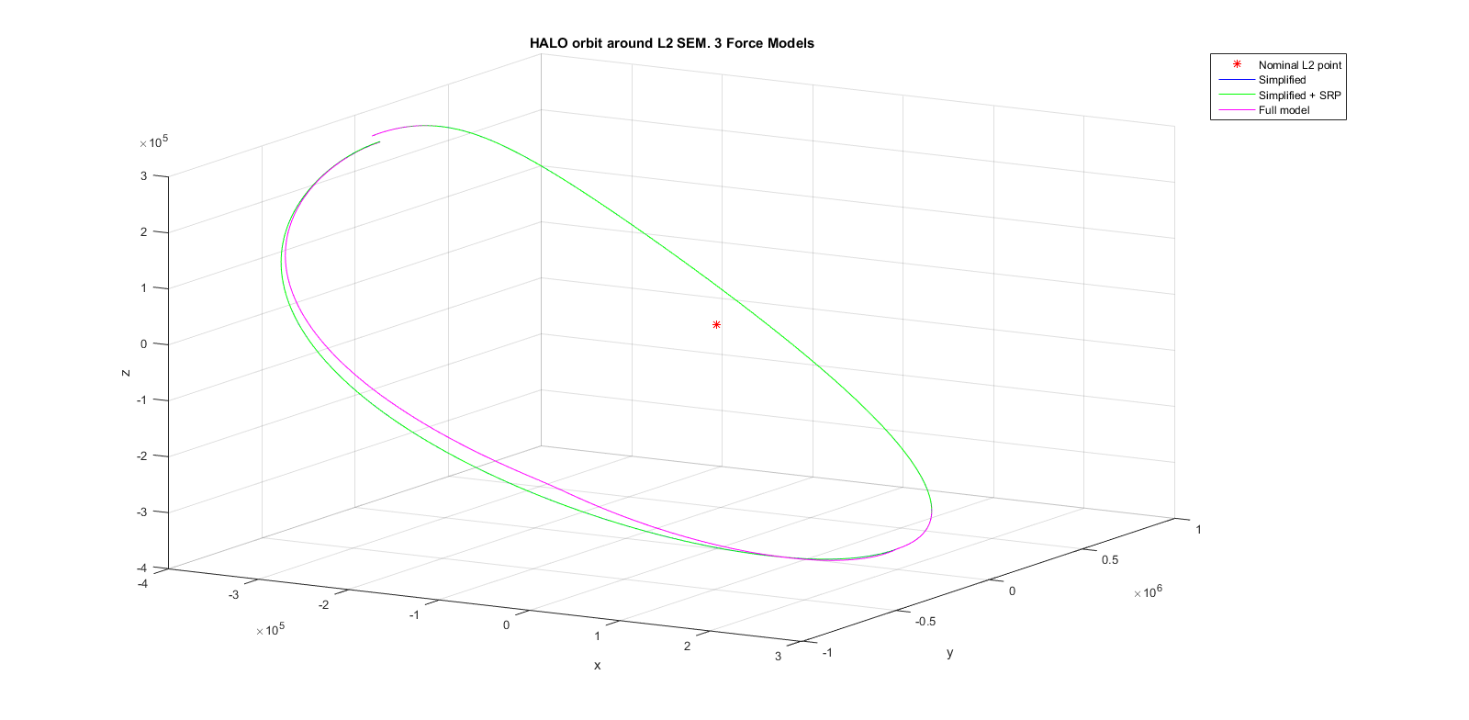
6. Results
Halo orbit propagation. View 1

Slide 27
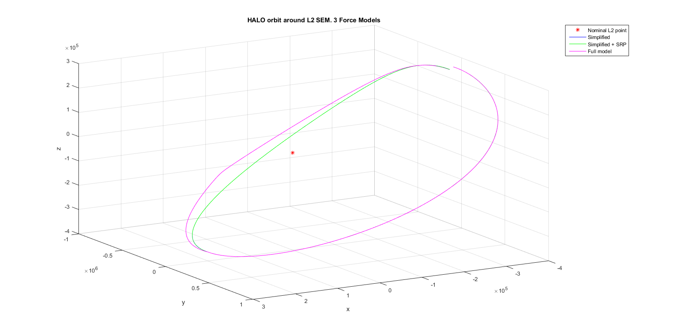
6. Results
Halo orbit propagation. View 2

Slide 28
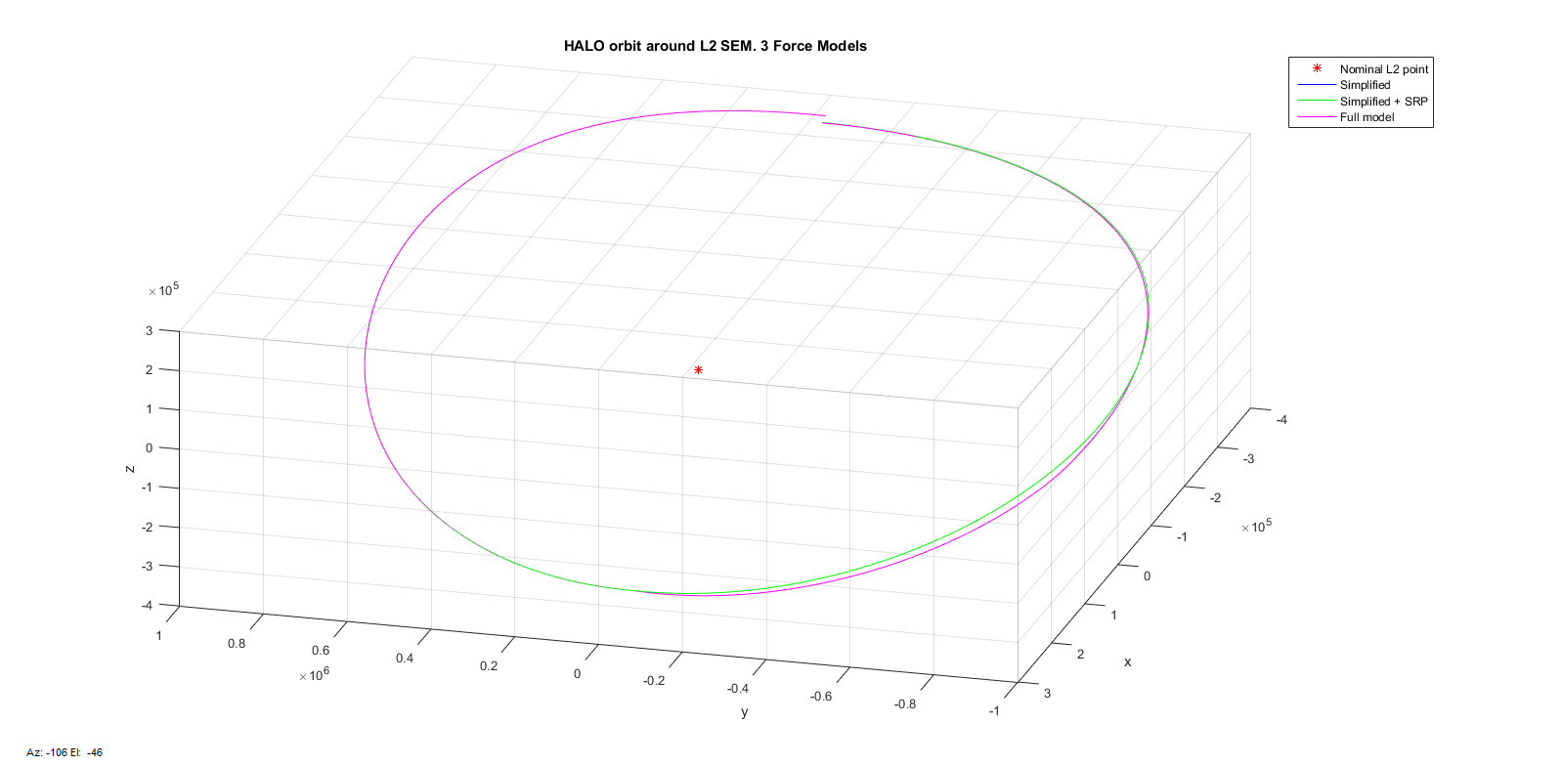
6. Results
Halo orbit propagation. View 3

Slide 29
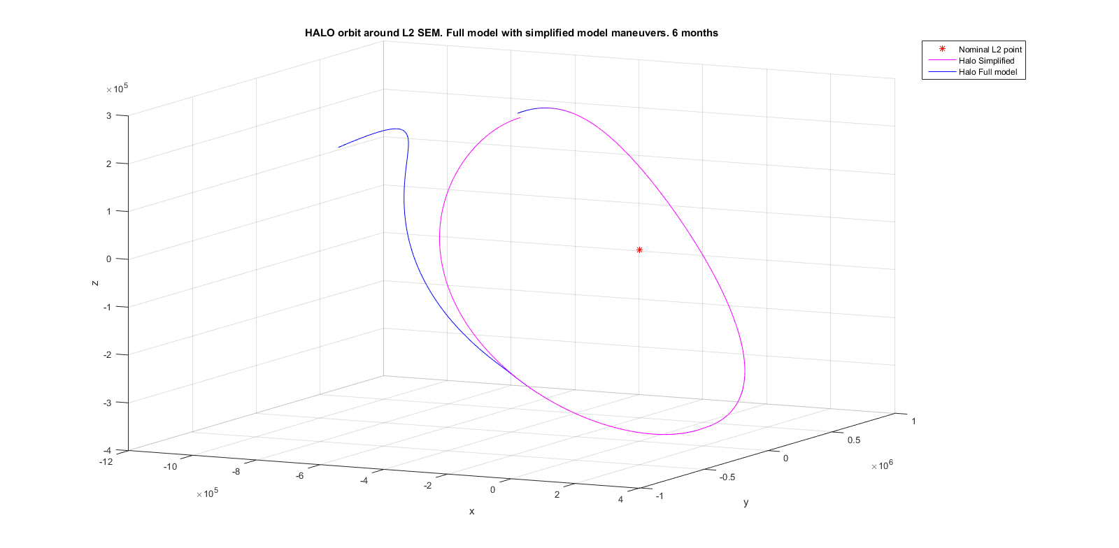
6. Results
Applying simplified case maneuvers for full model
Orbit after 6 months

Slide 30
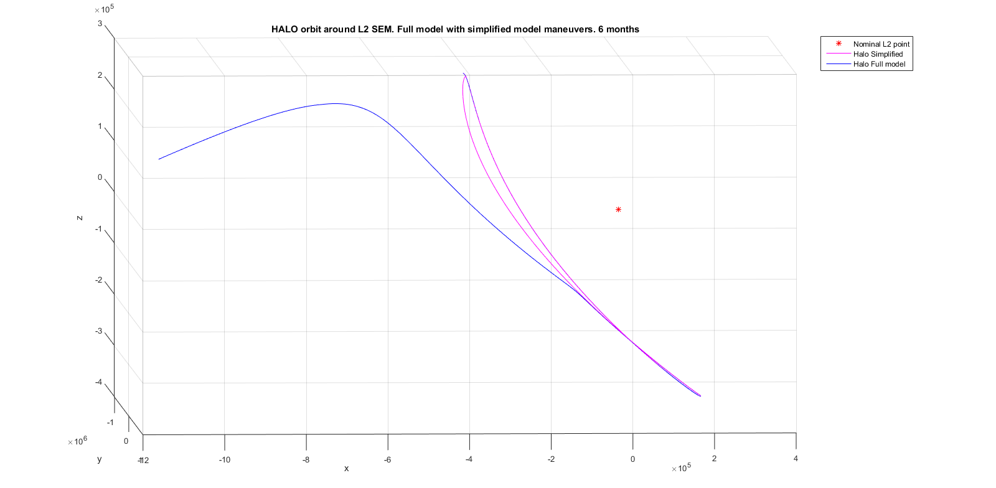
6. Results
Applying simplified case maneuvers for full model
Orbit after 6 months

Slide 31
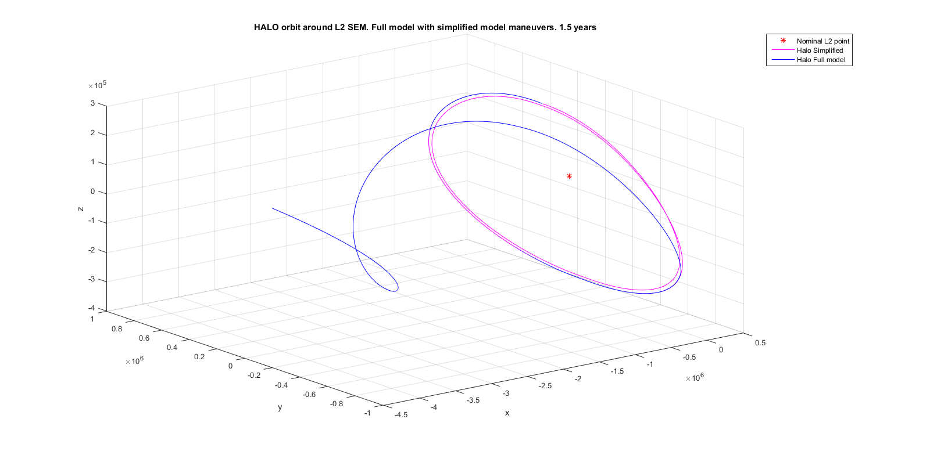
6. Results
Applying simplified case maneuvers for full model
Orbit after 1 year

Slide 32
6. Results
Conclusion
The best integrator for Halo orbit propagation was found
Significant influence of the force model simplification was shown
Matlab environment for Halo orbit propagation was created
Future work
Add features
Make maneuvers calculation process more automatic
Improve graphical representation of resulting orbits

Slide 33
And..that’s it.
Thank you for your attention!
Questions?

Slide 34
References
IRASSI paper
ESA web-site
Milano paper

Slide 35



Appendix 1 – Non-dimensional equations of motion
Non-dimensional quantities
Time derivative
Scalar distances
Mass quantities
Coordinates of primary masses
Non-dimensional equations of motion:
Relative distances:
Potential function:

Slide 36
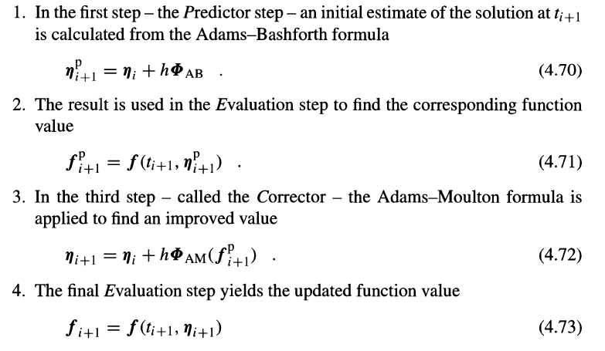
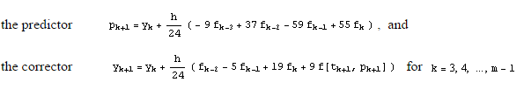
Appendix 2 - Predictor-Corrector method

Slide 37
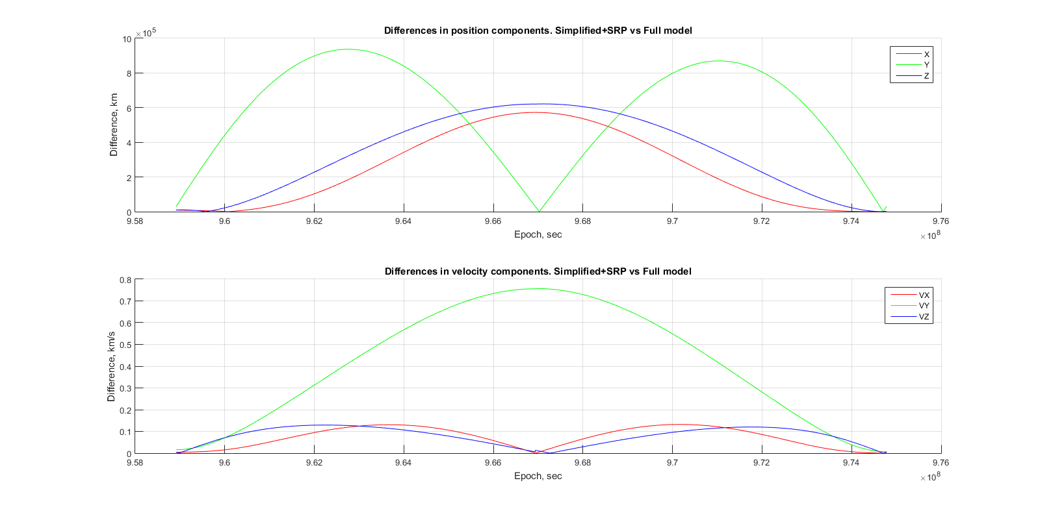
Appendix 3

Slide 38
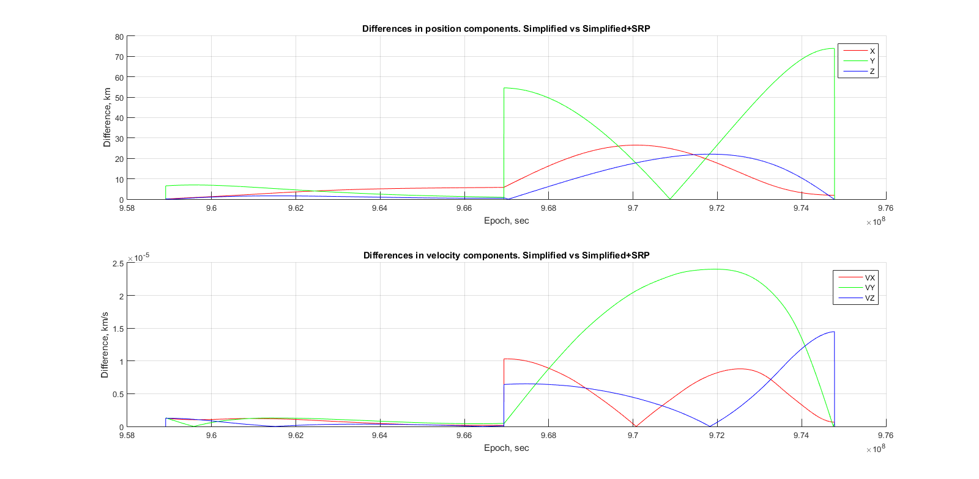
Appendix 4

