Slide 1
Cyclistic:
How Does a Bike-share Navigate Speedy Success

Slide 2
Background
Business Tasks:
Stakeholders:
How do annual members and casual riders use Cyclistic bikes differently?
Why would casual riders buy Cyclistic annual memberships?
How can Cyclistic use digital media to inﬂuence casual riders to become members?
Lily Moreno, the director of marketing and (supposedly) my manager, who is responsible for the development of campaigns and initiatives to promote bike-sharing program.
Cyclistic marketing analytics team, who are responsible for collecting, analyzing, and reporting data that helps guide the Cyclistic marketing strategy.
Cyclistic executive team, who will decide whether to approve the recommended marketing program.
Objective(s):
Moreno believes that maximizing the number of annual members will be key to future growth. Therefore, converting casual riders into annual members is the priority here.
The data analyst should design marketing strategies aimed at converting casual riders into annual members, preferably using the digital media.

Slide 3
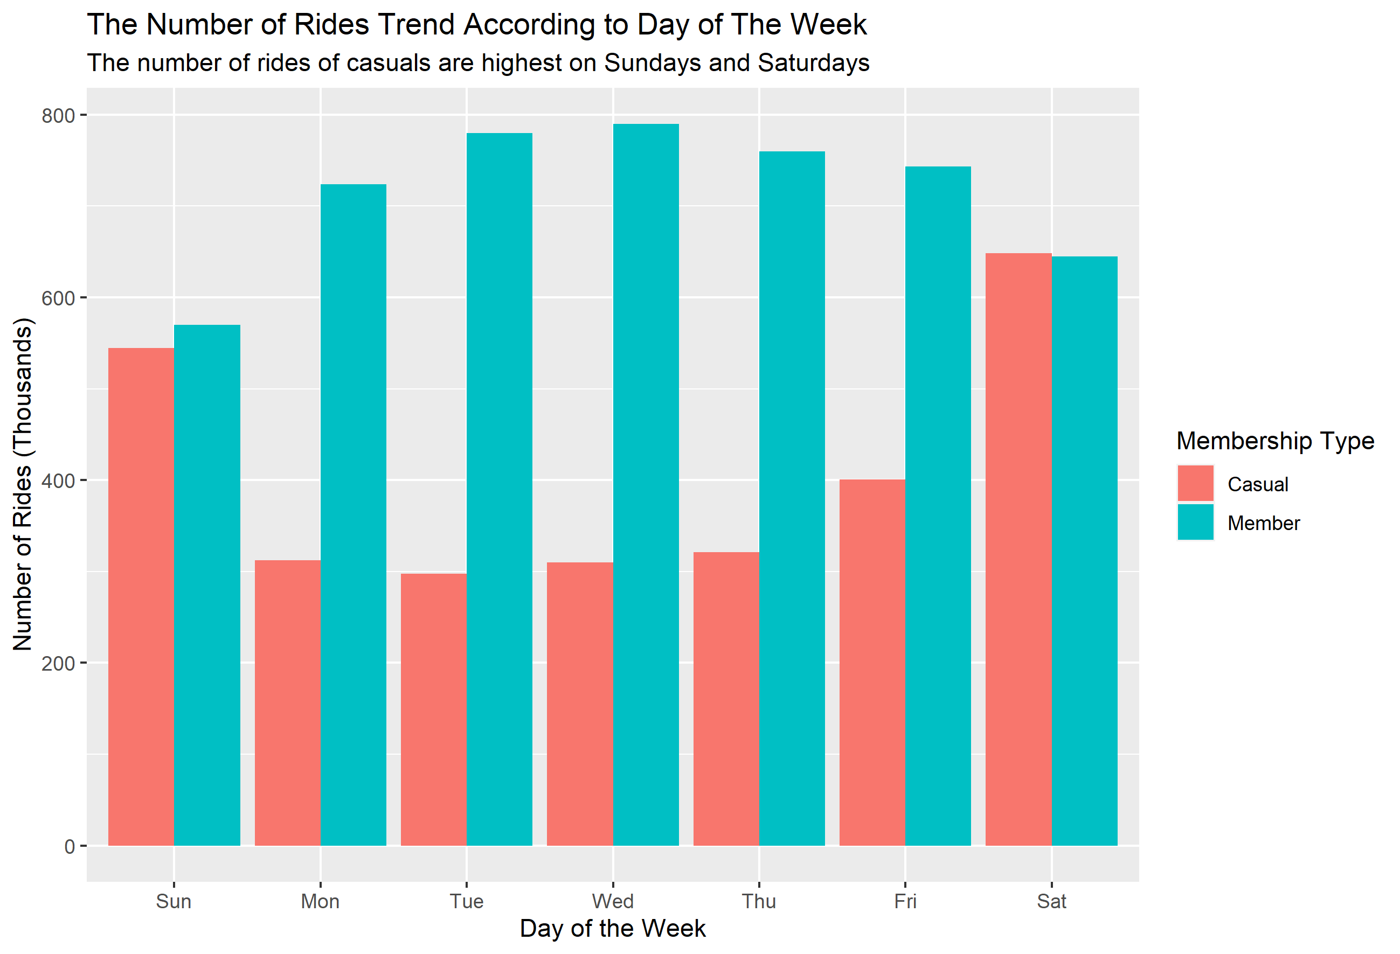
Number of Rides Trend
Casuals’ number of rides are highest on weekends, meanwhile Members are the opposite.
The number of rides of Casuals on weekdays are around half that of Members.
This may suggest that Members mostly use the bikes for work commute and Casuals use the bikes mostly for leisure on weekends.

Slide 4
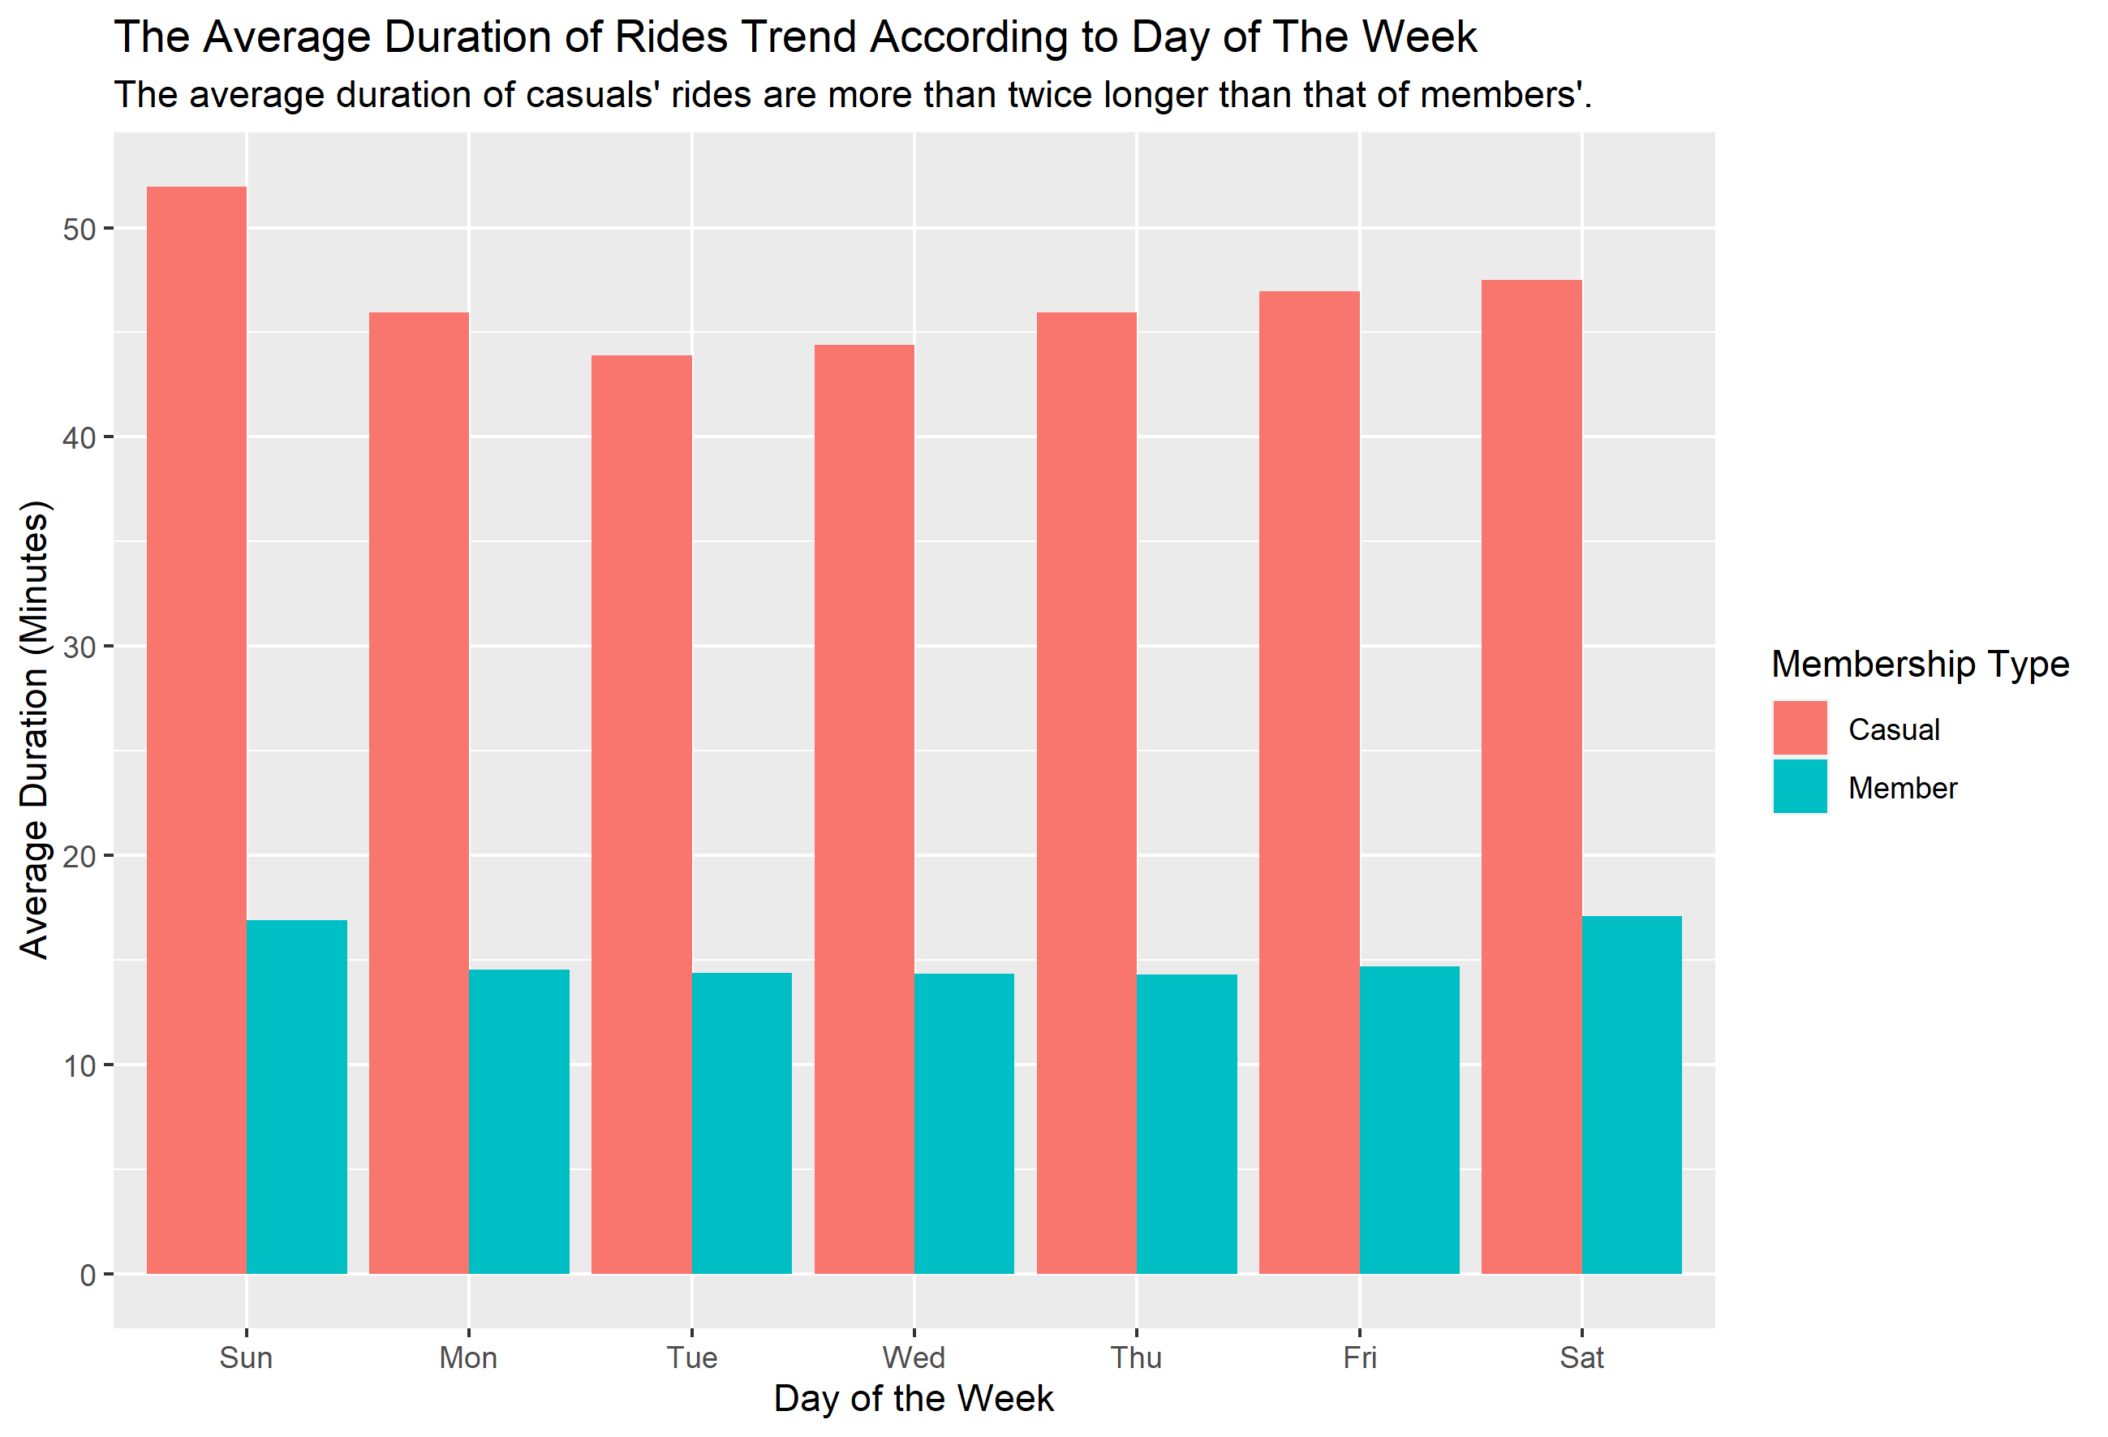
Average Duration Trend
On average, in all days of the week, the average duration of the rides of Casuals are much more than that of Members.
From the figure, the average of rides of Casuals are around 45 minutes and that of Members are around 15 minutes, which are almost one-third of Casuals’.
This further suggests that Members use the bike for work commute, since the duration is quite normal for work commute.
Meanwhile, the opposite is true for Casuals, who might use the bike not for work since the duration is too long. More evidences is needed to confirm.

Slide 5
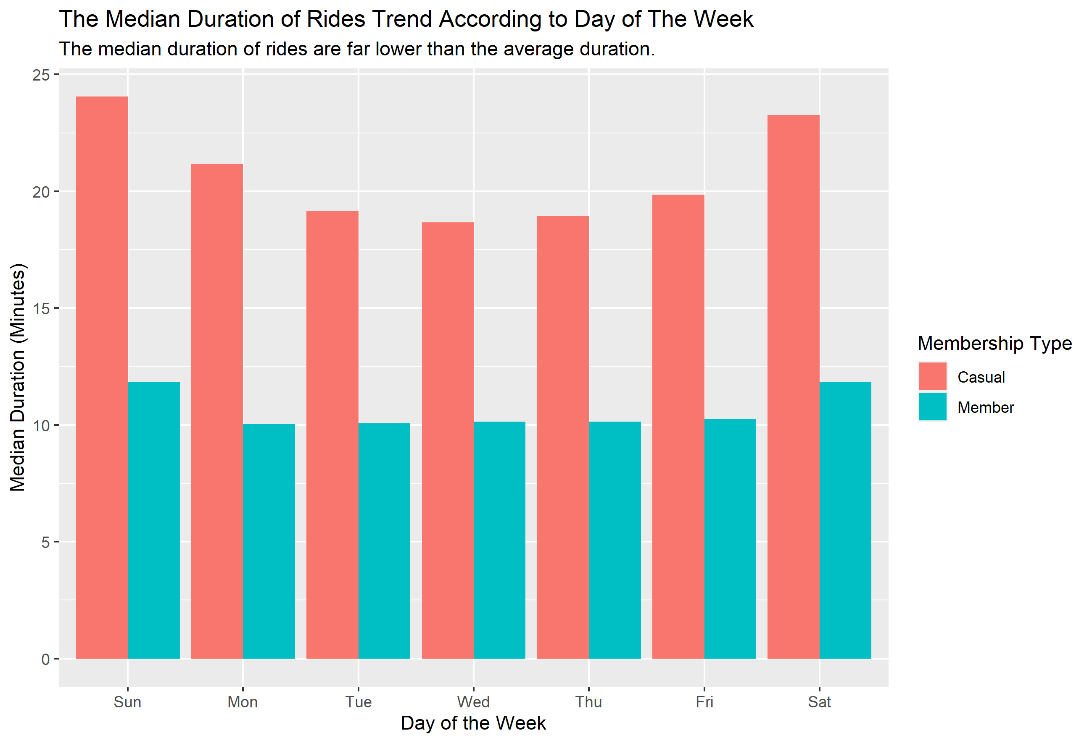
Median Duration Trend
The median duration is lower than average duration. This suggest that the distribution of rides duration are skewed to the right (positive skewness).
In contrast to Members, whose median trip duration is two-third of its average, the Casuals’ median trip is almost half of its average.
The skewed distribution is caused by a proportion of Casuals who use the bikes for far too long, which drags the average to be greater than the median.

Slide 6
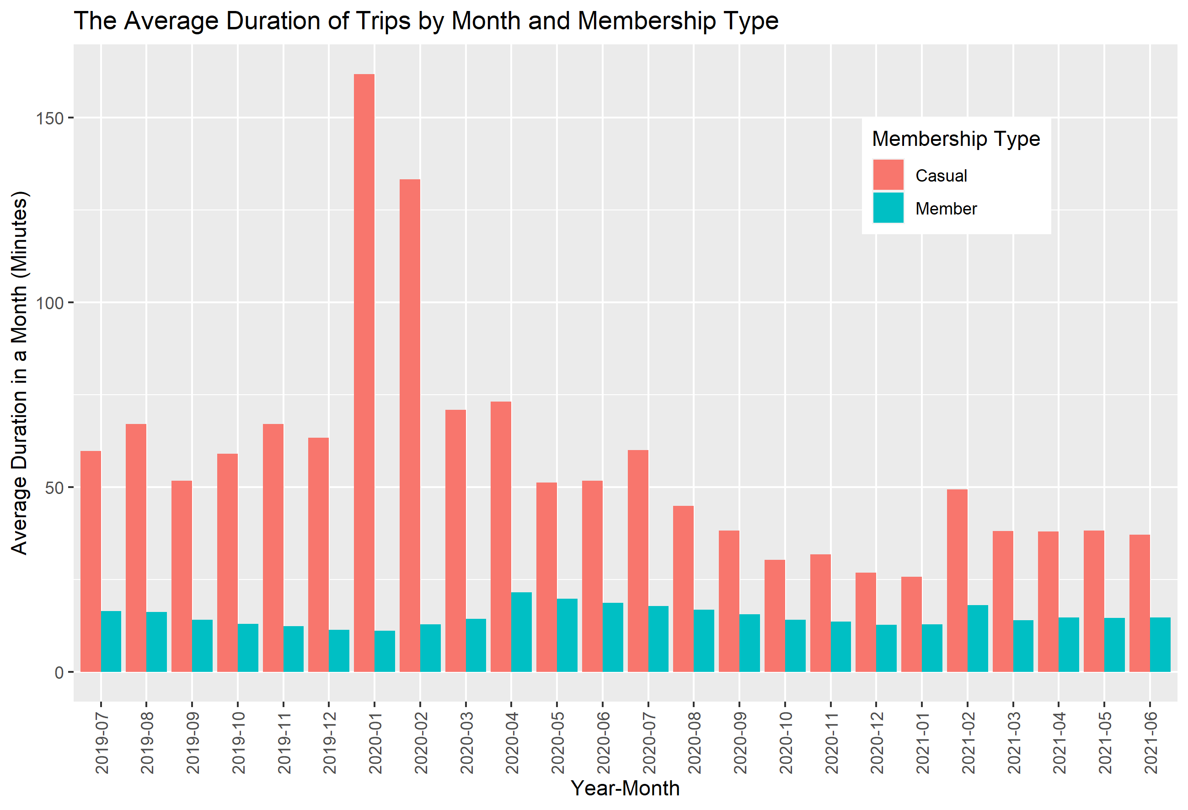
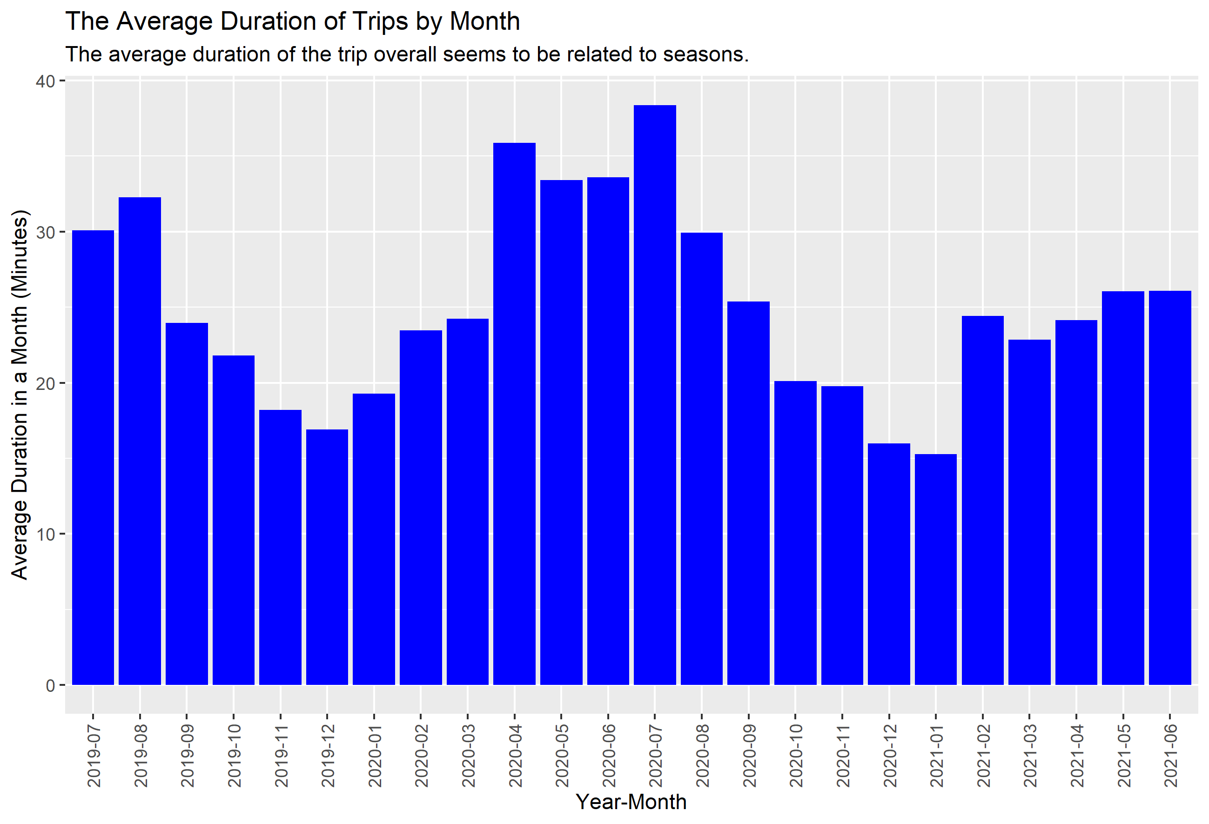
Trips Duration Trend by Month
Distinguished by membership type, there is no apparent trend in average duration of trips by month.
However, if both duration of Casuals and Members are combined, the trips duration are lower in winter seasons (around November, December, and January).

Slide 7
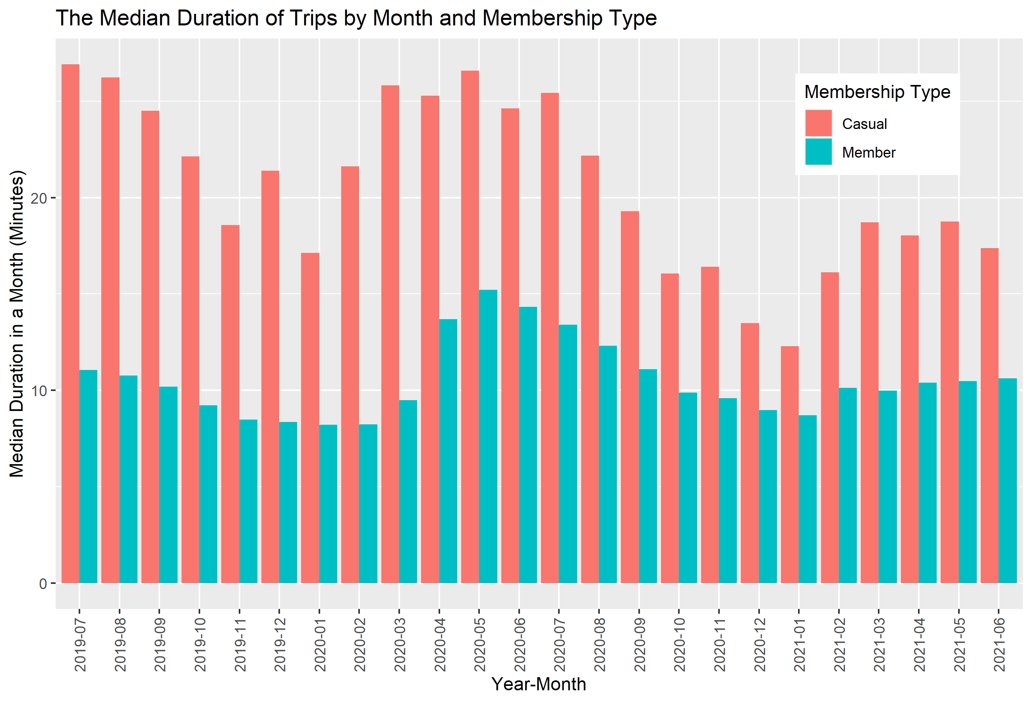
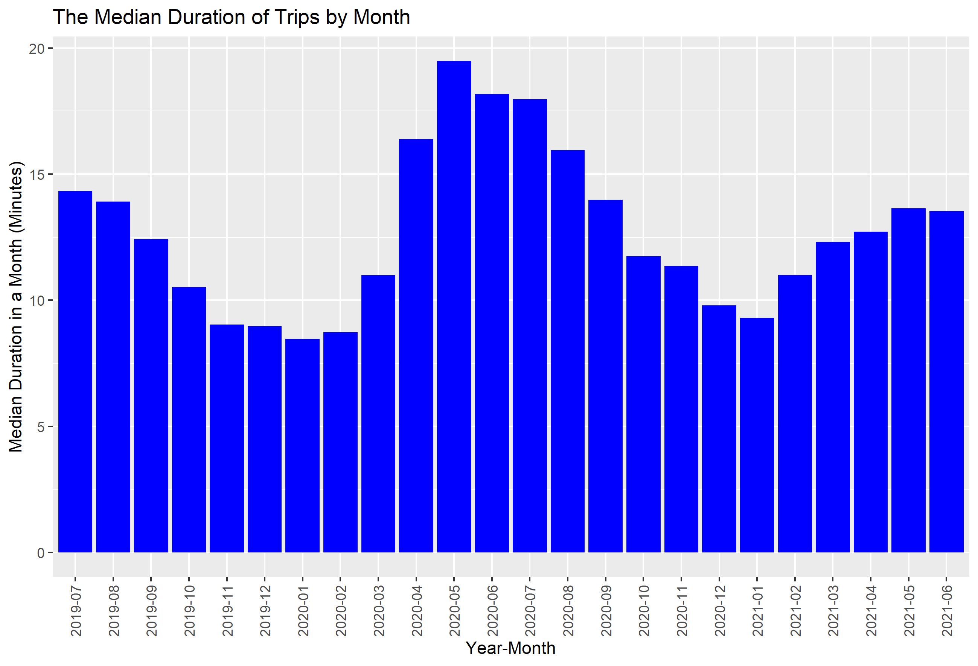
Trips Duration Trend by Month
The trend of lower trips duration during winter seasons are also apparent using median metric.

Slide 8
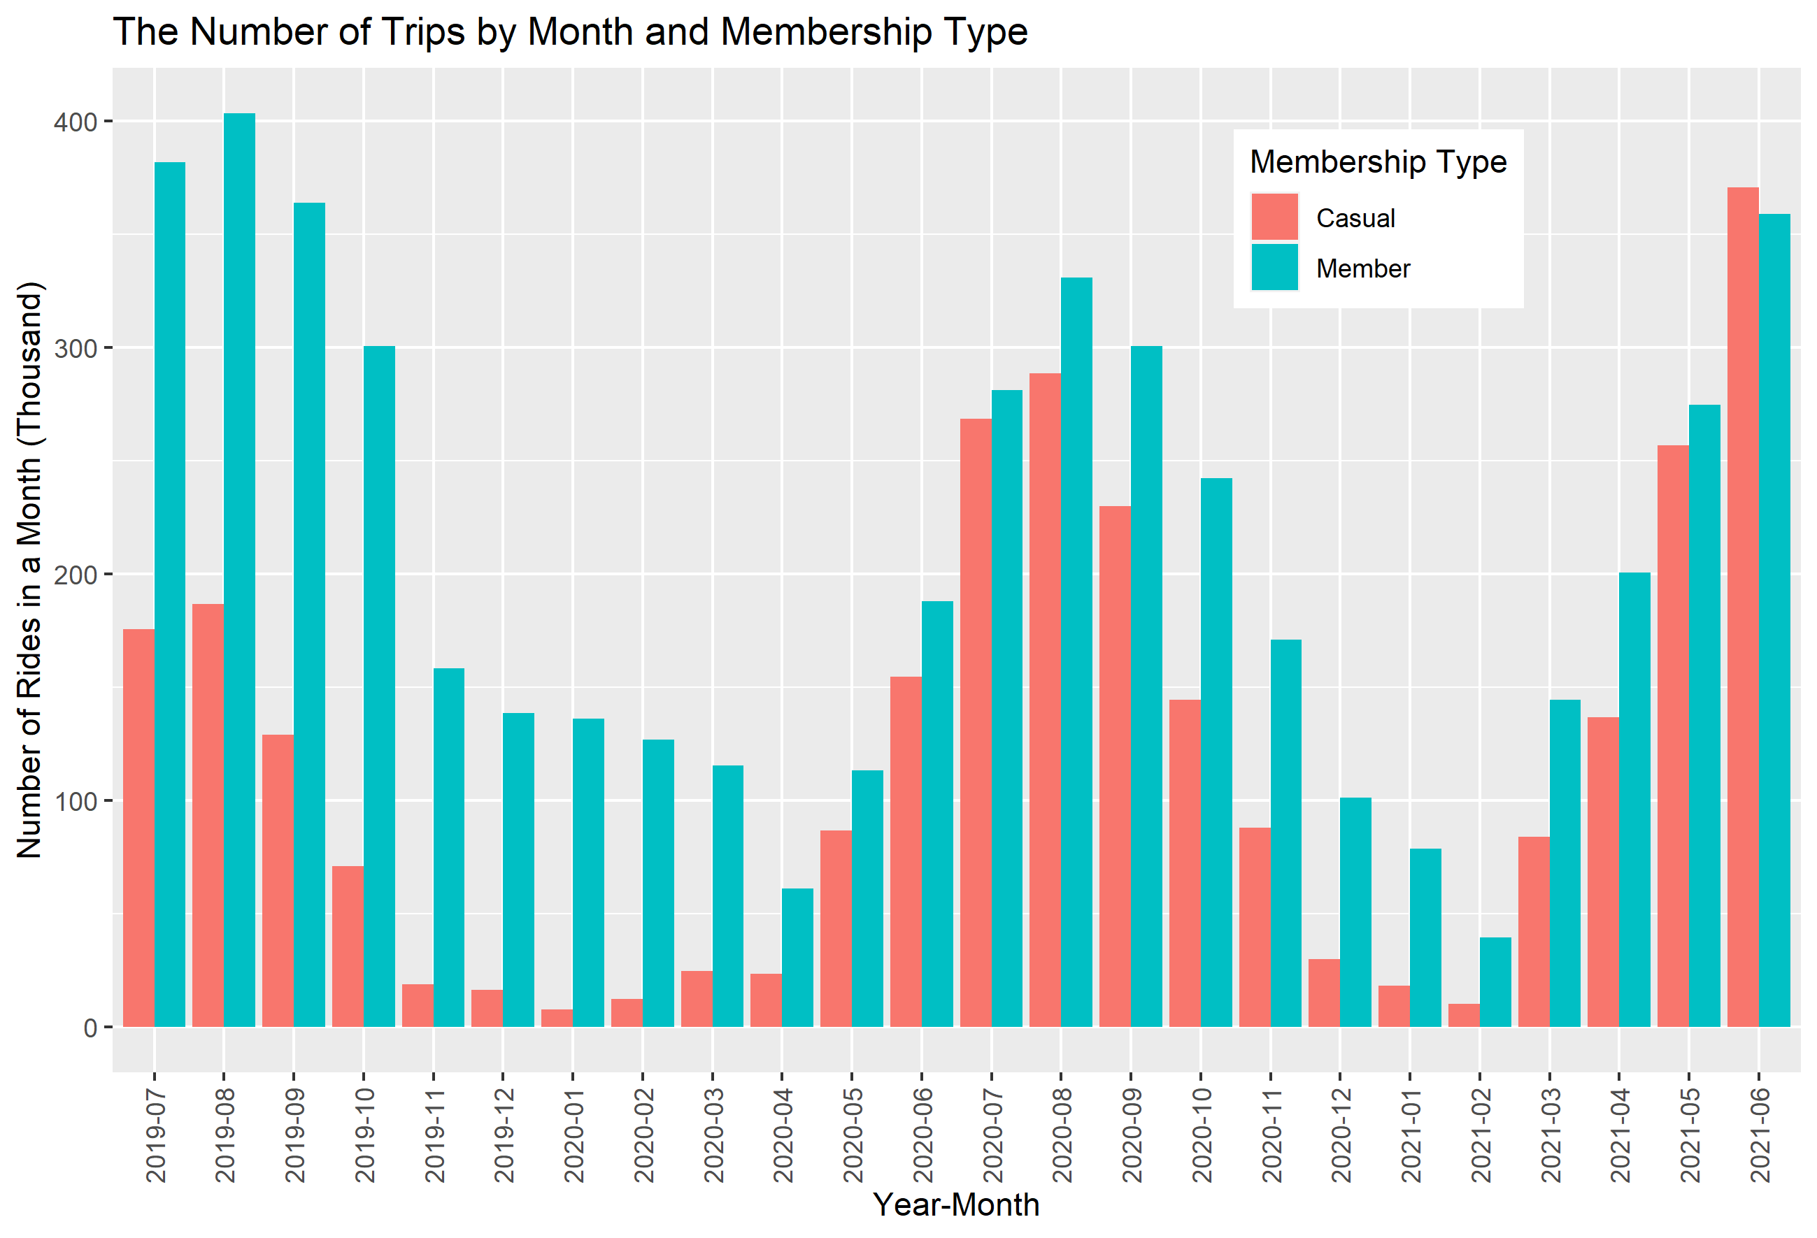
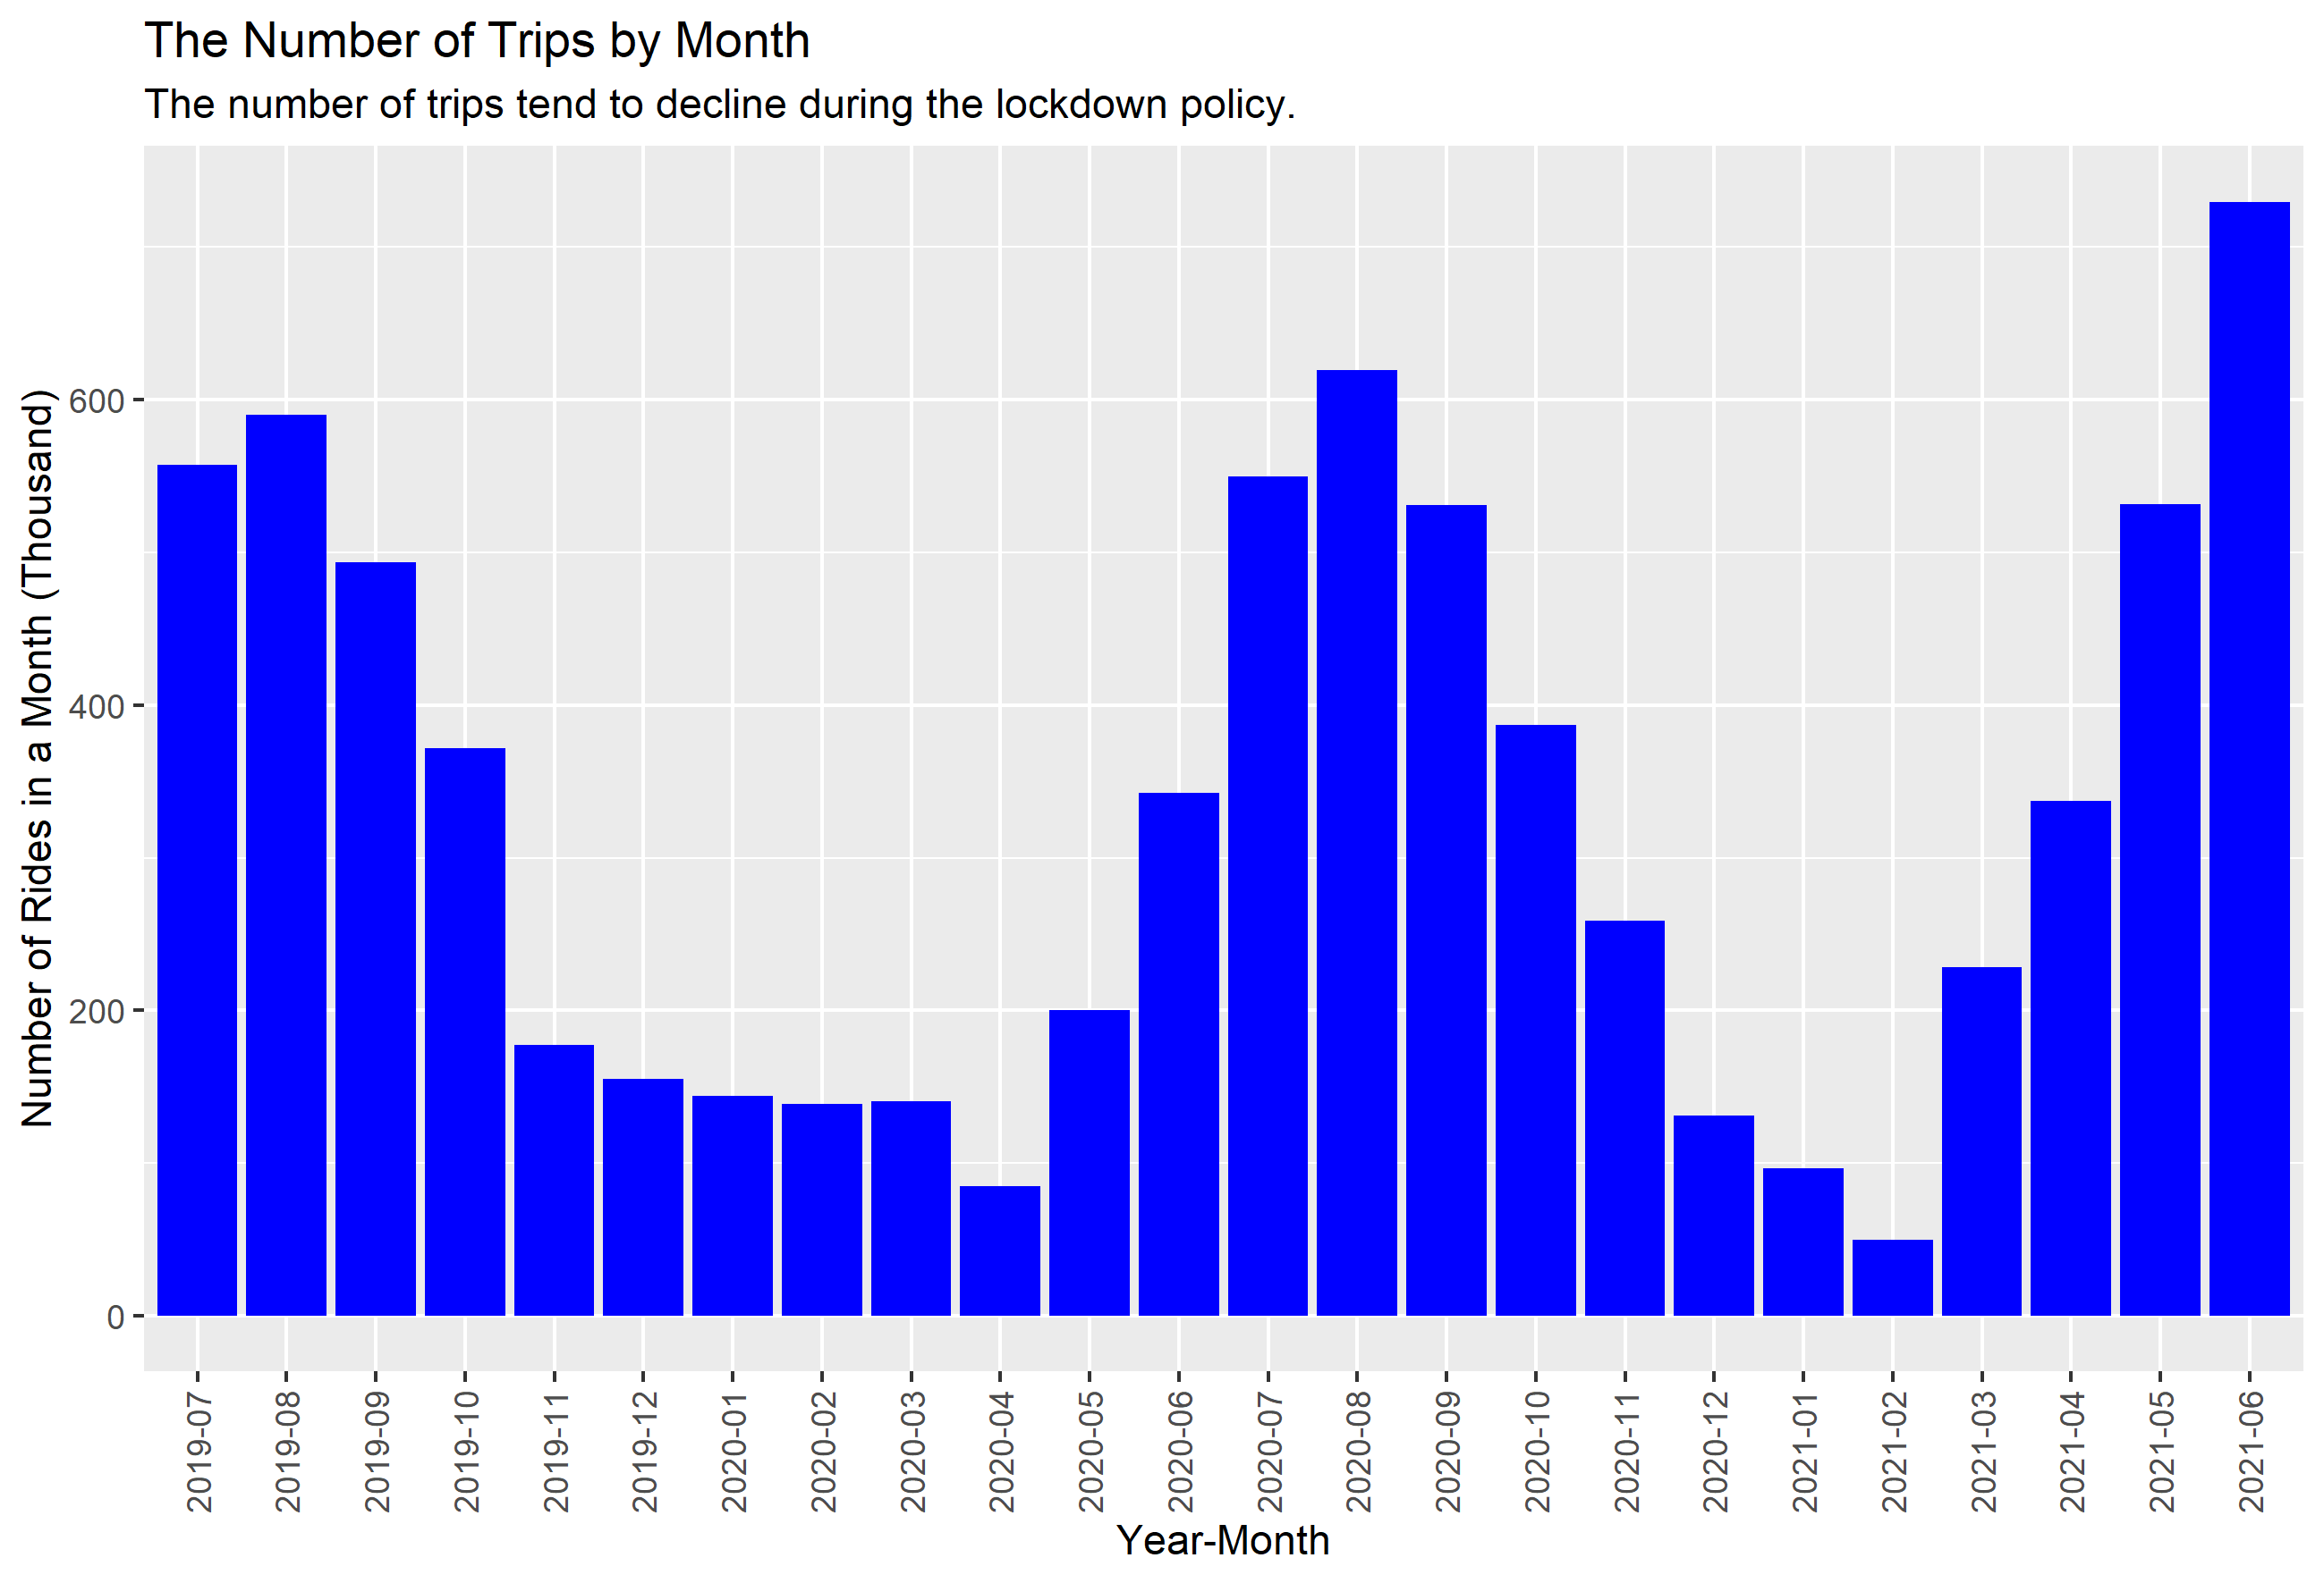
Trips Number Trend by Month
As expected, the trend of lower trips number during winter seasons are also confirmed, with Members having far lower number of rides. This might suggest that Members prefer using other mode of transportation for work commute instead of bikes during winter.

Slide 9
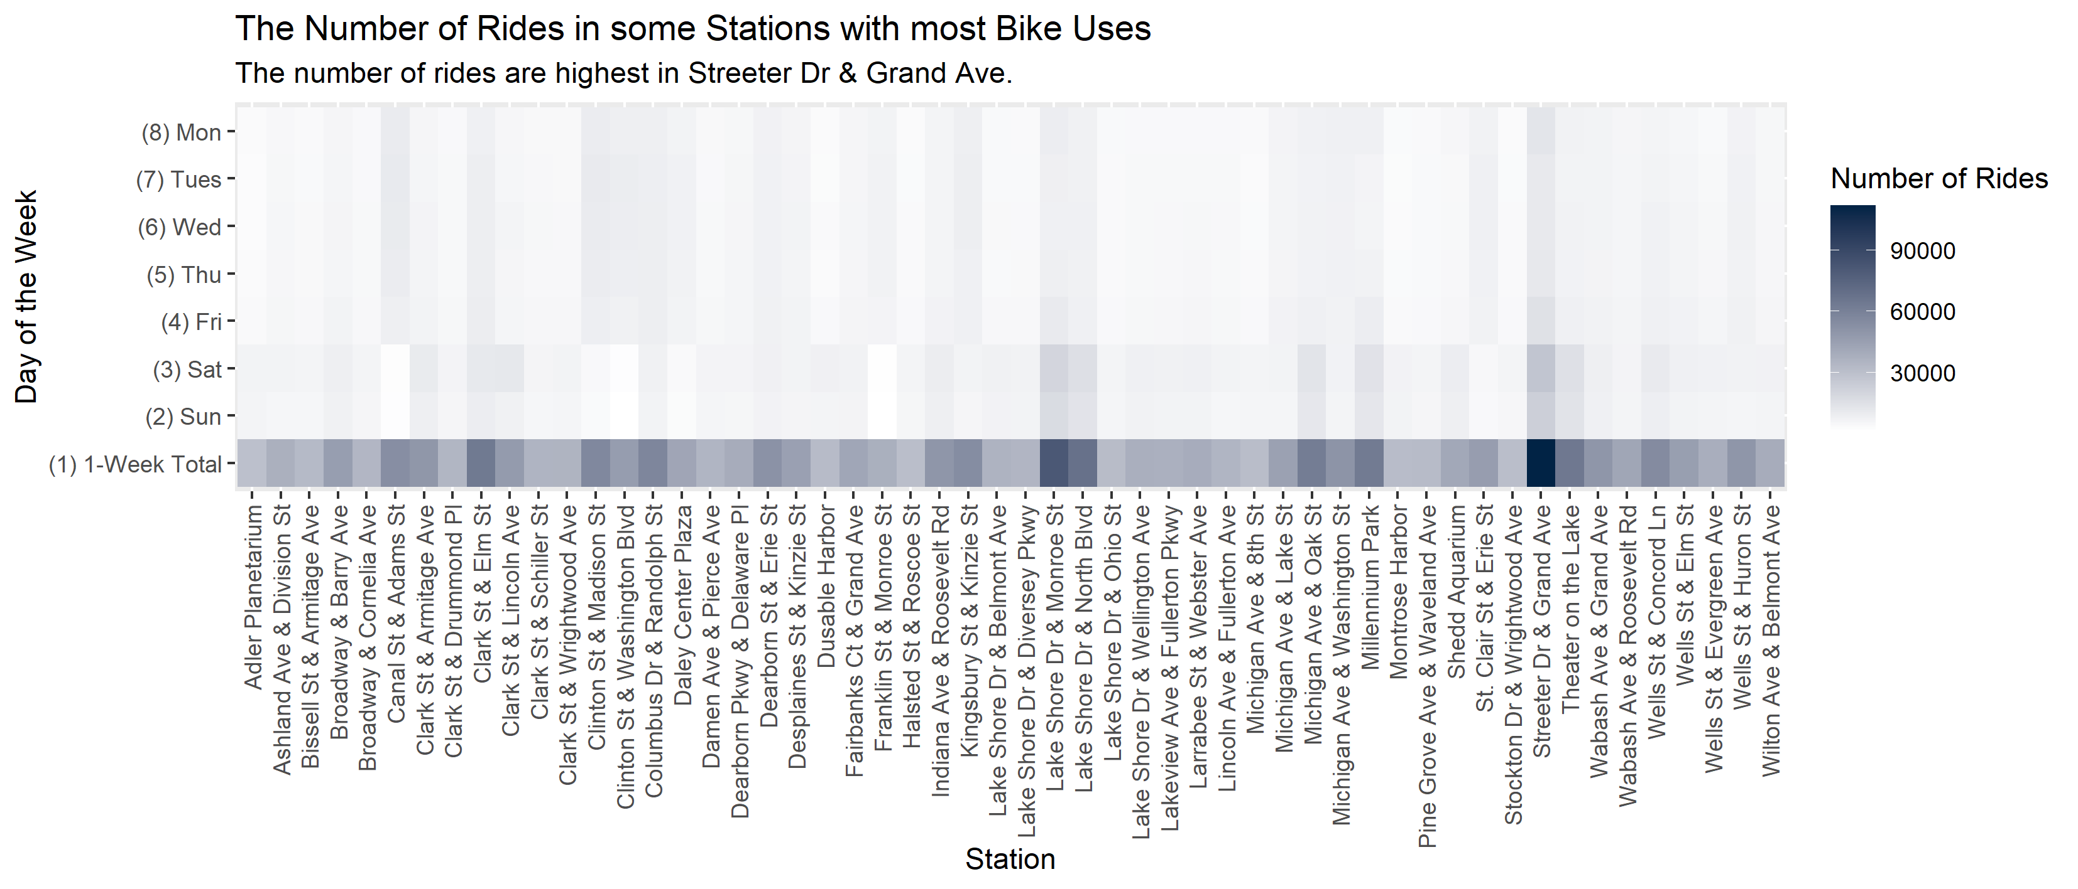
The Trips Number by Stations and Day of the Week
In total, the number of rides are highest at Streeter Dr & Grand Ave. It’s also apparent from the chart that in some stations the colors are darker on weekends than on weekdays. The opposite is true in some other stations. This might be related to the station location’s proximity to business district or leisure spots.

Slide 10
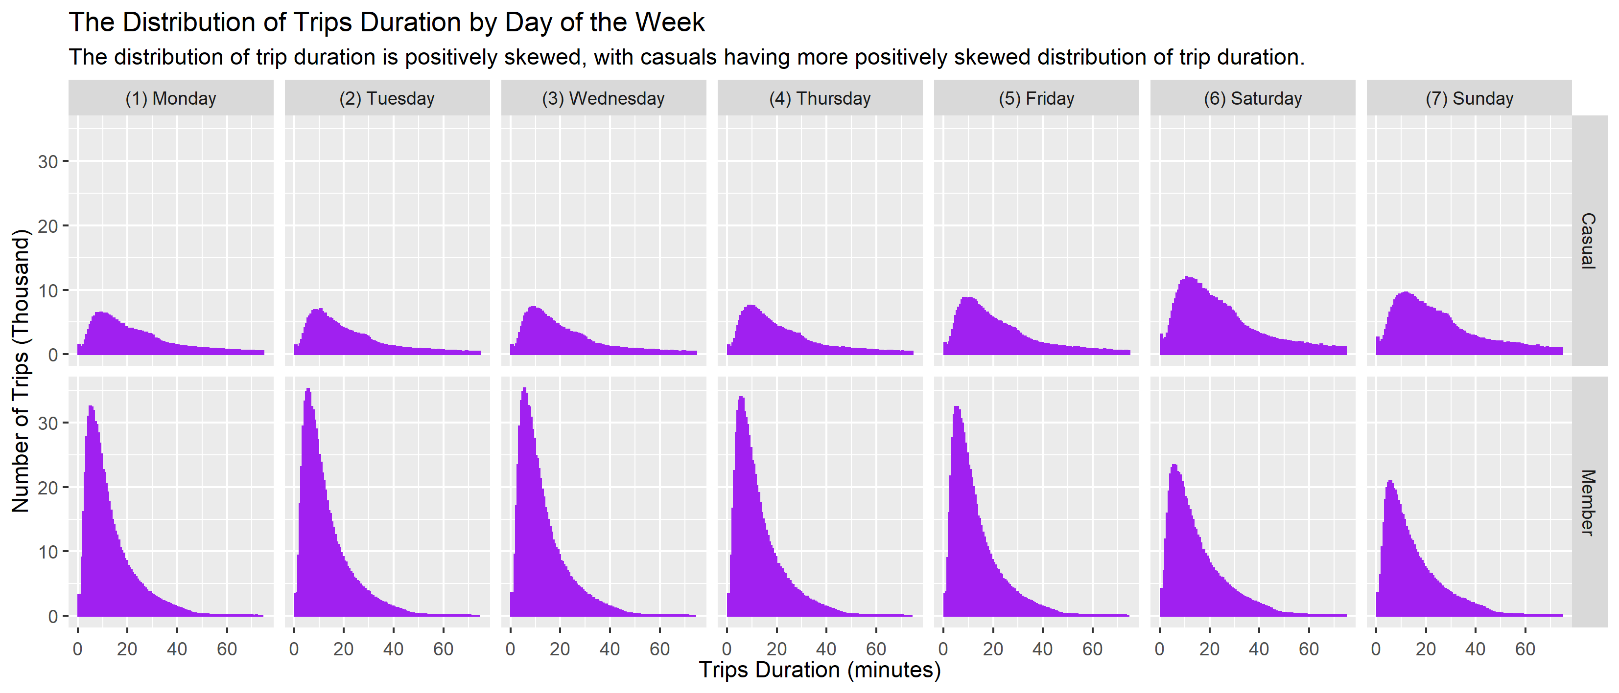
Trips Duration Distribution
Both Casuals’ and Members’ trips distribution have fat right tail in the distribution, which can be explained by the fact that a large number of riders uses the bike for far longer than average. Casuals’ have fatter right tail than Members’. Interestingly, the notions that Casuals use more bikes on weekends and Members use more bikes on weekdays are confirmed by the chart.

Slide 11
Observations and Recommendations
Observations
Recommendations
From the visualizations above, it can be observed that:
The number of trips done by casuals tend to lower on weekdays and higher on weekends. This might suggest that members paid annual membership because they use the bike for work.
The number of trips done by casuals on weekdays are around half of those done by members. This might suggest that a proportion of casuals don't really need the bike for work on weekdays. That's probably why they prefer casual membership.
The number of trips done by casuals on weekdays are almost the same as those done by members on weekends. This might suggest that casuals use bike for recreational purpose over trip to work.
The average trip duration by casuals by day are around three times as much as those done by members.
Saturday and Sunday are the most popular day for bike riding for members since the average trip duration tend to get higher on these two days.
On the other hand, Saturday is the most popular day for bike riding for casuals since the average trip duration is peaked on Saturday.
From the histogram, it's clear that the majority of members only use the bike for less than 20 minutes. Meanwhile, the histogram of trip length for casuals have significantly fatter tail, that is, positively skewed.
Considering the observations, recommendations to the stakeholders are as follows:
If the stakeholders are doing ads in person, it is better doing it on weekends and outside winter seasons since the trip number from casuals on weekends and outside winter seasons are almost as high as those of members.
If the stakeholders want to get as much casuals to convert into members as possible, they might consider offering membership of bike use on weekends only with different (slightly lower) pricing from regular annual membership.
If the stakeholders want to get as much casuals to convert into members as possible, they might also consider limit the duration of bike use for single-ride pass, say, for the first 30 minutes (1800 seconds), and charging additional fee for trip more than 30 minutes, while not limiting the duration for members. This should push the casuals to consider full-day passes, since the average trip duration of casuals are around 2500 seconds (42 minutes). To convert full-day passes further into annual membership, the stakeholder might want to consider different (higher) pricing on full-day passes on weekends.
Although the task only requires me to provide 3 recommendation, one recommendation regarding the use of digital data is probably proper. To understand the behaviors of the riders, the stakeholders might want to require the riders to install a mobile phone app by which Cyclistic can notify the users about any promotion or advertisements. The stakeholders might also want to install GPS trackers on the bikes to understand the riders’ behaviors on geolocation better. It’s unknown whether the company has implemented this already, but if not it might be useful to consider if it's not a violation of privacy. Also, the stakeholders might want to conduct marketing using social media, such as free-ride for users who post winning photo (uploaded in the users’ social media account) taken in various spots in the city. This will let the stakeholders identify which spots are better for marketing purpose.

