Slide 1
Simply BUY
“Easy to sell Simply to buy.”

Slide 2
What is the motivation of the project
The target of project that we are interested is prisoners who could not carry the cash cannot pay by ATM, Of course, which includes credit card. The system that the prison use is the coupon system is made up through account passbook that there are complex, multi-step processes, such as depositing, withdrawal in the book account. All of them that writing by hand and each step there are complexly and must use more time. We observe this issue, and we think our project Simply BUY is very beneficial to this organization. Simply BUY will reduce the complexity of the old system, reduce human error and increase comfort in manage account prisoners. According to the concept of Simply BUY "Simply BUY easy to sell. Simply to buy".

Slide 3
Process of system(present)
Process that prison use in now a day!!

Slide 4
Dealing
Dealing process

Slide 5
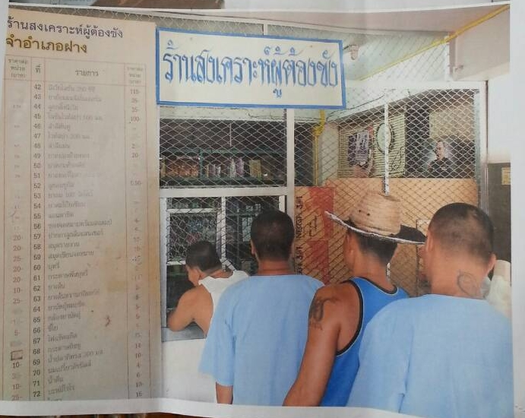
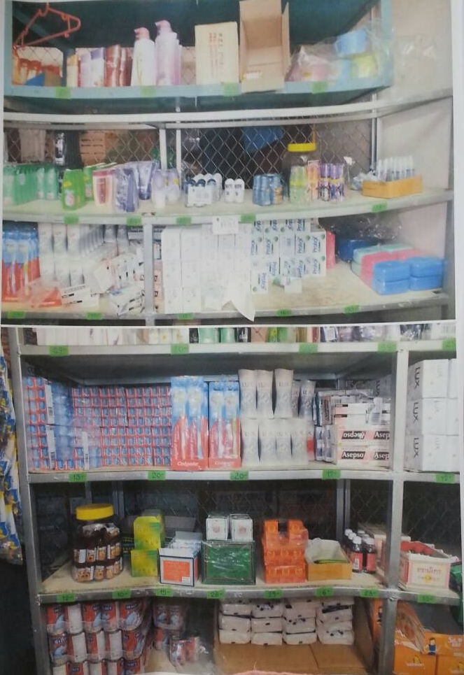
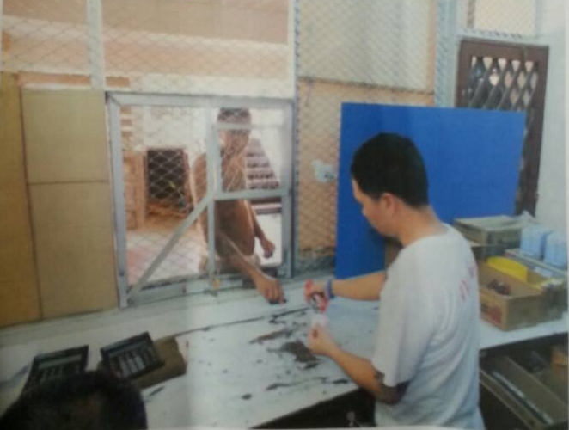
Dealing of coupon
1)Prison take coupon for buy product.
2) Officer check expiration date of coupon.
(coupon have expiration date two day)
3) Calculate product.
4)In case product not fit coupon.
officer can not commute to prison
they will give some product for fill the price.

Slide 6
The problem
old system | simply buy system
officer must check expiration date before calculate product. That unconformable to check in case had damage in coupon. | customer no need to take the coupon because he can dealing by his finger.
2.officer must calculate product by himself | 2.System shall calculate product by give list of menu to officer
3.officer must get product that sell into the book for do the stock account. | 3.There are stock product that can show history of dealing

Slide 7
The problem
.
Old system | Simply buy system
In case product not fit coupon. officer can not commute to prison they will give some product for fill the price. | System can calculate cash that fair to customer.

Slide 8
Coupon withdrawal
process of Coupon withdrawal

Slide 9
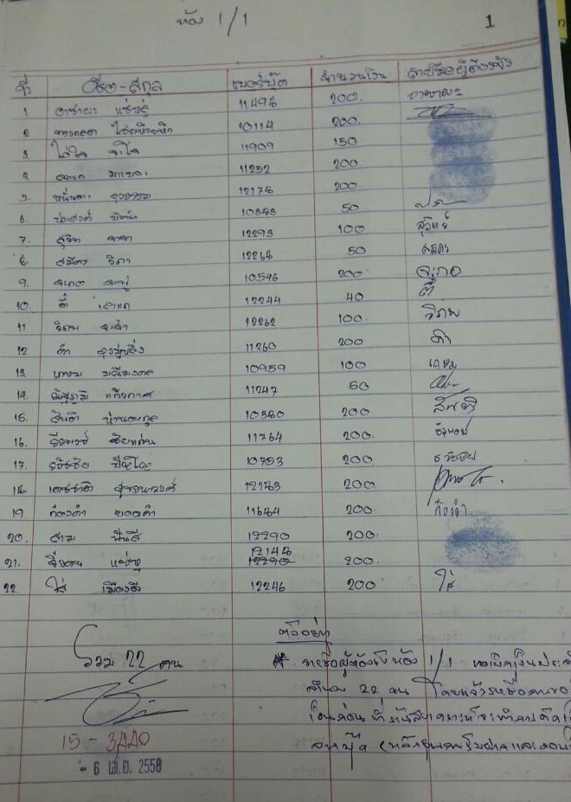
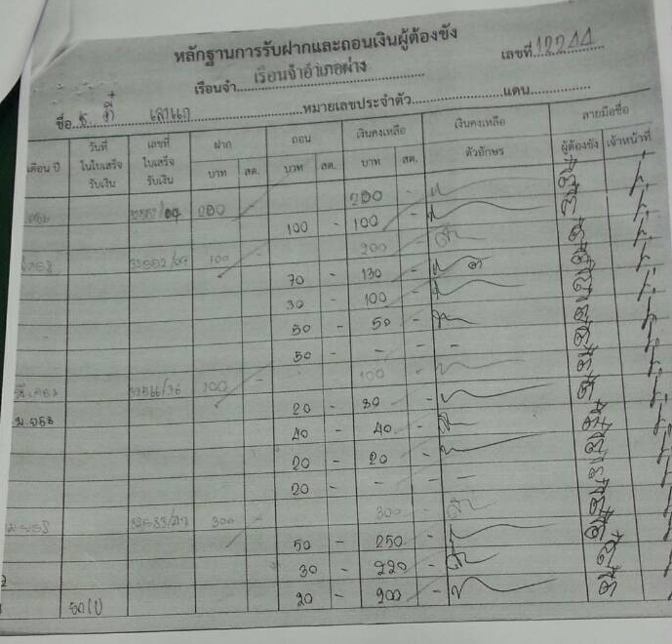
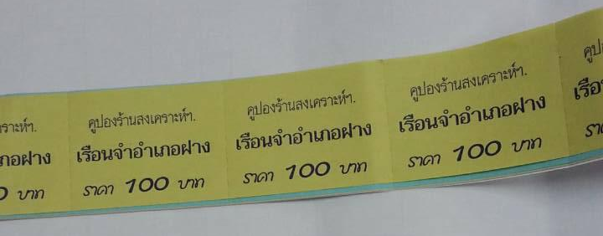
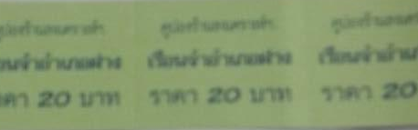
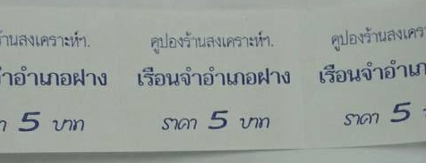
process of Coupon withdrawal
Process of coupon withdrawal
1.Prison require withdrawal coupon
of the day at header.
header will get the list of name
and signature to confirm
(Prisoner can not withdraw
more than 200 barth)
2.The header give the list to officer in store.
3.officer check withdrawal form list and do the
finacial in the account book of prison.
4.officer told prison come to get the coupon.
and prisoner signature at the account book

Slide 10
Problem
Old System | Simply Buy System
There are withdrawal every day and not more than 200 bath. | No need to withdrawal coupon because can buy by his finger.
Must check that prison have credit enough and check the require not more than 200 bath. | Prison can buy product just 200 baht per day.
Officer must check about require and account book that enough of noot. | the prisoner account will get in system. (database of prisoner)

Slide 11
Problem(Con.)
Old System | Simply Buy System
officer must give coupon to prisoner and do prison account. | There are prisoner account in the system.

Slide 12
Depositing
(deposit into account).
Deposit (bringing money into account).

Slide 13
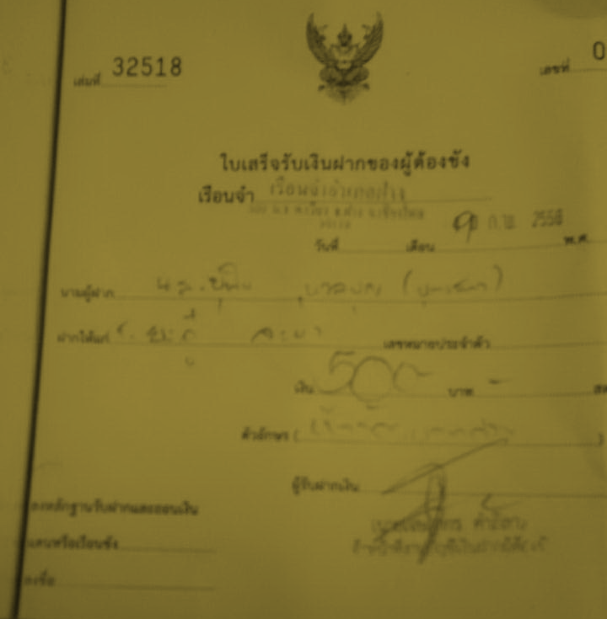
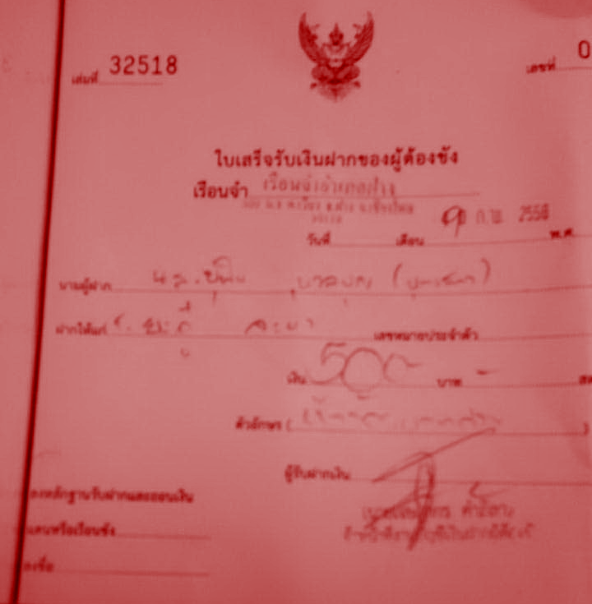
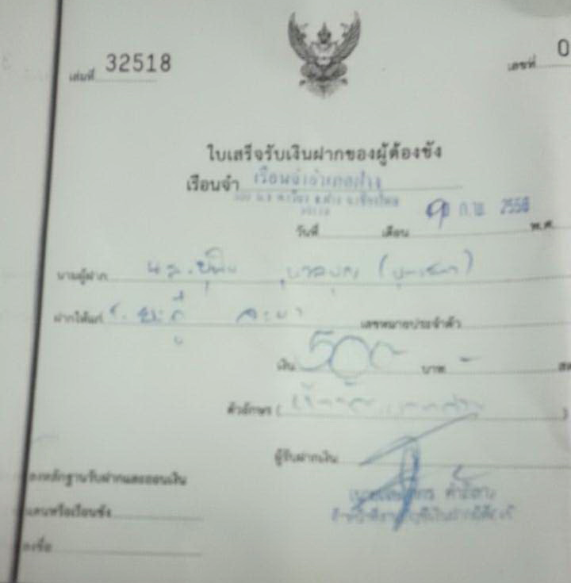
Depositing form famiry
depositing form famiry
depositor give money to officer.
and give information.
define that deposit form who to who.
There are 3 bill.
1 give to depositor 1 give to prison 1 officer.
Prison will come to confirm
and signature in account book.

Slide 14
Problem
.
Old System | Simply Buy System
Visiter need to confirm by use personal card copy every time when want to deposit.(Prevent fraud) | System will add data of visitor in the system .
.Officer must give the bill and do the prisoner book account. | .Officer and add credit into the prisoner's account.

Slide 15
Money income.
Money income when the prison work.
System can add credit to the prisoner
who working in the prison.

Slide 16
Manage
In the store part
The coupon for the balance and stock.

Slide 17
Management
Count the coupon and do account of the day.
Check stock product of the day.

Slide 18
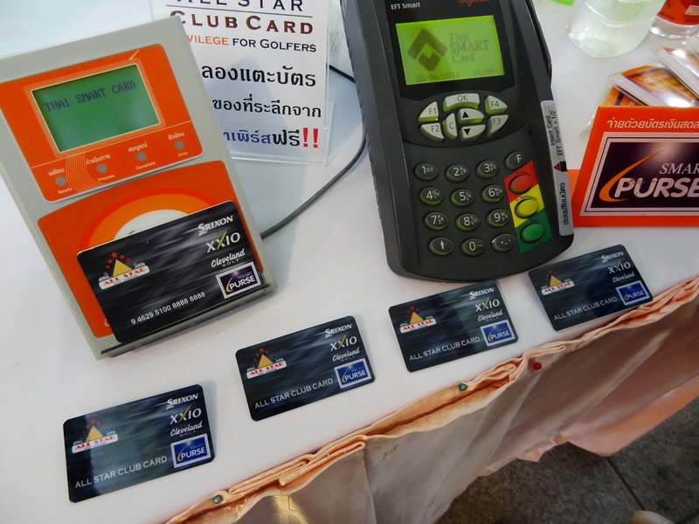
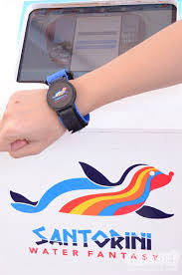
Reference concept that have already.
-The concept same card 7-11 or smartwatch that can use money credit in database by scan RFID of
bar code.But Simply buy use fingerprint for scan.
Pro..
-Easy to pay. Device can calculate credit by itself.
-There are precision.
Con…
-The device does not confirm ownership
that mean anyone can use.
-Always carry devices
We applied this concept Although the device can.
Portable, easy to scan in trading, but the thing that
convenience and can confirm ownership is a fingerprint.

Slide 19
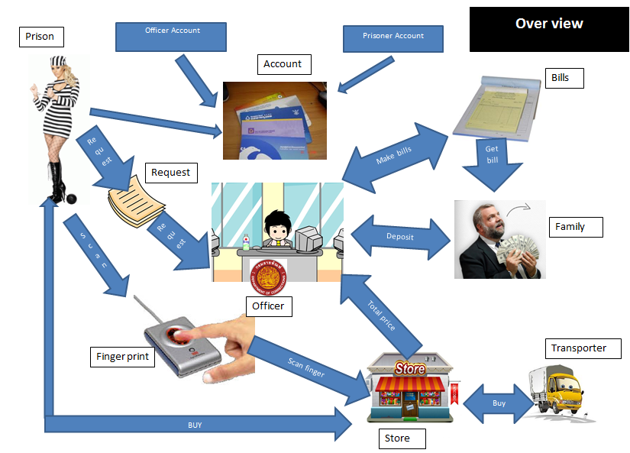

Slide 20


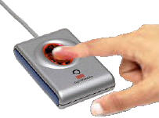


Prisoner
Register
Name:
Enter information for register.
Frist Credit:
Number:
Receive information to database.
Address
Input fingerprint
Receive information to database.
Database
Finger scan
Prison Account
Create Account for prison
5000 $
+

Slide 21
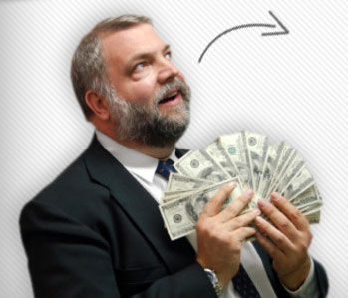

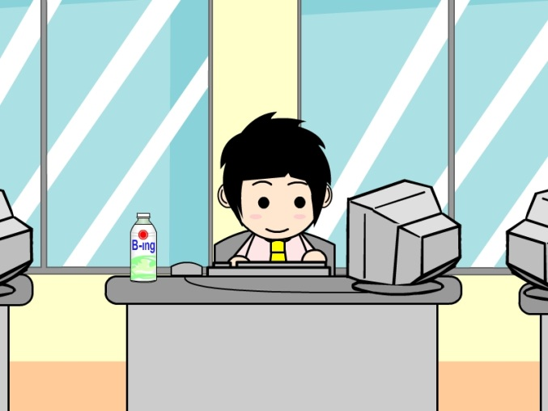

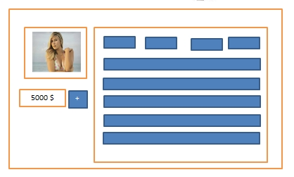
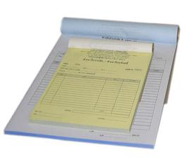
Deposit
Cash money
-Family deposit to prisoner by give money to officer at the counter.
-Officer will make 3 bills for depositor, prisoner and get one in office for used as evidence.
-officer will increase credit for that prisoner.
Family
Officer
10,000
+
Bill
Prisoner

Slide 22
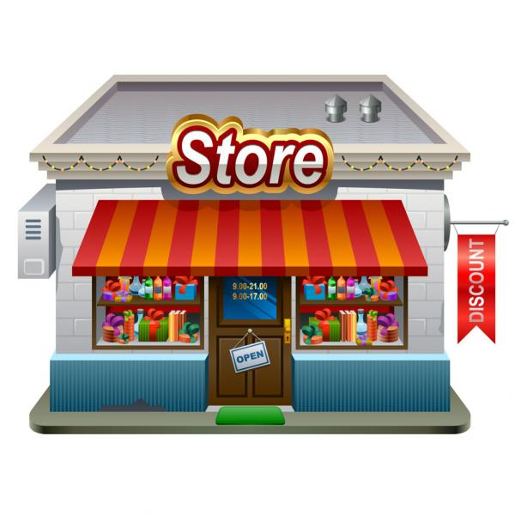
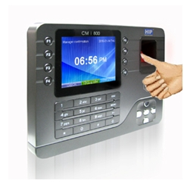
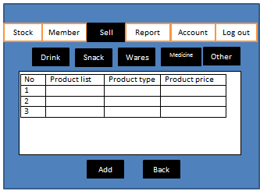
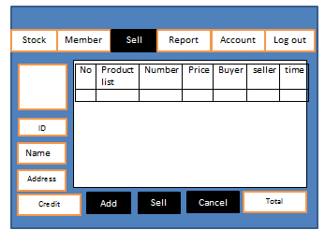
Dealing
Provide fingerprint scanner to user and user scan for call credit information.
Prisoners go to the store.
Program show information detail and list product.
Pick product
-Product will show in list
-clicks sell for finish
Notes:
Stock
Member
Sell
Report
Account
Log out
ID
Name
Address
500
Total
Sell
Cancel
Add

Slide 23

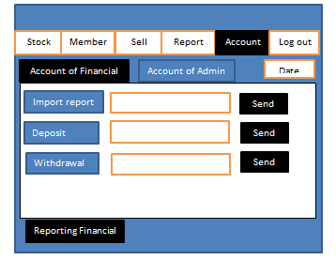
Request withdrawal
Give the cash to prisoner
Account
End of the day. Officer summary withdrawal for compare.
Withdrawal the cash

Slide 24
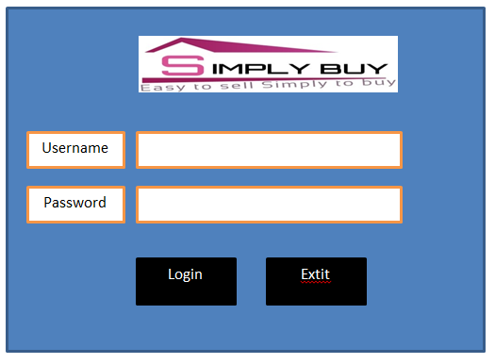
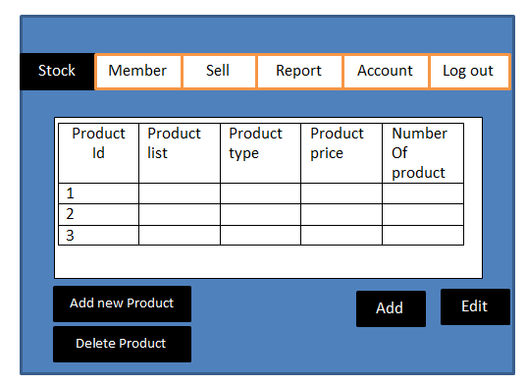
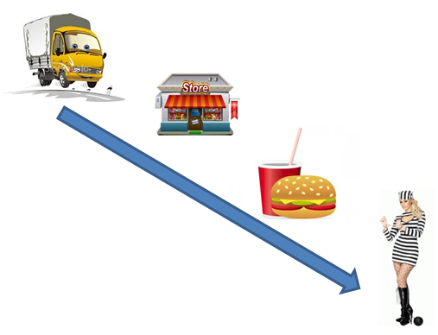
Interface Design
Manage Stock
-Can add new Product.
-Can delete product
-Can add product when increases product
-Can edit detail of product.

Slide 25
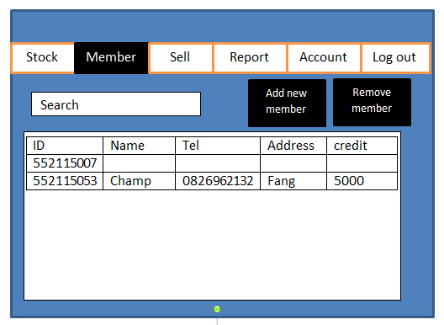
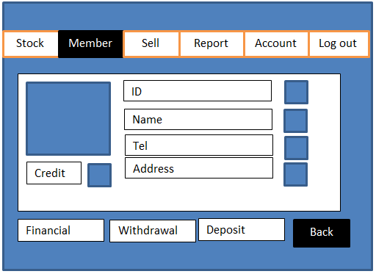
Interface Design
-Can see detail of all member
-Can Add new member
-Can remove or edit member
-Can Search for see each member
-Can Add or edit information

Slide 26
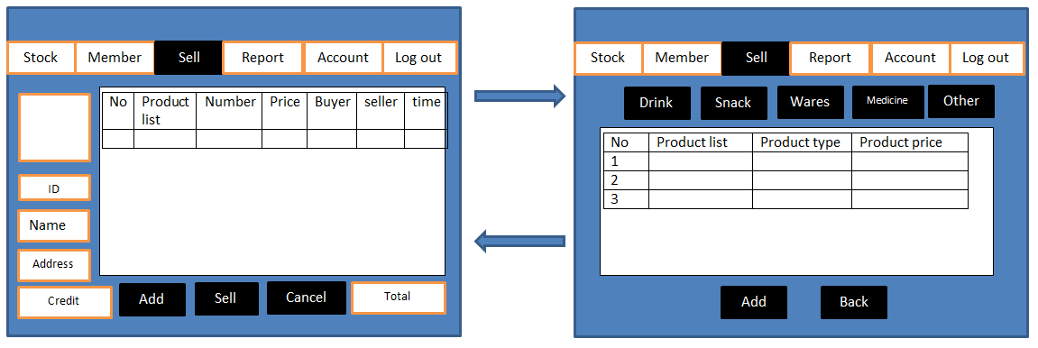
The list that prisoner sell will show in here It can calculate total.
Can pick product for add to the list.

Slide 27
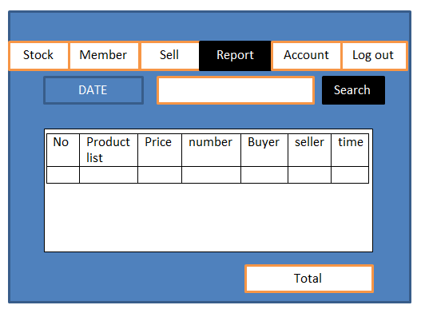
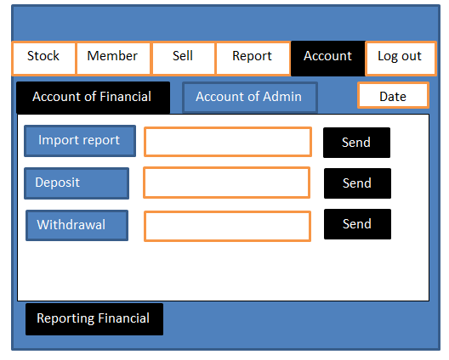
Show report about dealing of the day we can see history.
Can search the list that we want to see.
Officer must report of the day for compare the money that import or export from the system

Slide 28
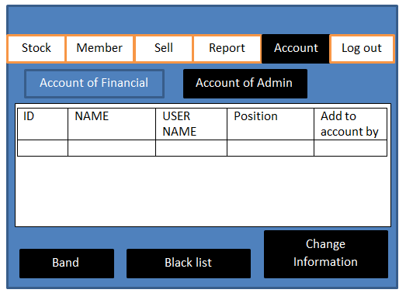
-Can see the list of admin
-Can band admin that Suspected wrongdoing to the black list.
-Can see the black list for delete admin
-Can change information such as change password or username.

Slide 30
Thank you !!
Mr.Kullawat cotanon 552115007
Mr.Peeraphut Punsuwan 552115053
Please accept me as an advisor of our group.
**if confirm please send e-mail to Dr.Chartchai for comfirm us**

