Slide 1
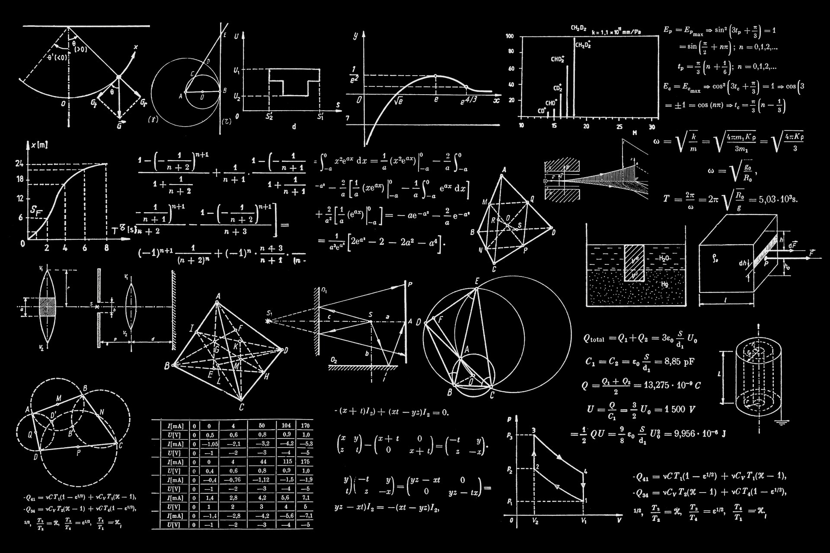
From Cloud to Edge
Building AI Computing Infrastructure
for the Age of Embodied Intelligence
Chao Chen | 陈超
General Manager, Suzhou Chuangjie Intelligent Technology
Vice Chair, Supercomputing & Intelligent Computing Committee, CCIA
IEEE ICTA 2026 | Singapore | October 2026
Notes:
Good morning, everyone. Thank you to the IEEE ICTA organizing committee for the invitation. It's a privilege to be here at a conference dedicated to advancing integrated circuits with AI.
My name is Chao Chen. I'm going to talk about AI computing infrastructure — but not from the chip designer's perspective. I'm going to talk about it from the other side: the perspective of someone who deploys chips at scale, who operates the data centers they go into, and who invests in the robots that will need them next.

Slide 2
About Me
📐 Quantitative Trading
🏗️ Traditional AI Infra
🤖 Embodied Intelligence
Applied Mathematics
High-frequency computation
"Compute = Profit"
Operating GPU clusters
at national scale (DC-centric)
"Compute = Infrastructure"
Investing in humanoid robots
Compute leaves the DC
"Compute = Autonomy"
Notes:
Let me start with a personal observation. In my career, I've lived through what I call three waves of compute demand.
The first wave was quantitative trading. I started in quantitative finance, building systems where microseconds mattered and computational throughput directly translated to profit. Computing power is not an IT cost — it's the core production asset.
The second wave — what I call "traditional AI" — is large-scale GPU clusters for training foundation models. This wave is data-center-centric: the chips stay in the rack, the cooling stays in the building, and the power stays on the grid. All the hard problems — thermal management, power delivery, interconnection, utilization — are system-level problems, but they happen in a controlled environment. 700 watts per chip is fine when you have liquid cooling. Megawatts of power is fine when you build next to a hydroelectric dam.
The third wave is fundamentally different: embodied intelligence. Compute leaves the data center. It walks out on two legs, runs on batteries, and must make safety-critical decisions in milliseconds. I'm an investor in LingShen Technology and TIEN Kung, and through these investments I've seen computing demands that break every assumption from the data center world.

Slide 3
Three Waves of Compute Demand
Wave 1
Wave 2
Wave 3
Quantitative Finance (2010s)
Traditional AI Training (2020s)
Embodied AI (2026→)
• Microsecond latency matters
• Every compute cycle = money
▸ Compute = Profit
• GPU clusters — stays in the data center
• Petaflops throughput, 700W/chip
• Liquid cooling, MW-scale power
▸ Compute = Infrastructure
• Compute leaves the data center
• On-body inference, <50W budget
• Real-time safety-critical control
▸ Compute = Autonomy
"Each wave demands fundamentally different IC design."
Notes:
According to Deloitte, inference workloads will account for roughly two-thirds of all AI compute in 2026 — up from one-third in 2023. The market for inference-optimized chips alone will exceed 50 billion US dollars this year. And the embodied AI market is projected to grow at a 31% compound annual growth rate.
The demand for compute is not just growing — it's diversifying. Each new form of compute creates new demands on IC design.
Today I want to take you on a journey from the cloud to the edge to the robot's body — and at each stop, I'll share what chip designers need to know.

Slide 4
AI Compute: The Numbers
2/3
$50B+
31%
of all AI compute is inference (2026)
inference chip market (2026)
embodied AI market CAGR
Source: Deloitte TMT Predictions 2026 | Omdia Market Radar 2026
Notes:
[Data slide — let the numbers speak]
Two-thirds of all AI compute is inference. 50 billion dollar inference chip market. 31% CAGR for embodied AI.
Source: Deloitte TMT Predictions 2026, Omdia Market Radar 2026.

Slide 5
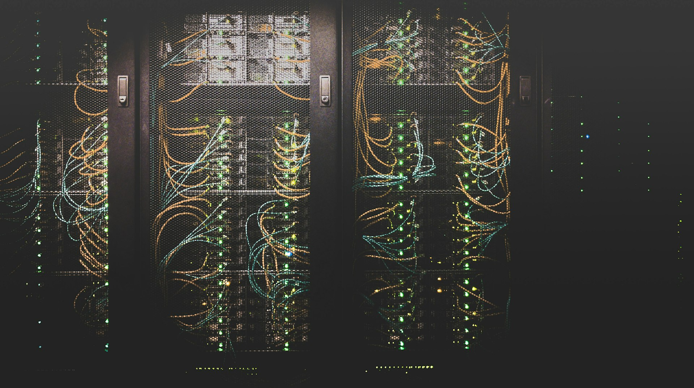
PART I
The Cloud
Operating AI at Scale
Notes:
Let me start with the data center.
[Section transition — pause briefly]

Slide 6
China's Intelligent Computing Centers
200+
intelligent computing centers built since 2023
60,000+
GPU accelerators deployed at leading operators
12+ EFlops
total deployed AI compute (and growing)
<30%
average GPU utilization rate
"The system-level challenges dominate everything."
Notes:
China has built over 200 intelligent computing centers in the past three years. I've been directly involved in several of these. The largest operators now manage over 60,000 GPU accelerators across multiple sites, with total deployed compute exceeding 12 exaFLOPS — spread across centers in Yichang, Ordos, Sichuan, Xinjiang, and more.
To give you a sense of scale: a single facility in Ordos deployed 3,000 petaFLOPS with a 10-billion-yuan investment. The largest planned facility — in Wenzhou — is targeting 50,000 petaFLOPS with investment of nearly 14 billion yuan. These are massive infrastructure projects comparable to building power plants.
Yet even at this scale, the most important lessons I've learned have nothing to do with chip specifications. When you operate thousands of GPUs in a single facility, the system-level challenges dominate everything. Let me walk you through the top three.

Slide 7
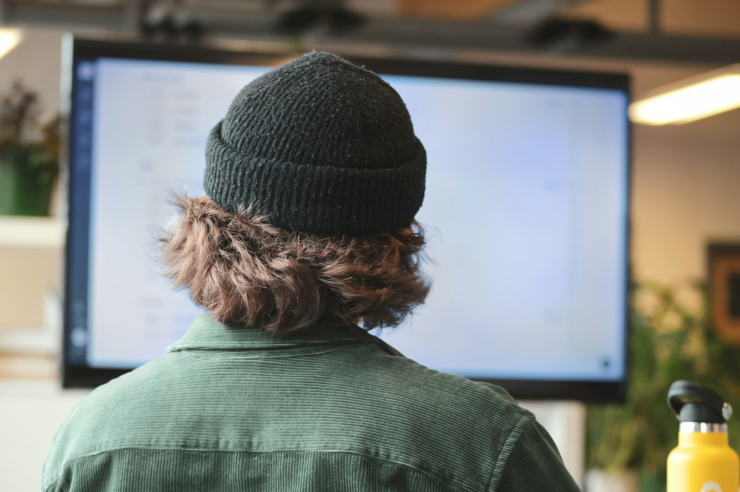
Challenge #1: Thermal Management
Single accelerator:
700W+
Single rack:
40–80 kW
Air Cooling → Liquid Cooling
PUE: 1.4 → 1.15
= millions saved per year
"Your chip's TDP is not a spec — it's a cost multiplier."
Notes:
Challenge number one: thermal management.
A single high-end AI accelerator now consumes 700 watts or more. A fully loaded rack can draw 40 to 80 kilowatts. At this power density, traditional air cooling simply cannot keep up.
In our facilities, we've transitioned from air cooling to liquid cooling, bringing our PUE from approximately 1.4 down to 1.15. That 0.25 reduction translates directly to millions of dollars in annual energy savings and, more importantly, to stable chip operating temperatures that extend hardware lifetime.
The takeaway for IC designers: your chip's thermal design power is not just a spec on a datasheet. It directly determines what kind of cooling infrastructure is required, which determines the total cost of ownership. Reducing TDP by even 50 watts can change the economics of an entire data center deployment.

Slide 8
Challenge #2: Power Supply
1,000 GPUs = 1 MW
10,000 GPUs = 10 MW
= a small town's power consumption
“Eastern Data, Western Computing”
WEST
Guizhou · Inner Mongolia
Gansu · Xinjiang
¥0.3/kWh
Abundant land
Clean energy + waste
heat recovery
EAST
Beijing
Shanghai
Shenzhen
¥0.8/kWh
Limited land
High demand
East China: ¥0.8/kWh → Expensive
West China: ¥0.3/kWh → AI moves west
"Power is the new oil of the AI era."
Notes:
Challenge number two: power supply.
One thousand GPU accelerators consume approximately one megawatt. A large center may have ten to fifty thousand cards — 10 to 50 megawatts — the electrical load of a small town. The largest planned facilities now reach 50,000 petaFLOPS, with investment exceeding one billion US dollars.
In China, this has led to a geographic redistribution of AI infrastructure — the "Eastern Data, Western Computing" national strategy. New centers are being built in Guizhou, Inner Mongolia, Gansu, and Xinjiang, where electricity costs one-third of eastern prices and renewable energy is abundant.
An interesting innovation: some operators are recovering waste heat from their cooling systems to power agricultural operations — aquaculture and hydroponic farming — turning an energy cost into a revenue stream. This is the kind of system-level thinking that matters.
For chip designers: performance per watt is arguably more important than absolute performance. A chip that delivers 90% of the FLOPS at 70% of the power will win in large-scale deployment every time.

Slide 9
Challenge #3: GPU Utilization
<30%
Why?
• Multi-tenant scheduling is hard
• Memory fragmentation between model sizes
• Daily hardware failures at scale
• Recovery and job migration overhead
Average GPU Utilization
→ Heterogeneous pooling + vGPU slicing can lift to 70%+
"Utilization rate matters more than total capacity."
Notes:
Challenge number three: utilization.
This one surprised me. The average GPU utilization rate across China's intelligent computing centers is estimated at less than 30 percent. We buy enormous compute capacity, and most of it sits idle.
Why? Multi-tenant scheduling is hard. Memory fragmentation between models of different sizes is a real problem. When a card fails — which happens daily at scale — recovery wastes hours of cluster time.
The good news is that heterogeneous resource pooling and vGPU slicing techniques are emerging — some operators have demonstrated that these can lift utilization from under 30% to over 70%, reducing cost by 40-70% compared to traditional cloud. But the fundamental point stands: hardware not designed for multi-tenant, fault-tolerant operation creates utilization problems that no software layer can fully solve.

Slide 10
What Cloud Operations Teach IC Designers
✅
1. Design for system deployability, not benchmarks
✅
2. Performance per watt > peak performance
✅
3. Build diagnostics into the silicon
✅
4. Reliability over years, not hours
"The best chip is the one that runs stable at 85% load for 365 days."
Notes:
So here are the cloud-scale lessons for IC designers:
First, design for system deployability, not just benchmark performance. A chip that runs hot, draws excessive power, or lacks diagnostic capabilities creates downstream costs that dwarf the chip's purchase price.
Second, power efficiency is king. Performance per watt matters more than peak performance.
Third, build observability into the silicon. Remote monitoring, temperature reporting, error logging — at scale, they are operational necessities.
Fourth, reliability over years, not hours. We need chips that run stable at 85% load for 365 days, not chips that hit a record benchmark for 60 seconds.

Slide 11
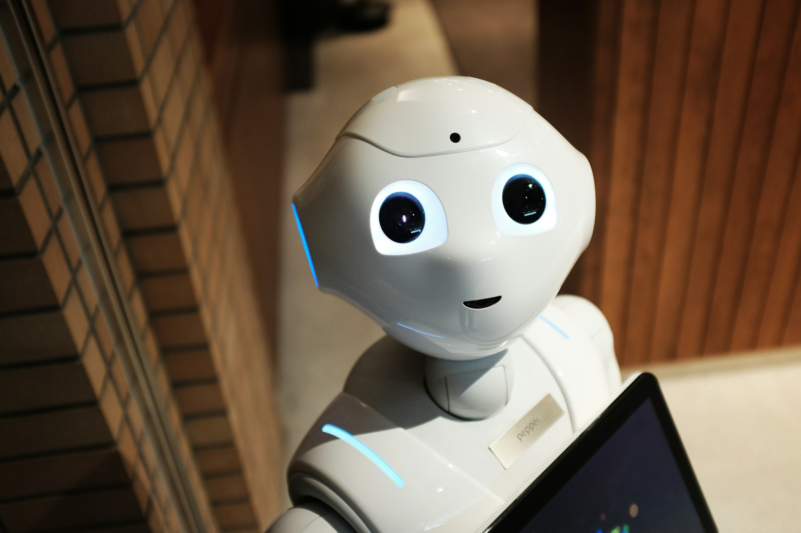
PART II
From Racks to Bodies
When Compute Walks Out of the Data Center
Notes:
Now I want to shift gears dramatically.
Everything I just described — liquid cooling, megawatt power supplies, high-speed interconnects — assumes the chip lives in a data center. But what happens when compute needs to leave the data center and walk around on two legs?
[Section transition — pause for effect]

Slide 12
Why I Invest in Embodied AI
"I asked the engineering teams: What is your biggest bottleneck?"
❌ Not funding
❌ Not algorithms
✅ On-body compute
"The available processors simply cannot deliver
what we need within our power and size constraints."
Notes:
A few years ago, I started asking: what comes after the data center? Where does AI compute go next? The answer is into the physical world — into robots, vehicles, and industrial equipment.
When I talk to the engineering teams, I always ask: what is your biggest bottleneck?
The answer is never funding. It's never algorithms. The answer is consistently: on-body compute. The available processors simply cannot deliver what we need within our power and size constraints.

Slide 13
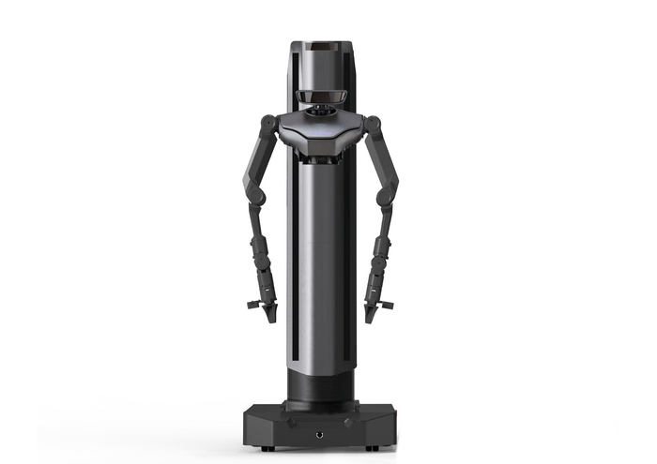
Portfolio: LingShen Technology 灵生科技
• Tsinghua University origin, founded 2023
• “Universal Brain” platform for humanoid robots
• 4-in-1 embodied large model:
▸ Perception + Movement + Manipulation + Planning
• L1 Robot: 26 DOF, 85 kg, NVIDIA Orin, 12h+ endurance
• <300 samples for new scenario, deploy in 5 hours
• Deployed: smart manufacturing, hospital rounds, DC inspection
• Pre-A / Pre-A+ funding: >100M RMB
Notes:
LingShen Technology, or LivSyn — founded by a Tsinghua University team in 2023. They're building what they call a "universal brain platform" for humanoid robots.
What sets them apart is their four-in-one embodied large model that integrates perception, movement, manipulation, and planning. Their L1 robot has 26 degrees of freedom, weighs 85 kilograms, runs on NVIDIA Orin compute, and achieves over 12 hours of endurance.
What's remarkable from a deployment perspective: their pretrained models can generalize to a new scenario with fewer than 300 data samples, and be deployed in just 5 hours. They're already operating in smart manufacturing, hospital ward rounds, and data center inspection. Over 100 million RMB in Pre-A financing.

Slide 14
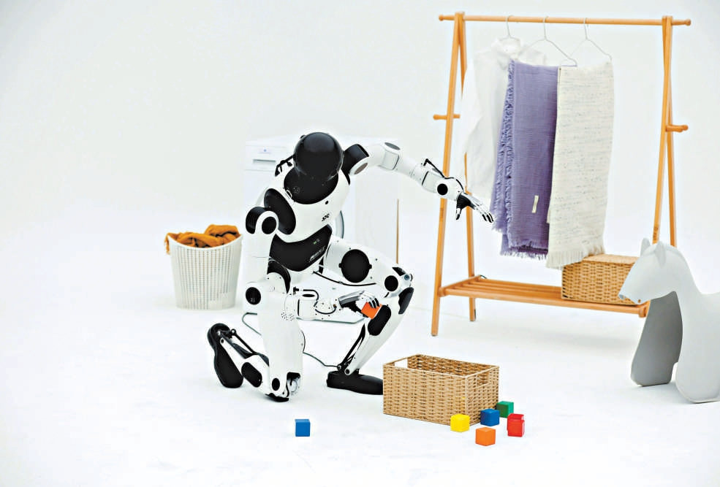
Portfolio: TIEN Kung 天工
• Beijing Innovation Center of Humanoid Robotics (MIIT)
• World’s first pure-electric full-size humanoid running at 6 km/h
• v2.0 Pro: 173 cm, 73 kg, 42 DOF (incl. dexterous hands)
• On-body compute: dual NVIDIA Orin AGX → 550 TOPS
• Payload: 4 kg/arm (16 kg bimanual), 3.5 h endurance
• Open-source universal robot mother platform
Notes:
TIEN Kung — developed by the Beijing Innovation Center of Humanoid Robotics, a national-level platform supported by MIIT.
World's first purely electric-driven full-size humanoid robot capable of running at 6 km/h. Let me share some real numbers from their 2.0 Pro version: 173 centimeters tall, 73 kilograms, 42 degrees of freedom including dexterous hands, and on-body compute powered by dual NVIDIA Orin AGX modules delivering 550 TOPS — that's the kind of compute budget embodied AI has to work with.
Single-arm payload is 4 kilograms, bimanual up to 16. Battery life is 3.5 hours with hot-swappable battery packs. And critically, they've chosen an open-source platform strategy, making it a universal robot mother platform for the broader ecosystem.

Slide 15
Where Embodied AI Is Already Working
Smart Manufacturing
Hospital Ward Rounds
Data Center Inspection
• Injection molding + stamping
production lines
• Grasping, sorting, quality
inspection, assembly
• ROI: replaces 2–3 manual
workers per robot
LingShen L1 deployed
• Automated vital signs
(BP, SpO₂, temperature)
• 30 wards/morning, data
synced to HIS system
• Medical LLM + voice
interaction for pre-diagnosis
LingShen L1 deployed
• 24/7 autonomous patrol
of server racks
• Anomaly detection: power-on/
off, restart, LED status
• <300 samples to train
for new DC environment
LingShen L1 deployed
TIEN Kung 2.0: open-source platform enabling logistics, elder care, hazardous environments
Notes:
Let me show you three real-world deployments that are already operating today.
First, smart manufacturing. LingShen's L1 robot is deployed on injection molding and stamping production lines — handling grasping, sorting, quality inspection, and assembly. Each robot replaces two to three manual workers, with ROI achieved within months.
Second, hospital ward rounds. The L1 robot assists doctors in completing morning rounds across 30 wards. It carries vital sign measurement devices — blood pressure, SpO2, temperature — syncs data to the hospital information system, and generates daily ward round reports automatically. It even conducts pre-diagnosis through medical large model and voice interaction.
Third, data center inspection. This one is close to my heart — 24/7 autonomous patrol of server racks. The robot detects anomalies like power failures, LED status changes, and can perform simple equipment restarts. And remember: it only needs 300 training samples and 5 hours to adapt to a new data center environment.
TIEN Kung's open platform is enabling applications in logistics, elder care, and hazardous environments.

Slide 16
Cloud Chips vs. On-Body Chips: Two Worlds
Cloud
On-Body
Compute
PetaFLOPS
550 TOPS (dual Orin)
Power
700W (liquid cooled)
<50W (battery)
Latency
~1 second OK
<10ms required
Failure mode
Swap & restart
Cannot fail
Workload
Single model
Vision+LLM+Motor+Tactile
Form factor
Rack-mounted
Fits in 73 kg torso
Cost target
$30,000/card
<$500/unit
Notes:
Here is the comparison — and now I can give you real numbers from the robots I've invested in.
In the cloud, we measure in petaFLOPS. On TIEN Kung's body, total compute is 550 TOPS from dual Orin modules — that's all you get.
Power: 700 watts per accelerator in a liquid-cooled rack versus less than 50 watts total for on-body compute running on a 30-amp-hour battery. That's a 15x reduction.
Latency: one second is fine for cloud inference. For a robot catching its balance, you need under 10 milliseconds. Hesitate for one second and it falls.
Workload: in the cloud, typically one model at a time. On the robot body, you're running vision, large language model, motor control, and tactile processing simultaneously on the same silicon.
And cost: $30,000 per accelerator card is acceptable for data centers. But to reach mass adoption, on-body compute must be under $500 per unit.

Slide 17
"Cloud computing's challenge:
fitting chips into racks.
Embodied computing's challenge:
fitting racks into bodies."
These require fundamentally different IC design philosophies.
Notes:
[Pause — let this sink in]
Cloud computing's challenge is fitting chips into racks. Embodied computing's challenge is fitting racks into bodies.
These require fundamentally different IC design philosophies.

Slide 18
The Three-Tier Compute Architecture for Embodied AI
☁️ CLOUD “Big Brain”
Model training, world model updates, data flywheel
GPU Cluster | Heterogeneous pool | EFlops
Latency: Hours / Days
🏭 EDGE “Mid Brain”
Scene inference, swarm orchestration, 5G/6G uplink
Edge Server | 100–300W | Multi-robot coordination
Latency: ~100ms
🤖 ON-BODY “Small Brain”
Perception, safety-critical control, autonomous action
SoC / NPU | <50W | 550 TOPS
Latency: <10ms
Notes:
The good news: robots don't have to do everything locally. The emerging architecture is what I call the Big Brain, Mid Brain, Small Brain model.
The Big Brain is the cloud — our heterogeneous GPU pools running exaFLOPS of compute. This is where models are trained and world models are updated. It runs on the timescale of hours and days, and it's where innovations like heterogeneous resource pooling and vGPU slicing are maximizing utilization.
The Mid Brain is the edge — servers at the factory floor or warehouse. This is where multi-robot swarm coordination happens, connected via 5G or future 6G uplinks. Response time is in the hundreds of milliseconds.
The Small Brain is on-body compute — the SoC inside the robot itself. With 550 TOPS from dual Orin modules, it handles real-time perception, safety-critical control, and autonomous decision-making. Response time must be under 10 milliseconds.
[Walk through each tier, pointing to the diagram]

Slide 19
IC Demands by Compute Tier
Cloud
Edge
On-Body
Key IC type
GPU / AI accelerator
Inference accelerator
Heterogeneous SoC + NPU
Power
400–700W
100–300W
<50W (battery)
Real example
60K+ GPUs in pooled clusters
5G/6G connected edge servers
550 TOPS (dual Orin AGX)
Key challenge
Interconnect & utilization
Multi-model scheduling
Multi-modal integration
Market status
Mature
Exploding
GREENFIELD BIGGEST OPPORTUNITY
Notes:
Each tier creates different IC demands.
Cloud tier — we know this well. GPU and AI accelerator market. Scale, power, interconnect.
Edge tier — where the inference chip market is exploding. High-throughput inference at 100-300 watts, multiple model types, real-time scheduling.
On-body tier — the wide-open frontier. Heterogeneous SoCs integrating CNN, transformer, and control processors, all under 50 watts.
This third tier is the single largest greenfield opportunity for IC designers in the next decade.

Slide 20
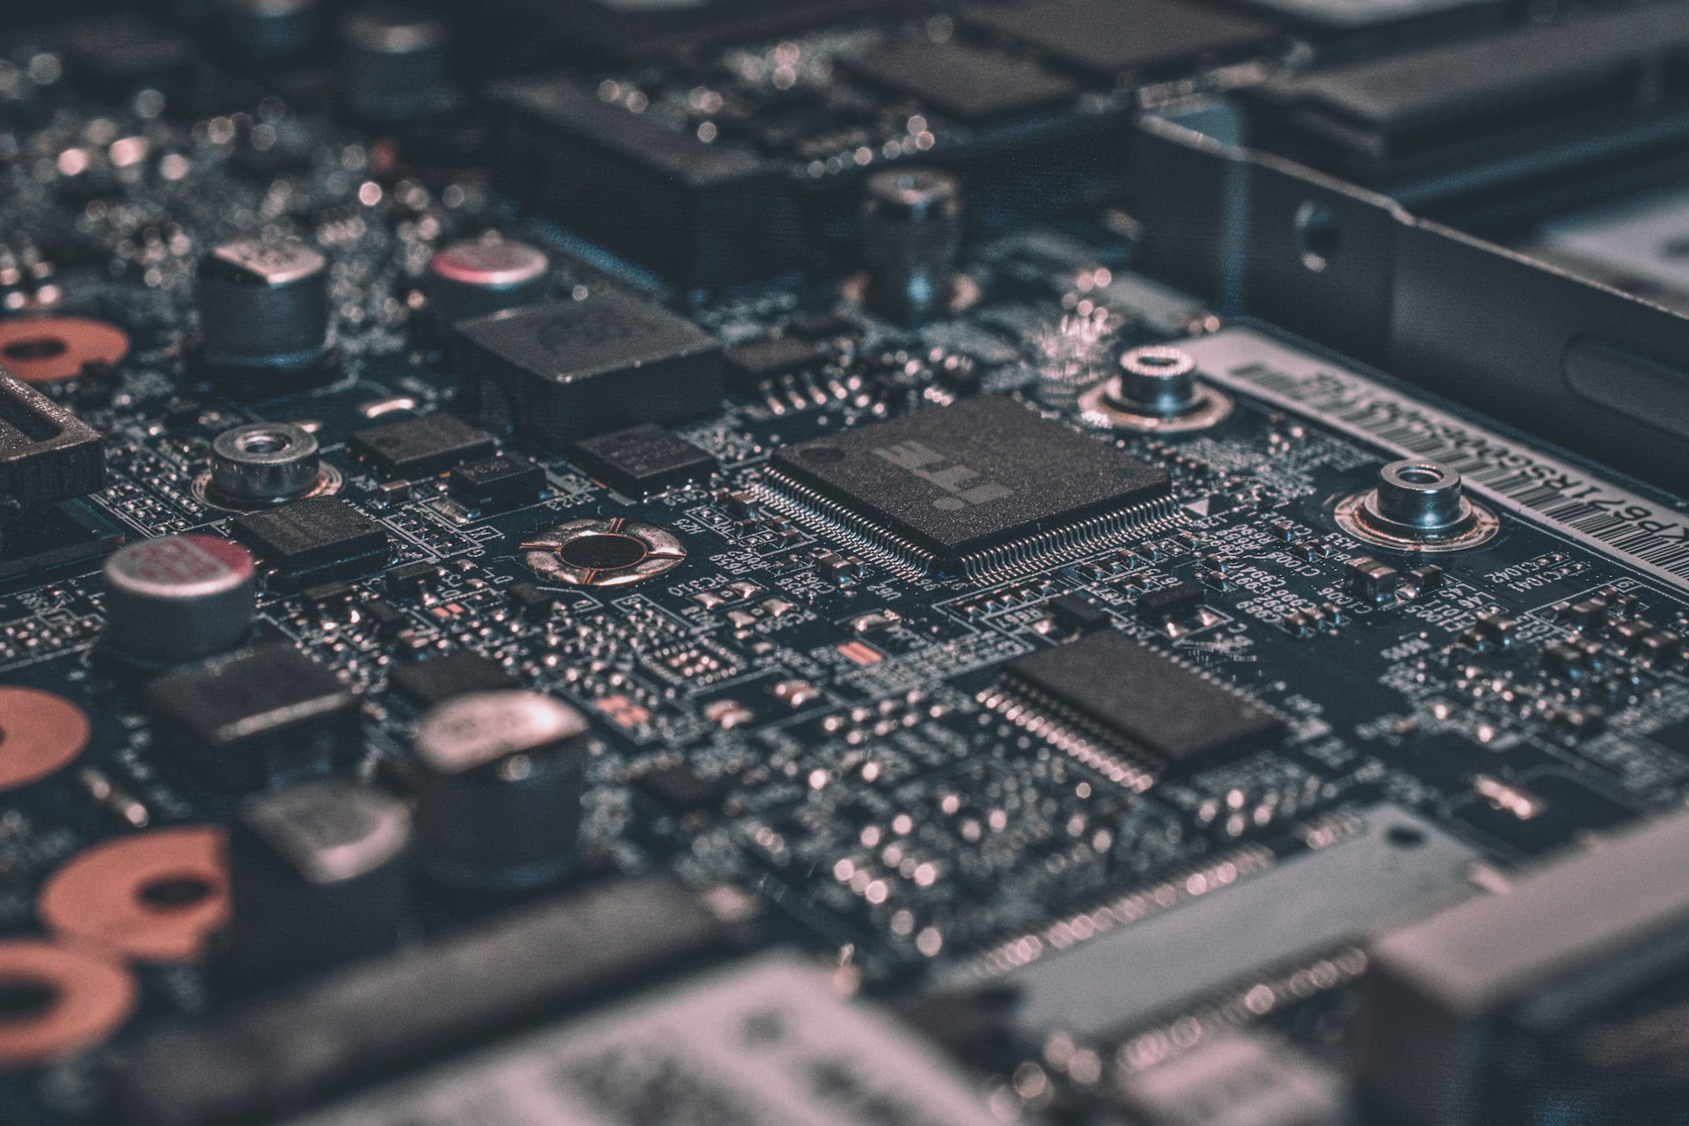
PART III
Recommendations
for IC Designers
Notes:
[Section transition]
Let me synthesize what I've learned from operating at cloud scale and investing at the robot edge into specific recommendations.
[Pause briefly]

Slide 21
For Cloud / Data Center Chip Designers
1. Performance per watt > peak performance
Your customer's #1 cost is electricity
2. Standardize interconnects
Proprietary = lock-in = slow adoption
3. Build diagnostics into silicon
Remote monitoring is an operational necessity
4. Design for multi-tenant workloads
Hardware isolation improves utilization
Notes:
For cloud and data center chip designers:
One — prioritize performance per watt. Your customers' biggest cost is electricity, not your chip.
Two — standardize interconnect interfaces. Proprietary interconnects create vendor lock-in that slows adoption.
Three — build diagnostics into the silicon. Remote health reporting, error counters, thermal sensors are not optional. They make large-scale operation viable.
Four — design for multi-tenant workloads. Hardware-level memory isolation, secure context switching, QoS guarantees directly improve utilization rates.

Slide 22
For Edge / Embodied Chip Designers
1. Heterogeneous compute is mandatory
CNN + Transformer + Control on one die
2. Power is the hard constraint
Design to 50W first, then maximize compute
3. Latency > throughput
One result in 5ms, not 1000 results per second
4. Safety is non-negotiable
Functional safety, error correction, graceful degradation
5. Cost at scale: <$500/unit
A $200K robot will never reach mass adoption
Notes:
For edge and embodied chip designers:
One — heterogeneous compute is a requirement. CNN, transformer, and real-time control on a single die.
Two — power is THE hard constraint. Design to 50W first, then maximize compute. Sacrifice TOPS if needed.
Three — latency over throughput. One result in 5ms, not 1000 results per second.
Four — safety is non-negotiable. These chips operate inside machines alongside humans. Functional safety, error correction, graceful degradation — designed in from day one.
Five — cost under $500. A $200K robot will never reach mass adoption.

Slide 23
"The best chip is never the one
with the highest benchmark score.
It is the one that runs reliably,
efficiently, and affordably
in its target deployment environment."
— From quantitative trading,
through data centers, to robots.
Notes:
[Pause — key message]
The best chip is never the one with the highest benchmark score. It is the one that runs reliably, efficiently, and affordably in its target deployment environment.
This connects my entire career: from trading systems, through data centers, to robots. The principle is the same.

Slide 24
Looking Ahead
2026
"Inference Famine"
Demand for inference compute outpaces supply
2027
First wave of mass-produced humanoid robots
Logistics, manufacturing, elder care
2028+
On-body AI compute market
Comparable in scale to smartphone SoC market
Every robot = a mobile computing platform
Aggregate demand = enormous new IC market
Notes:
Looking forward:
2026 — the year of "inference famine." Demand for inference compute is growing faster than supply. Operators are racing to build out — some with plans for 50,000 petaFLOPS facilities. The gap will widen as embodied AI moves from labs to factories.
2027 — first wave of mass-produced humanoid robots in commercial deployment. Companies like LingShen already produce 25-30 units per month. Logistics, manufacturing, elder care — these are the first beachheads.
2028 to 2030 — the industry targets hardware costs dropping to around 30,000 RMB per robot, enabling C-end service scenarios. On-body AI compute market becomes comparable in scale to the smartphone SoC market. Every robot is a mobile computing platform.

Slide 25
The Convergence
Cloud AI Training chips (mature)
Edge AI Inference chips (growing)
On-Body AI Embodied SoCs (emerging)
The IC Opportunity
Notes:
[Convergence diagram]
Three markets converging: cloud training chips (mature), edge inference chips (growing), and on-body embodied SoCs (emerging).
The intersection is the IC opportunity — the core message of this talk.

Slide 26
For Everyone in This Room
You are designing the
nervous system
of tomorrow's intelligent machines.
Your decisions on:
• Architecture
• Power efficiency
• Reliability
will determine whether embodied AI
becomes reality — or stays in the lab.
Notes:
For those of you in this room who design integrated circuits — you are designing the nervous system of tomorrow's intelligent machines.
Your decisions on architecture, power efficiency, and reliability will determine whether embodied AI becomes reality — or stays in the lab.
[Speak directly to the audience, make eye contact]

Slide 27
"I started optimizing compute for financial models,
where microseconds meant money.
I then built computing centers,
where power efficiency meant survival.
Now I invest in robots,
where real-time inference means safety."
Advancing IC with AI.
Advancing AI with IC —
from the cloud, through the edge, into the body.
Notes:
I started optimizing compute for financial models, where microseconds meant money.
I then built computing centers, where power efficiency meant survival.
Now I invest in robots, where real-time inference means safety.
At every stage, the lesson is the same: great chips don't just compute — they integrate into systems, they operate at scale, and they serve the real world.
The theme of this conference is "Advancing IC with AI." I'd like to add: we also need to advance AI with IC — from the cloud, through the edge, into the body.
[Pause for emphasis on last line]

Slide 28
Thank You
谢谢
Chao Chen 陈超
Suzhou Chuangjie Intelligent Technology Co., Ltd.
苏州创界智能科技有限公司
IEEE ICTA 2026 | Singapore
Notes:
Thank you.
[Wait for applause, then invite questions]
Q&A prepared topics:
- US chip export restrictions → focus on supply chain diversification driving innovation, avoid geopolitical commentary
- Domestic chips deployed → speak generally about maturing ecosystem, importance of deployment feedback loops. Mention heterogeneous pooling can compensate for individual chip performance gaps.
- Timeline for mass humanoid robots → 13,000 units shipped in 2025, expect 10x by 2028. LingShen already at 25-30/month. Industry targets 30K RMB cost by 2030. Bottleneck is compute, not mechanical hardware.
- Liquid cooling ROI → yes, unambiguously, for >30kW/rack, 18-24 month payback from energy savings alone. Waste heat recovery for agriculture is an emerging bonus.
- On-body compute specifics → TIEN Kung 2.0 Pro uses dual Orin AGX at 550 TOPS total, 42 DOF, 3.5h battery. LingShen L1 uses single Orin, 26 DOF, 12h+. Both NVIDIA platform — shows current dependence and opportunity for new entrants.
- 5G/6G for swarm robotics → emerging "mid brain" architecture uses dedicated wireless for multi-robot coordination, especially in industrial and logistics scenarios

