Slide 1
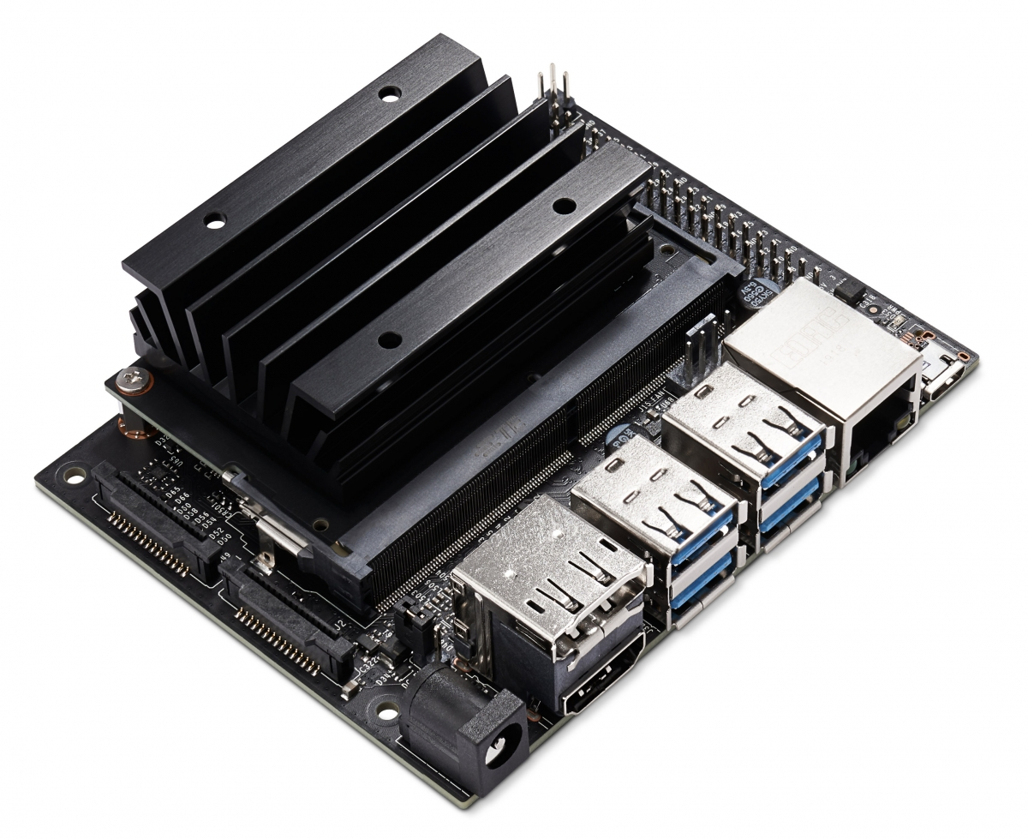
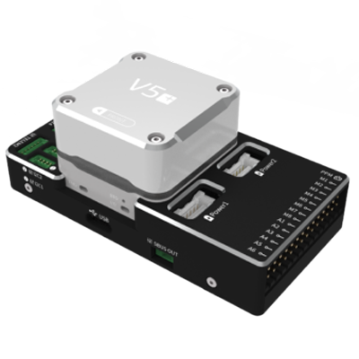
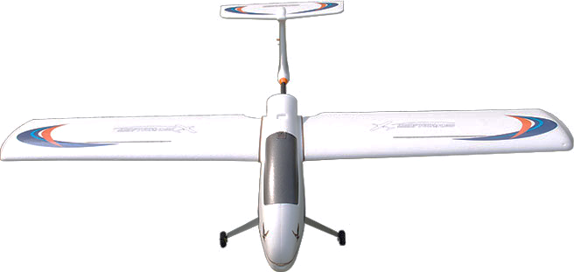
HOST COMPUTER
FIXED_WING_FORMATION_CONTROL
NODE1
MAVROS
NODE2
attitude setpoint
plane states
ATTITUIDE INNER LOOP
SALVE COMPUTER
actuator
plane states
UAV DYNAMAIC
PLATFORM

Slide 2
ROS
PX4 on SITL
MAVLINK
UDP
FIXED_WING_FORMATION_CONTROL
mavlink_main.cpp
NODE1
NODE2
UDP
port 14540
MAVROS
port 14580
port 14550
QGC Ground Station
UDP
port 14570
Gazebo Simulator
UDP
random port
simulator_mavlink.cpp
TCP 4560

Slide 3
STORAGE
Parameter
Database
Logging
STORAGE
DRIVERS
Parameter
GPS
RC Input
Message Bus
Logging
IMU
Message Bus
FLIGHT CONTROL
State Machine
Navigator
Sensor Hub
Position Control
Position & Attitude Estimator
Attitude Control
Output Driver

Slide 4
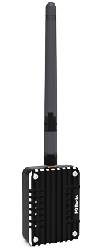
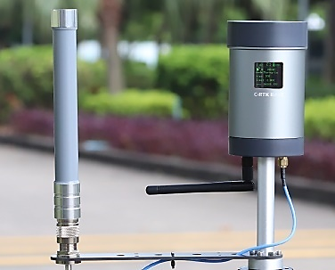
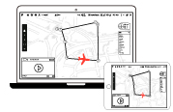
Follower
Leader
Mavlink
Mavlink
Mavlink
WIFI
Ground monitoring station

