Slide 1
Enterprise Service Intake
Power Pages
Dataverse
Authenticated multi-step external intake.
>
Request, rule, SLA, evidence, and log data.
Power Platform Senior Developer take-home case
Secure customer intake, configurable SLA routing, manager approvals, resilient ERP synchronization, and non-bypassable Dataverse guardrails.
v
C# plugins
Power Automate
Routing, SLA, protected fields, and closure guard.
>
Approval, OAuth, ERP POST, and catch logging.
Dataverse authority
Power Pages intake
Plugins + flows
Review proof
Managed solution, source, docs, demo data, and verification.
Prepared for live architecture review
Forrest Zhang | May 2026
Enterprise Service Intake | Power Platform Senior Developer take-home | May 2026
01

Slide 2
REQUIREMENT COVERAGE
Every requested capability maps to a concrete build artifact.
The assignment was implemented as a complete vertical slice, not a disconnected component sample.
SCOPE POSTURE
Capability
Reviewable evidence
Status
Vertical slice
Dataverse model
Service Request, Routing Rules, SLA Policy, Departments, Evidence Reviews, Sync Logs, Error Logs
Built
Portal submit through approval, ERP sync, and monitoring.
Power Pages UX
Private authenticated site, My requests, save-for-later drafts, multi-step intake, required-file gate
Built
REVIEWER HANDOFF
Automation
Approval flow, OAuth mock ERP sync, confirmation email, Try/Catch scopes, error logging
Source + solution
Built
Managed package, PAC source, code, docs, and demo script.
Pro-code
Routing plugin, closure guard plugin, protected-field policy, PCF SLA/status indicator
Built
Security
Contact-scoped portal access, field allowlists, internal field protection, secret-free repo
Built
DEMO EVIDENCE
Live verified
ALM
Managed/unmanaged exports, PAC unpacked source, source repo, docs, demo script, verification notes
Built
Smoke tests cover portal, files, plugins, flows, and app UX.
Enterprise Service Intake | Power Platform Senior Developer take-home | May 2026
02

Slide 3
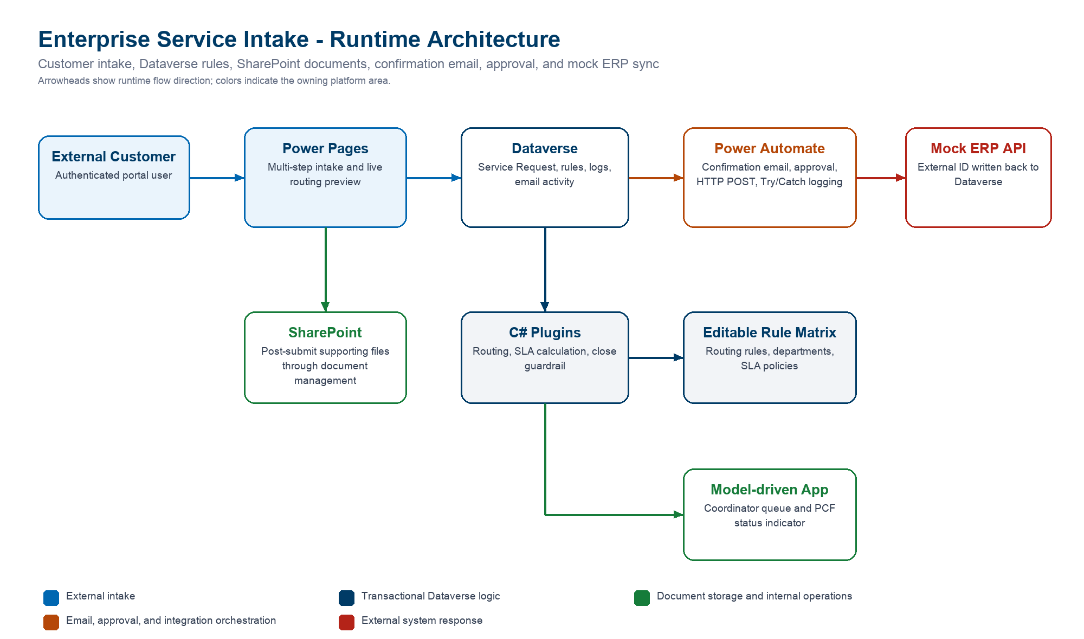
ARCHITECTURE
Dataverse is the authority; each platform component owns the work it enforces best.
The design separates customer experience, transactional rules, human workflow, integration, and operational telemetry.
SYSTEM OF RECORD
Dataverse
Requests, rules, evidence, sync logs, and error logs.
TRANSACTIONAL LOGIC
C# plugin
Routing and close guard run before Dataverse commit.
LONG-RUNNING WORK
Power Automate
Approvals, OAuth, REST POST, run history, and Catch logging.
Placement principle: low-code for orchestration and UX; plugins for non-bypassable business rules.
Enterprise Service Intake | Power Platform Senior Developer take-home | May 2026
03

Slide 4
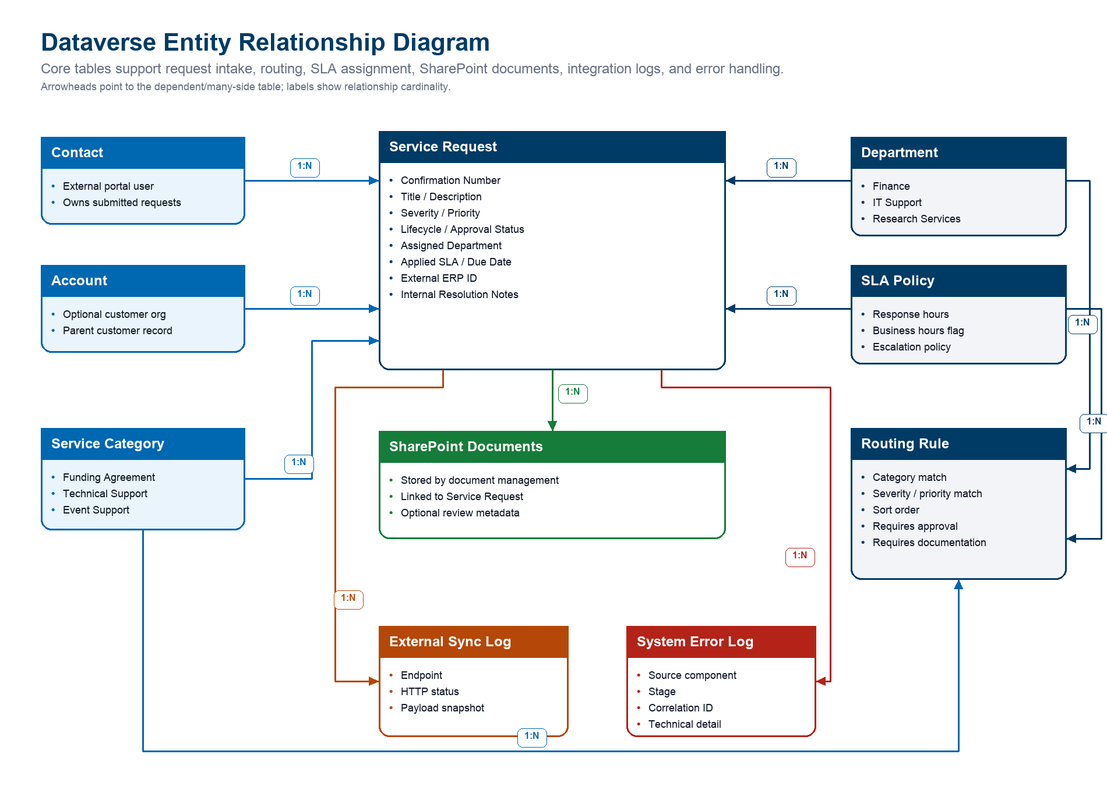
DATA STRATEGY
Request state, routing, evidence, sync, and errors are separated for scale and auditability.
The model keeps customer-facing intake simple while preserving internal controls and integration telemetry.
FORMATTED CONFIRMATION
SR-yyyyMMdd-######
Server-generated; users never supply it.
RULES AS DATA
80 exact-match rows
Complete category x impact x urgency coverage.
EVIDENCE STRATEGY
SharePoint + Dataverse
Files stay in SharePoint; review metadata stays in Dataverse.
External customers see only their own requests.
Internal fields and logs stay out of the portal.
ERP and automation errors are queryable records, not hidden run failures.
Enterprise Service Intake | Power Platform Senior Developer take-home | May 2026
04

Slide 5
EXTERNAL EXPERIENCE
Customers get a guided, authenticated intake without seeing internal fields.
The portal previews response expectations in real time, saves drafts, and blocks required-document bypass before submission.
1
Details
2
Impact
3
Documents
4
Review
Title, category, and description are validated before the user continues.
Impact and urgency update the response estimate without a full page reload.
If the matched rule requires files, a Draft request is saved and secure upload opens inline.
The final submit button appears only after required details and files are complete.
Response estimate preview
Needs review
SECURITY POSTURE
RESUME PATH
Authenticated
My requests
Team
Finance
Contact-scoped access; internal notes, approval, ERP, and logs stay hidden.
Drafts can be saved and resumed without sending confirmation email.
Target response
4 hours
Supporting files
Required before review
Enterprise Service Intake | Power Platform Senior Developer take-home | May 2026
05

Slide 6
ROUTING MATRIX
Routing is exact-match and editable, not hidden threshold logic.
Power Pages preview, Dataverse plugin routing, and admin edits all use the same Routing / SLA Rule rows.
Impact x Urgency
Low
Normal
High
Urgent
RULE VOLUME
Low
Low
Standard
High
Critical
80 active rows
No
Opt
No
Opt
Rev
Docs
Rev
Docs
Five categories by impact and urgency, plus fallback.
Medium
Standard
Standard
High
Critical
No
Opt
No
Opt
Rev
Docs
Rev
Docs
ADMIN UX
Editable matrix
High
High
High
High
Critical
Category tabs, inline edits, toggles, and source-record links.
Rev
Docs
Rev
Docs
Rev
Docs
Rev
Docs
Critical
Critical
Critical
Critical
CONSISTENCY
Critical
One rule source
Rev
Docs
Rev
Docs
Rev
Docs
Rev
Docs
Portal preview and plugin both read active Dataverse rows.
Enterprise Service Intake | Power Platform Senior Developer take-home | May 2026
06

Slide 7
INTERNAL OPERATIONS
Coordinators work from task-focused navigation, not raw tables.
The app was redesigned around intake work, configuration, and monitoring so reviewers can follow the operational flow quickly.
INTAKE WORK
ROUTING CONFIGURATION
MONITORING
Requests + Evidence
Matrix-first admin
Logs + dashboards
Active queue, approvals, documentation guardrails, SharePoint files, and Evidence Reviews.
Editable matrix replaces normal 80-row maintenance and opens source rule records.
System Error Logs, External Sync Logs, and three purpose-built dashboards.
Service Request form
Views and PCF signal
Two-column sections for request, triage, routing/SLA, approval, and resolution.
Active Service Requests includes confirmation, customer, category, status, department, SLA, approval, and ERP sync.
SharePoint Documents tab shows the actual uploaded files.
SLA/status PCF gives coordinators a compact visual severity and risk signal.
SR Evidence Reviews records accepted/rejected evidence metadata and file links.
Deprecated document view names were cleaned up to Evidence Review terminology.
Enterprise Service Intake | Power Platform Senior Developer take-home | May 2026
07

Slide 8
AUTOMATION AND INTEGRATION
Approval and ERP sync use Flow where human workflow and run history matter.
The integration path is intentionally resilient: Try/Catch scopes, approval records, OAuth token request, protected REST call, writeback, and custom error logs.
Dataverse trigger
Manager approval
OAuth token
REST POST
Dataverse writeback
Approval-required, pending, unsynced request.
>
Approval history is reviewer evidence.
>
Client-credentials token from HelloX.
>
Bearer-token POST returns external ID.
>
Approval, lifecycle, ERP status, ID, and sync log.
>
Catch - log automation error
Failures in approval, token, HTTP, or writeback create a System Error Log with correlation/run detail and mark the request sync/approval state as failed.
WHY FLOW HERE
MOCK ERP CHOICE
Human approvals, connector run histories, retries, and evidence are first-class.
HelloX endpoint supports OAuth, deterministic IDs, and deliberate failure mode.
Enterprise Service Intake | Power Platform Senior Developer take-home | May 2026
08

Slide 9
PRO-CODE PLACEMENT
Plugins enforce rules that cannot be bypassed; PCF improves coordinator signal.
Low-code remains the default, but transactional guardrails and advanced visual cues are deliberately placed in pro-code components.
Component
Layer
Reason
PLUGIN OVER FLOW
Transactional consistency
Routing plugin
PreOperation
Assigns department, SLA policy, due date, approval flag, and documentation requirement from active rules.
Runs before commit across portal, app, API, imports, and automation.
Closure guard
PreOperation
Blocks critical closure unless internal notes and accepted evidence with SharePoint file URL exist.
EVIDENCE OVER CHECKBOX
Non-bypassable guardrail
External update policy
Shared C# policy
Rejects portal/API updates to approval, ERP, routing, SLA, lifecycle, and internal-note fields.
Checks accepted evidence rows and file URL, not a user-editable flag.
SLA status PCF
Model-driven UX
Summarizes severity, SLA risk, approval, and integration state for coordinators.
PCF OVER TEXT FIELD
Fast coordinator scan
Shows risk signal without adding another workflow branch.
Enterprise Service Intake | Power Platform Senior Developer take-home | May 2026
09

Slide 10
SECURITY AND ALM
Security, source control, and verification are part of the deliverable, not afterthoughts.
The handoff includes environment links, source, managed package, documentation, user manual, demo script, and live verification evidence.
PORTAL SECURITY
INTERNAL SECURITY
SECRETS
Contact-scoped access
Protected fields
Out of Git
Authenticated users create/resume only their own requests; Web API fields are allowlisted.
Internal notes, approval, routing/SLA, lifecycle, and ERP fields are blocked by plugin policy.
Reviewer passwords and OAuth secrets are shared separately and rotated after interview.
ALM artifacts
Verification evidence
Managed and unmanaged solution exports.
Plugin build
PCF push
Portal upload
Flow smoke
PAC-unpacked source under solution/unpacked.
Live verification notes document portal dynamic preview, required-file gate, SharePoint upload, model-driven UX, routing matrix save, flows, dashboards, and guardrail smoke tests.
C# plugin, PCF, Power Pages, web-resource, and provisioning source in Git.
Enterprise Service Intake | Power Platform Senior Developer take-home | May 2026
10

Slide 11
LIVE DEMO PATH
The walkthrough is structured around observable outcomes, not screen hopping.
A 12-15 minute review can prove the external UX, internal operations, automation, resiliency, and ALM story.
0-2 min
Architecture + ERD
Show Dataverse as authority and why plugin/Flow boundaries are placed that way.
2-6 min
Portal submission
Sign in, save draft, preview response estimate, upload required file, submit.
6-9 min
Coordinator app
Open Service Request, Documents tab, Evidence Reviews, PCF status, and dashboards.
9-11 min
Routing Matrix
Edit a low-risk toggle, show save, then revert; explain one source of rule truth.
11-13 min
Approvals + ERP
Show approval flow Try/Catch, OAuth token step, REST POST, writeback, and logs.
13-15 min
Guardrail + Q&A
Show critical close block and defend plugin vs Flow / evidence vs checkbox choices.
Safe live-change rule: any matrix edit shown during the demo is reverted immediately after the saved status appears.
Enterprise Service Intake | Power Platform Senior Developer take-home | May 2026
11

Slide 12
What I would defend in the review
The decisions are intentionally split by enforcement boundary: Dataverse for state, plugins for non-bypassable rules, Flow for human/integration orchestration, and Power Pages for customer intake.
Why plugin for routing?
Routing is transactional and must apply equally from portal, app, API, import, and automation.
Reviewer path
Why Flow for approval and ERP?
Approvals, HTTP calls, retries, and run history are better served by orchestration with Try/Catch scopes.
Power Pages
Model app
Why exact matrix?
Admins can audit and edit every category/impact/urgency outcome without hidden frontend thresholds.
Repository: helloxtech/EnterpriseServiceIntake
Accounts: agent, manager, admin reviewer
Passwords and secrets shared separately by admin
Why Evidence Reviews?
SharePoint stores files; Dataverse owns review metadata, accepted evidence status, and closure policy inputs.
How is security handled?
Contact-scoped portal access, field allowlists, plugin protected-field policy, and secrets outside Git.
Close-out: the solution is ready to demonstrate portal submission, exact-match routing, approval/ERP sync, catch logging, and critical-request guardrails.
Enterprise Service Intake | Power Platform Senior Developer take-home | May 2026
12

