Slide 1
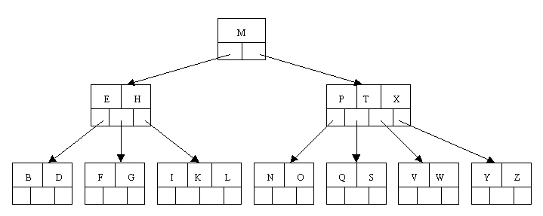
B-TREE
________________________________________________________
A B-Tree is a height balanced search tree. A B-Tree of order m satisfies the following properties:
The root node has at least 2 children (if it is not empty or is not a leaf
node)
All nodes other than root have at least ceil(m/2) children (i.e. links) and
ceil(m/2)-1 keys
All leaf nodes are at the same level
A B-Tree of order 4 (3-4 search tree)

Slide 2
B-TREE
________________________________________________________
The following is an example of a B-tree of order 5 (A 4-5 B-Tree).
A 4-5 B-Tree means 4 key values and 5 links/children. To be precise,
  Other that the root node, all internal nodes have at least,
  ceil(5 / 2) = ceil(2.5) = 3 children. Maximum is 5.
  At least ceil(5/2)-1 = ceil(2.5)-1 = 3 -1 = 2 keys. Maximum is 4.
  In practice B-trees usually have orders a lot bigger than 5.

Slide 3
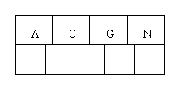
B-TREE
________________________________________________________
B-tree of order 5: (Creation & Addition)
C N G A H E K Q M F W L T Z D P R X Y S

Slide 4
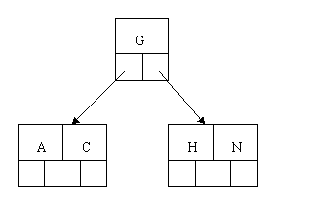
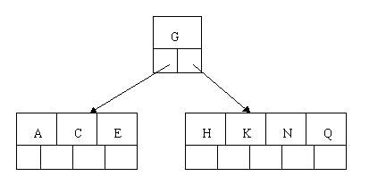
B-TREE
________________________________________________________
C N G A H E K Q M F W L T Z D P R X Y S
C N G A H E K Q M F W L T Z D P R X Y S

Slide 5
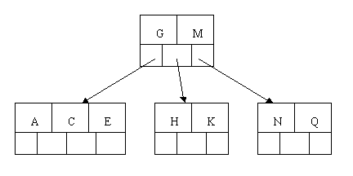
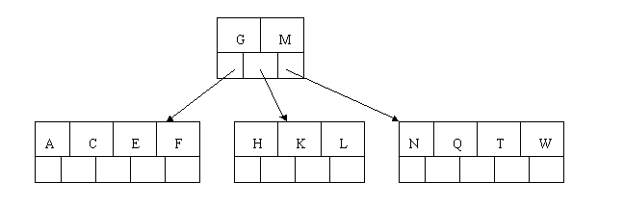
B-TREE
________________________________________________________
C N G A H E K Q M F W L T Z D P R X Y S
C N G A H E K Q M F W L T Z D P R X Y S

Slide 6
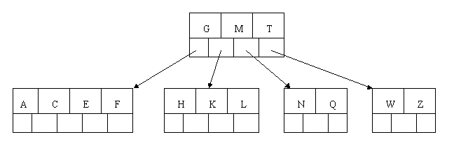
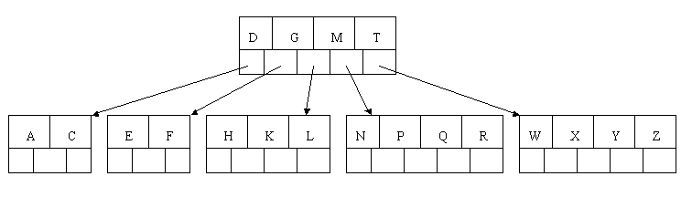
B-TREE
________________________________________________________
C N G A H E K Q M F W L T Z D P R X Y S
C N G A H E K Q M F W L T Z D P R X Y S

Slide 7
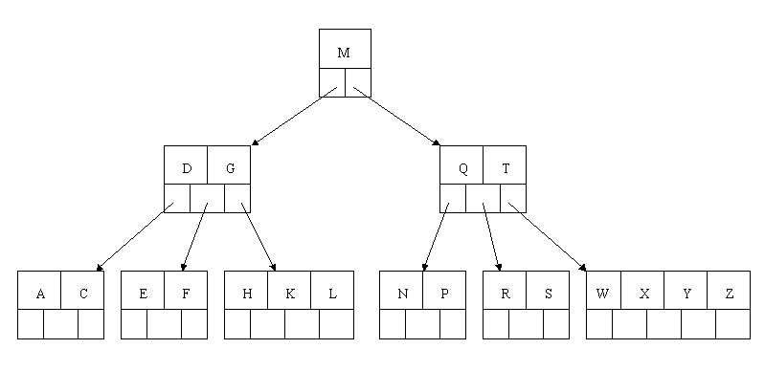
B-TREE
________________________________________________________
C N G A H E K Q M F W L T Z D P R X Y S

Slide 8
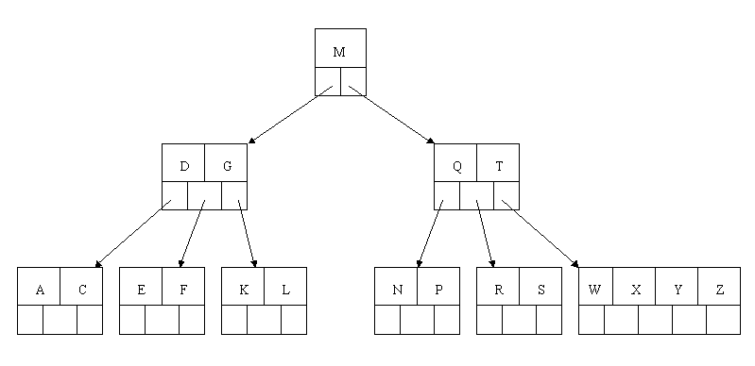
B-TREE
________________________________________________________
Deletion:
Delete H: Since H is in a leaf and the leaf has more than the minimum number of keys, this is easy. We move the K over where the H had been and the L over where the K had been. (Next T)

Slide 9
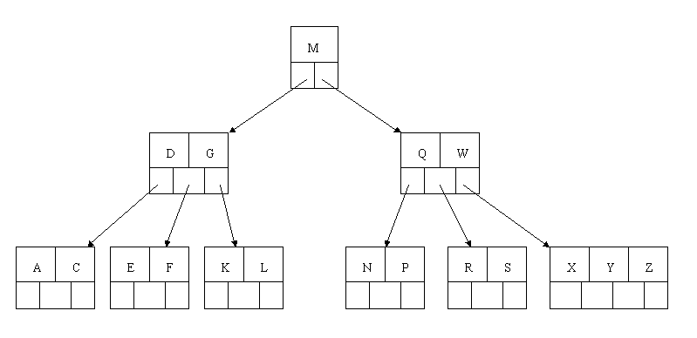
B-TREE
________________________________________________________
Delete T : Since T is not in a leaf, we find its successor (the next item in ascending order), i.e. W, and move W up to replace the T. That way, what we really have to do is to delete W from the leaf, which we already know how to do, since this leaf has extra keys. In ALL cases we reduce deletion to a deletion in a leaf, by using this method. (Next R)

Slide 10
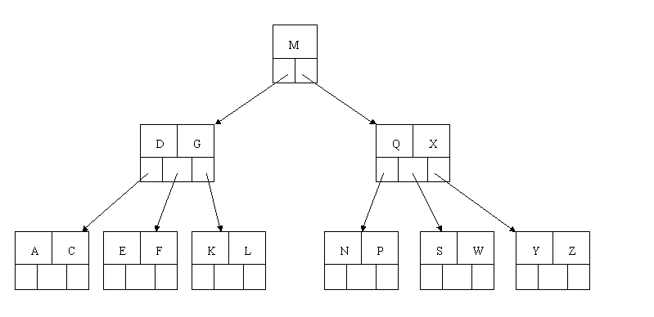
B-TREE
________________________________________________________
Delete R: Although R is in a leaf, this leaf does not have an extra key; the deletion results in a node with only one key, which is not acceptable for a B-tree of order 5. If the sibling node to the immediate left or right has an extra key, we can then borrow a key from the parent and move a key up from this sibling. In our specific case, the sibling to the right has an extra key. So, the successor W of S (the last key in the node where the deletion occurred), is moved down from the parent, and the X is moved up. (S and W are inserted in their proper place.) (Next E)

Slide 11
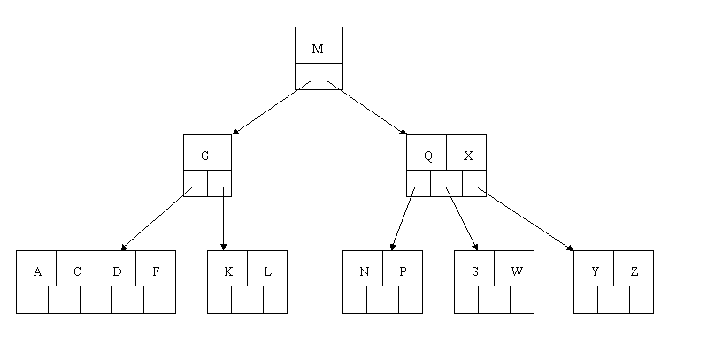
B-TREE
________________________________________________________
Delete E: This one causes lots of problems. Although E is in a leaf, the leaf has no extra keys, nor do the siblings to the immediate right or left. In such a case the leaf has to be combined with one of these two siblings. This includes moving down the parent's key that was between those of these two leaves. In our example, let's combine the leaf containing F with the leaf containing A C. We also move down the D.

Slide 12
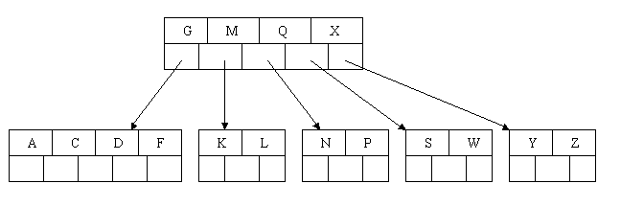
B-TREE
________________________________________________________
Delete E: The parent node now contains only one key, G. This is not acceptable. If this problem node had a sibling to its immediate left or right that had a spare key, then we would again "borrow" a key. Since we have no way to borrow a key from a sibling, we must again combine with the sibling, and move down the M from the parent. In this case, the tree shrinks in height by one.

Slide 13
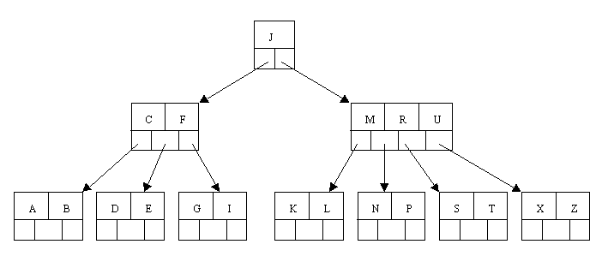
B-TREE
________________________________________________________
Another example:
Delete C: Find the immediate successor, which would be D, and move the D up to replace the C. However, this leaves us with a node with too few keys.

Slide 14
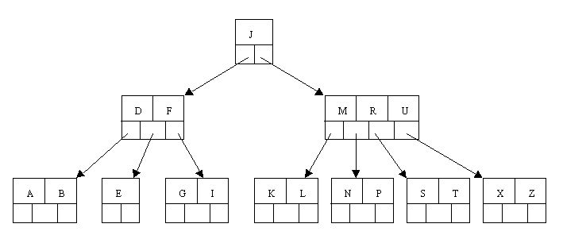
B-TREE
________________________________________________________
Delete C: C is removed and D went up so E is the only node (not allowed). Since neither the sibling to the left or right of the node containing E has an extra key, we must combine the node with one of these two siblings. Let's consolidate with the A B node.

Slide 15
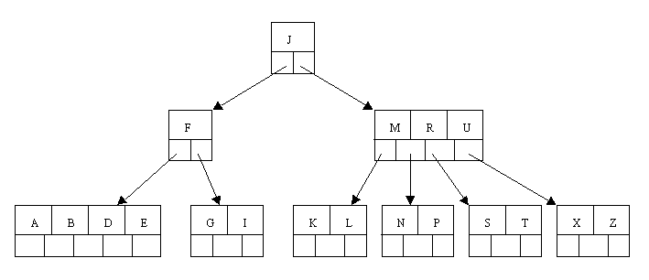
B-TREE
________________________________________________________
Delete C: But now the node containing F does not have enough keys. However, its sibling has an extra key. Thus we borrow the M from the sibling, move it up to the parent, and bring the J down to join the F. Note that the K L node gets reattached to the right of the J.

Slide 16
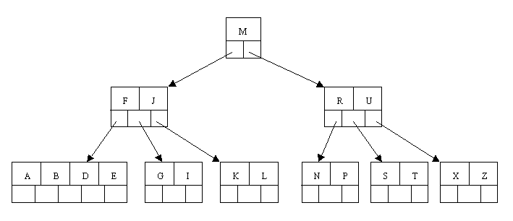
B-TREE
________________________________________________________
Delete C: Thus finally C is deleted and tree is once again height balanced.

