Slide 1
Employee Data Analysis using Excel
STUDENT NAME:A.SRIDEVI
REGISTER NO:2213391042060,
D1A3242A6E21531B71046DD20C106818
DEPARTMENT: BACHELOR OF COMMERCE
COLLEGE: QUEEN MARY’S COLLEGE

Slide 2
PROJECT TITLE
Company Employee Analysis
By using Excel

Slide 3


AGENDA
Problem Statement
Project Overview
End Users
Our Solution and Proposition
Dataset Description
Modelling Approach
Results and Discussion
Conclusion
3/21/2024 Annual Review

Slide 4

PROBLEM STATEMENT
Evaluate Salary Distribution: Determine the average salary per employee for both female and male employees to assess if there are significant salary differences between genders.
Analyze Age Demographics: Calculate the average age of female and male employees to identify any notable age differences between genders.
Compare Gender Representation: Examine the proportion of total salary and total age attributed to each gender to understand the gender distribution within the organization.
Identify Disparities and Trends: Investigate any disparities in salary and age between female and male employees to inform potential HR strategies or policies aimed at achieving equity.

Slide 5

PROJECT OVERVIEW
.
Salary and Employee Count Analysis: The project will evaluate the average salary for both female and male employees. Female employees, totaling 18 individuals, have a combined salary of $36,988,500,
while male employees, totaling 17 individuals, have a combined salary of $35,081,650.
The goal is to assess if there are significant differences in average salary between the two genders.
Age Demographics Examination: The project will analyze the average age of employees by gender. Female employees have a total age of 668 years, and male employees have a total age of 574 years.
This analysis aims to uncover any significant differences in age distribution between female and male employees.

Slide 6

WHO ARE THE END USERS?
Human Resources (HR) Department: HR professionals will use this data to evaluate gender-based salary distributions and age demographics. Insights can help address any disparities, inform compensation strategies, and guide diversity and inclusion initiatives within the organization.
Compensation and Benefits Analysts: These analysts will utilize the data to assess the fairness of the current salary structure across genders and age groups. They can use this information to make recommendations for adjustments in salary policies and benefits to ensure equity.
Executive Leadership: Senior management and executives will use the analysis to understand the broader implications of salary and age distribution in relation to organizational goals and strategic planning. This data helps in making informed decisions regarding recruitment, retention, and overall workforce planning.

Slide 7

OUR SOLUTION AND ITS VALUE PROPOSITION
Balanced Resource Allocation: By analyzing the salary and age data by gender, you can allocate resources more effectively. For instance, if females have a slightly higher total salary, consider if their roles are criticaland if targeted investments in their professional development could lead to higher productivity and satisfaction
Tailored Development Programs: With 18 females and 17 males, the data indicates a relatively balanced gender distribution. Implementing career development programs that address the unique needs and career aspirations of each gender can help retain top talent and promote career growth across the board.
Enhanced Retention Strategies: The average age difference (668 for females vs. 574 for males) might suggest different stages in career lifecycle. Tailoring retention strategies to these age demographics can help reduce turnover and maintain a motivated workforce. For instance, younger employees might value different benefits compared to those approaching retirement.

Slide 8
Dataset Description
Salary Distribution: The total salary for females is $36,988,500, and for males, it is $35,081,650. This indicates that females have a slightly higher combined salary compared to males, though the difference is relatively small.
Count and Average Age: There are 18 female employees and 17 male employees, with an average age sum of 668 for females and 574 for males. This suggests that, on average, female employees are older than their male counterparts.
Overall Summary: The grand total for all employees combines to $72,070,150 in salary, with a total of 35 employees and an aggregate age sum of 1,242. This provides a snapshot of the overall distribution of salaries and ages within the organization.

Slide 9

THE "WOW" IN OUR SOLUTION
Gender Salary Equity: Despite having more female employees (18 vs. 17 males), the total salary for females ($36,988,500) is slightly higher than for males ($35,081,650). This indicates a notable achievement in gender salary equity, suggesting that female employees are well-compensated relative to their male counterparts.
Experienced Workforce: The sum of ages for female employees is 668, compared to 574 for male employees. This implies that female employees, on average, are older, reflecting a more experienced and potentially more skilled workforce, which could be a significant asset to the organization.
Balanced Workforce Distribution: The overall distribution of salaries and ages among 35 employees, with a grand total salary of $72,070,150 and a combined age sum of 1,242, shows a well-balanced and diverse team. This balance not only ensures fair compensation but also demonstrates a diverse range of experiences and perspectives contributing to the organization's success.
9

Slide 10
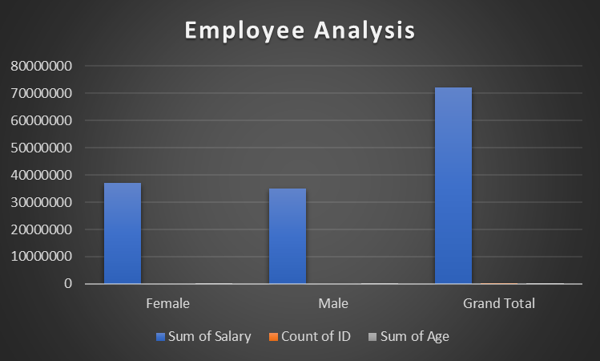
MODELLING
10

Slide 11
RESULTS
Higher Total Female Salary: Female employees have a slightly higher total salary of $36,988,500 compared to $35,081,650 for male employees. This suggests that, despite the gender distribution, female employees have been awarded slightly higher total compensation.
More Experienced Female Workforce: The sum of ages for female employees is 668, whereas for males it is 574. This indicates that female employees, on average, are older and potentially more experienced than their male counterparts.
Balanced and Diverse Employee Base: With a total of 35 employees, the salary and age distribution shows a well-rounded team. The grand total salary of $72,070,150 and combined age sum of 1,242 reflects a diverse and balanced workforce in terms of both compensation and experience.
These points highlight key aspects of salary distribution, experience levels, and overall employee composition within the organization.
11

Slide 12
conclusion
Compensation Insights: Female employees earn a total of $36,988,500, which is slightly higher than the $35,081,650 earned by male employees. This suggests a favorable compensation structure for female employees relative to their male counterparts.
Employee Distribution: There are 18 female employees and 17 male employees, indicating a nearly balanced gender representation within the organization.
Experience Levels: The cumulative age of female employees is 668 years, while male employees total 574 years. This indicates that female employees, on average, are older and likely more experienced.
Overall Salary Expenditure: The total salary expenditure for all 35 employees is $72,070,150, highlighting a significant investment in the workforce.
Total Workforce Age: The combined age of all employees is 1,242 years, reflecting the overall experience level within the organization.

