Slide 1


Final Project: Environmental Factors in Bike Rentals
Prepared for Entity Academy
By Heather Ewert

Slide 2


Background
My name is Heather. I’m a registered nurse specializing in the area of nephrology and dialysis. I also have a degree in linguistics.
In addition to nursing, I have a background in marketing, copywriting, social media management, and search engine optimization.

Slide 3
Project Scope
In this project, I examined a data set about environmental factors as they related to bike rental count.
I conducted a statistical analysis on these factors and trained a machine learning model to predict rental rates based on these insights.
To accomplish this, I utilized skills in Tableau, Python, R, and Jupyter.

Slide 4

Methods
Conducted data wrangling in both R and Python
Reduced amount of unusable data and repurposed data that is difficult to categorize.
Searched for relationships between data points:
Weather and rental rate
Seasons and rental rate
Average rentals
Holiday rentals
Rentals over time
Analyzed relationships using statistics

Slide 5
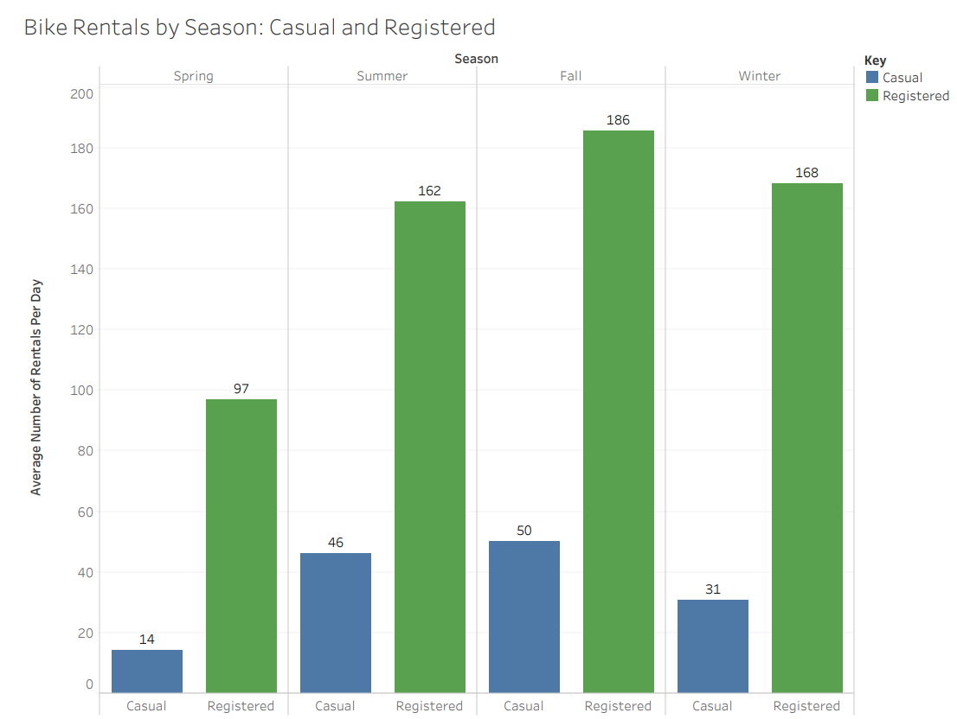
Bike Rentals by Season

Slide 6
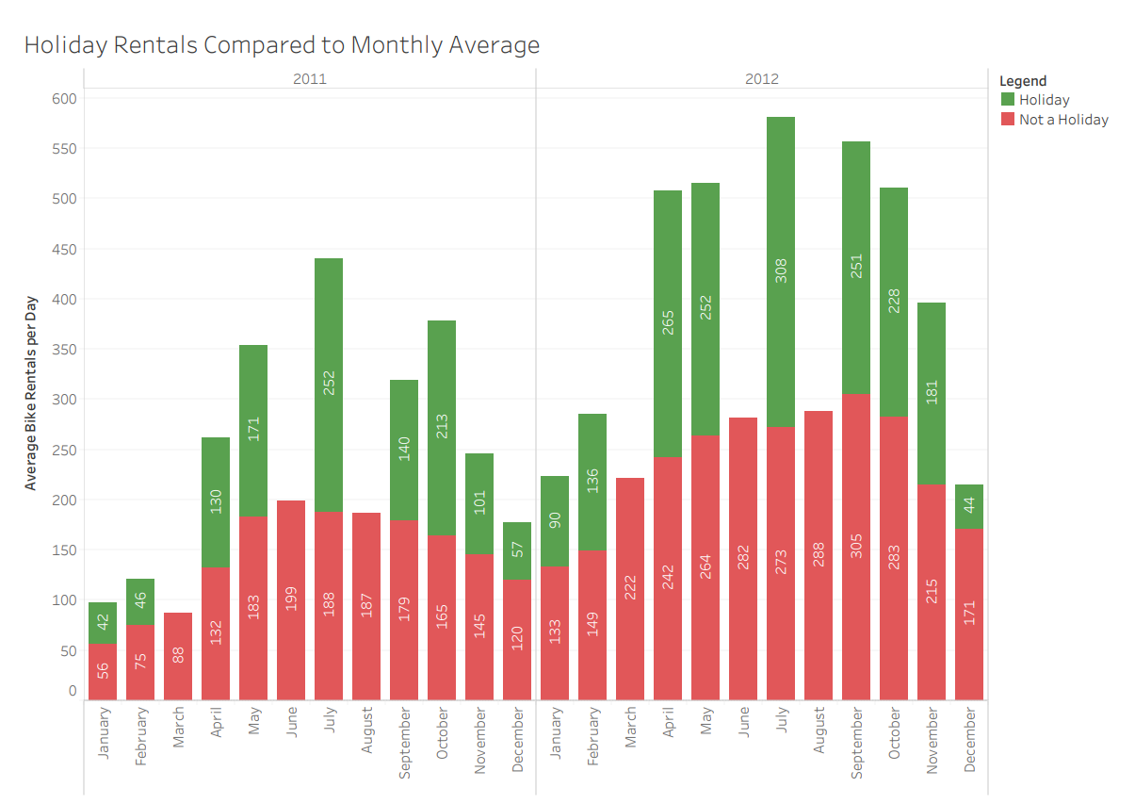
Bike Rentals by Holiday

Slide 7
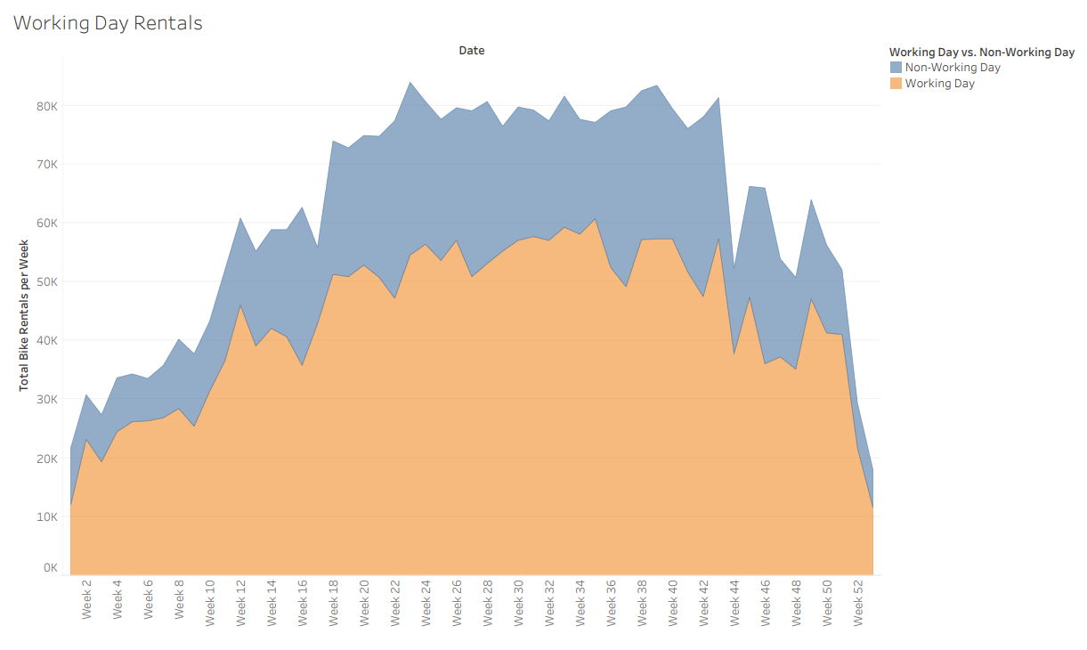
Bike Rentals by Working Day

Slide 8
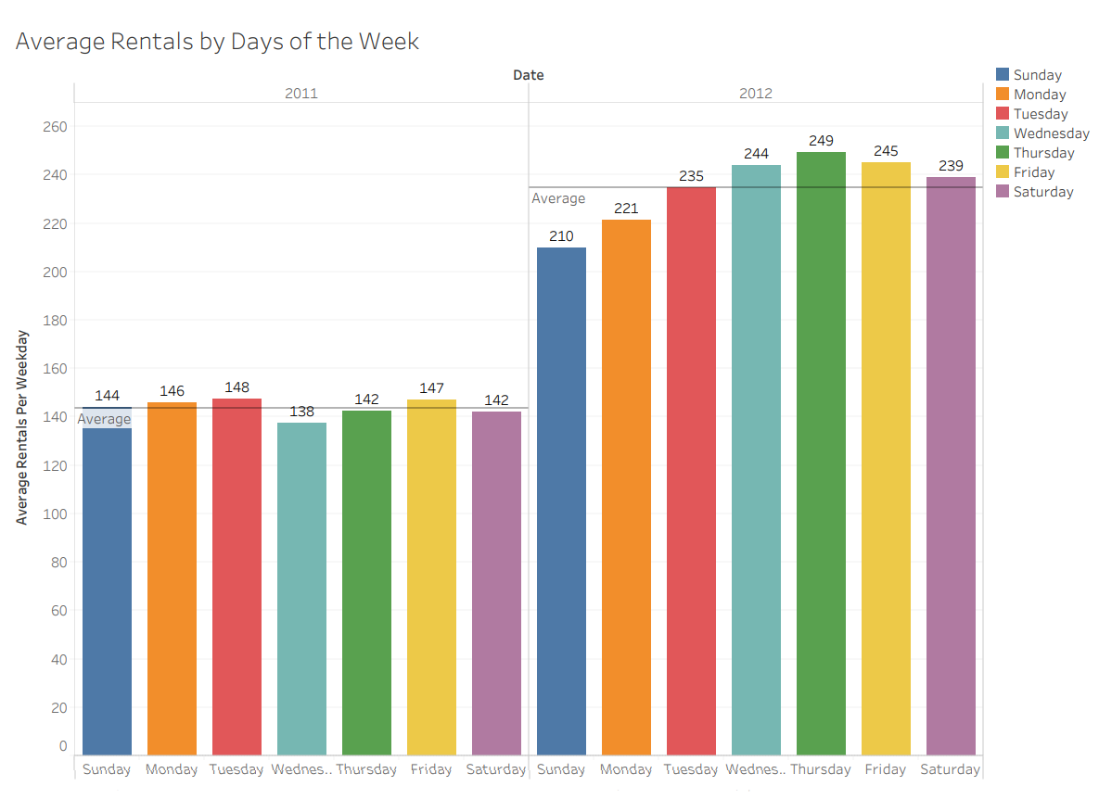
Bike Rentals by Weekday

Slide 9
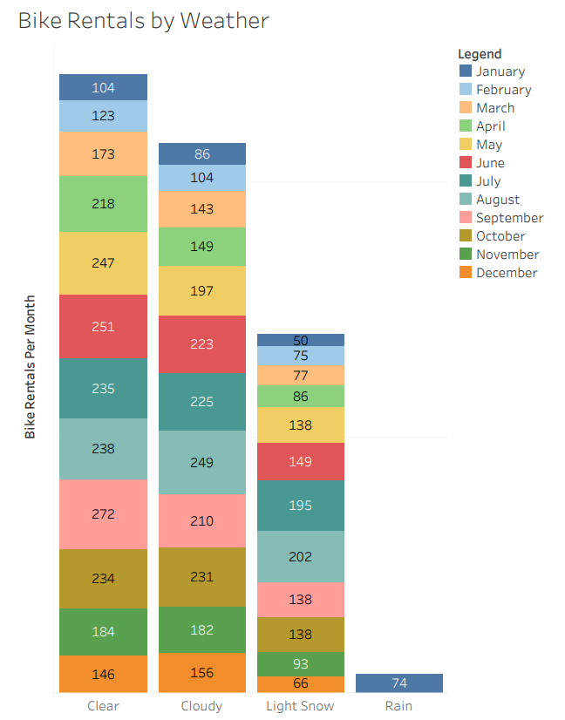
Bike Rentals by Weather

Slide 10
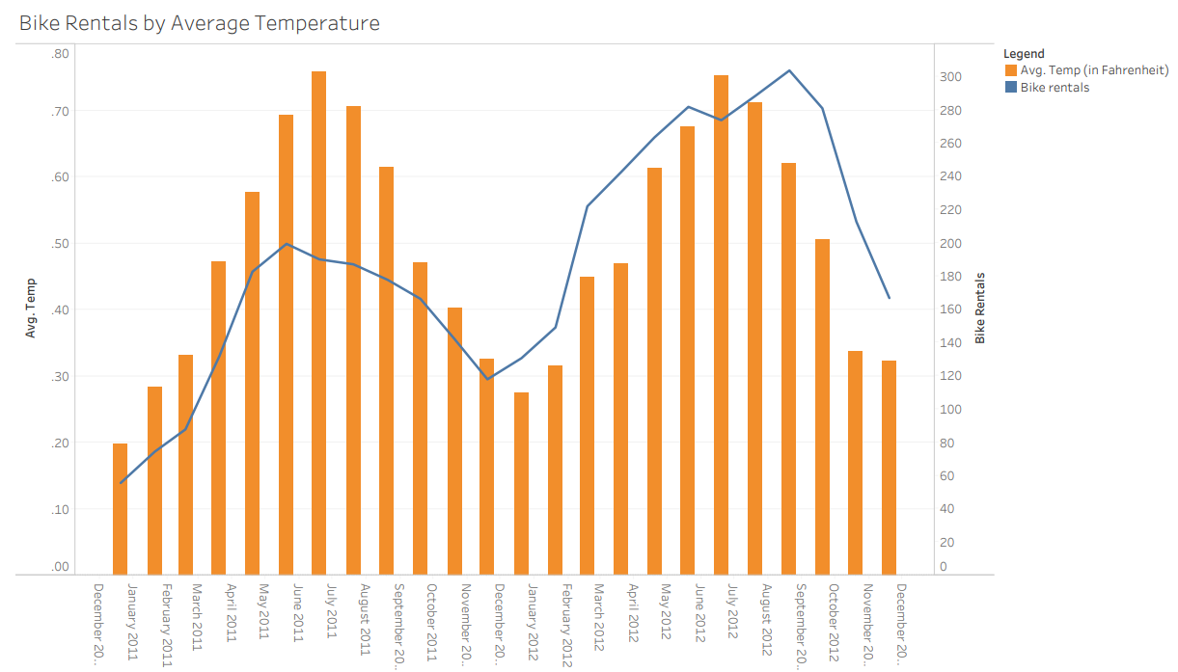
Bike Rentals by Temperature

Slide 11
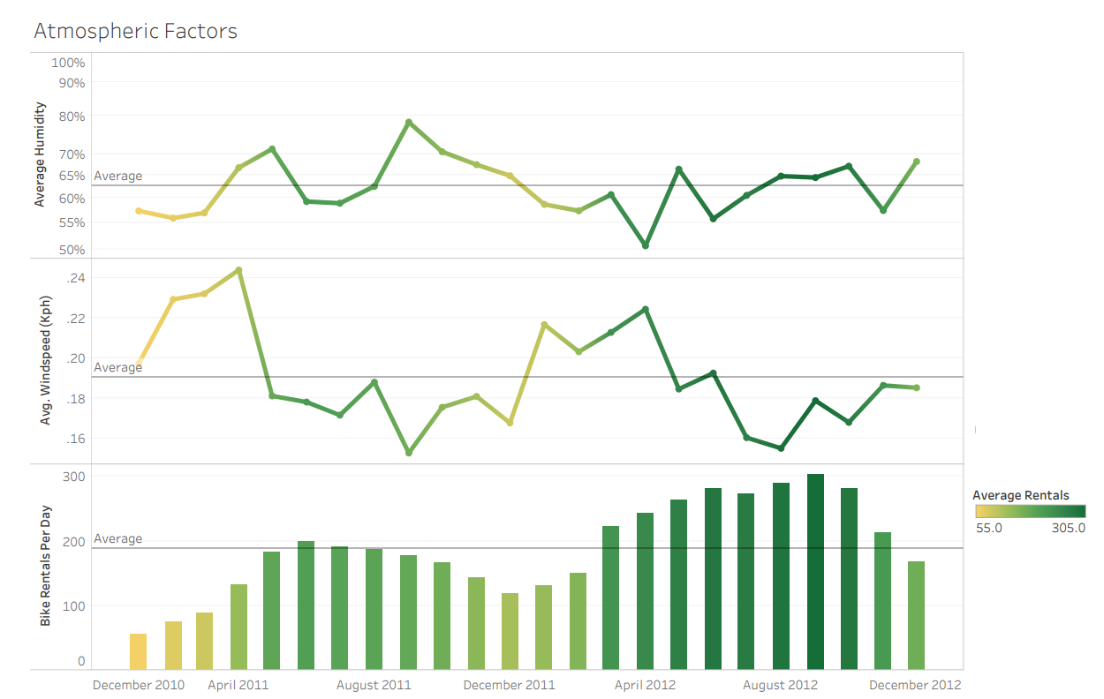
Bike Rentals by Atmospheric Factors

Slide 12
Conclusions
Given multiple environmental factors, the thing that is most likely to affect bike rental rates is the “feeling” temperature.
While humidity and weather also affect whether people rent bikes, they play a lesser role.
Overall, environmental factors only account for a small portion of bike rental rates.
The company should consider a financial and/or marketing analysis as well.
The company appears to be growing—rental rates have increased from 2011-2012, making some of the data positively skewed. If growth continues to be strong, environmental factors again will play less of a role.

Slide 13
Questions?
Thank you for your attention!
Contact:
Ninja.superwoman@gmail.com

