Slide 1

State Management in React: Local, Remote, and More
Notes:
Welcome to our React State Management workshop! Today, we will explore different types of state in React and practical ways to manage them.

Slide 2
INTRODUCTION
Overview of state management in React
Importance and applications of different state types
Notes:
State management is one of the core aspects of React development. We’ll cover various types of state and when to use them

Slide 3
LOCAL STATE
State confined to a single component.
Directly managed with useState.
Useful for small, isolated pieces of state.
Quick to set up, ideal for simple toggles or form inputs.
Notes:
Local state is specific to individual components, such as for managing toggles or form fields. It’s directly controlled with the useState hook.

Slide 4
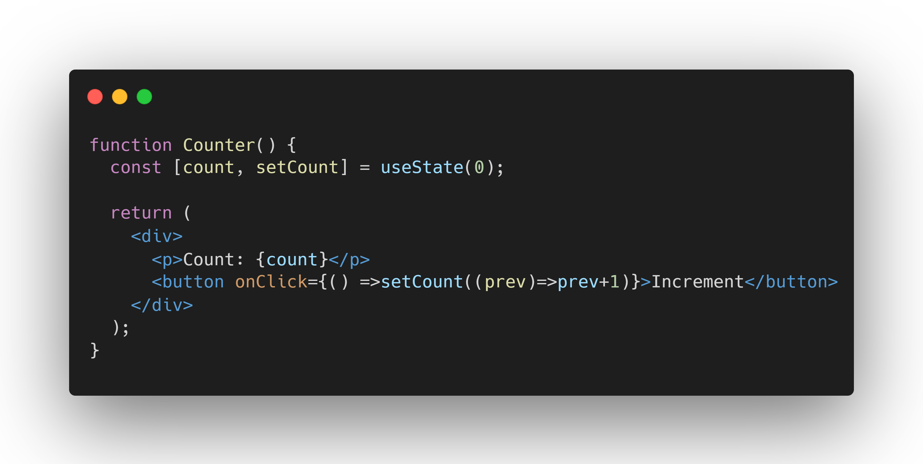

Slide 5
REMOTE STATE
State fetched from an external source, like an API..
Often asynchronous.
Requires additional hooks like useEffect for fetching.
Used for dynamic data like user profiles or lists from a server.
Notes:
Remote state comes from external sources like APIs and typically involves asynchronous data fetching, making it crucial for dynamic data in your app

Slide 6
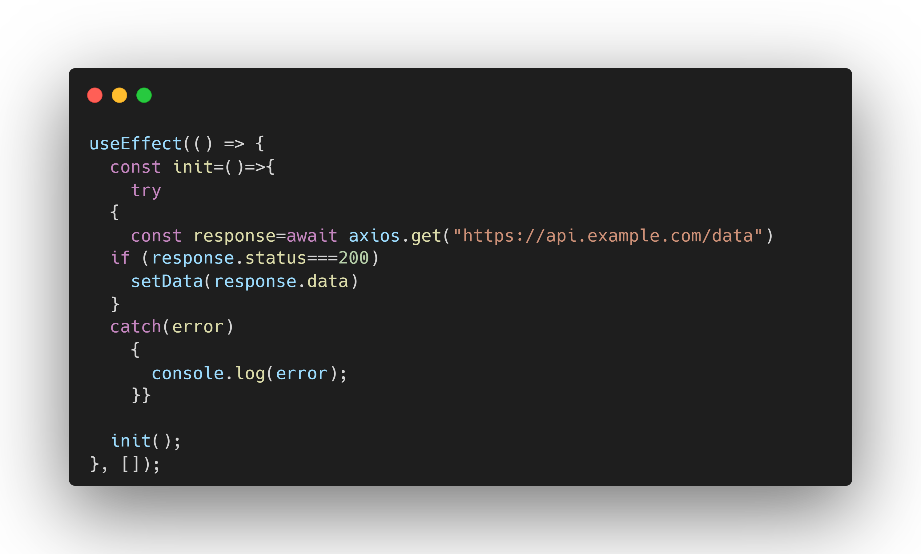
Notes:
Web storage allows you to persist state even after a page reload. localStorage is useful for saving user preferences, while sessionStorage is limited to the current session.

Slide 7
URL STATE
State stored in the browser’s URL
Can be persisted in the URL for bookmarking or sharing.
Used in combination with routing.
Great for search terms, pagination, or filter selections.
Notes:
URL state allows your app to store state in the URL, so users can bookmark or share the exact state of the page. This is often useful in search or filter-heavy apps.

Slide 8
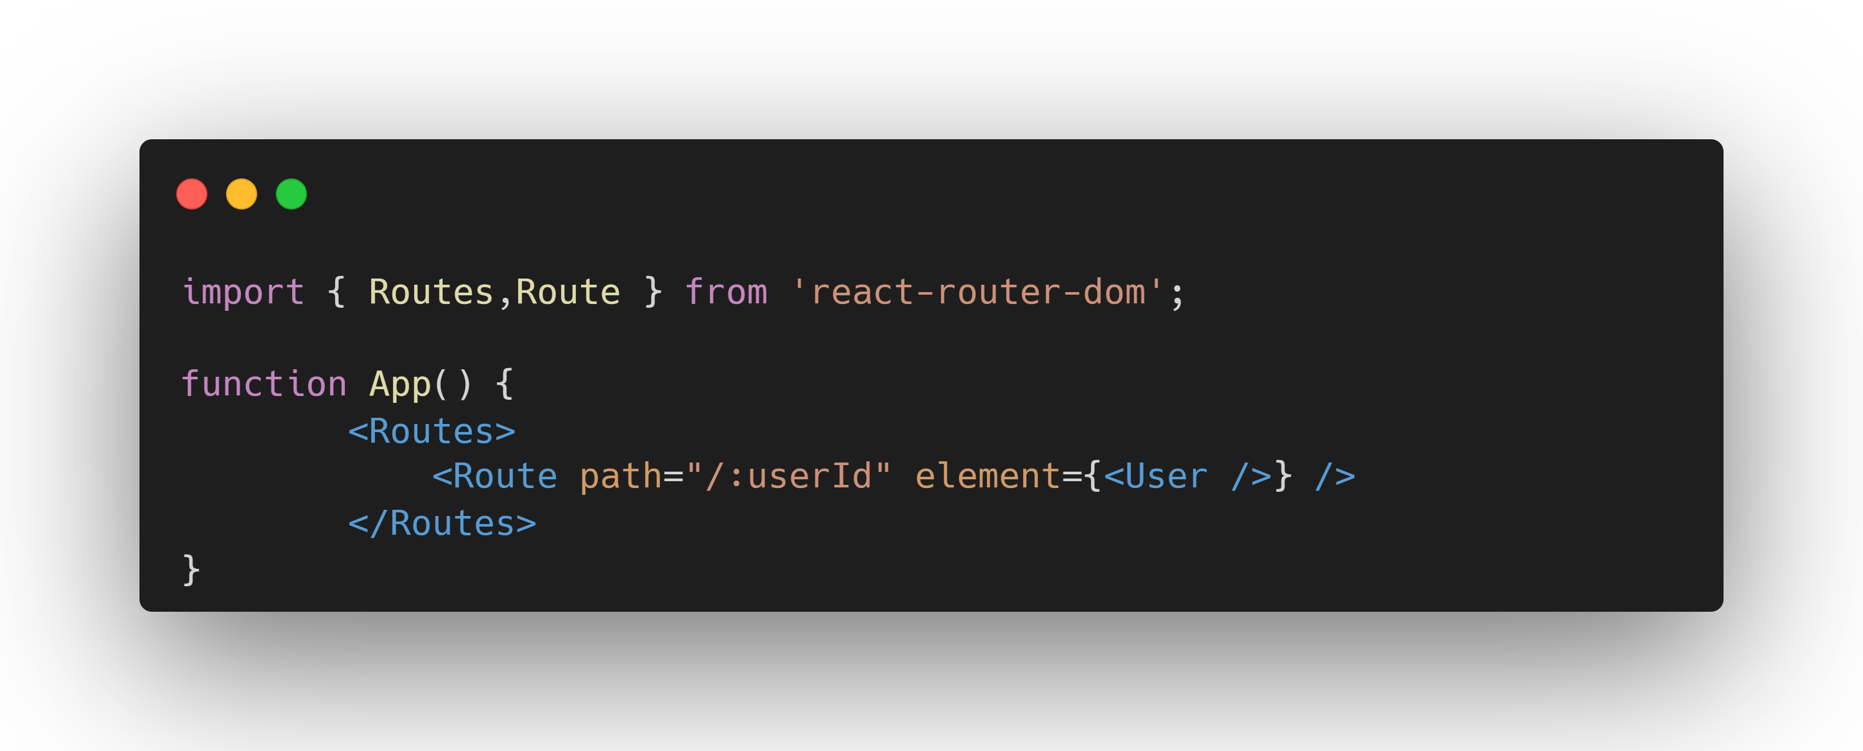
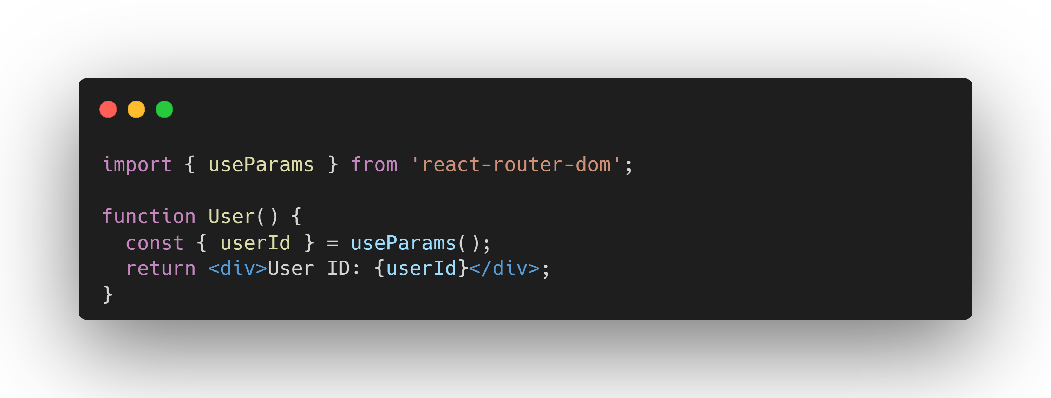

Slide 9
WEB STORAGE
State stored in localStorage or sessionStorage for persistence.
Persists across page reloads or sessions.
Stores small amounts of data on the client-side.
Commonly used for user preferences (like themes) or auth tokens.
Notes:
Web storage allows you to persist state even after a page reload. localStorage is useful for saving user preferences, while sessionStorage is limited to the current session

Slide 10
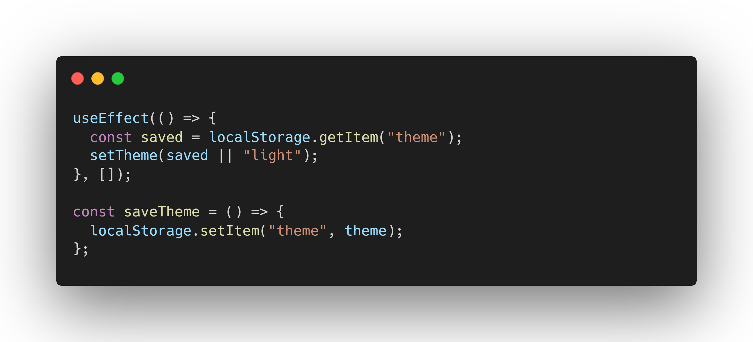

Slide 11
SHARED STATE
State shared across multiple components.
Prop drilling or Context API for sharing state.
Important for keeping components in sync.
Useful for state that needs to be accessed in different parts of the app.
Notes:
Shared state is passed between components and helps keep data in sync across your application, often using props or the Context API

Slide 12
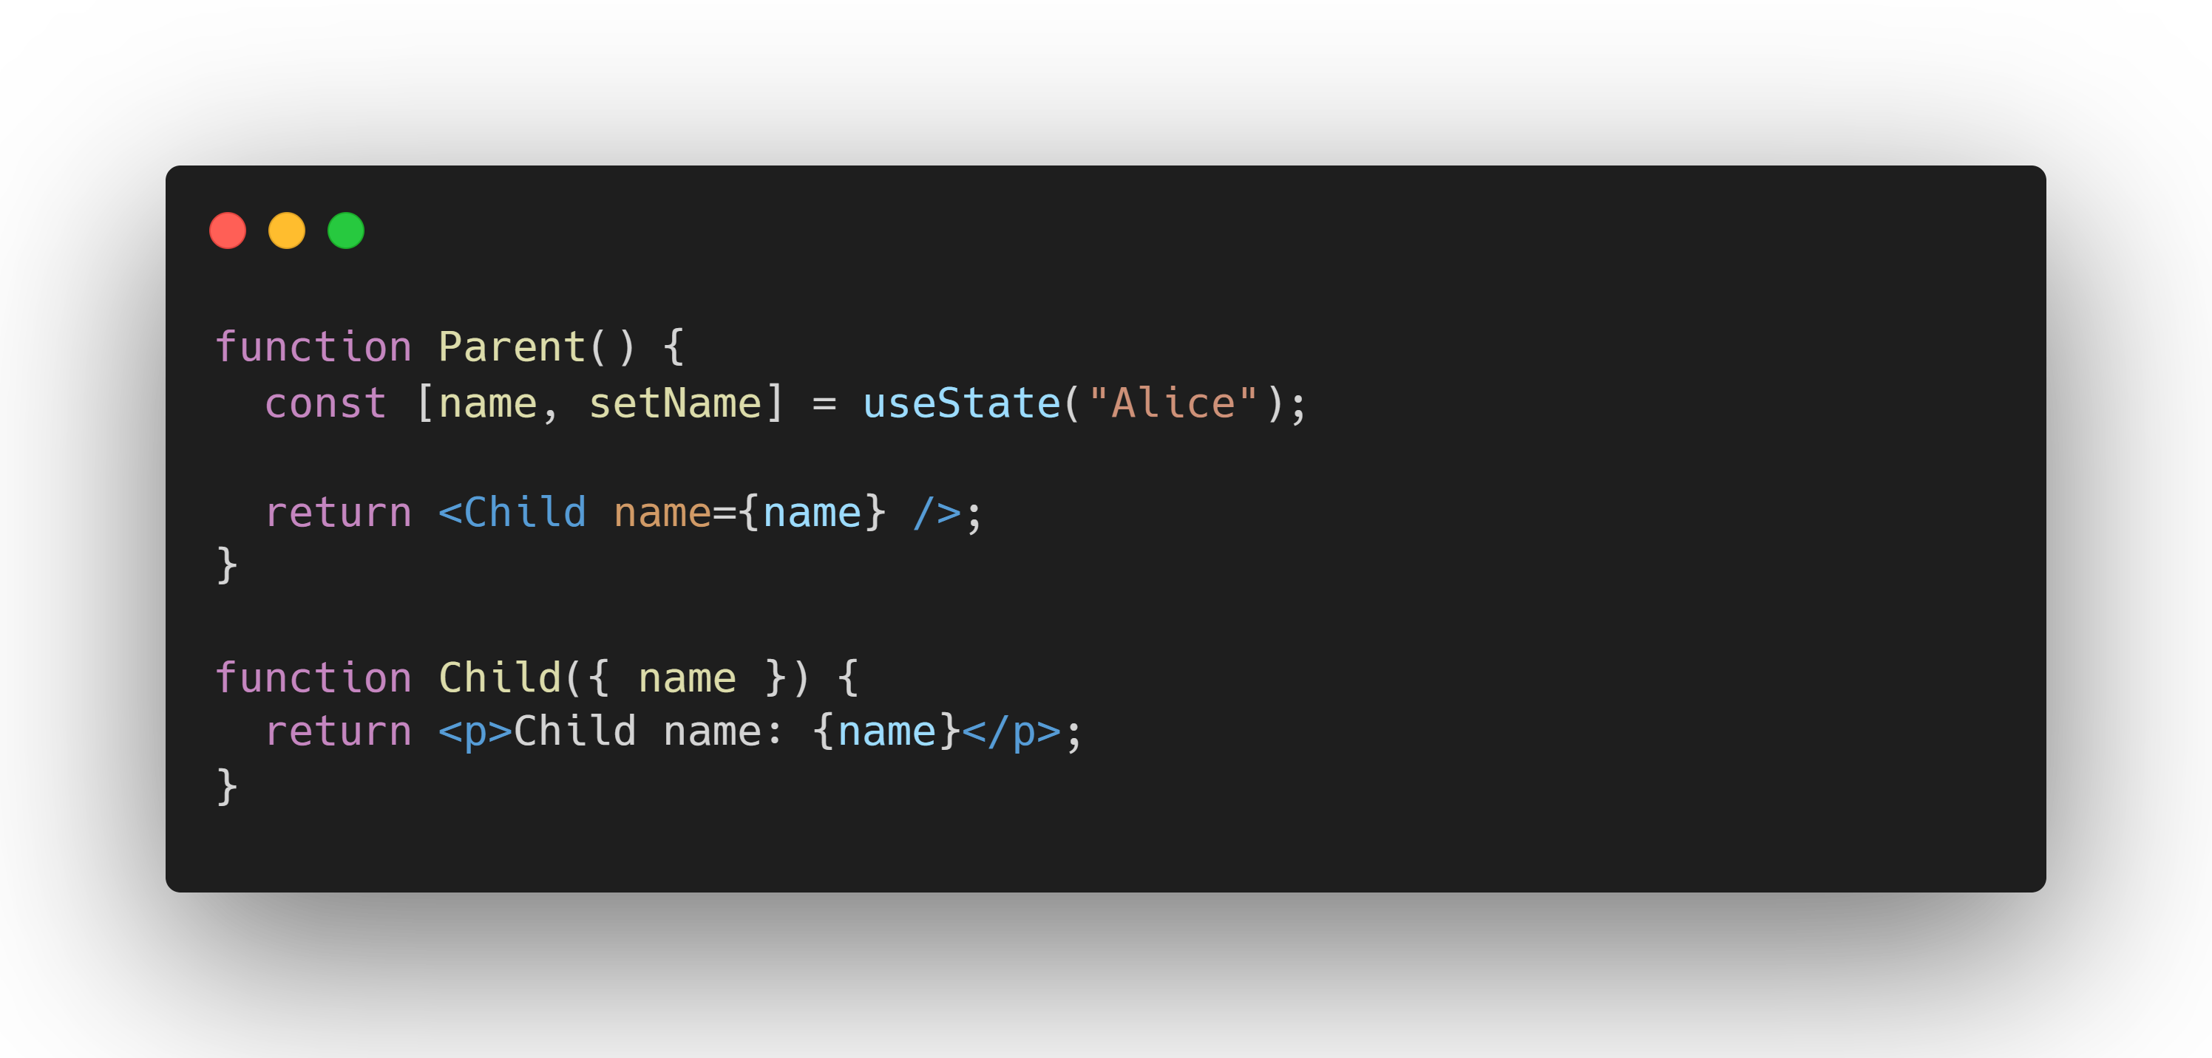

Slide 13

DERIVED STATE
State that is computed from other state.
Not directly stored but calculated on the fly.
Avoids unnecessary duplication of data.
Useful for filtering lists or calculating totals.
Notes:
Derived state is computed from existing data rather than being stored separately, which helps avoid duplication and keeps your app logic clean

Slide 14
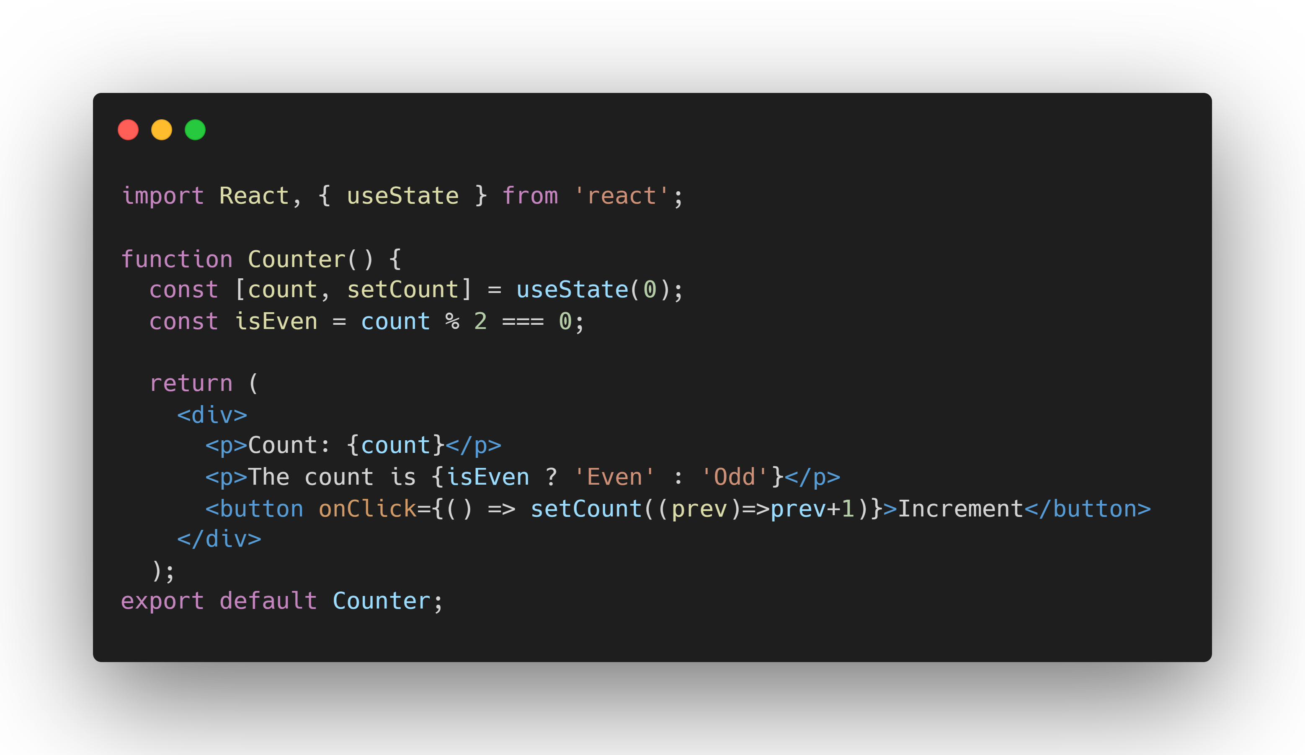

Slide 15
UMMUTABLE STATE
State that cannot be modified directly.
New state is created rather than mutating existing state.
Helps prevent bugs by ensuring data integrity.
Notes:
Immutable state ensures that once state is created, it can’t be modified. This allows for more predictable and safe state updates.

Slide 16
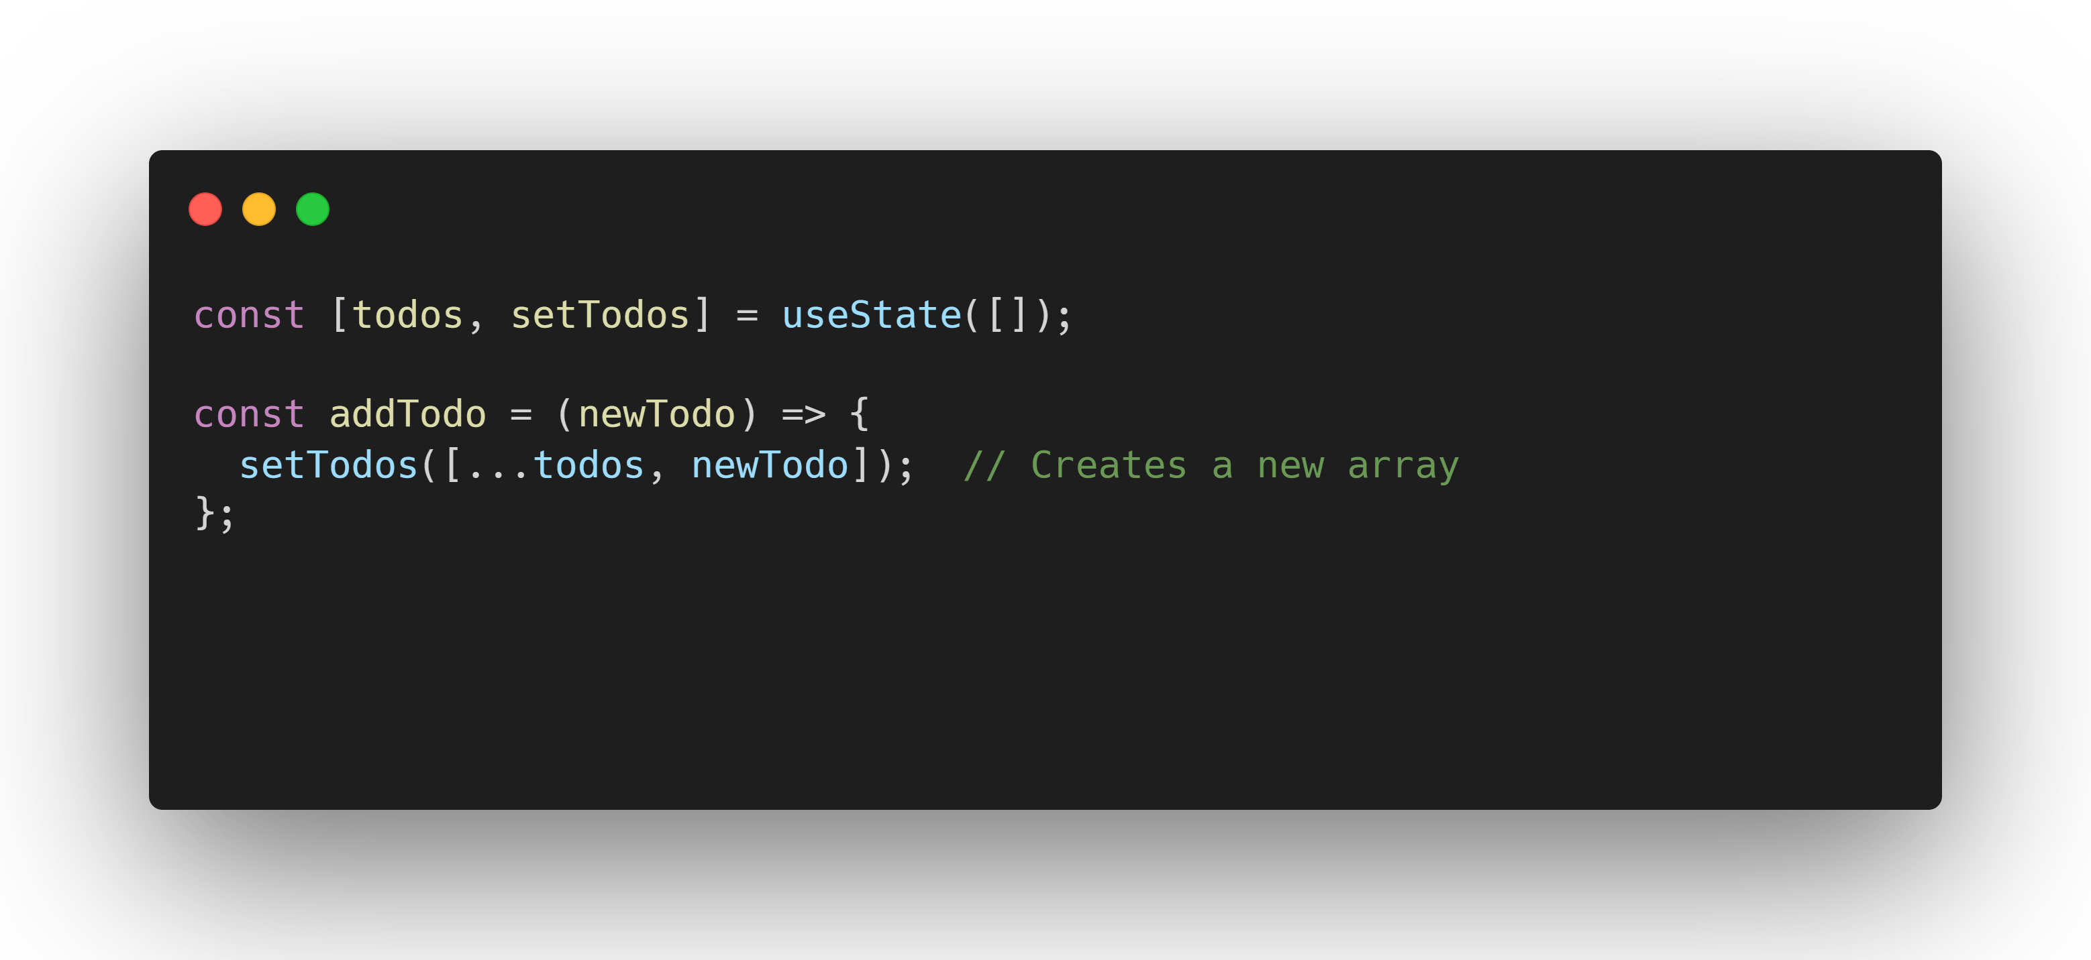

Slide 17
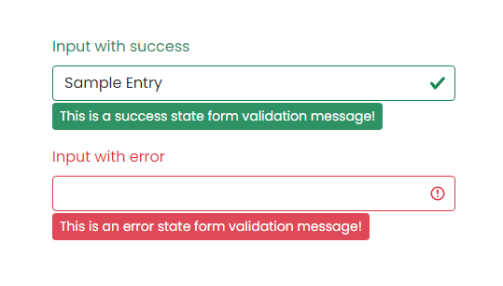
FORM STATE AND VALIDATION
Managing form state and handling validation.
Tracks form input values and errors.
Validates user input before form submission.
Can get complex with multiple fields or steps.
Notes:
Form state tracks user inputs and validation rules, ensuring data is correct before it’s submitted. Managing form state efficiently is key to handling complex forms

Slide 18
STATE VIA REFS
Using useRef to store non-rendering state.
Used to store mutable values that do not trigger re-renders.
Great for referencing DOM elements or timers.
Notes:
useRef is useful for storing mutable values that don’t affect rendering, like DOM element references or timers. It’s efficient when state updates shouldn’t cause re-renders

Slide 19
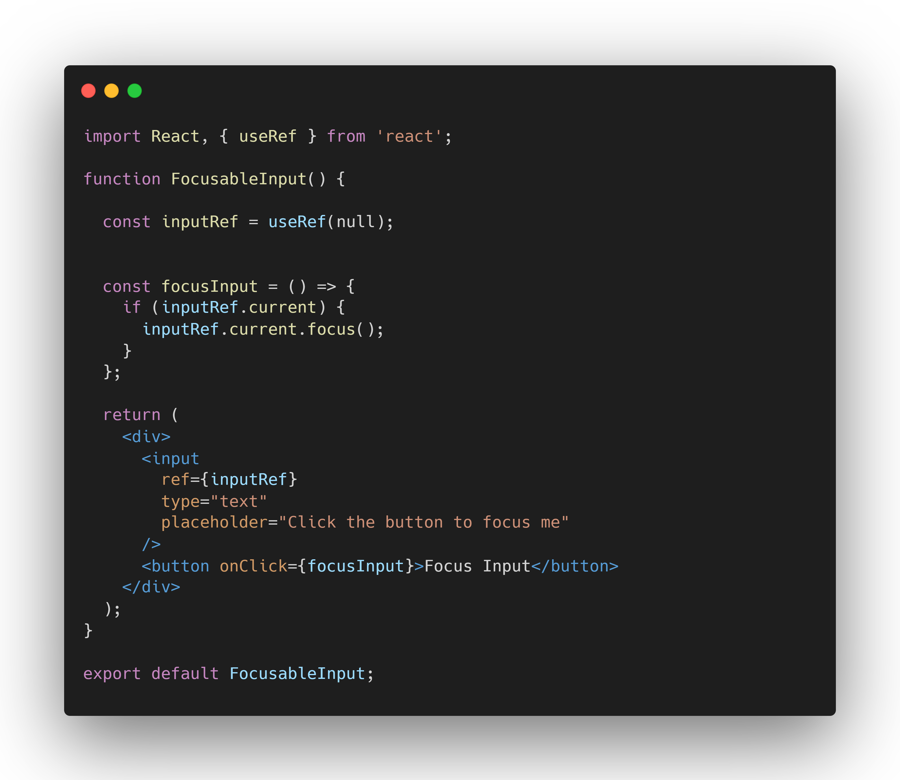

Slide 20
Managing Complex State with useReducer
managing complex state transitions.
Useful for complex state logic or multiple interdependent updates.
Actions dispatched to update the state.
Works well for cases like managing a shopping cart or form with multiple steps.
Notes:
useReducer is a powerful hook that helps manage complex state logic. Instead of using useState for multiple interdependent updates, you dispatch actions to update the state in a more structured way

Slide 21
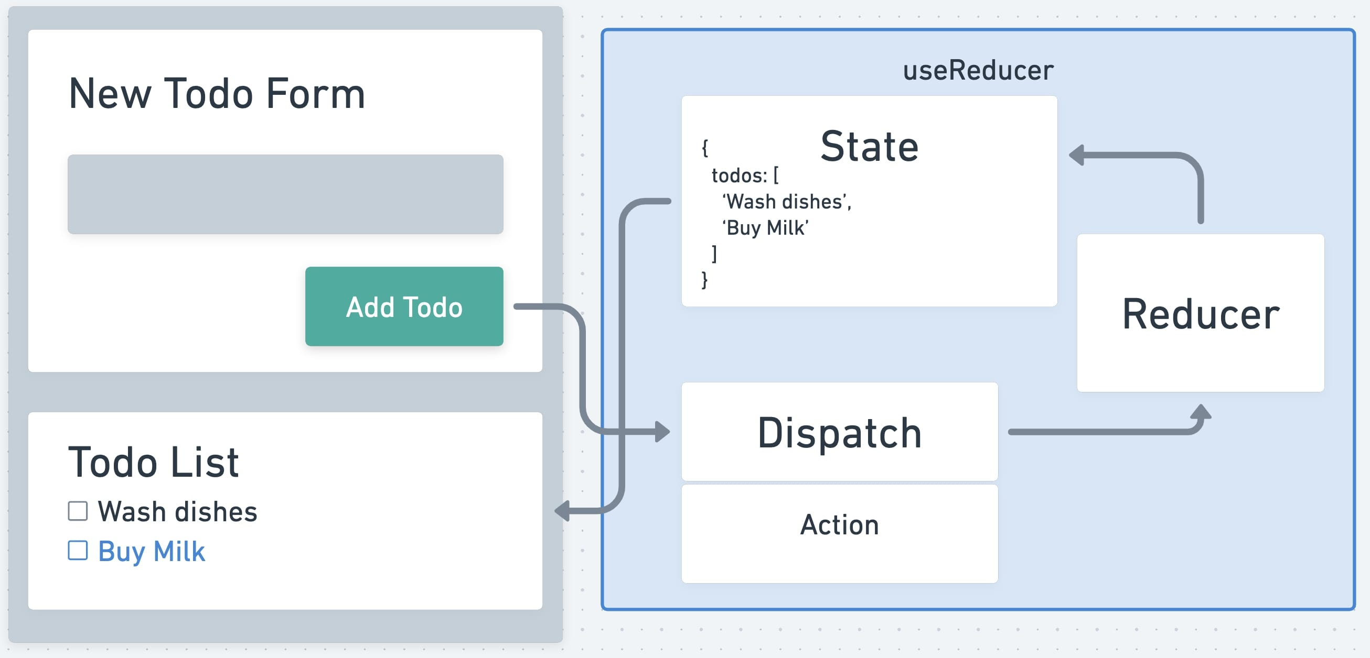

Slide 22
useState VS useReducer
Hook | useState | useReducer
State Complexity | ⭐️ Simple state (e.g., toggles, counters) | 🌐 Complex state logic (e.g., forms, multiple actions)
Action Handling | 💡 Direct update with a setter function | 🚦 Action-based dispatch for state transitions
State Update Logic | 📝 Defined inline within the component | 📚 Centralized in a pure reducer function
Best for... | Small, isolated state changes | ⚙️ Large components with complex state requirements

Slide 23
DEMO

