Slide 1
Project Organization
Beautify and Organize Your Projects
(Do It)

Slide 2
Conventions
For You & Your Team

Slide 3
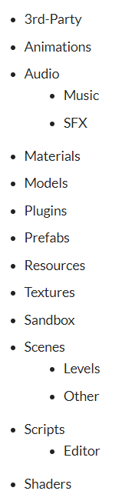
Directory Structure
Have an order
Don’t have folders outside of these
Place specialty folders in as sub-folders

Slide 4
Scene Hierarchy Structure
Lights
Cameras
AR_Manager
World
GUI
Scene_Manager
_Dynamic

Slide 5
Script Organization
Public variables (Alphabetical/Importance)
Private variables ‘’
Public Properties
Private Properties
Sub Class/Struct/Enum Definitions
Public Methods
Private Methods

Slide 6
Namespaces
Helps to differentiate classes when there may be duplicates. (Protects your code from other people’s code.)
C# Convention
<Company>.(<Product>|<Technology>)[.<Feature>][.<Subnamespace>]
My convention
<ProjectName>[.<SubType>]

Slide 7
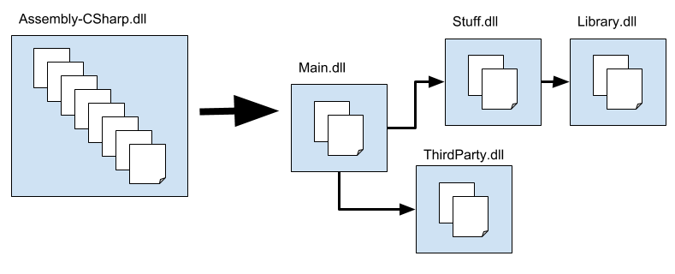
Assembly Definition Files (Multiple Projects)
Use for compilation of multiple dll’s
Include in each sub folder that has scripts

Slide 8
Other Personal Tips & Tricks
Use prefabs for everything
Split up classes
Use Version Control
Not commented code blocks
Learn Editor Scripts
Editor Cheats

Slide 9
Other Team Tips & Tricks
Version Control
I own the scene
Multi-scene editing
Scene Fusion
Before branch merges have someone else check the merge
Sandbox Folder
Use same structure as usual
Communicate Structure

Slide 10
Resources
https://blog.theknightsofunity.com/7-ways-keep-unity-project-organized/
http://www.arreverie.com/blogs/unity3d-best-practices-folder-structure-source-control/
https://www.kinematicsoup.com/news/how-to-effectively-collaborate-in-unity
https://www.gamasutra.com/blogs/CharlesHinshaw/20180611/319682/My_Top_3_Tips_for_Starting_a_New_UnityProject.php
Assembly Definition Files: https://docs.unity3d.com/Manual/ScriptCompilationAssemblyDefinitionFiles.html
Scene Fusion: https://www.kinematicsoup.com/scene-fusion/about

