Slide 1



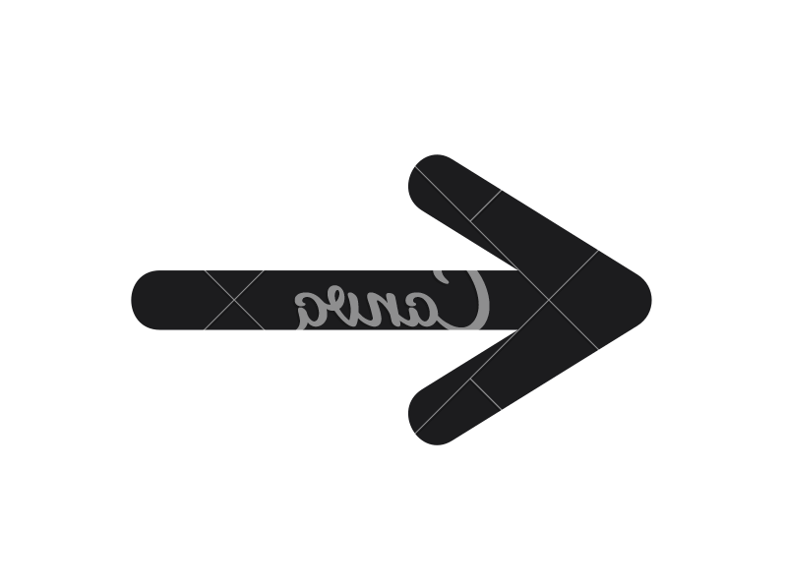
STUDY PROJECT REPORT :
Drug Consumption
By
Chloé Coursimault Héloïse de Castelnau
01

Slide 2

DataSet Exploration
02

Slide 3





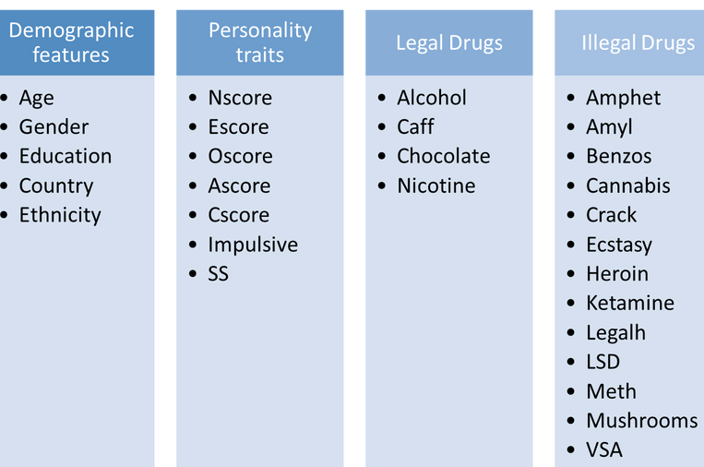




Oscore is the general appreciation for art, unusual ideas, and imaginative, creative, unconventional, and wide interests.
Our dataset from the UCI Machine Learning repository is the result of an online survey conducted between 2011 and 2012 among 1,885 respondents aged 18 and over, from English-speaking countries.
The survey collected data including Big Five personality traits (NEO-FFI-R), impulsivity (BIS-11), sensation seeking (ImpSS), and demographic information.
The data set contained information on the consumption of 18 central nervous system psychoactive drugs legal and illegal. For each of these drugs, each individual had to choose his level of consumption :
Escore is manifested in outgoing, warm, active, assertive, talkative, cheerful, and in search of stimulation characteristics.
Cscore is the tendency to be organized and dependable, strong-willed, persistent, reliable, and efficient.
Personality traits details
SS is an impulsive sensation seeing measured by ImpSS.
Nscore is the long-term tendency to experience negative émotions.
CL0 Never Used
CL1 Used over a Decade Ago CL2 Used in Last Decade CL3 Used in Last Year
CL4 Used in Last Month CL5 Used in Last Week CL6 Used in Last Day
Impulsive is impulsiveness measured by BIS-11: The Barratt Impulsiveness Scale is a widely used measure of impulsiveness
Ascore is the dimension of interpersonal relations, characterized by altruism, trust, modesty, kindness, compassion, and cooperativeness.
Furthermore, to detect Fraud, the survey organizers added a fake drug "sumer".
03

Slide 4
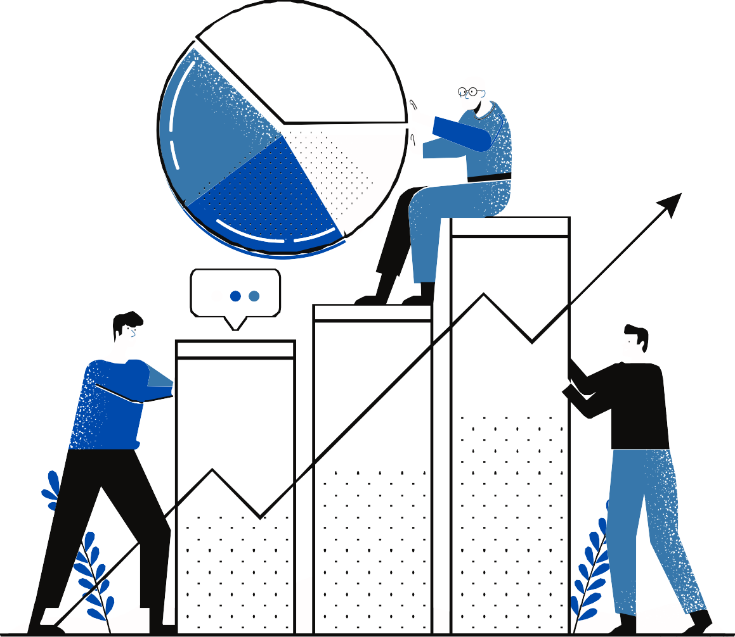
DataSet Analysis
04

Slide 5

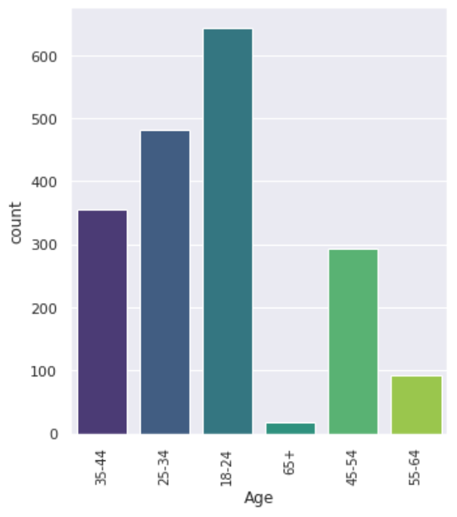
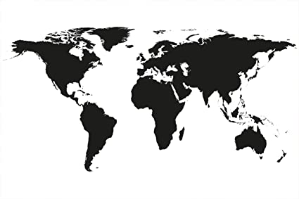
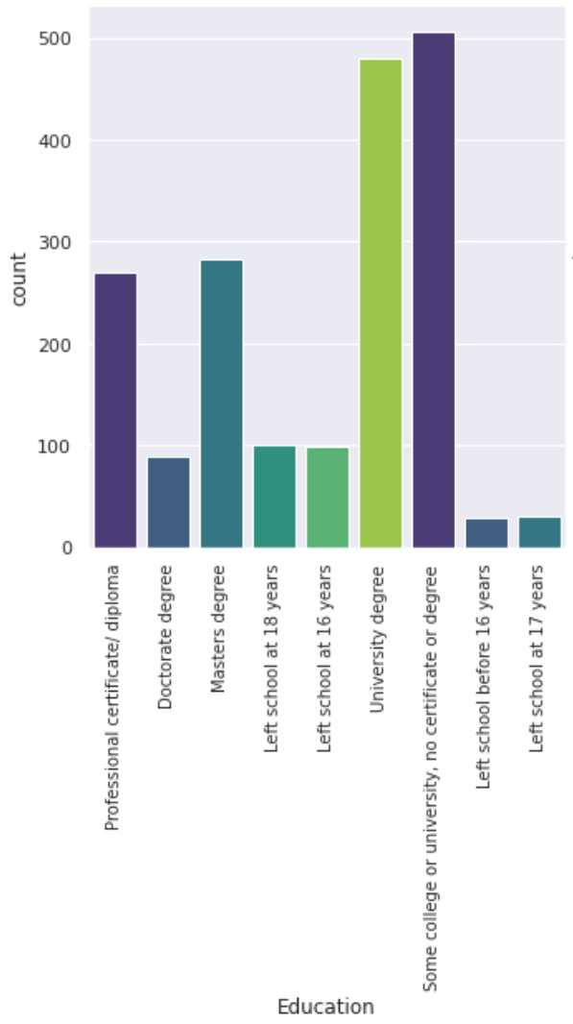
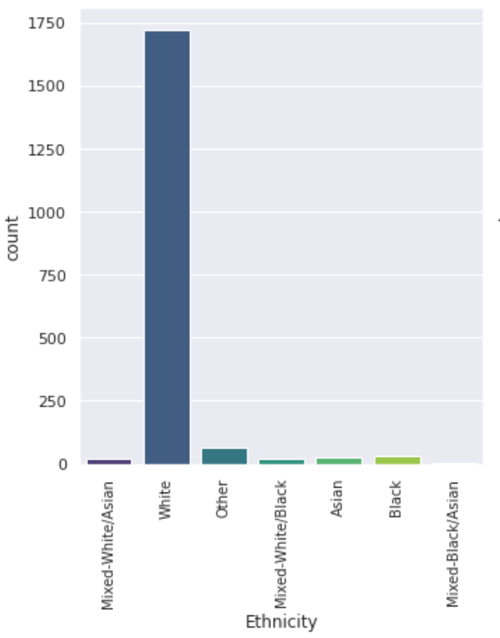
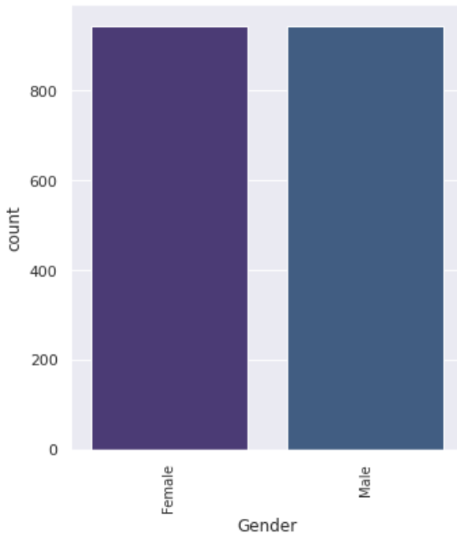
DEMOGRAPHIC DATA
We can observe some unevenly represented categories within the columns of the Dataframe, suchs as Ethnicity that count up to 90% of white or Country with mostly UK participants. This biais may false our predictions so we can already say that we will get rid of thoses ubalanced goups distribution.
Some categories are almost uniformaly disparate such as Education and Age or even equally represented wich Gender.
Country | %
UK | 55.38
USA | 29.55
Other | 6.26
Canada | 4.61
Australia | 2.86
Republic of Ireland | 1.06
New Zealand | 0.26
05

Slide 6

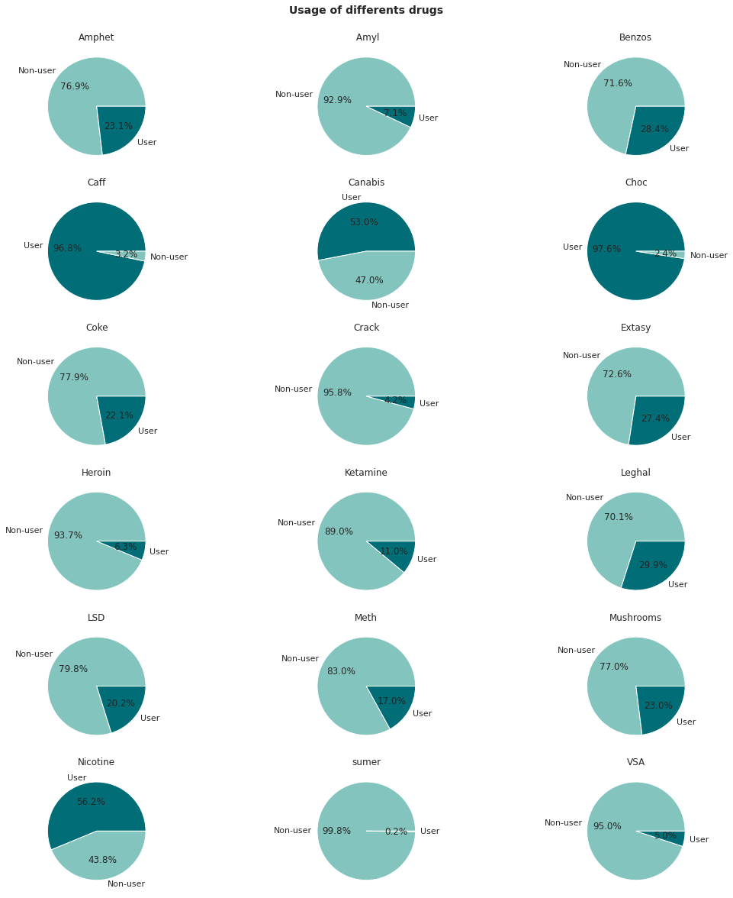
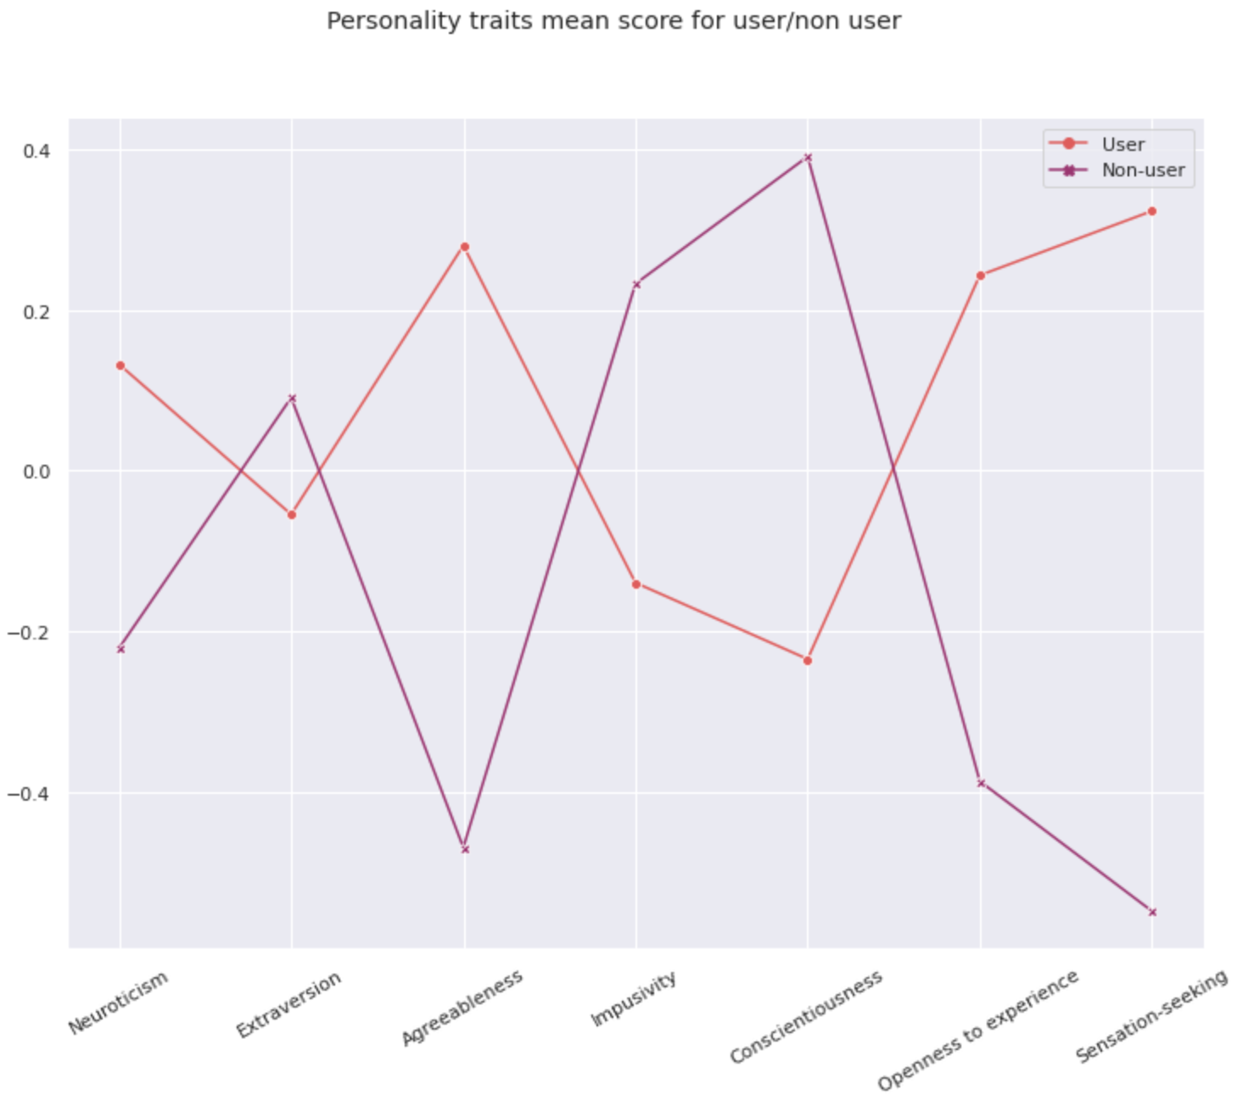
INTERESTINGS OBSERVATIONS
We can observe a widely disparate representation of user/non-user for illegal and legal drugs.
Fisrt, we can spot a small proportion of cheater 0.2%, but because it may add noise we will get rid of this column in our futur prediction.
Then we can see that the illegal drug the most used is the Cannabis with up to 47% of users, this drug is weel-known as a Getaway drug.
A gateway drug is a habit-forming drug that can lead to the use of other, more addictive drugs. They include alcohol, marijuana, nicotine, and prescription drugs.
By creating a new column of user/non-user based on the annual consumption of illegal drugs, we ploted the mean score for each personality traits for cosumer or not consumers.We can see a strong correlation between the consumption and the changing behaviour, the personality traits are diametricelly opposed. It’s interesting because we may argue that it’s drugs use that may change the behaviour of the participants. Because the question of how personality change would affect how we will develop our ML model later.
06

Slide 7
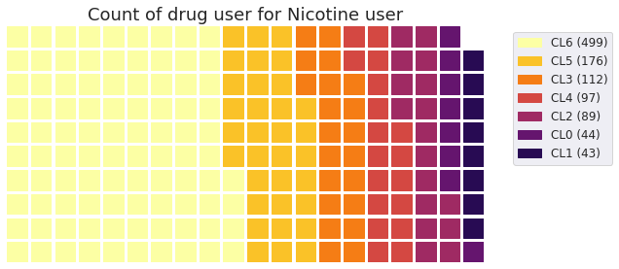
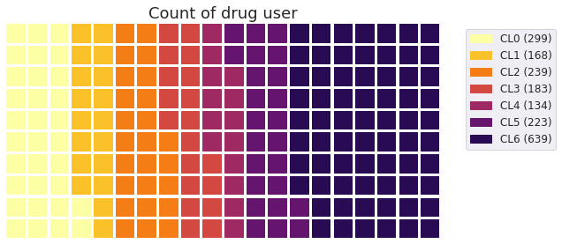
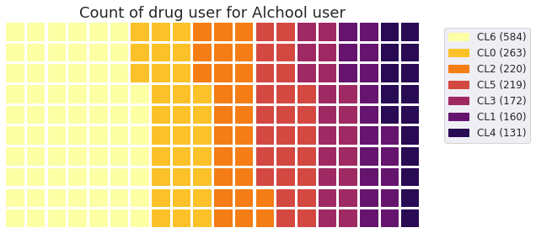
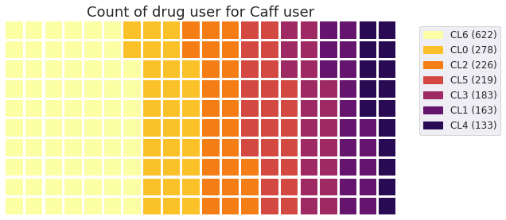
INTERESTINGS OBSERVATIONS (2)
Normal use
Getaway drugs
We can observe here that the Getaway drugs Nicotine & Alchool seems to have a more highly count of illegal drug user.
However, we didn’t get the timeline for each participants of their consumption, so it’s complicated to say if the use of alchool could impact the use of Amphets for example.
We will see thoses correlations more detailled in the Machine Learning part, but it do seems that the consumption of Nicotine or Alchool is strongly correlated with the consumption of others illegal drugs.
We ploted the proportion of different categories of drugs usage within the dataset. We can see a widely disparate representation of thoses classes, with a majority of users up to a year (rf Machine Learning part). Before studying the Getaway drugs we also poted a waffle chart for Caffeine as a referent.
07

Slide 8

Machine Learning
08

Slide 9

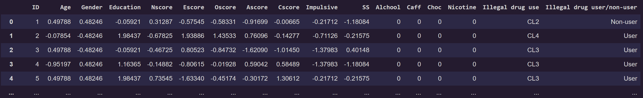
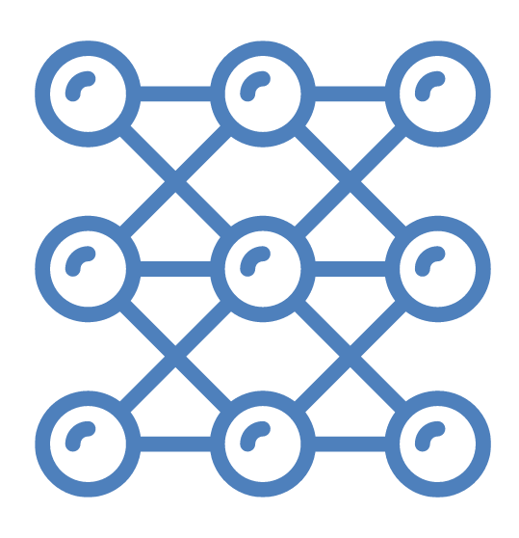
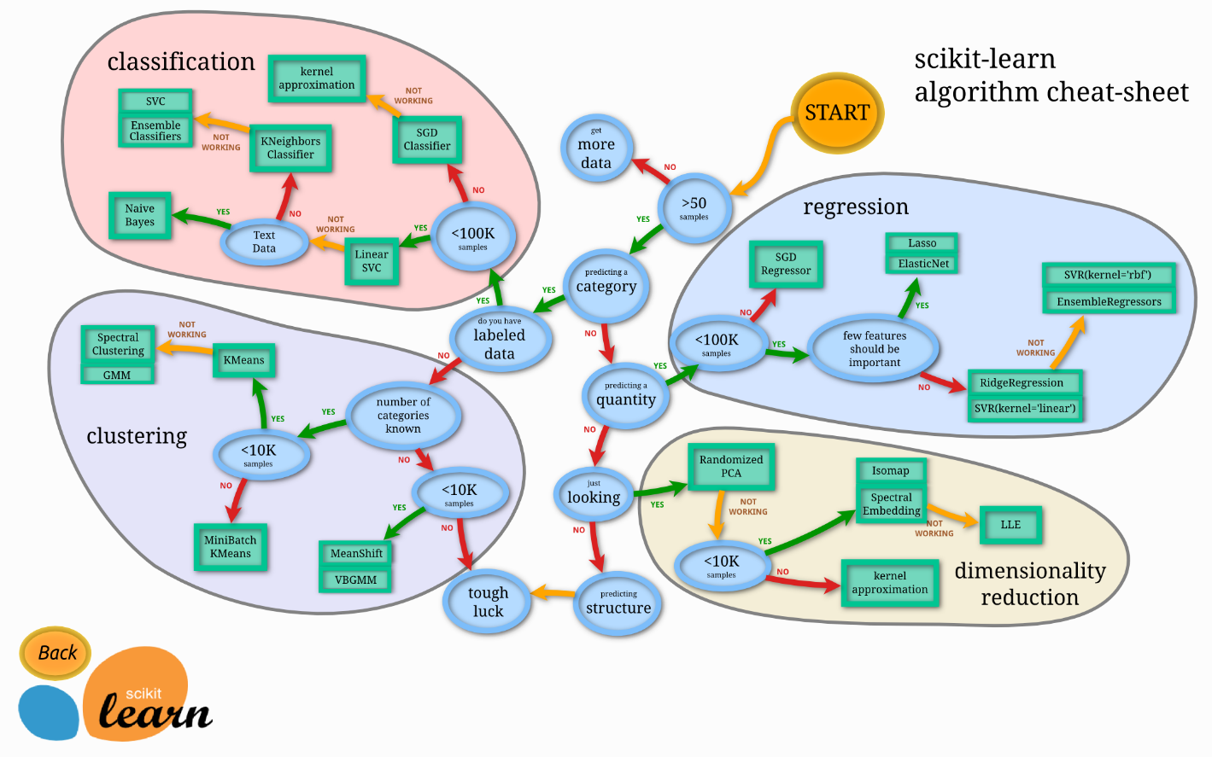
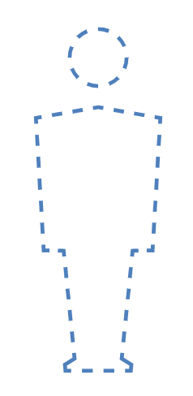

Choosen Output
MultiClass prediction:
How much the individual with the characteristics X used illegal drugs lately (up to one year) ?
We created a category « Illegal drug use » wich take for each participant withing the illegal drugs column his highest consumption. We tried to make predictions on this output using Logistic Regression and Neural network but got mixed results. We thought that our dataset is unbalanced (it has more samples for some classes than others). This can make the classifier biased toward the one or two classes with lost of samples. We also made the hypothesis that our dataset was not specific enough.
What Algotihms did we implemented?
We tried multiple Machine Learning Algorithms from the scikit-learn library with the « Illegal drug user/non-user » as an output, by checking for each individual if he used an illegal drug up to a year before the survey.
Here is a little overview of the algorithms we tested :
Logistic Regression
Linear SVC
Gaussian NB
Random Forest
Decision Tree
KNN
XGBOOST
SVM
Neural Network
Binary Classification
Has the individual with the characteristics X used illegal drugs lately (up to one year) ?
CL0 CL1 CL2
Non-user
CL3 Used in Last Year
CL4 Used in Last Month
CL5 Used in Last Week
CL6 Used in Last Day
User
Here is a little cheat sheet of the scikit-learn library.
09

Slide 10

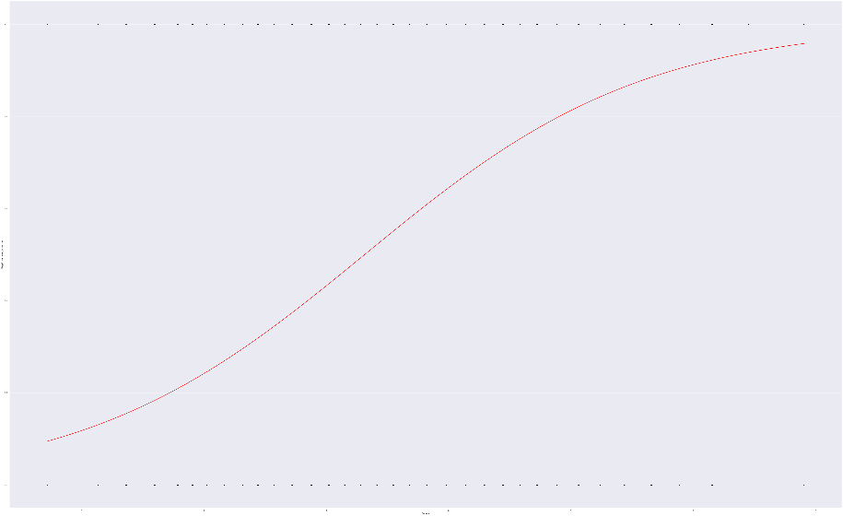

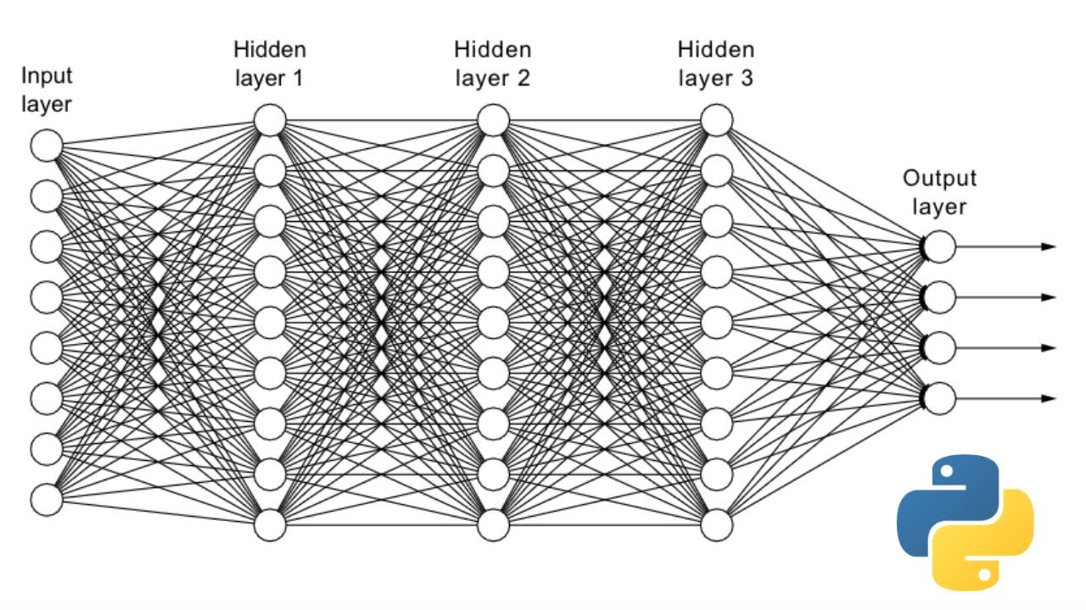
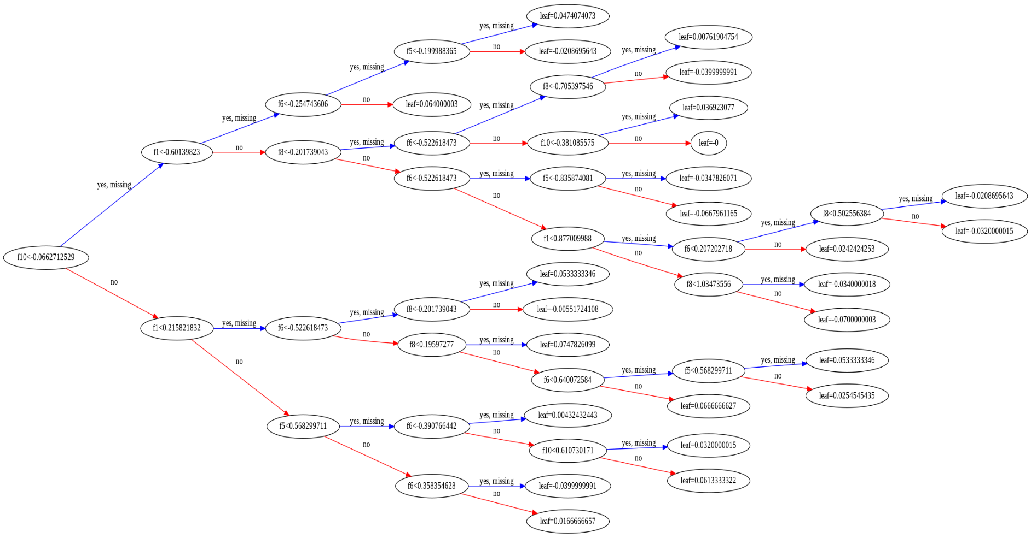
Algorithms predictions
How does it work ? – a short overview
XGBOOST, Linear Regression & Neural network
Logistic regression Regression-
For the base-line model, we consider the multiple linear regression model from sklearn.linear_model library LogisticRegression.
It’s a statistical model that in its basic form uses a logistic function to model a binary dependent variable, although many more complex extensions exist. In regression analysis, logistic regression (or logit regression) is estimating the parameters of a logistic model (a form of binary regression).
Illegal drug user/non-user
XGBOOST-
We employ XGBoost, a fast and strong gradient boosting framework that is also based on multiple decision tree learning, in this part. Gradient boosting is a technique for transforming weak learners into strong ones. When combined with prior models, it is based on the premise that predicting the next tree inside a model can minimize prediction errors.
XGBoost, like Random Forest, provides a number of benefits, including: trains quicker and more effectively while consuming less memory.In general, very efficient, especially on huge datasets, with more complicated trees using a level-wise level-wise growth strategy.
You can see that variables are automatically named like f1 and f5 corresponding with the feature indices in the input array.
You can see the split decisions within each node and the different colors for left and right splits (blue and red).
Oscore
Neural Network-
In essence, neural networks are self-optimizing functions that map inputs to the desired outputs. The function may then take a fresh input and predict an output based on the function it developed with the training data.
An ANN is made up of the following elements:
An input layer that receives data and pass it on
A hidden layer
An output layer
Weights between the layers
A deliberate activation function for every hidden layer.
Remark -
For each of thoses algorithms we used a GridSearch with cross-validation to select the hyperparameters that are most suited. It entails putting a machine learning model through many permutations of hyperparameters in order to assess its performance and make improvements.
10

Slide 11

Conclusion
11

Slide 12

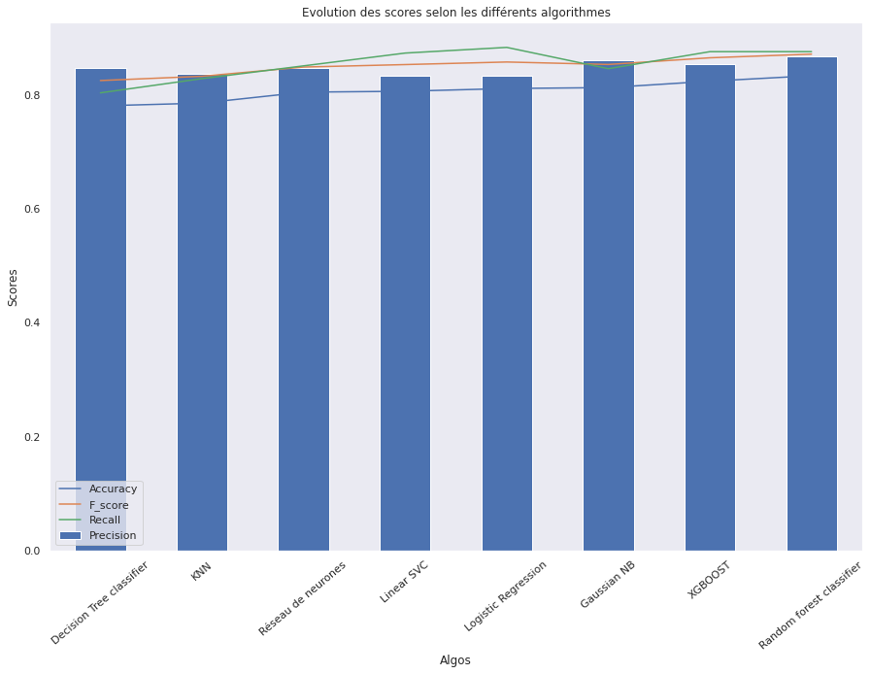
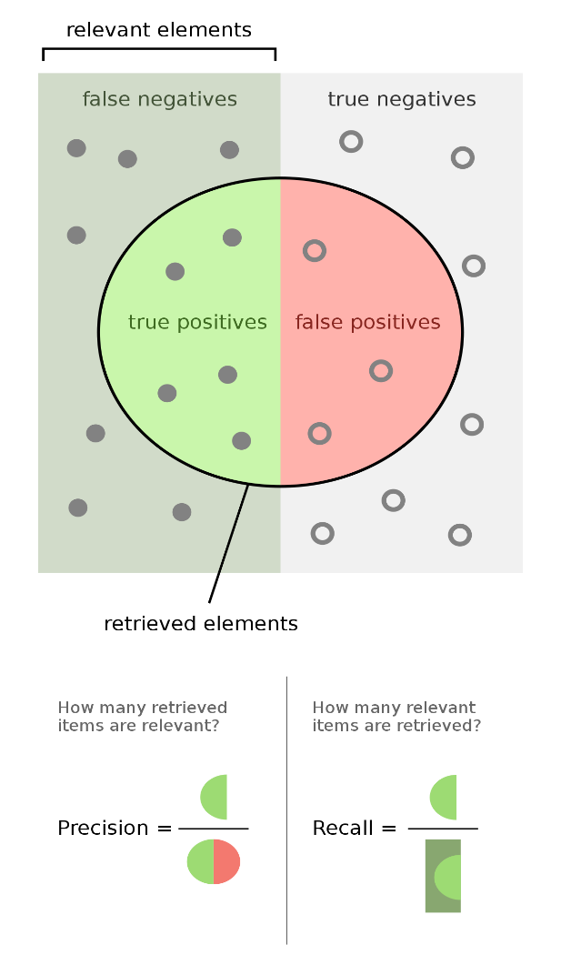
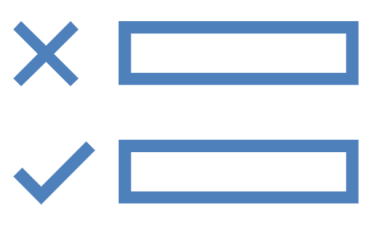
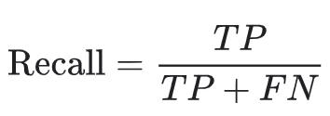

Which ones are the best model ?
What metrics did we used ?
The goal of our predictions is to predict if someone is going to be a drug user or not, so we want to reduce the False positive rates. Therefore we want to maximize our recall in attempts to answer to the following question What proportion of actual positives was identified correctly?
We will also keep an eye on the other metrics such as the accuracy, the precision and in extension the f1-score (wich is the report between recall and precision)
XGBOOST
Logistic Regression
Neural network
12

