Slide 1
TempTracker

Slide 2
Agenda
Greetings (name, school year, program, and project title)
Explain what the project does and how it works
Demo data and project details
Language and tools to build the project
How the implementation changed along the way
Describe the outcomes of the research completion
Technical challenges faced
Biggest success and disappointment in this project
Would you do anything differently and why
Close by thanking the audience

Slide 3
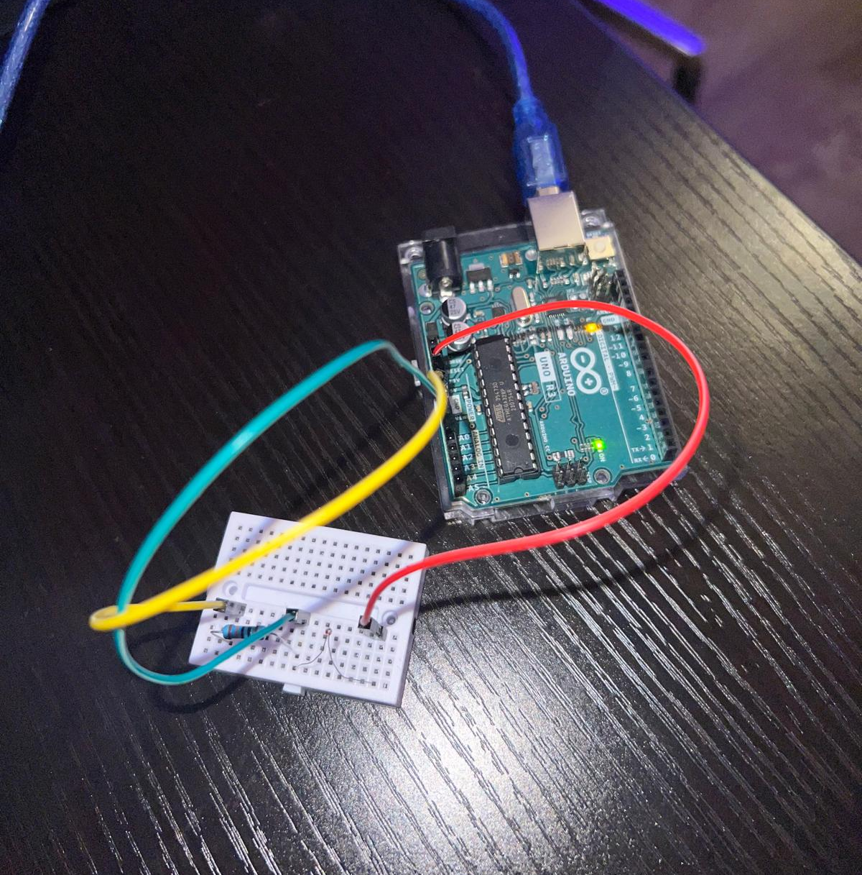
Hello everyone, my name is Heloiza Camargo and I’m in my last year of school. I’m enrolled in the Computing Technology and Software Development program and the project I’m showing today is titled TempTracker.

Slide 4
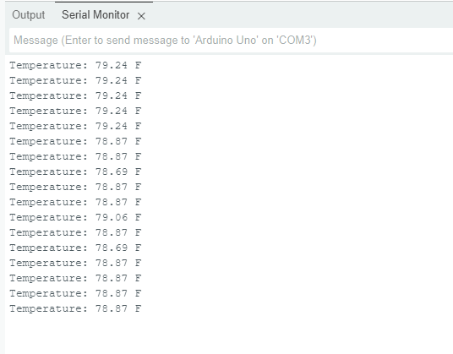
As the name suggests, I built a temperature tracker that would show my room’s temperature on my computer. The reason why I decided to do the temperature tracker is because I’m also enrolled in the Software Development Project class, and for that class, we need to create a web application for the school to track the temperatures of rooms and machines so that the school complies with Second Harvest Food Bank and the food donated to them.
As you can see, my temperatures are displayed in my Arduino IDE Serial Monitor every 5 seconds. If I decide to touch my sensor, it should change my temperature.

Slide 5
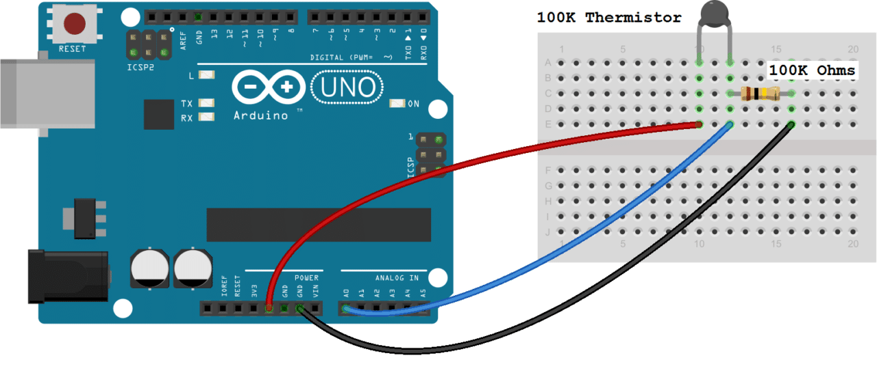
A 100K ohm thermistor temperature sensor, a 100K ohm resistor, a mini breadboard with male-to-male wires, and an Arduino UNO board with a USB cable were all the materials needed for this project.
After that, I connected my tools like this:

Slide 6
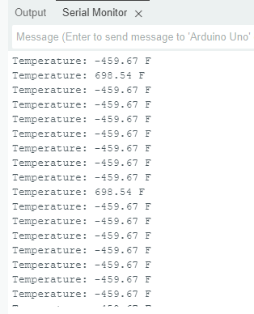
Lastly, I had to download the Arduino’s IDE, and to output my data, I wrote my code in Arduino’s programming language which is a variant of the C++ programming language.
I did some research before deciding on this project, so I haven’t had any changes in implementation along the way. The research was very helpful in finding all the tools and information necessary to build this project. The only challenge I had was when I was getting incorrect data results because I bought the wrong sensor and because my code wasn’t correct.

Slide 7

I can conclude this presentation by saying that the project was an overall success with no disappointments. I wouldn’t do anything different besides possibly adding an LCD to show my data for convenience purposes. Thank you for watching!

