Slide 1
If you think you can do it You Can!!!
If you think you cannot do it you cannot!!!

Slide 2
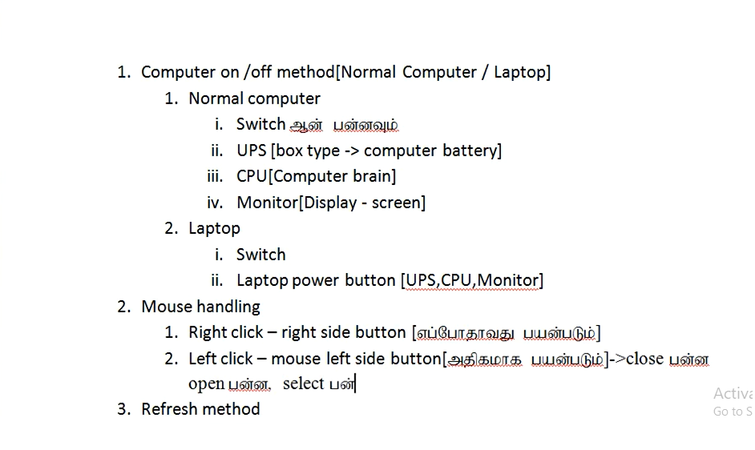
Ms office [Basics]

Slide 3
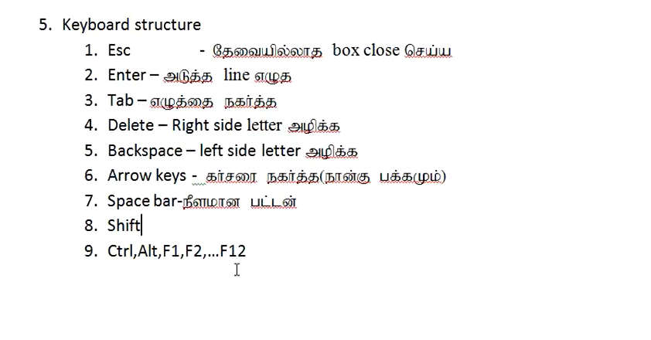
Ms office [Basics]

Slide 4
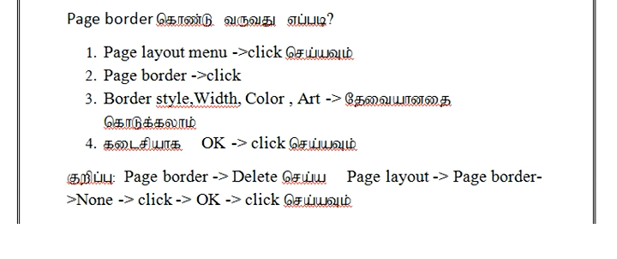
Ms office [Basics]

Slide 5
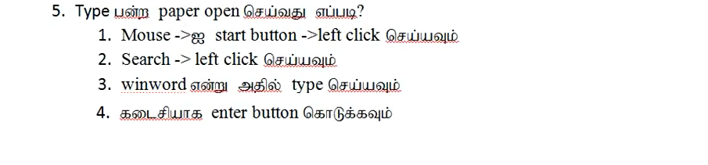
Ms office [Basics]

Slide 6
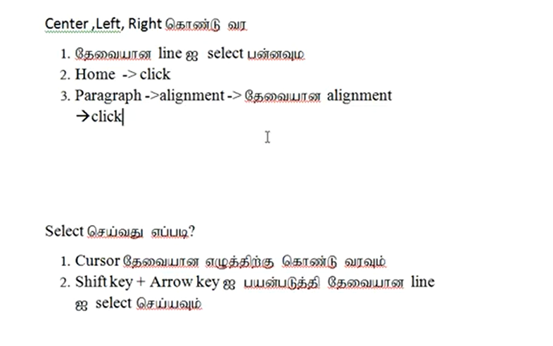
Ms office [Basics]

Slide 7
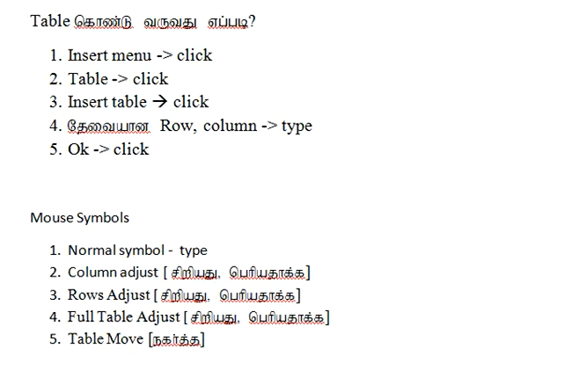
Ms office [Basics]

Slide 8
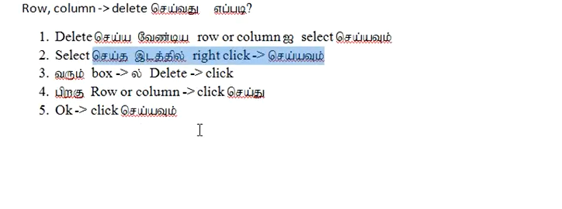
Ms office [Basics]

Slide 9
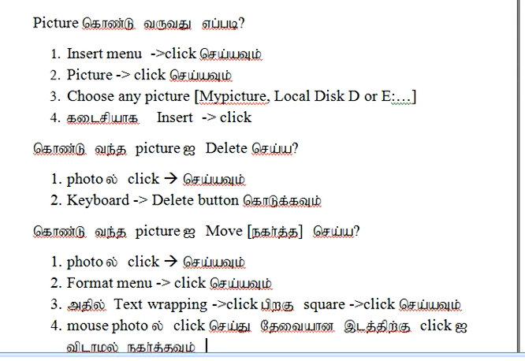
Ms office [Basics]

Slide 10
Ms office [Basics]

Slide 11
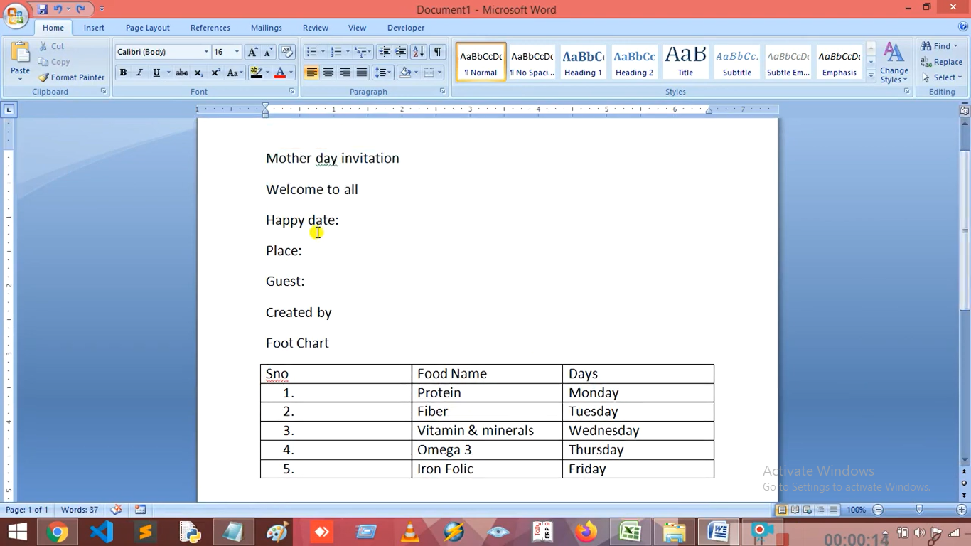
Ms office [Basics]

Slide 12
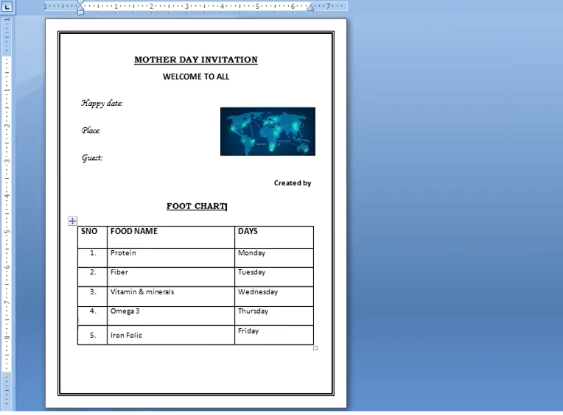
Ms office [Basics]

Slide 13
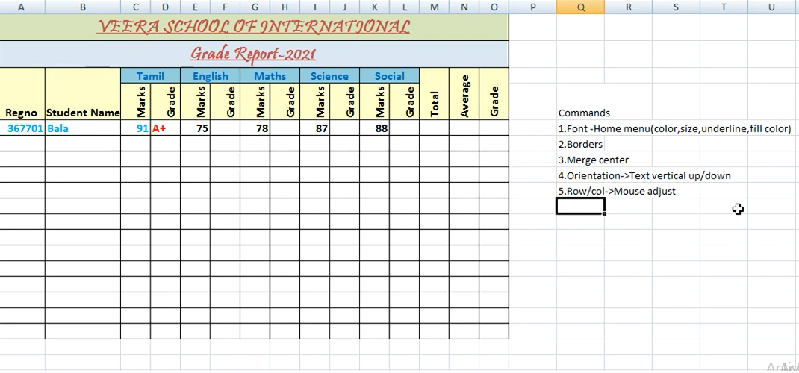
Ms office [Basics]

Slide 14
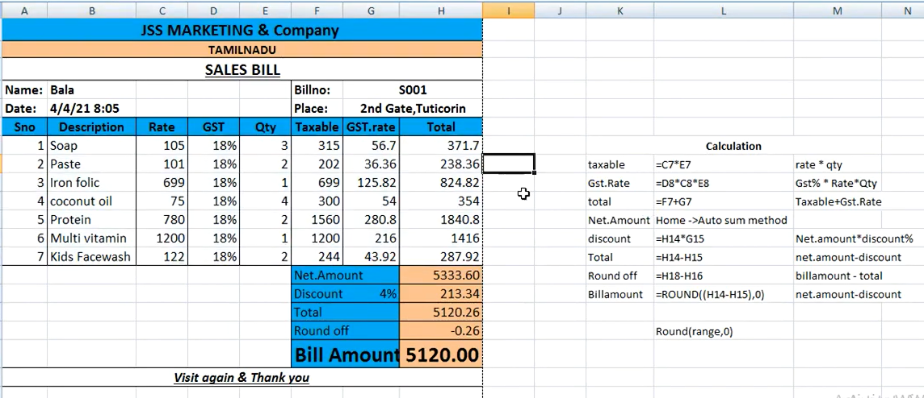
Ms office [Basics]

Slide 15
Computer Rate
Hard Disk – size, type
Ram
Processor
Monitor size
Graphical Card
My computer
Right click
Properties
Configuration verify
My computer
Open
Hard disk size verify

Slide 16
Software Structure & Troubleshoot
Title bar
Software Name
Menu bar
Home, insert,delete
Tool bar
Short cut
icons[commands]
Working area
Main page,typing page
Status bar
Working are status
Task bar
Time, start button
Installed or not - verify
Start ->search
Run →command
Appwiz.cpl
Local disk :C->open
Desk top
Note:
Double click [wait]
Proper save
Proper close / Refresh
OS update – off verify

Slide 17
Hardware Structure & trouble shoot
Internal Device
Mother board
Ram
Hard disk
BIOS
External Device
Input
Mouse, keyboard,scanner
Output
Monitor, speaker,printer
CMOS Battery
Time Issue
HDD failure
OS Problems
RAM, Processor, Board
Multi tasking
Proper Shutdown
Virus, anti virus[Proper updates]

Slide 18
Software Installation
Windows
MS office
Photoshop
Tally
C/C++/Java
Sublime,
Visual code
Linux
Basic Commands
Official Link
Verify EXE format
Check software installed
Software Update Off
Windows
Linux
Refer Documentation
Notes
Shortcut keys

Slide 19
OS Update[Windows/Linux]
Windows
Start
Windows update
Turn on / off
Linux
sudo apt-get update
sudo apt-get upgrade

Slide 20
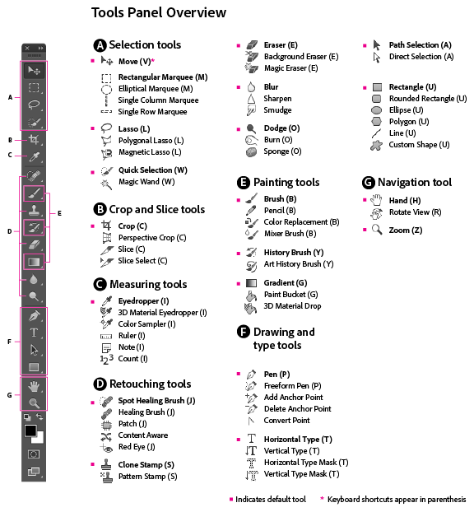
Photoshop Tools
Selection tool
Lasso tool
Magic wand
Polygonal
Rectangular Marquee
Crop tool
Text tool
Navigation Tool
Zoom, normal

Slide 21
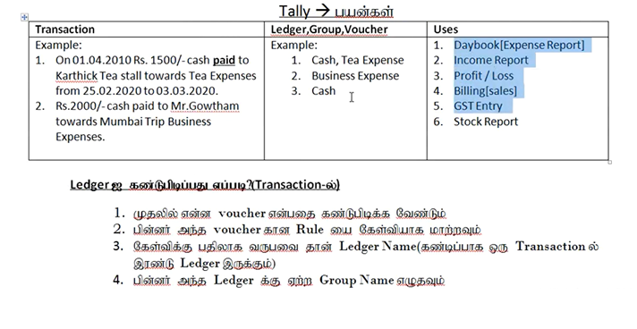
Accounts Rule[Tally]

Slide 22
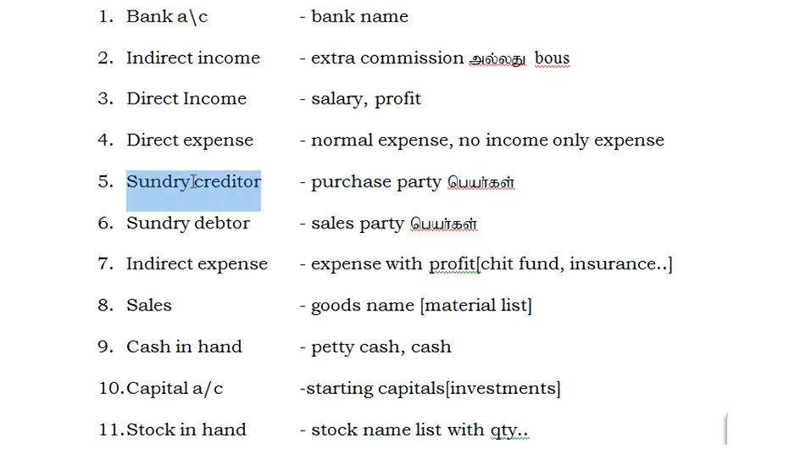
Accounts Rule[Tally]

Slide 23
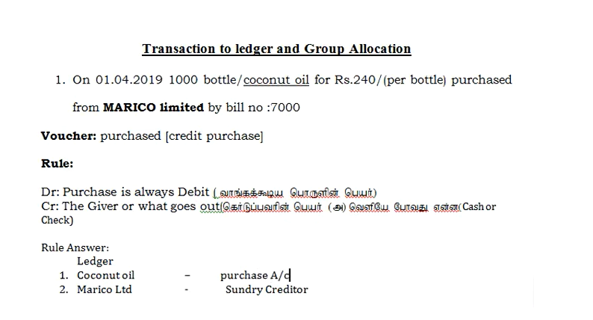
Accounts Rule[Tally]

