Slide 1
Augmented Reality
Prepared by: Khyati Ganatra
(12CE082)
1

Slide 2
Topics discussed
Augmented Reality Augmented Reality System How it Works
Display techniques AR vs VR Technology
Applications & Examples
γ
γ
γ
γ
γ
γ
γ
Feb 4, Spring 2002
CS 7497
2

Slide 3
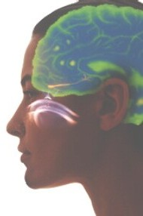
What is Augmented Reality?
A combination of a real scene viewed by a user and a virtual scene generated by a computer that augments the scene with additional information.
γ

Slide 4
γ
An AR system adds virtual computer- generated objects, audio and other sense enhancements to a real-world enviornment in real time.

Slide 5
What is the Goal of AR?
γ
To enhance a person’s performance and perception of the world
γ
But, what is the ultimate goal????

Slide 6
The Ultimate Goal of AR
γ
Create a system such that a user CANNOT tell the difference between the real world and the virtual augmentation of it.

Slide 7
Augmented Reality vs. Virtual Reality
Augmented Reality
Virtual Reality:
Totally immersive environment
Visual senses are under control of system (sometimes aural and proprioceptive senses too)
γ
System augments the real world scene
User maintains a sense of presence in real world
Needs a mechanism to combine virtual and real worlds
γ
γ
γ
γ

Slide 8
Miligram’s Reality- Virtuality Continuum
Mixed Reality (MR)
Real
Augmented Reality (AR)
Augmented Virtuality (AV)
Virtual
Environmen t
Environment
Miligram coined the term “Augmented Virtuality” to identify systems which are mostly synthetic with some real world imagery added such as texture mapping video onto virtual objects.

Slide 9
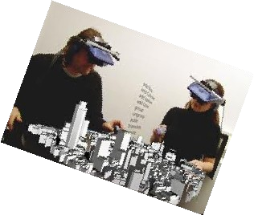
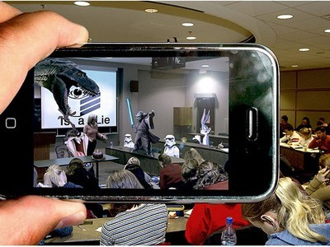
This is how AR works
γ
γ
γ
γ
Pick A Real World Scene Add your Virtual Objects in it. Delete Real World Objects
Not Virtual Reality since Environment Real.

Slide 10
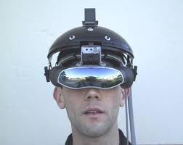
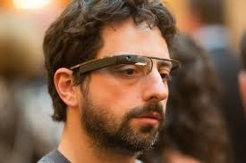
DISPLAY
γ
Head-mounted Display(HMD)
– device paired
to a headset such as a
harness or helmet
γ
Eye Glasses
– eye wear that employs
cameras to intercept the real world view and re-display it's augmented view through the eye pieces

Slide 11
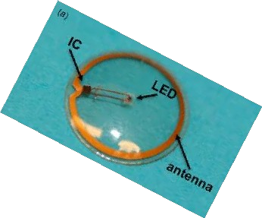
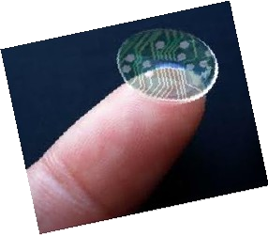
DISPLAY(cont..)
γ
Contact Lenses
– Contain the elements for display embedded into the lens including integrated circuitry, LEDs and an
antenna for wireless communication.
Under development
Virtual Retina Display
a personal display device under development .
a display is scanned directly onto the retina of a viewer's eye.
γ
11

Slide 12
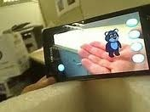
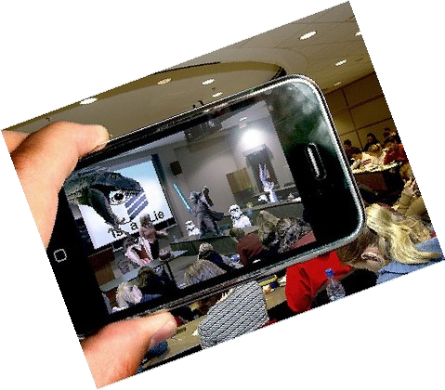
DISPLAY(cont..)
Handheld
γ
γ
γ
γ
γ
a small display that fits in a user's hand. Portable
Ubiquitous
Physical constraints of the user having to hold the device Distorting effect
♦
Spatial
γ
makes use of digital projectors to display graphical information.
user is not required to carry equipment or wear the display over their eyes.
can be used by multiple people at the same time without each having to wear a head-mounted display.
γ
γ

Slide 13
Display Technologies
Monitor Based
Head Mounted Displays:
Video see-through
Optical see-through
γ
γ

Slide 14
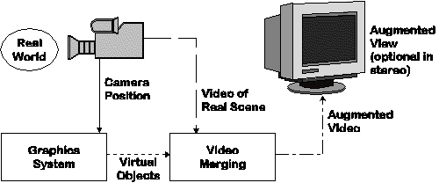
Monitor Based Augmented Reality
Simplest available
Little feeling of being immersed in environment
γ
γ

Slide 15
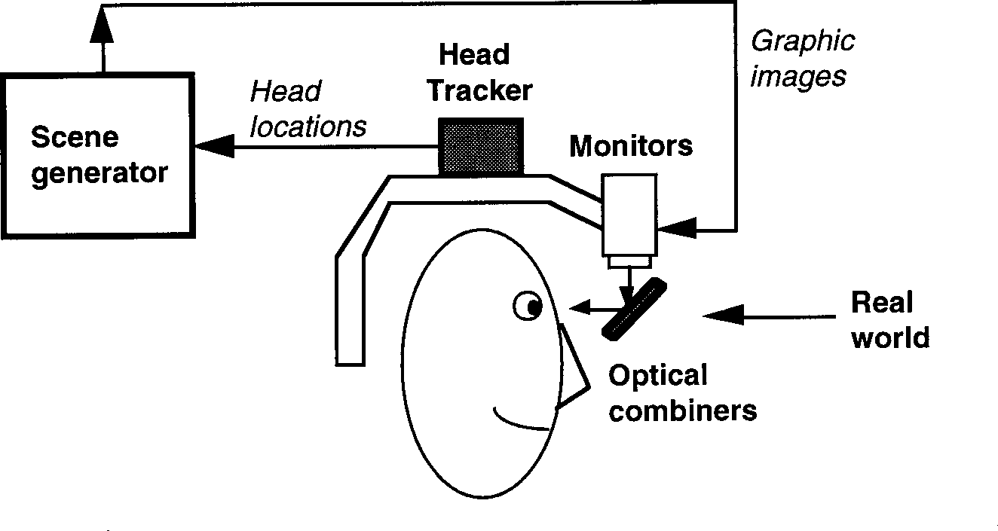
Optical see-through HMD

Slide 16
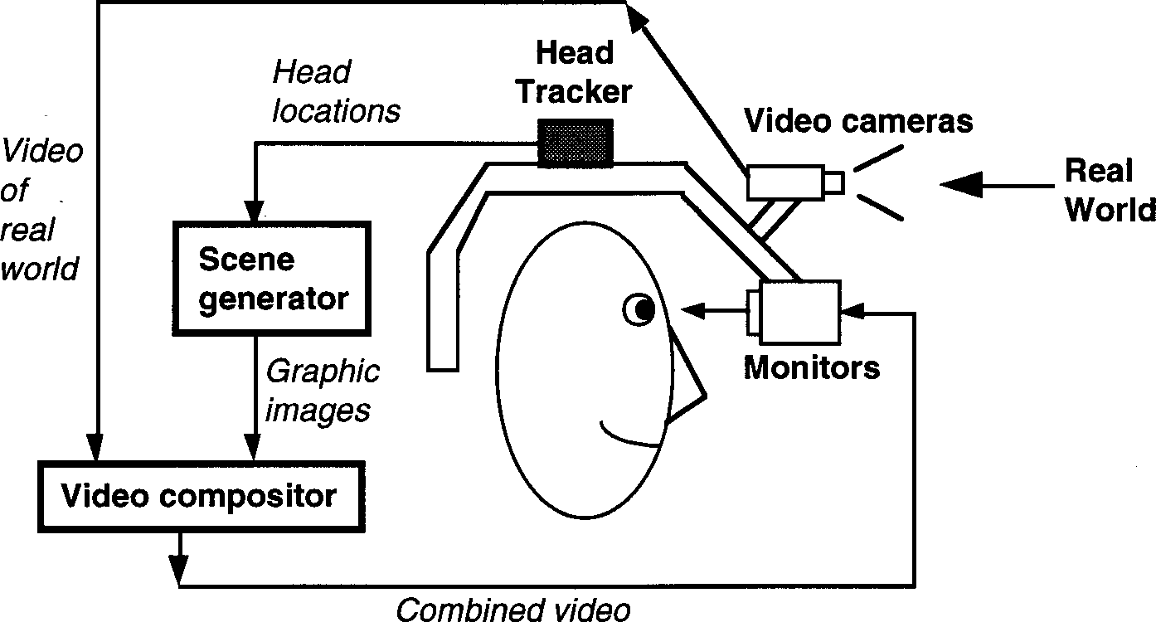
Video see-through HMD
Feb 4, Spring 2002 CS 7497 16

Slide 17
Video Composition
for Video see-through HMD
γ
Chroma-keying
Used for special effects
Background of computer graphics images is set to a specific color
Combining step replaces all colored areas with corresponding parts from video
Depth Information
Combine real and virtual images by a pixel- by-pixel depth comparison
γ

Slide 18
Advantages of
Video see-through HMD
Flexibility in composition strategies Wide field of view
Real and virtual view delays can be matched
γ
γ
γ

Slide 19
Advantages of
Optical see-through HMD
Simplicity Resolution No eye offset
γ
γ
γ

Slide 20
Applications
Medical Entertainment Military Training
Engineering Design
Robotics and Telerobotics
Manufacturing, Maintenance, and Repair
Consumer Design Hazard Detection Audio
γ
γ
γ
γ
γ
γ
γ
γ
γ

Slide 21
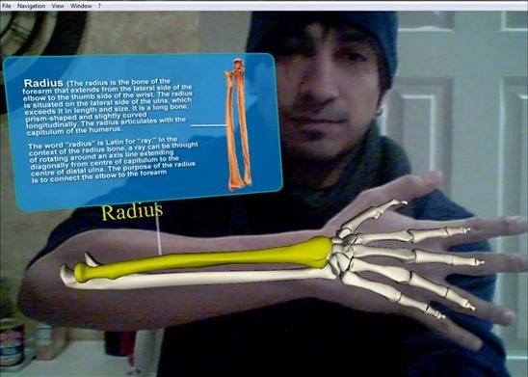
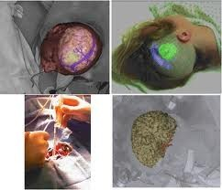
Medical

Slide 22

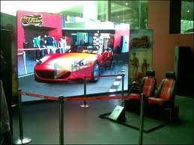
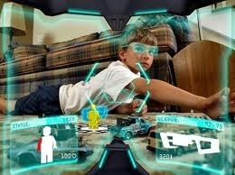
Entertainment

Slide 23
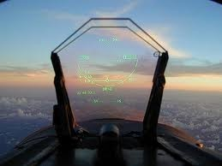
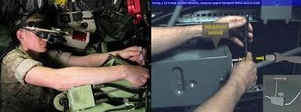
Defence

Slide 24
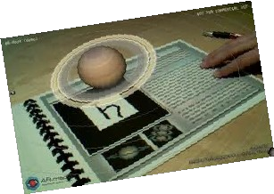
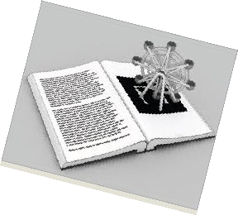
Education

Slide 25

THANK YOU

