Slide 1


Samuel Aubertin

Slide 2


Summary
– Design overview
– RDDs
– Spark MapReduce
– Spark SQL
– Examples

Slide 3

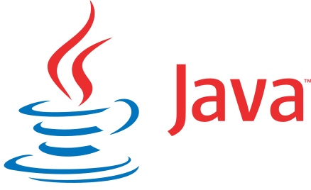

Spark?
A big data cluster-computing framework written in Scala
Open Sourced originally in AMPLab at UC Berkley
Highly compatible with Hadoop Storage API
  → Can run on top of an Hadoop cluster
Developers can write programs using multiple programming languages

Slide 4
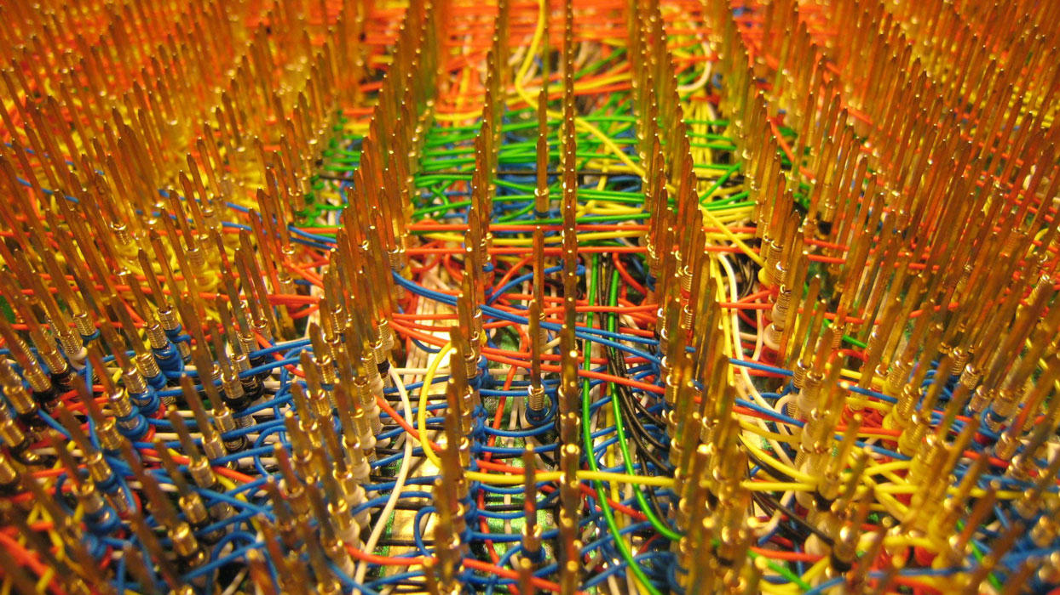


Slide 5
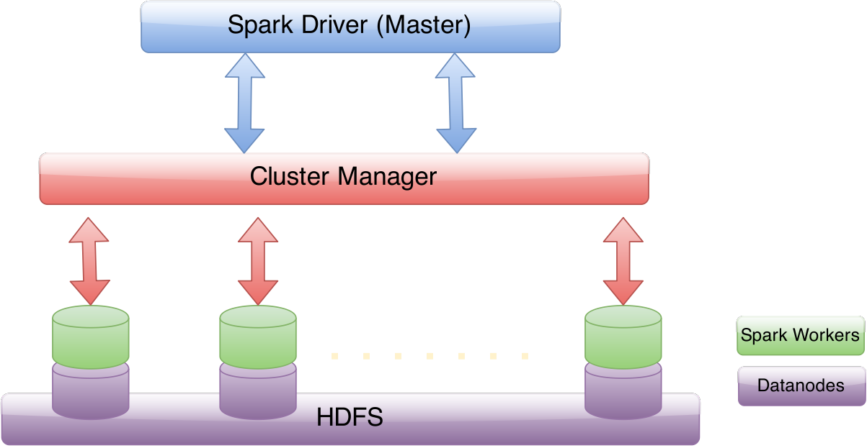
Spark – Architecture

Slide 6
Spark – Motivations
Hadoop limitations
  MapReduce is slow due to replication, serialization and disk I/O
  Inefficient for iterative algorithms and interactive data mining
We want more complex and fast apps!
Efficient primitives are needed for data sharing: DRAM

Slide 7
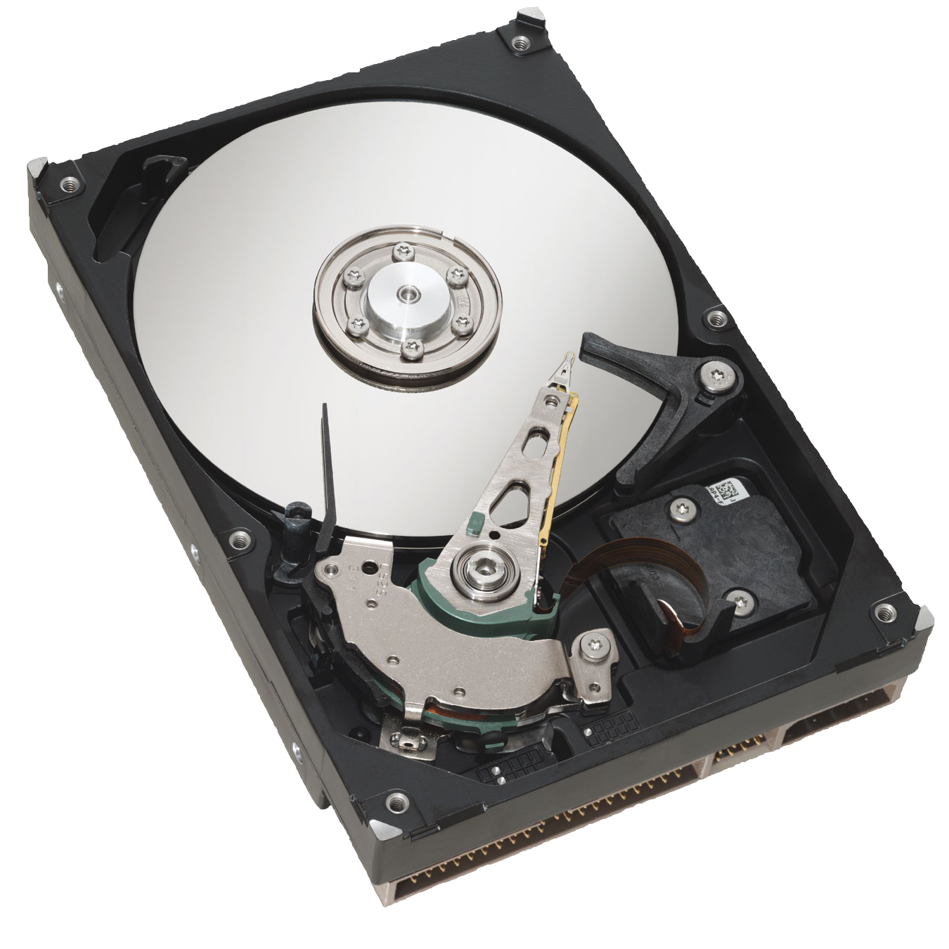
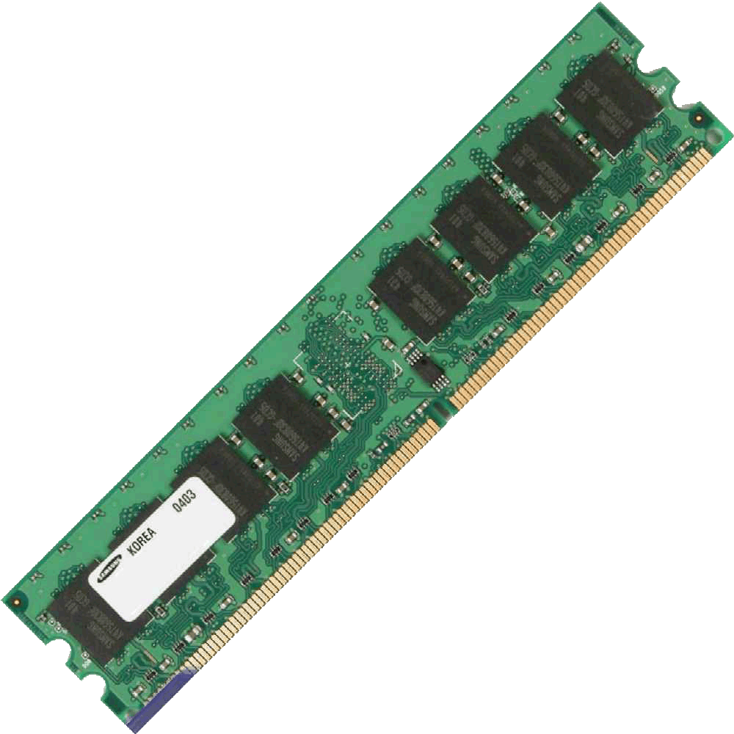
Spark – DRAM VS HDD
DRAM i/o = nanoseconds (10⁻⁹ s)
HDD i/o = milliseconds (10⁻³ s)
<
x10⁶

Slide 8
Grace Hopper on nanoseconds

Slide 9
OR Nanoseconds ?
What a billion looks like?
Speed of light ≈ 3 x 10⁸ m/s
1 nanosecond (10⁻⁹ s) ≈ 30 cm
1 millisecond (10⁻³) ≈ ?
300 km !
So you better get your nanoseconds !

Slide 10
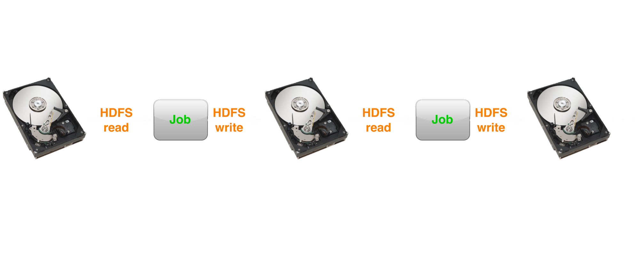
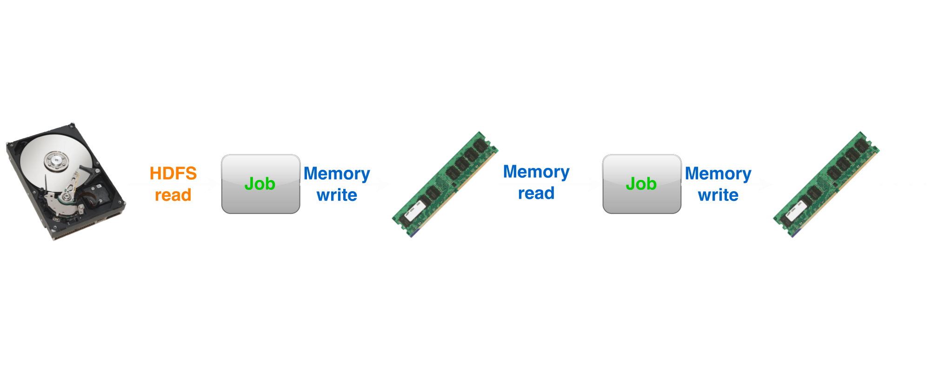
Spark – Data motion
Hadoop MapReduce
Spark

Slide 11
Spark – DRAM storage
10-100x FASTER
than disk

Slide 12
Spark – Cool... but how?
Challenge
  How to design a distributed memory abstraction that is both fault-tolerant and efficient?
Solution
  Resilient Distributed Datasets
  (aka RDDs)

Slide 13

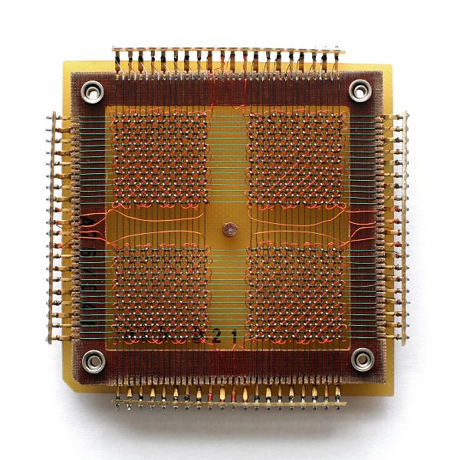
  Resilient Distributed
  Datasets

Slide 14
Spark – RDDs definition
Restricted form of distributed shared memory
  Immutable, partitioned collection of records
  Can only be built through coarse-grained deterministic transformations (map, filter, join, ...)
Transformation

Slide 15


Spark – RDDs error handling
Efficient fault recovery using lineage
  Track the graph of transformations that build themselves
  Recompute lost partition on failure
  No cost if nothing fails

Slide 16
Spark – Programming Interface
Programmer can perform 3 types of operations
  Transformations: Create a new dataset from and existing one. Lazy in nature. They are executed only when some action is performed.
    Map(), Filter(), Distinct()
  Actions: Returns to the driver program a value or exports data to a storage system after performing a computation.
    Count(), Reduce(), Collect(), Take()
  Persistence: For caching datasets in-memory for future operations. Options to store on disk or RAM or mixed (Storage Level).
    Persist(), Cache()

Slide 17
Spark – RDDs methods
Transformations (define a new RDD) | map – filter – sample groupByKey – reduceByKey sortByKey – flatMap – union join – cogroup – cross mapValues
Actions (return a result) | collect – reduce – count save – lookUpKey

Slide 18

Spark – RDD laziness
Laziness
  Since RDDs track every transformations applied to themselves
  No need to compute anything until an action wants a result!
So we just compute what we need

Slide 19
Spark – RDD Persistence
One of the most important capabilities in Spark is persisting (or caching) a dataset in memory across operations
Caching is a key tool for iterative algorithms and fast interactive use
You can mark an RDD to be persisted using the persist() or cache() methods on it
The first time it is computed in an action, it will be kept in memory on the nodes.
  → Fault-tolerant !

Slide 20
Spark – RDD Persistence
In addition, each persisted RDD can be stored using a different storage level
  On disk
  In memory
  Replicated or not across nodes
  Off-heap in Tachyon
Spark also automatically persists some intermediate data in shuffle operations (e.g. reduceByKey), even without users calling persist

Slide 21
Spark – Shared Variables
Normally when functions are executed on a remote node it works on immutable copies
However, Sparks does provide two types of shared variables for two usages:
  Broadcast variables
  Accumulators

Slide 22
Spark - Broadcast Variables
Broadcast variables allow the programmer to keep a read-only variable cached on each machine rather than shipping a copy of it with tasks.
val broadcastVar = sc.broadcast(Array(1, 2, 3))
broadcastVar.value()
→ res0: Array[Int] = Array(1, 2, 3)

Slide 23
Spark - Accumulators
Accumulators are variables that are only “added” to through an associative operation and can therefore be efficiently supported in parallel
Spark natively supports accumulators of numeric types, and programmers can add support for new types
val accum = sc.accumulator(0, "My Accumulator")
sc.parallelize(Array(1, 2, 3, 4))
.foreach(x => accum += x)
accum.value()
→ res7: Int = 10

Slide 24
Spark – RDDs abstraction
RDDs express many parallel algorithms
→ Simply applies the same operation to many items
Unify many programming models
  Data Flow models: MapReduce, SQL, …
  Specialized models for iterative apps: Graph processing, iterative MapReduce, bulk incremental, …
Support new apps that these models don't!

Slide 25
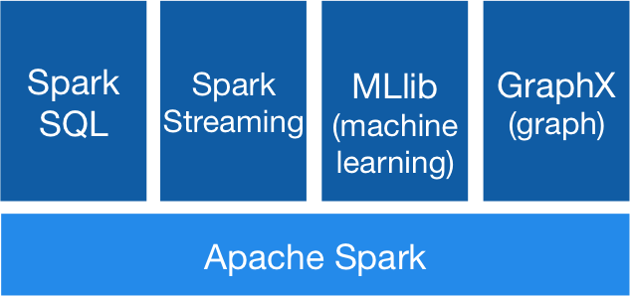
Spark – New applications

Slide 26
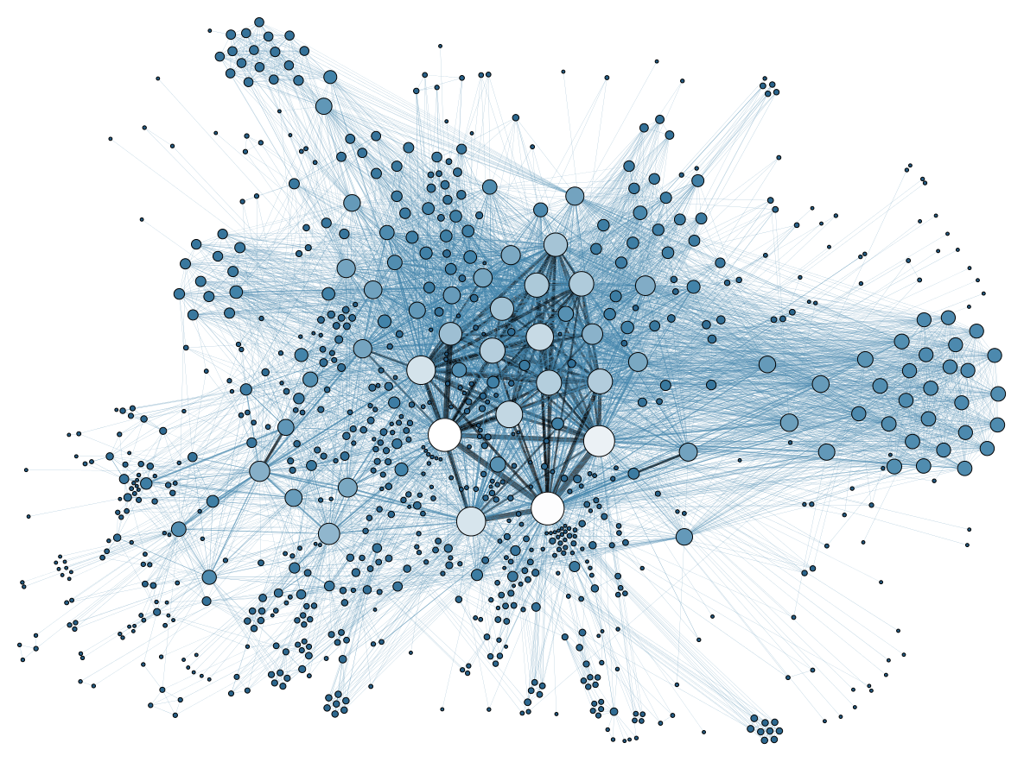
Spark MapReduce
5
MapReduce with Spark

Slide 27
Spark – Mapreduce
User create RDDs, transform them, and run actions on them
This results in a DAG (Directed Acyclic Graph) of operators
DAG is compiled into stages
Each stage is executed as a series of Task
(one Task for each Partition)

Slide 28

Spark – MapReduce Example
sc.textFile(“access.log”) RDD[String]

Slide 29
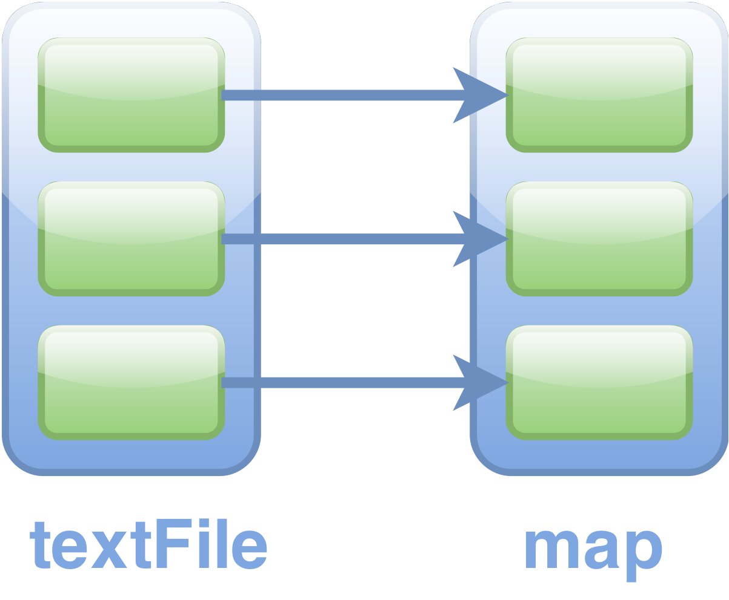
Spark – MapReduce Example
sc.textFile(“access.log”) RDD[String]
.map( line => line.split(“\t”) ) RDD[List[String]]

Slide 30
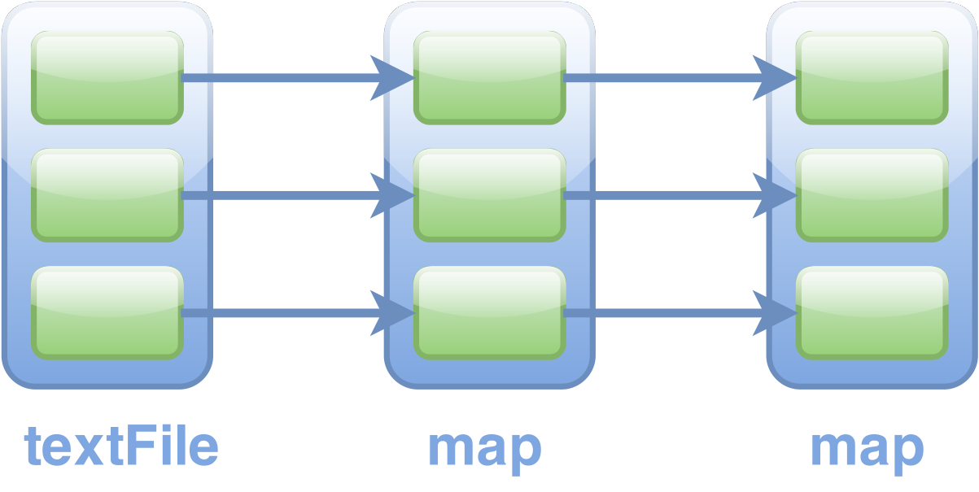
Spark – MapReduce Example
sc.textFile(“access.log”) RDD[String]
.map( line => line.split(“\t”) ) RDD[List[String]]
.map( R => (R[0], int(R[1])) ) RDD[String, Int]

Slide 31
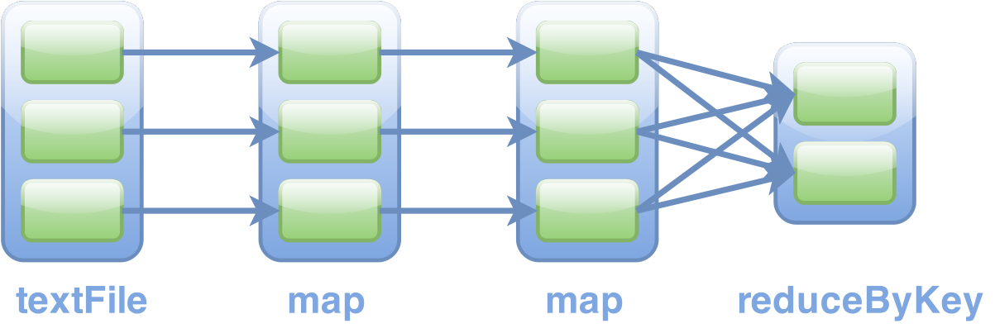
Spark – MapReduce Example
sc.textFile(“access.log”) RDD[String]
.map( line => line.split(“\t”) ) RDD[List[String]]
.map( R => (R[0], int(R[1])) ) RDD[String, Int]
.reduceByKey( _+_, 3 ) RDD[String, Int]

Slide 32
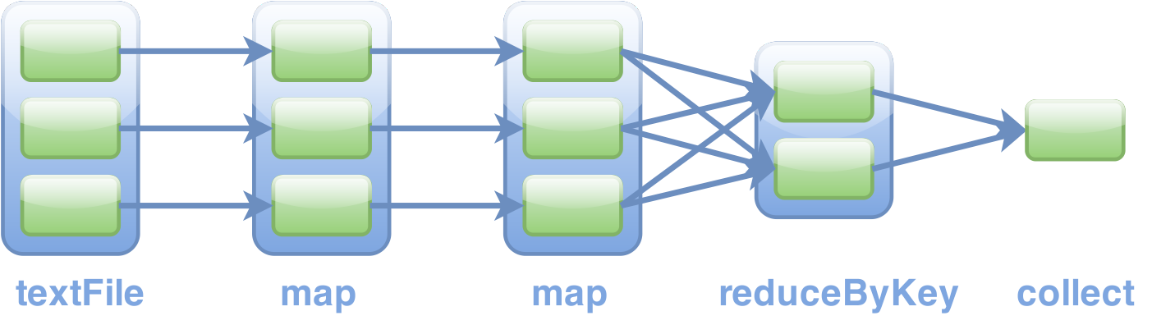
Spark – MapReduce Example
sc.textFile(“access.log”) RDD[String]
.map( line => line.split(“\t”) ) RDD[List[String]]
.map( R => (R[0], int(R[1])) ) RDD[String, Int]
.reduceByKey( _+_, 3 ) RDD[String, Int]
.collect() Array[(String, Int)]

Slide 33
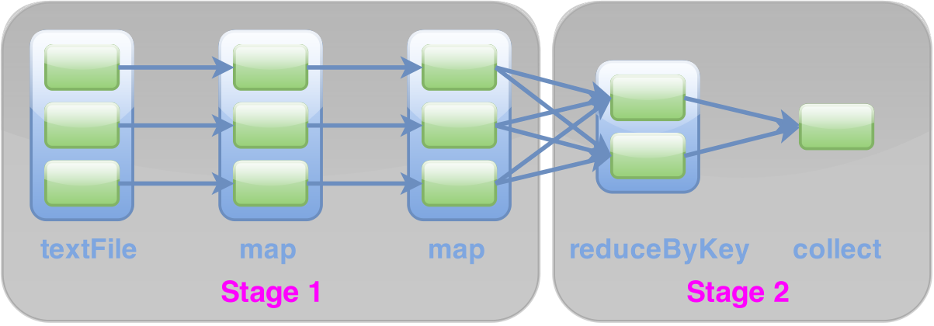
Spark – MapReduce Execution
Stages are sequences of RDDs, that don’t have a MapReduce Shuffle in between !

Slide 34
Spark - Summary of Components
Task
  The fundamental unit of execution in Spark
Stage
  Set of Tasks that run parallel
DAG
  Logical Graph of RDD operations
RDD
  Parallel dataset with partitions

Slide 35
Spark – MapReduce Tests
Setup
  3 x (1CPU x64 @ 2.5GHz, 2GB RAM) VMs with CentOS 7
  Hadoop 2.6.0, Spark 1.3.1, OpenJDK 1.8
Datasets
  shakespeare.txt
    5,4 MB, 124 787 lines, 904 061 words
  shakespeare_N.txt
    shakespeare.txt * N

Slide 36
Spark – Tests Methodology
Run “WordCount“ in Java, Hadoop and Spark on the same dataset
Collect
  From app submitting to prompt return duration = appTime
Compare
  appTime between Java, Hadoop and Spark

Slide 37
Java VS Hadoop VS Spark

Slide 38
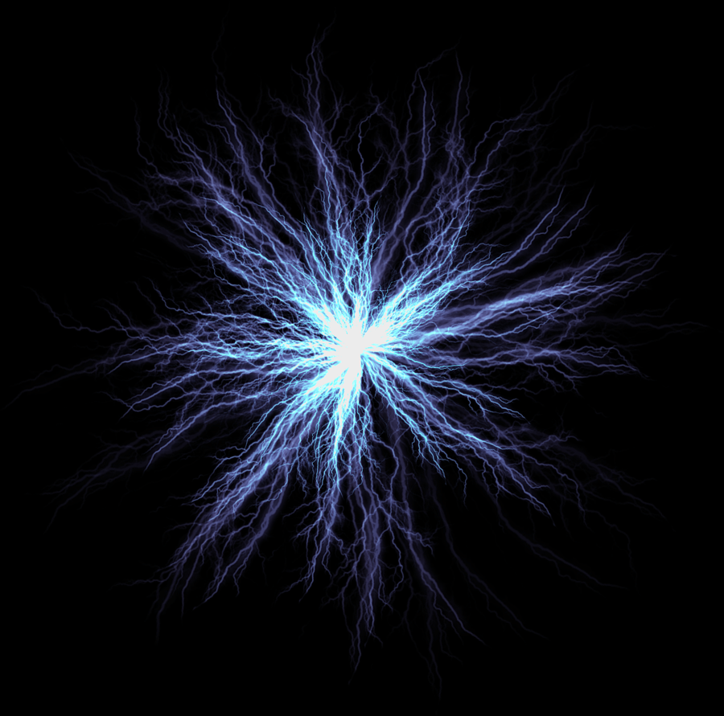
Java VS Hadoop VS Spark
Hadoop is always slower than Java !
Hadoop and Spark overhead on small files is comprehensible
  Clustering induces delay on small jobs
For files > 100MB, Spark is always the fastest

Slide 39

Spark SQL

Slide 40
Spark - DataFrames
A DataFrame is a distributed collection of data organized into named columns
Conceptually equivalent to a table in a relational database but with richer optimizations under the hood
DataFrames can be constructed from a wide array of sources such as:
  Structured data files, Hive tables, external databases or existing RDDs.

Slide 41

Spark – MySQL in spark-shell
Using the MySQL JDBC driver is easy :
  [hadoop@hspoc-m ~]$ ./spark-shell-mysql.sh
→ Interactive Spark shell with MySQL integration !

Slide 42
Spark – MySQL to DataFrames
Let's connect to MySQL, load a table and save it to HDFS :
  val user = "hadoop"
  val pass = "yol0mysql"
  val mysqlurl = "jdbc:mysql://10.0.10.1:3306/help?user=" +
  user + "&password=" + pass
  val logDF = sqlContext.load("jdbc", Map(
  "url" -> mysqlurl,
  "dbtable" -> "mdl_log",
  "driver" -> "com.mysql.jdbc.Driver"))
  logDF.saveAsParquetFile("help.log")

Slide 43

Live Examples

Slide 44
Spark – SQL Query
val sqlResult = logDF
.filter(logDF("time") >= 1404070000)
.filter(logDF("time") <= 1404150000)
.join(courseDF, logDF("course") === courseDF("id"))
.join(coursecatDF, courseDF("category") === coursecatDF("id"))
.select(logDF("time"), courseDF("fullname"))
sqlResult.map(t => "Time : " + t(0) + " Course : " + t(1))
.collect().foreach(println)

Slide 45
Spark – PageRank Analytics
val graph = GraphLoader.edgeListFile(sc, "graphx/data/followers.txt")
val ranks = graph.pageRank(0.0001).vertices
val users = sc.textFile("graphx/data/users.txt").map { line =>
val fields = line.split(",")
(fields(0).toLong, fields(1))
}
val ranksByUsername = users.join(ranks).map {
case (id, (username, rank)) => (username, rank)
}
println(ranksByUsername.collect().mkString("\n"))

Slide 46
Thanks !
Any Questions ?
sk4nz@sk4nz.ninja
https://github.com/samuelaubertin/hspoc
https://twitter.com/sk4nz

Slide 47
Webography
Apache Spark documentation
https://spark.apache.org/docs/latest/
Resilient Distributed Datasets: A Fault-Tolerant Abstraction for
In-Memory Cluster Computing
Matei Zaharia - Mosharaf Chowdhury - Tathagata Das
Ankur Dave - Justin Ma - Murphy McCauley
Michael J. Franklin - Scott Shenker - Ion Stoica
https://www.cs.berkeley.edu/~matei/papers/2012/nsdi_spark.pdf

