Slide 1


MapReduce & Hadoop
Gilbert Ooi Sin Cheak
03 June 2015

Slide 2
Flashback
Parallel Processing
Distributed Systems

Slide 3


Glossaries
Master node
Worker node

Slide 4
What is MapReduce?
MapReduce is a programming framework and an associated implementation for processing and generating large data sets.
Jeffrey Dean and Sanjay Ghemawat, Google

Slide 5

What is MapReduce?
This framework allows processing of data or a search of query / topic across several HUGE databases in lightning speed and providing summary in the form of table of contents
MapReduce is easy to implement as it has combination of two methods
Map method
Reduce Method

Slide 6
Map Method
Master node delegates problem by dividing it into sub-problems to worker nodes for processing
If worker nodes could not manage the problems, they too repeat step a.
Worker nodes then filter, sort and map keys to values
Return the processed mapped values back to master node

Slide 7
Reduce Method
Master node collects the processed mapped values and perform summary functions like sum, max or min
Master node then provides the answer(s) which are relevant to user’s requests

Slide 8

Who Pioneered MapReduce?
The research team in

Slide 9


Who Pioneered MapReduce?
Jeffrey Dean
Sanjay Ghemawat
MapReduce: Simplified Data Processing on Large Clusters
Publication appeared in
OSDI'04: Sixth Symposium on Operating System Design and Implementation, San Francisco, CA, December, 2004.

Slide 10

Trivia

Slide 11


The Bean Problem
Mommy gives you a huge bag of mixed of 5 different colours of beans (8,000 beans)
Mommy tells you that since you have nothing to do, divide and count all the beans by colour
Mommy tells you this at 4pm and wants this done by 6pm
Mommy will decide to cook bean soup based on the highest count of beans by colour

Slide 12
The Bean Problem
Option 1
Start dividing and counting
Option 2
Call your 10 friends and delegate the task and tell them they can have bean soup after completing the task

Slide 13
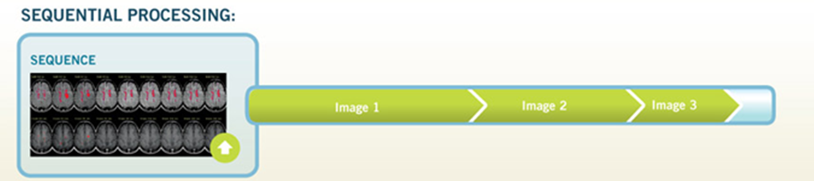
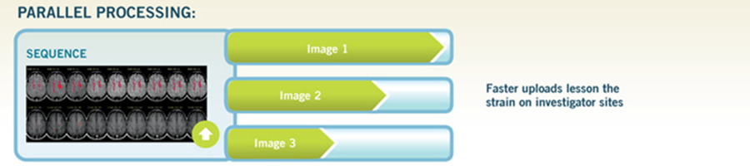
Flashback

Slide 14
The Bean Problem
 | Option 1 | Option 2
Method | Sequential processing | Parallel processing
Completion time | 5 – 6 hours | 45 minutes
Chances of having bean soup | low | very high

Slide 15
The Bean Problem – MapReduce Method
Defining several parameters
Parameter | Parameter Value
Input | 8,000 beans
Problem | Divide and count beans by colour and answer which colour beans count is the highest
Master Node | You
Worker Nodes / Distributed System | 10 friends
Key | 5 colours (red, green, black, brown, yellow)
Values | Bean count by colour in form of [1, ..]
Answer | Summary of all bean counts by colour

Slide 16
The Bean Problem – MapReduce Method
input
split
map (colour, cnt)
map
reduce (colour)
max
8000 beans
800
3200
800
800
[1, ..]
1500
800
[1, ..]
800
[1, ..]
250
3200
800
[1, ..]
800
[1, ..]
1130
800
1920
800
800

Slide 17
The Bean Problem – MapReduce Method
That’s what FRIENDs are for!

Slide 18
We have the method, what now?
Implement it and manage it!

Slide 19
Data Everywhere
“Every two days now we create as much information as we did from the dawn of civilization up until 2003”
Eric Schmidt
then CEO of Google
Aug 4, 2010
Notes:
Read this quote. That data is something like 4 exabytes.

Slide 20




Data Everywhere
Notes:
User-generated content

Slide 21

Data Everywhere
Notes:
Traditional retailers are creating this data too

Slide 22

Data Everywhere
Notes:
And government has troves of data too

Slide 23
What is Hadoop?
Apache Hadoop (High-availability distributed object-oriented platform) is an open-source software framework that supports data-intensive distributed applications. It supports the running of applications on large clusters of commodity hardware.
http://en.wikipedia.org/wiki/Apache_Hadoop

Slide 24

Who Created Hadoop?
Douglass Read Cutting
Worked on Hadoop project since 2005

Slide 25

Hadoop the Logo

Slide 26
How Hadoop Works?
Hadoop was developed with the MapReduce method
Hadoop is essentially a manager of table of contents containing processed data (Map) in each data storages clusters
When data is requested, relevant data from the table of contents will be extracted for summary (Reduce) and summarised results are presented

Slide 27


2 Kinds of Nodes
Master Nodes
Slave Nodes
Notes:
In the cluster there are two kinds of nodes….

Slide 28
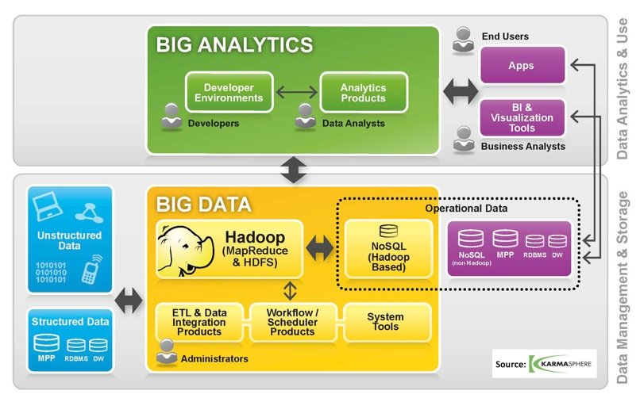
How Hadoop Works?

Slide 29
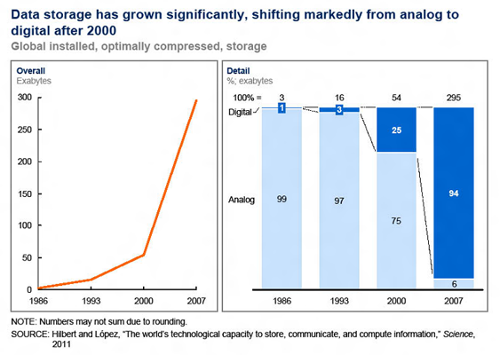
Data Storage and Input Mode

Slide 30
The Scenario
This is exactly what happens on the Internet, HUGE amount of data are being generated every second from:
Data entry
sales, reports, hotel and flight booking
User generated data
social media, mobile devices
Machine generated data
weather forecast, CCTV, web bots / crawlers

Slide 31
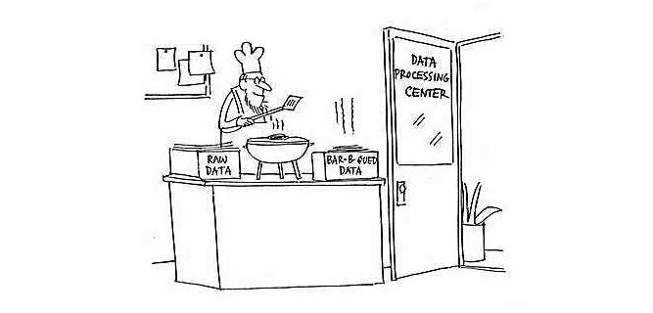
Where to Process Big Data?
Simple data processing center

Slide 32
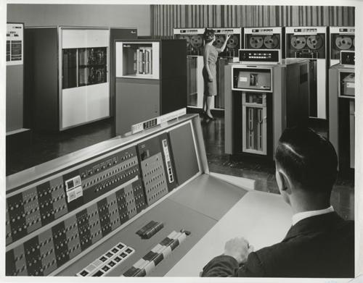
Where to Process Big Data?
Data processing center in 1960s

Slide 33

Where to Process Big Data?
Data processing center in 1970s and 1980s

Slide 34

Where to Process Big Data?
This is what heaven looks like
in the Cloud
Data processing center in 1990s and 2000s

Slide 35


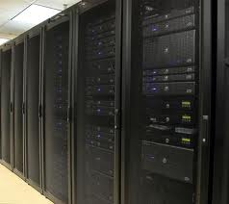

How to process Big Data FAST?

Slide 36
Thank you

