Slide 1


Cassandra Implementation
Nathan Poncelet

Slide 2
Summary
History
What is Cassandra ?
Why use Cassandra ?
How Cassandra works ?
Architecture
Cassandra Installation / features
Little introduction to CQL
Who use Cassandra ?
Example of Cassandra Implementations

Slide 3
History
Cassandra was initially developed by Facebook for their inbox search
Open-Source since 2008
Since march 2009, Cassandra has been supported by the largest Open-Source Consortium: i.e Apache
Based on Amazon and Google technologies

Slide 4
Flashback => CAP Theorem
C.A.P

Slide 5
Cap Theorem(explain)
CONSISTENCY
MongoDB
MySQL
PARTITION
TOLERANCE
AVAILABILITY
Cassandra

Slide 6
So what is Cassandra ?

Slide 7
What?
Cassandra is an Open-Source distributed database management system (hybrid)
Perfect for managing a large amounts of data
NSPOF
Failure Detection
Proven horizontal scalability
High availibility
Low latency, solid performance

Slide 8
Remember!
Partition
Tolerance
Availability
Cassandra

Slide 9
Now, Why use Cassandra?

Slide 10
Why?
GigaByte to PetaByte scalability (cf Dr choong)
Multi-data center and Cloud compliance
Data compression (like winrar)
CQL (similar to SQL)
Flexible schema design *feature/exampleofenterprise
Easy replication and data distribution

Slide 11
How Cassandra Works?

Slide 12
Architecture
Cassandra has a masterless architecture
Peer-to-peer distributed system (GOSSIP)
Data partitioning among the nodes in the cluster
Customizable data replication for fault tolerance

Slide 13
Cassandra
He know were the other
node are
Seed
node
Cluster
He know where
The seed node is
Simple
Node

Slide 14
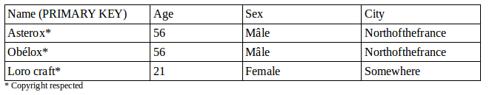
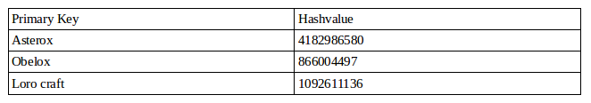
Data Partition
At first we have the following data:
Cassandra gives a hash for each Primary Key:

Slide 15
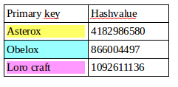
Data partitionned (2) change qualiy
N3
N2
N1

Slide 16
Cassandra Failure Detection
Cluster
Suddenly, this node
is down

Slide 17
GOSSIP Communications
Seed node contains
information about the other
nodes
Cluster

Slide 18
Database Schema
Keyspace(Example : Help CAT)
Column Family ( IT Department)
Row ( One students)
Column (name, age, gender)

Slide 19
Cassandra Coordinators
Client sends a request
to a node in the
cluster
Cluster
This node will be a
coordinator, it will send request
to the other nodes
Client
The node take the data
From the other node

Slide 20
Cassandra Write System
Write
Memtables
Memory
SStables
SStables
Disk
Commit log
SStables
SStables
Immutable

Slide 21
Now , It's time to see how to install
Cassandra

Slide 22
Cassandra installed on Linux (CentOS)
At the beginning you need Java:
Add the datastax repository (/etc/yum.repos.d/datastax.repo)
And now, you just have to install cassandra
Yum -y update ; yum -y install java
[datastax]
name = DataStax Repo for Apache Cassandra
baseurl = http://rpm.datastax.com/community
enabled = 1
gpgcheck = 0
Vim /etc/yum.repos.d/datastax.repo
Yum -y install dsc20-2.0.14 cassandra20-2.0.14

Slide 23
Cassandra configuration
Now edit cassandra.yaml
And add for these line :
vim /etc/cassandra/cassandra.yaml
cluster_name: 'Name that you want for your cluster'
- class_name: org.apache.cassandra.locator.SimpleSeedProvider
parameters:
# seeds is actually a comma-delimited list of addresses.
# Ex: "<ip1>,<ip2>,<ip3>"
- seeds: "ipadressofyourseednode"
listen_address: ipadressofthenode

Slide 24
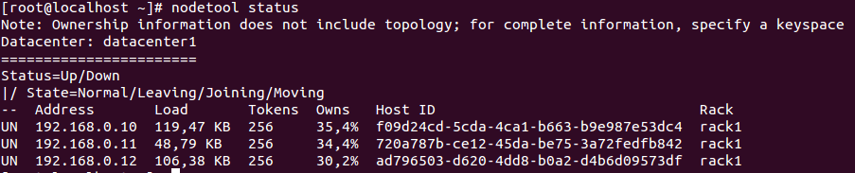
See if Cassandra work
For see if the cluster is working well we can do :
- nodetools status :
- Or we can install opscenter for see the cluster

Slide 25
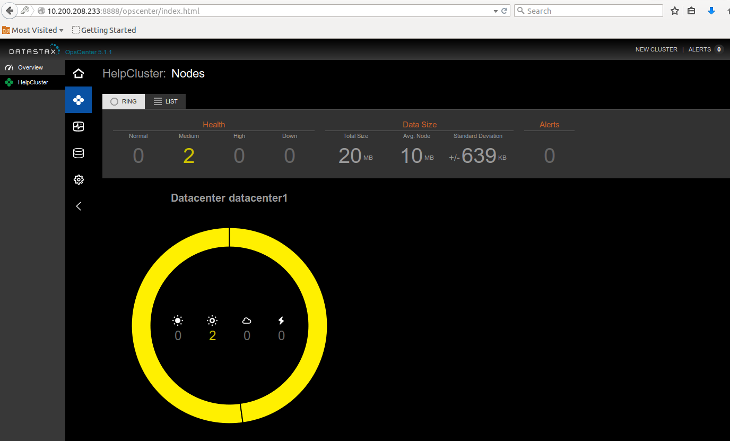

Slide 26
Cassandra Features
Cassandra propose many features for his cluster
Security (SSL)
Multi-Cluster system
Etc …

Slide 27
Introduction to Cassandra Query Language (CQL)

Slide 28
What is CQL
CQL is Cassandra Query Language
More extensible than Thrift API

Slide 29
CQL create a Keyspace
Replication factor , determine how
Many replication you want/need
At first we need to connect to our cluster
Now we create the Keyspace with the syntax :
After that we use this keyspace :
Determine the kind of Cluster you use,
SimpleStategy means one cluster
cqlsh
CREATE KEYSPACE thisisanexample
WITH REPLICATION = { 'class' : 'SimpleStrategy', 'replication_factor' : 3 };
USE thisisanexample

Slide 30
Create table
Now , we are in our keyspace « thisisanexample » let create a table :
For add some data in our Table we use this command :
CREATE TABLE example (
id int PRIMARY KEY,
Sometext text,
Somenumber int
) ;
INSERT INTO exampe (id, sometext, somenumber,somedata)
VALUES (01, 'text',23) ;

Slide 31

And now let's see it
SELECT * FROM example ;
As you can see this was a very little things , if you want to know more about CQL3 go to this link :
http://docs.datastax.com/en/cql/3.1/pdf/cql31.pdf

Slide 32
Insert data into Cassandra ( CSV)
At first we go into our Keyspace ;
If our table exist we do nothing
Else we Create it with the command see bellow
We do the command line :
Copy example ( id , sometext , somenumber) from 'example.csv ' ;

Slide 33
Insert data into Cassandra (SQL)
Create the Table into the keyspace
Be sure that the SQL file is the type : Insert Into aa ( a,b,c) Values (aa,bb,cc) ;
You need to modify a bit your sql files :
- replace ` with « »
-erase the CREATE TABLE on SQL
And use the command :
cqlsh -f « filename.sql » -h « keyspace »

Slide 34
Cassandra Advantage / Disadvantage
Advantage :
- Open-Source
  Schema free
  High Performance
Disadvantage :
  No JOIN query
  Need a = symbol for a WHERE query

Slide 35
Who Uses Cassandra?

Slide 36





Who Uses Cassandra?

Slide 37
Let see some example of
Cassandra implementations

Slide 38
Implementations of Cassandra
With netflix

Slide 39
Netflix (maj or not ? )
2 cases:
- « What I Watch » is what I like
-The « Shared Account » (family case )

Slide 40


Slide 41
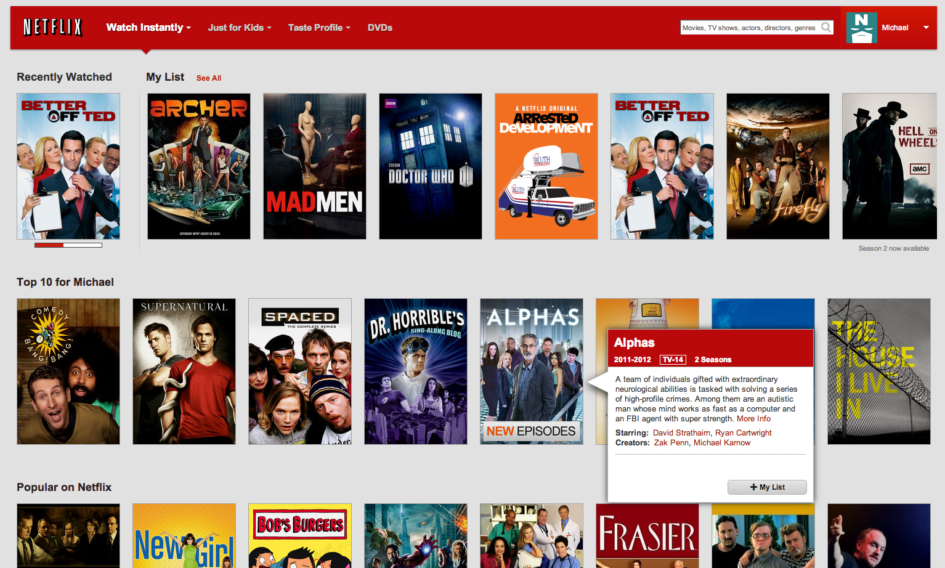

Slide 42
But how they do « What I Watch » is what I like ?
Netflix
Cassandra
Sessions
Watcher
Cassandra
Viewing history

Slide 43
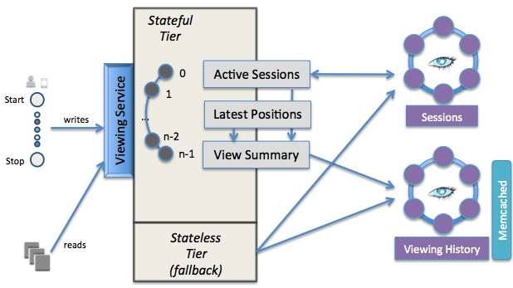
Netflix Architecture

Slide 44
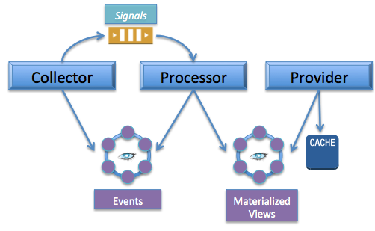
Trying to evolte to

Slide 45
My Work, a Simple Implementation

Slide 46
My Work Environment
1GB RAM ;
2-core ;
CentOS 7
512MB RAM ;
1-core ;
CentOS 7
Seeds
node
Simple
Node

Slide 47
SLIDE Environment
Take from lylian presentation

Slide 48
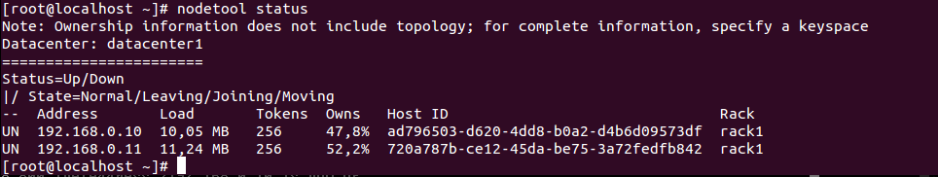
The beginning
At first I make sure that my cluster work :
After I load my database into my cluster ( in my case) :
I had the 3 data ( mdl_log ≈1GB , mdl_course≈50 MB , mdl_course_categories≈10MB)

Slide 49
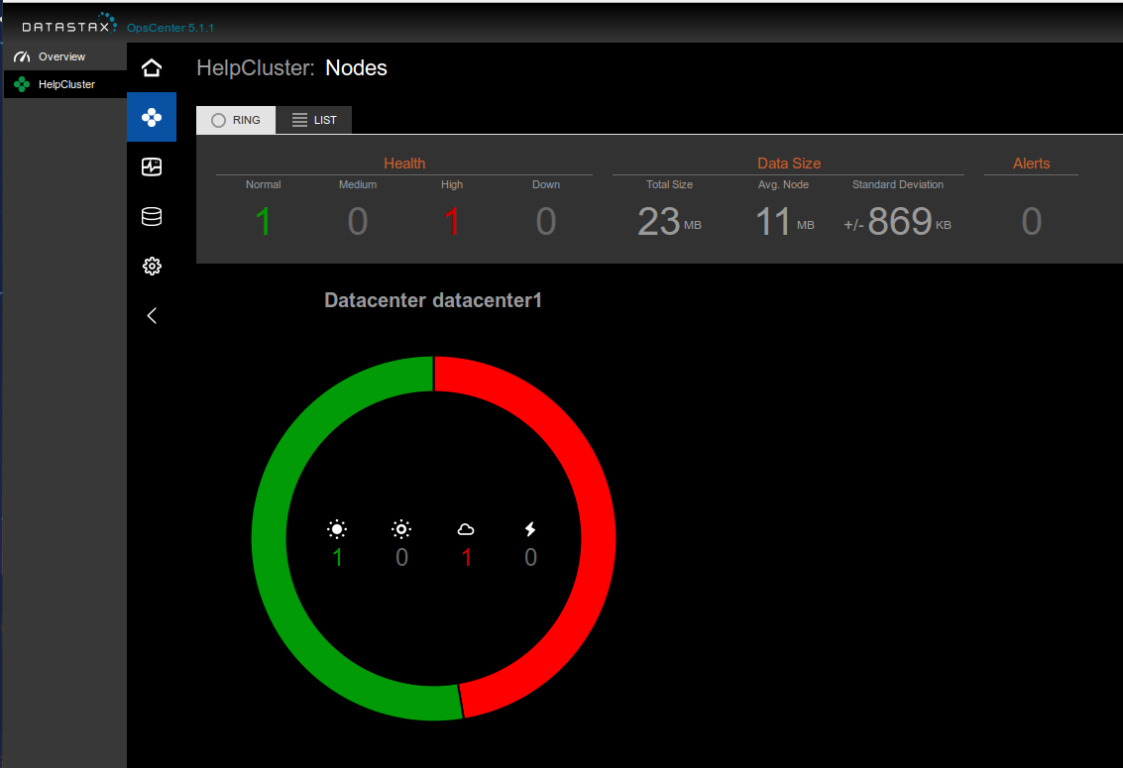

Slide 50
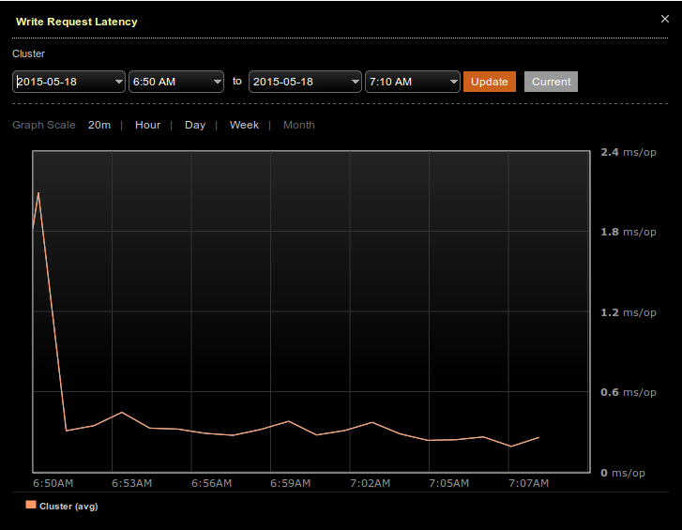
When I start to insert data
Into my cassandra cluster
Now we can see the
Write is separate
Between each node
So the Write Request
Are faster

Slide 51
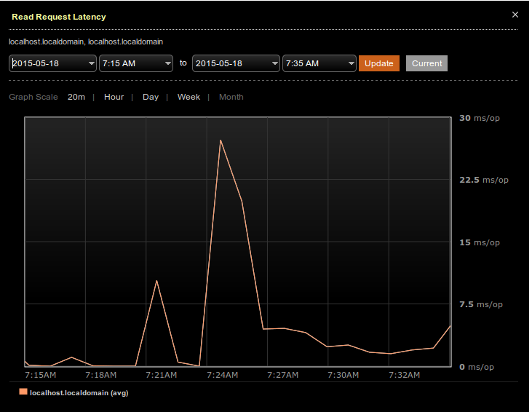

Slide 52
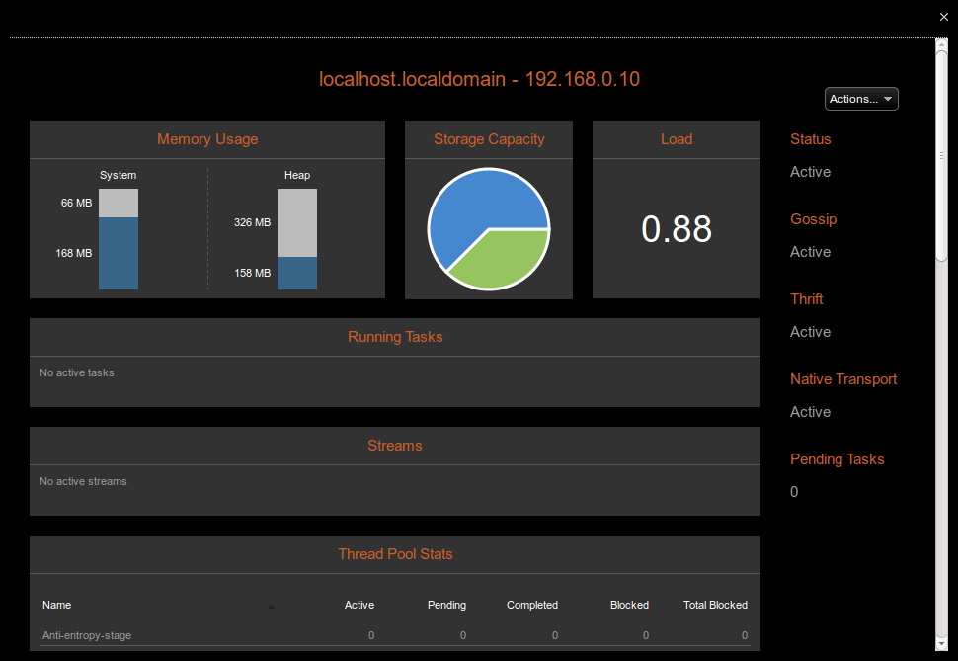

Slide 53
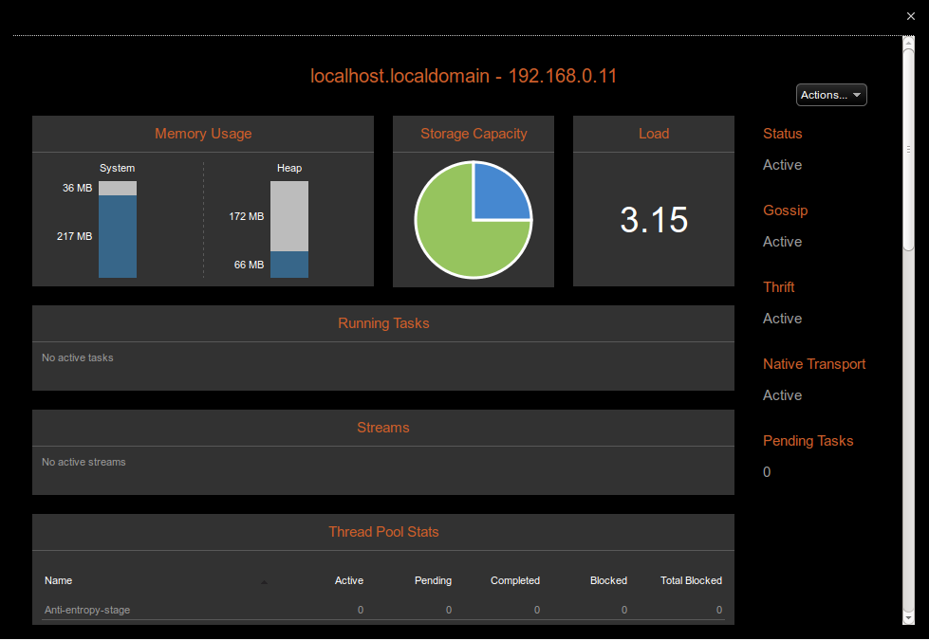

Slide 54
MySQL into Cassandra
Row | Time(s)
60154 | 210
18280 | 78
21492 | 145
4128 | 26
34851 | 156
33720 | 125
37403 | 158
11689 | 69
17174 | 74
19542 | 94
160000 | 240
38039,3636363636 | 125
304,3149090909 | 1
With Cassandra we have 3 row imported each ms with a cluster of two small node

Slide 55
Glossary
CAP
GOSSIP = Whispers between each nodes
Seed nodes

Slide 56
Thank you , any question ?

