Slide 1

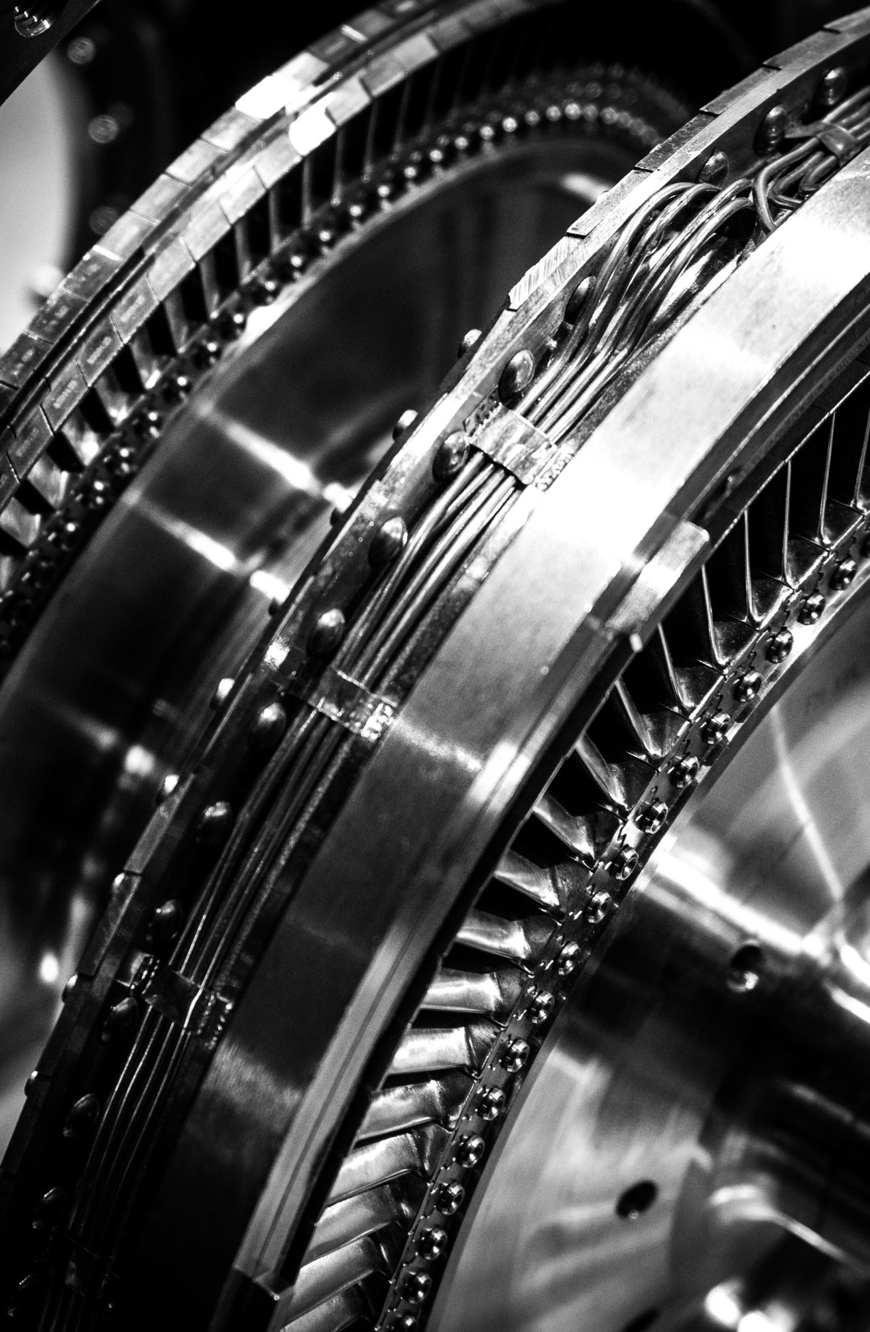
Style and Mechanics
Presented By:
Tulasa Pandit
Kushum Subedi
BBA 3rd sem

Slide 2
Content
Style
Features
Technical definition, Terminologies or Jargons
Mechanics
Punctuation
Abbreviations
Capital Letters
Numbers
Spelling

Slide 3
Style
It refers to guidelines for ensuring clear consistent communication and presentation in written work.
Style is not about what is “correct” or “incorrect’’.
Style can be categorized into three groups: attributes, technical definitions and mechanics.
Features
Clarity
Conciseness
correctness

Slide 4
Clarity
To be clear, a text must be readable
Use simple words, phrases and sentences.
Anticipate readers’ questions and answer them.
Provide specifics.
Avoid awkward constructions
Be cohesive
Be coherent

Slide 5
Conciseness
A concise tightly written text is brief and at the same time complete.
we can also used (KISS Techniques) keep it short & simple.
Avoids repeating words and phrases that readers already know.

Slide 6
Correctness
The quality or state of being free from errors, accuracy.
We must be proper and appropriate to our readers.
Communication must be correct in ( Grammar, mechanics, voice, tone, figures.
Tips on correctness
follow a guidelines
Be objective
Know the subject-matter
Avoid stereotyping

Slide 7
Technical Definitions, Terminologies or Jargons
Avoid difficult words
Use simple terms so, that the reader don’t have to use dictionary to find the meanings.

Slide 8
Mechanics
It refers a rules about punctuations, abbreviations, capitalizations, numbers, spellings, etc.
Punctuations
It is used in writing to separate sentences and their elements and to clarify meaning.(full stop, comma, brackets, question marks and so on.)

Slide 9
Abbreviations
It is a shortened form of a written word or phrase.
Used for save space, time, to avoid repetition of long words or phrases.
Capitalization
The action of writing or printing in capital letters.
For eg: She is beautiful.

Slide 10
Number
Write out 1 to 9: one, two, … nine
Punctuate number: start last 3 digits(300,000) for number comprising four digits or more
Spelling
Sometime errors are possible when writing words that sound alike. Some example: Accept/except, affect/effect, advice/advise so on.

Slide 11
Thank You Any Queries?

