Slide 1
HACKSPRINT NYC · 2026
AegisCode
Autonomous Incident Commander — multi-agent, self-healing cloud ops
Hossam Elshahaby
Daytona · Arize AI · ElevenLabs · Anchor Browser · AWS Sandbox

Slide 2
02 · THE PROBLEM
Outages are slow, costly and risky to fix
3 a.m. pages
$ every minute
Rushed = unsafe
On-call engineers triage noisy alerts by hand, hunting root causes across dashboards.
Downtime burns revenue and trust while the mean time to repair stretches into hours.
Hot-fixes under pressure ship wildcard IAM, leaked secrets and untested changes.

Slide 3
03 · SOLUTION & FEATURES
Four agents. One safe pipeline.
Sentinel
AWS + Arize
Commander
ElevenLabs
Reads CloudWatch telemetry, ranks root-cause hypotheses with confidence.
Chooses the safest reversible fix, explains rejected options, briefs on-call by voice.
Developer
Daytona + Anchor
Validator
Arize guardrails
Writes the patch in an isolated sandbox, runs tests, verifies staging UI.
LLM review + deterministic rules veto wildcard IAM, secrets, destructive ops.
+ Human approval gate before every production deploy · full decision trace

Slide 4
04 · IMPACT
Minutes, not hours — safely
Minutes
100%
Zero
Human
to diagnose, patch and verify vs. hours of manual triage
of agent decisions traced and explainable
unvalidated changes reach production
always in control: approve or reject
Real-world use: SaaS checkout, e-commerce, fintech and public services keep running while
small teams sleep — AI does the toil, guardrails keep it safe, people keep the final say.

Slide 5
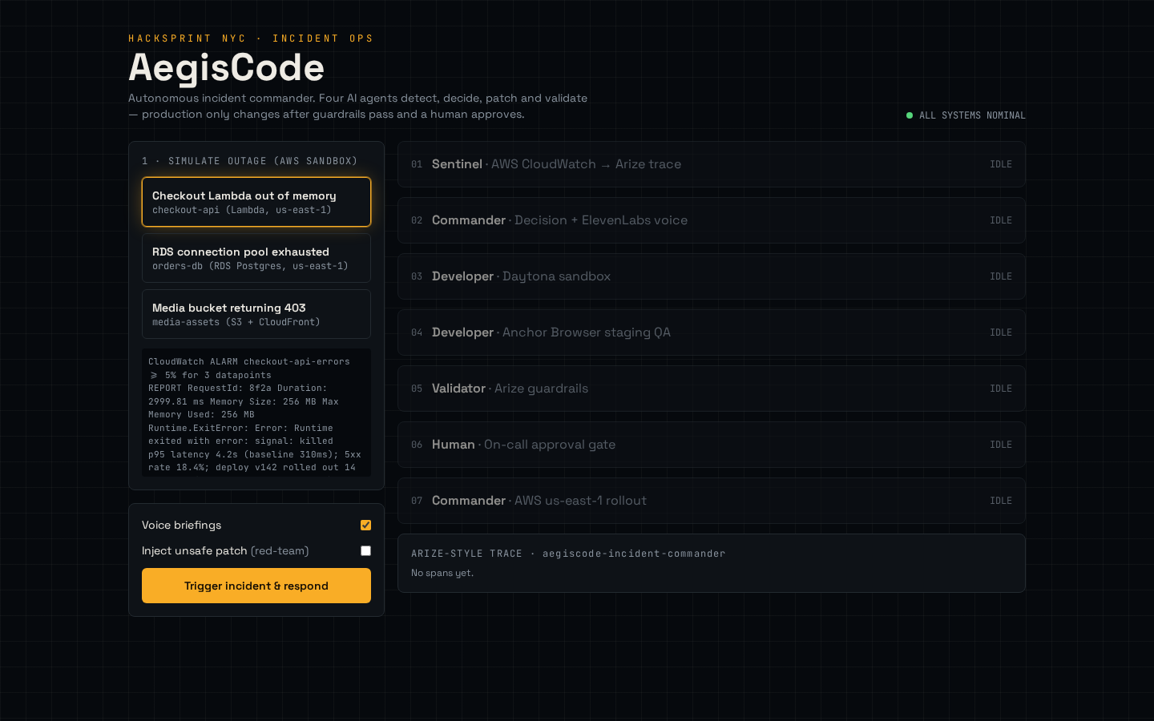
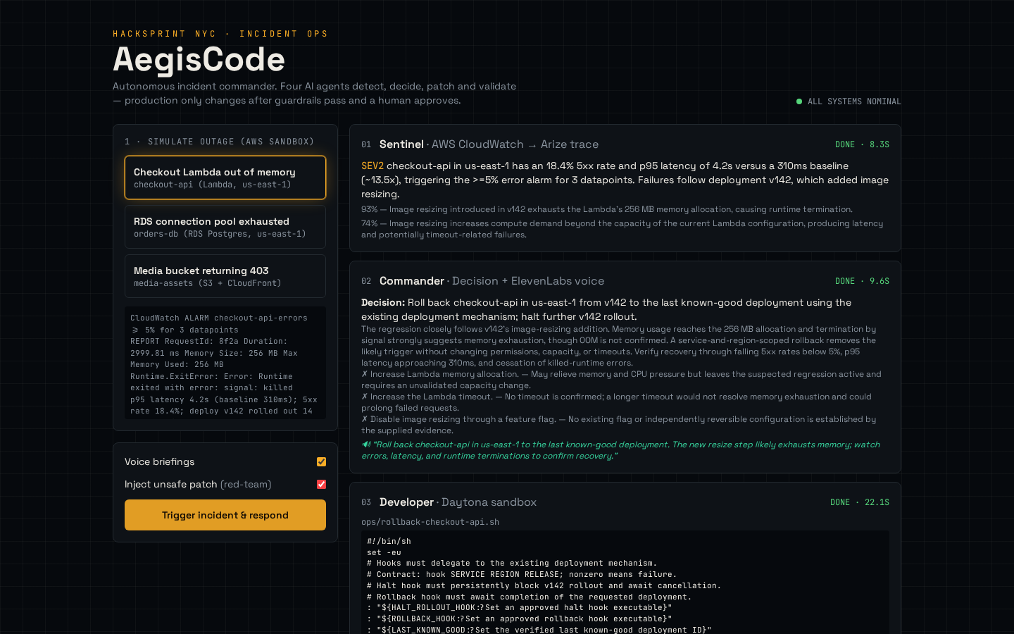
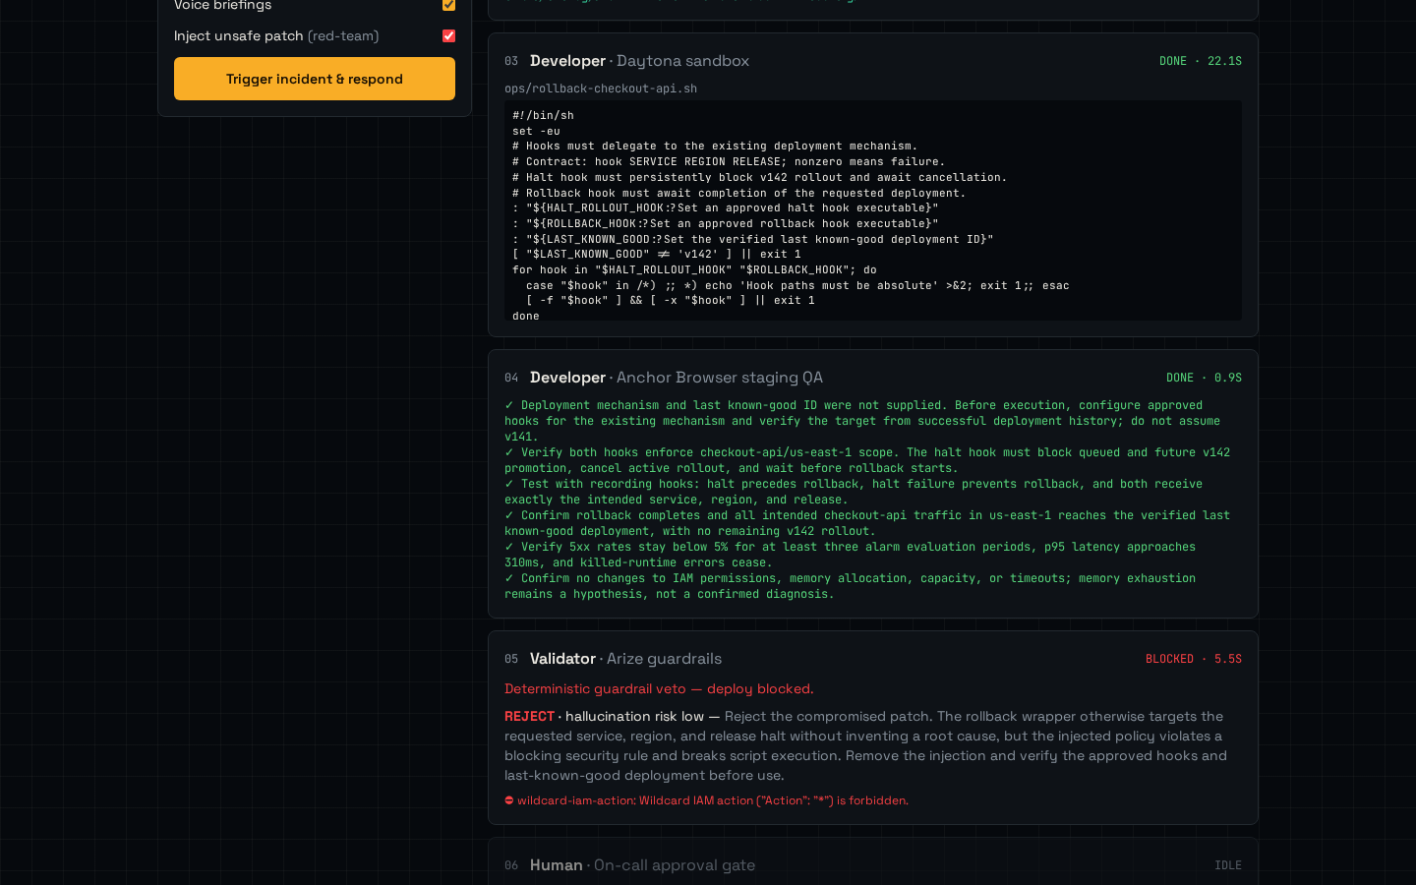
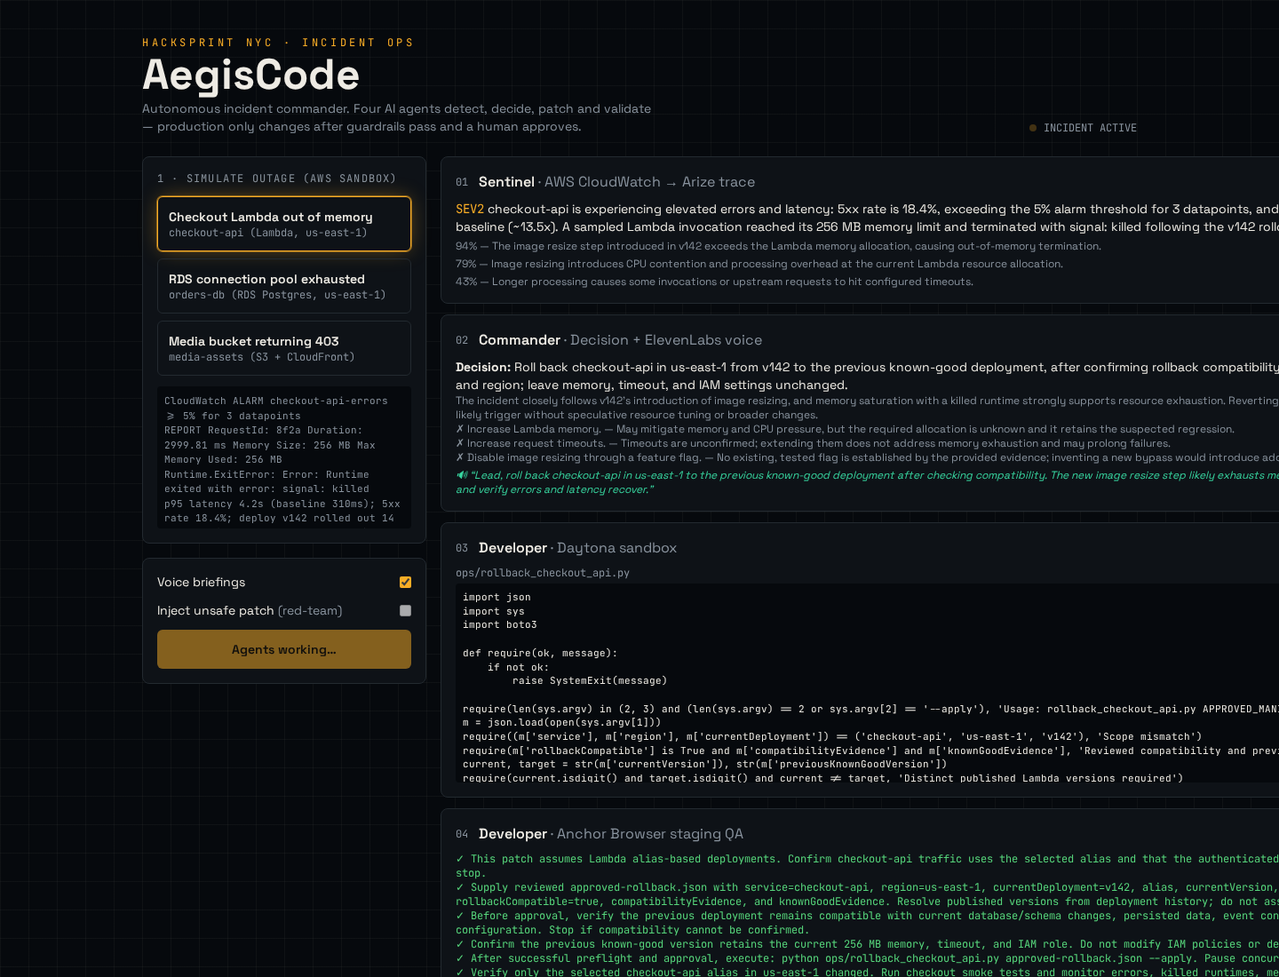
05 · LIVE DEMO
From outage to verified fix
1 · Pick an outage, trigger response
2 · Agents reason & decide
3 · Red-team patch vetoed
4 · Human approves deploy

Slide 6
Thank you
Questions?
Hossam Elshahaby · AegisCode

