Slide 1
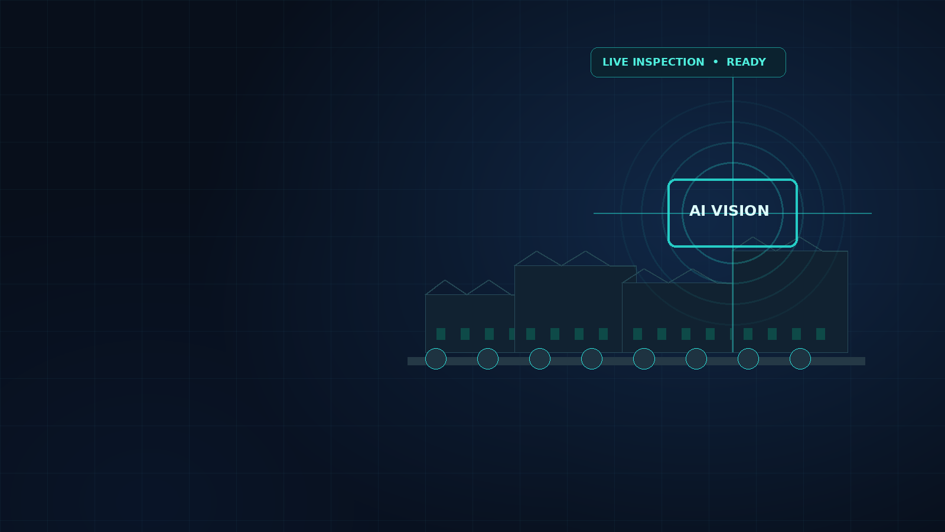
INTELLIGENT INDUSTRY • AI QUALITY INSPECTION
BRIGHT EYE
DETECT
See defects earlier.
Keep production moving.
AI-powered visual inspection for smarter, safer factories.
PROJECT INTRODUCTION
Built for operators • Designed for action
Hossam Elshahaby
BRIGHT EYE DETECT / INTELLIGENT INDUSTRY
01 / 05

Slide 2
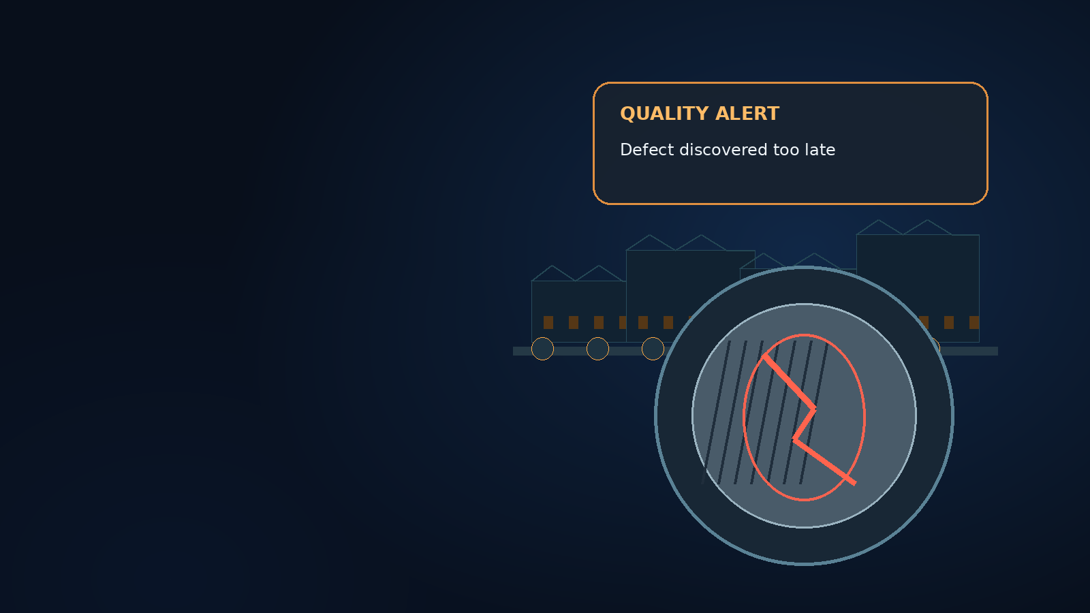
02 / THE PROBLEM
Small defects become
expensive surprises.
When inspection is slow, inconsistent, or disconnected from evidence, problems can travel down the line before anyone sees them.
01
LATE DETECTION
Defects found after extra work or scrap.
02
FRAGMENTED EVIDENCE
Photos, notes, and decisions get separated.
03
SLOW FOLLOW-UP
Teams lack a clear priority and next action.
BRIGHT EYE DETECT / INTELLIGENT INDUSTRY
02 / 05

Slide 3
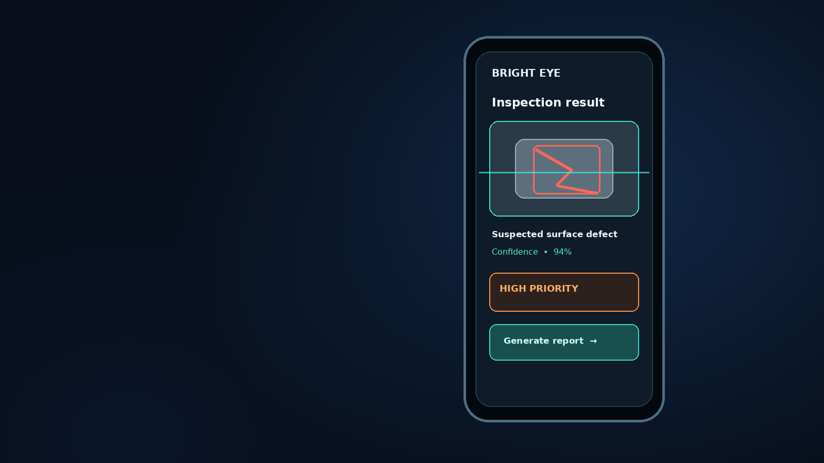
03 / THE SOLUTION
From visual evidence
to confident action.
Bright Eye Detect turns a phone or factory camera into the start of a traceable inspection workflow.
01 CAPTURE
02 DETECT
Photo & video upload
Flag suspected defects
03 REVIEW
04 REPORT
Confidence + human verification
Evidence-backed PDF record
BRIGHT EYE DETECT / INTELLIGENT INDUSTRY
03 / 05

Slide 4
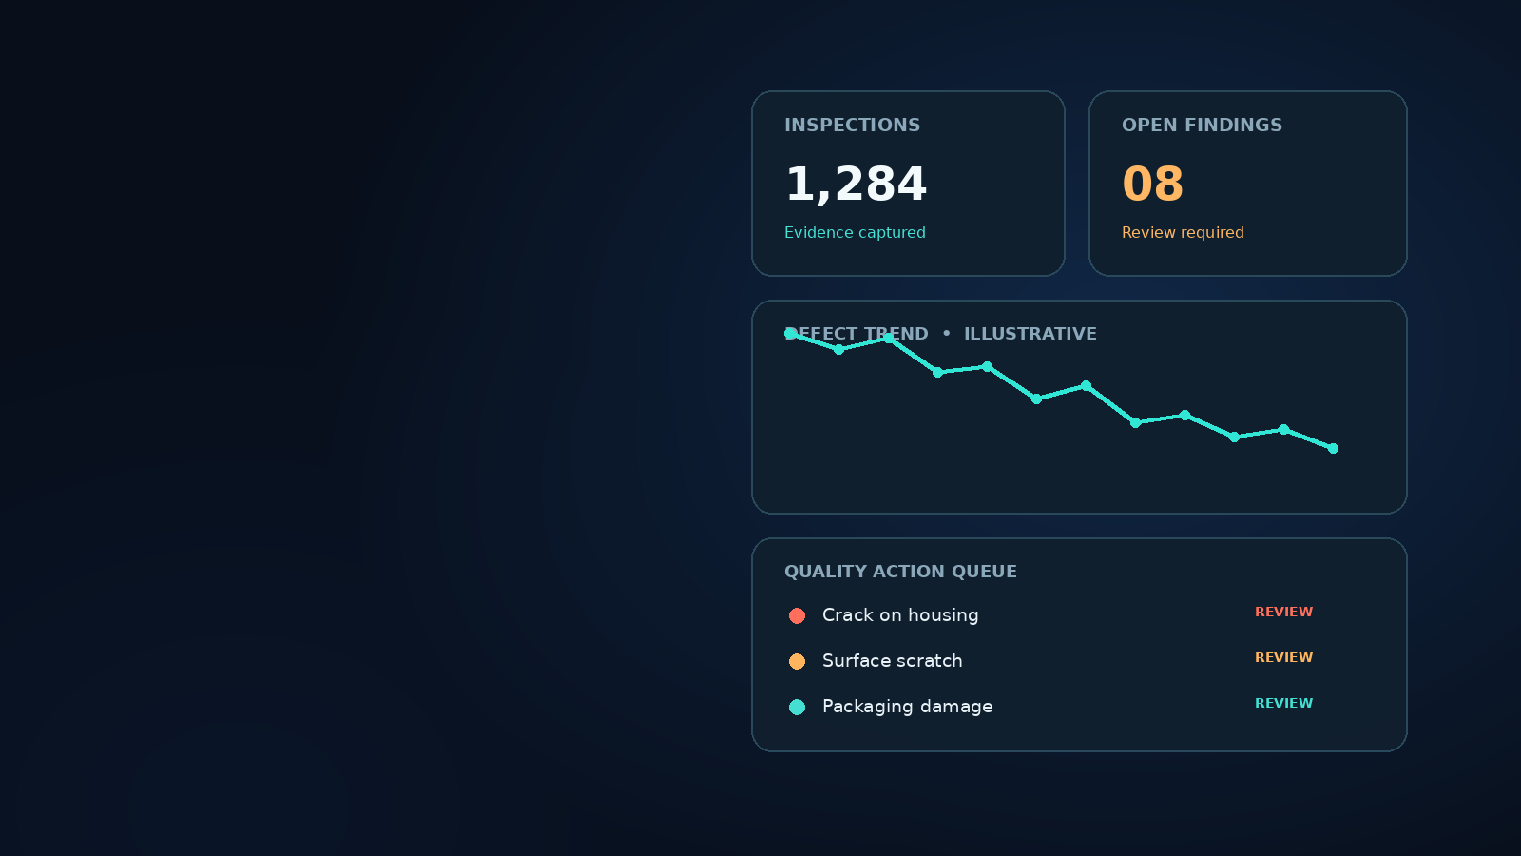
04 / INTELLIGENT FACTORIES
Make quality visible.
Make action measurable.
A shared evidence trail helps operators, quality teams, and maintenance work from the same facts.
LESS DOWNTIME
Surface issues sooner; route urgent findings for review.
BETTER QUALITY
Improve consistency and trace recurring defect patterns.
SAFER OPERATIONS
Escalate potential hazards to qualified reviewers.
LESS WASTE
Catch defects before more material and effort are invested.
Illustrative dashboard metrics — replace with validated app data
BRIGHT EYE DETECT / INTELLIGENT INDUSTRY
04 / 05

Slide 5
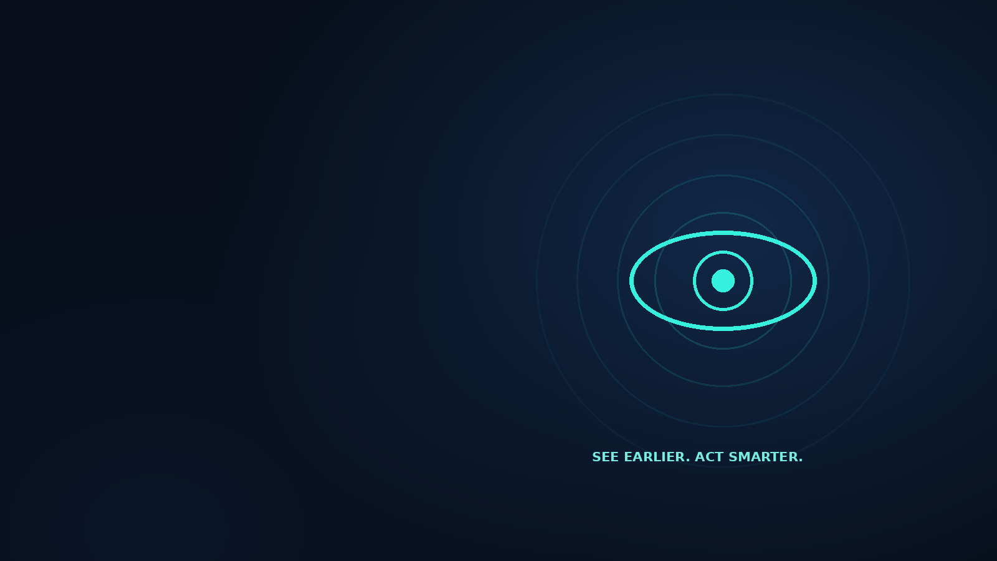
05 / DISCUSSION
Thank you.
Questions?
Bright Eye Detect
See defects earlier. Act with evidence.
Explore the app
bright-eye-detect.lovable.app
BRIGHT EYE DETECT / INTELLIGENT INDUSTRY
05 / 05

