Slide 1
AGENTCOFOUNDER · CONTRACTS TRACK
TEAM
LOOPZERO
RUN SNAPSHOT
491,343
tokens total
100%
pass rate
0
repairs needed
One raw idea in. One tested, running, persistent proof-of-concept out.
Hossam Elshahaby · Paul Grönborg · Ali Sina
Mohamed Akif · Shivam Gupta
Pi coding agent · Qwen3.8-27B-FP8 · Berget AI · Sweden
01

Slide 2
THE PROBLEM
Ideas die between the pitch and the prototype.
A founder with a raw idea has no way to get a real, working artifact without a technical cofounder.
01
02
03
Nobody to build it
Coding agents drift
Nothing is verified
"I have a great idea but no one to build it with." Hiring is slow, agencies are expensive, and momentum dies first.
Point a raw agent at a vague idea and you get half-features, no tests, no persistence, and code nobody can extend.
A demo that only runs on the author's laptop proves nothing. No tests, no build, no start command, no evidence.
The hackathon brief says it plainly: build the coding module that turns a raw idea into a runnable POC.
02

Slide 3
THE SOLUTION
A self-verifying build loop, not a single prompt.
IDEA
raw text
SPEC
structured
BUILD
Pi + Qwen
VERIFY
runner-owned
REPAIR
bounded
RESULT
evidence
verify fails ──► one focused repair pass ──► re-verify (the loop is part of the contract)
Reusable app toolkit
Runner-owned truth
Typed storage with corrupt-data recovery, repository, validation, dates, state machines and an accessible UI kit ship in the template — the model never writes them.
Tests, build, startup, HTTP probe and token totals are measured by the harness, never claimed by the model.
Bounded test-and-repair
Token-aware prompting
On failure the runner replays only the failing checks and log tails, then re-verifies — no unbounded agent flailing.
Stable prefix first, idea last, skill inlined. Output tokens cost 3x, so the template absorbs the boilerplate.
03

Slide 4
IMPACT
What this changes for the software industry.
3x
100%
13 min
output tokens cost triple — so the toolkit, not the model, writes the boilerplate
pass rate on the demo run with zero repair attempts required
raw idea to a tested, running, persistent web application
For founders
A non-technical founder gets a real artifact in minutes — something to test with users, not a slide.
For engineering teams
Verification moves into the harness. Agent output is only accepted when tests, build and startup all pass.
For the agent ecosystem
An open, auditable contract: trace.jsonl, summary.md and result.json make every run replayable and comparable.
For the Nordic AI stack
Runs entirely on Berget AI with Qwen — sovereign European compute, no US hyperscaler in the loop.
04

Slide 5
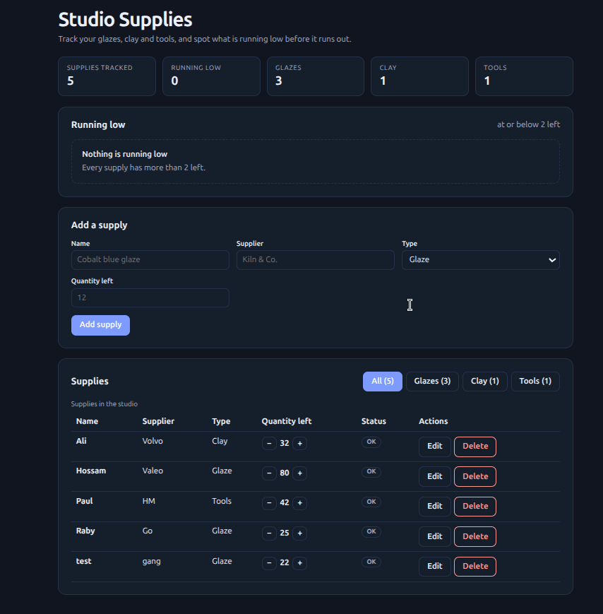
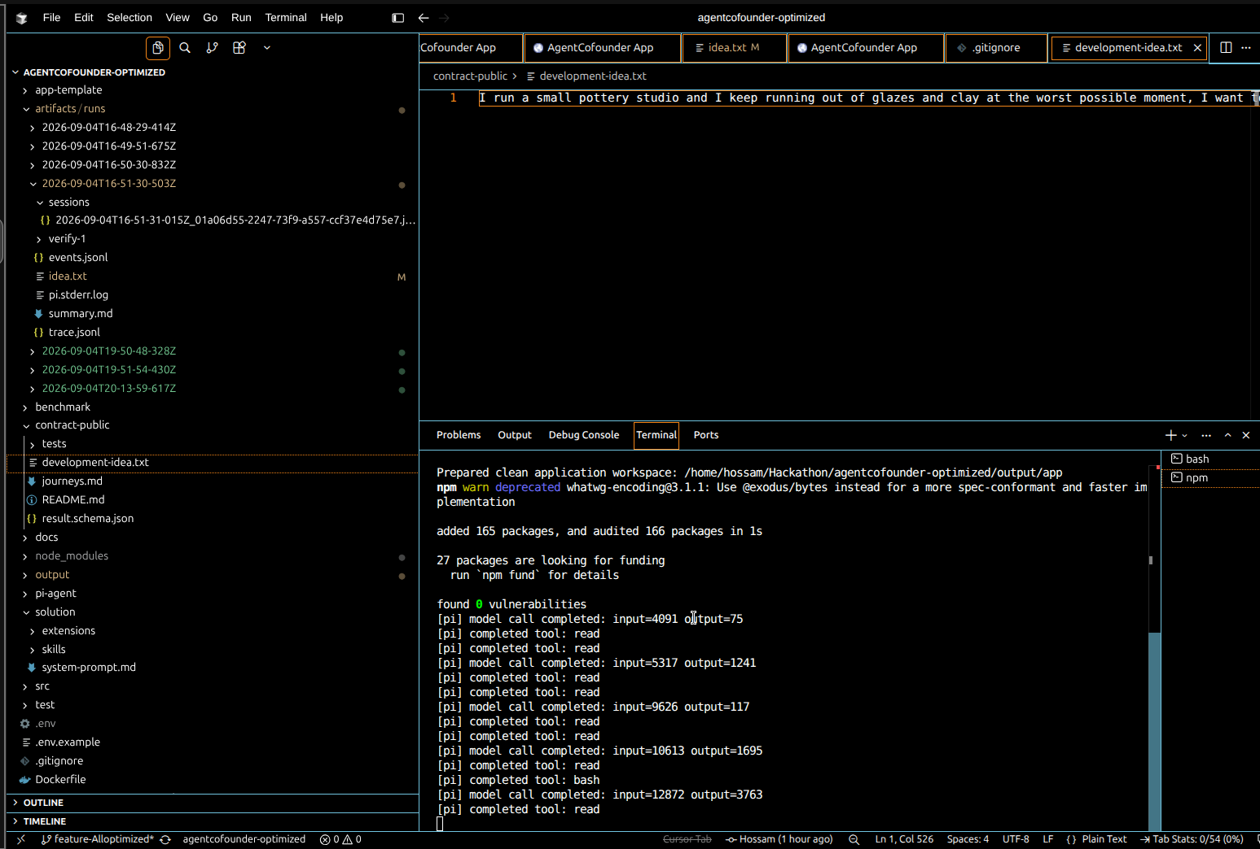
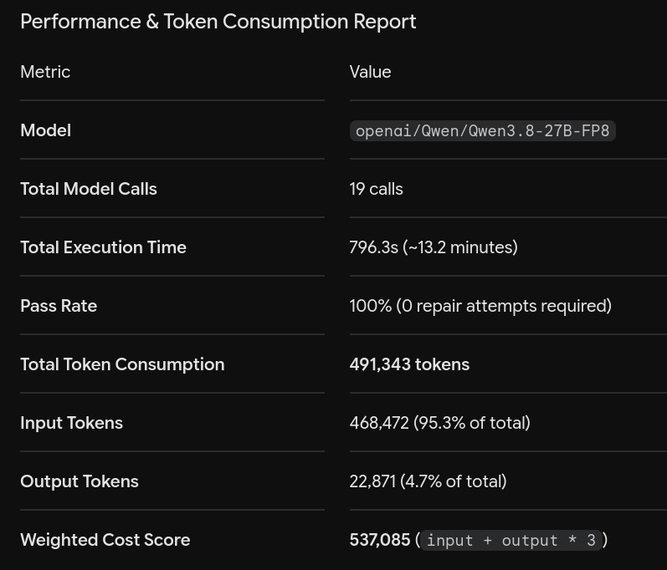
DEMO
One unseen idea → a live, persistent app.
"I run a small pottery studio and I keep running out of glazes and clay at the worst possible moment."
Harness drives Pi, counts every model call
Runner-owned token + pass evidence
Tests pass · build clean · server up · refresh keeps the data · result.json validated
Generated app — running on :3000, data survives refresh
05

Slide 6
Thank you.
Happy to take your questions.
Team LoopZero — Hossam Elshahaby · Paul Grönborg · Ali Sina · Mohamed Akif · Shivam Gupta
AgentCofounder Hackathon · Contracts Track · Stockholm AI
Demo video: https://youtu.be/UVS3UMYBTQc
Code: https://github.com/helshahaby/LoopZero
06

