Slide 1
LostLoop
AI lost & found agent
A photo. A description.
A verified reunion.
Hossam Elshahaby
Agentic AI Hack · Stockholm · 3 October 2026
01
Notes:
App: https://itemlostandfound.lovable.app
Video: https://youtu.be/P0A6O4n_xd8
Presenter: Hossam Elshahaby

Slide 2
Problem
Finding an item is only half the job
Owners search scattered posts and reception desks.
Staff repeatedly compare vague descriptions.
A convincing description alone does not prove ownership.
02
Notes:
Problem framing for event venues, campuses and workplaces. No quantified market claims.

Slide 3
Solution and app features
An agent guides the recovery process
01 Photo reporting and AI-assisted listing drafts
02 Natural-language search for a lost item
03 A private detail supports ownership verification
04 Live activity log explains the agent’s actions
05 Handover and return tracking complete the workflow
03
Notes:
Source: live app homepage, /found and /claim inspected 4 October 2026. Search and verification question observed in a demo run. Handover and return tracking are app-described workflow, not end-to-end validated here. Gemini attribution appears in the UI.

Slide 4
Impact and real-world use
A venue can manage each case in one place
For owners
Describe the loss once and receive a focused follow-up.
For reception teams
Review candidate matches and verification before a handover.
Pilot measures: recovery time, successful returns, staff minutes per case
04
Notes:
Expected benefits, not measured outcomes. Pilot should measure recovery time, confirmed returns, false claims and staff effort.

Slide 5
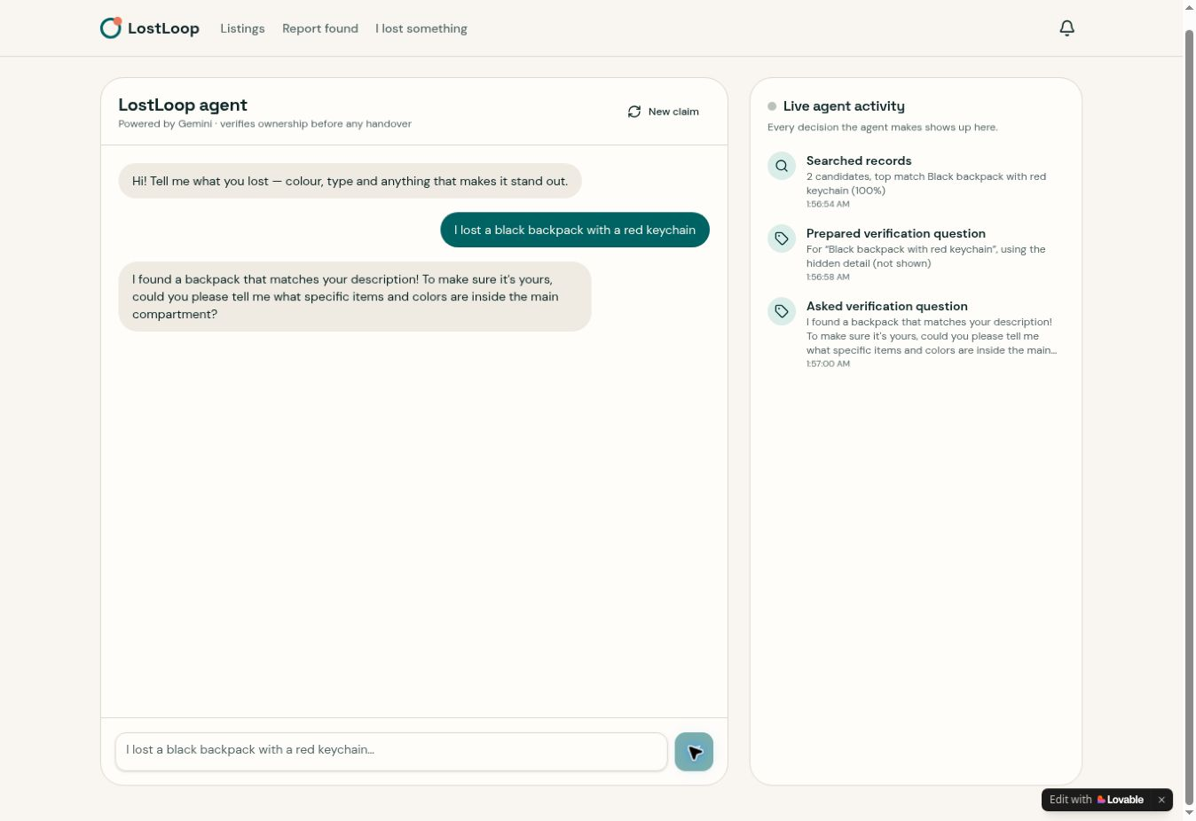
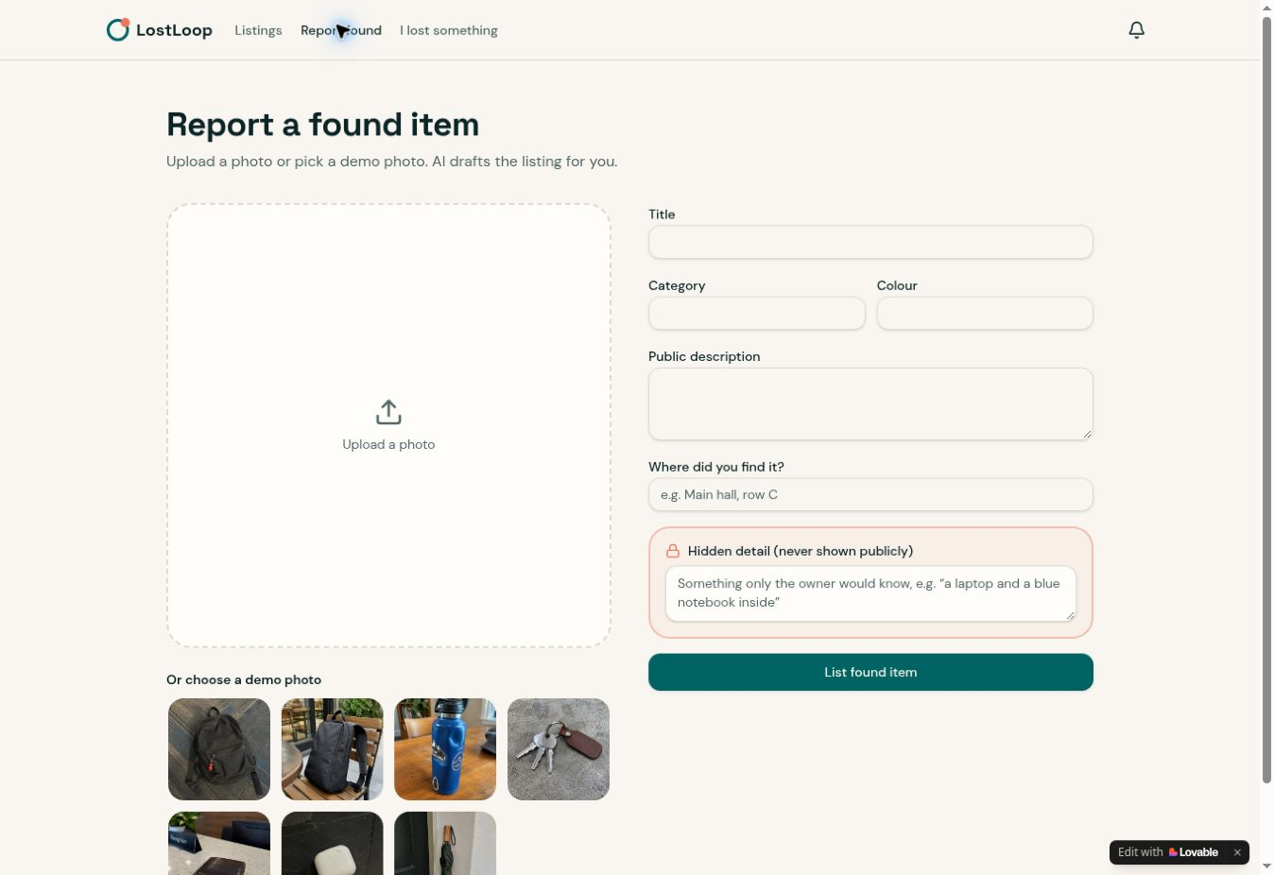
Demo: search and verification
1. Report a find
2. Agent searches and asks a private-detail question
05
Notes:
Real app screenshots captured 4 October 2026. Backpack is explicitly labelled demo data on the homepage. Demo input: I lost a black backpack with a red keychain. Observed: two candidates and a verification question. No ownership or handover completion claimed. Open https://itemlostandfound.lovable.app or video https://youtu.be/P0A6O4n_xd8

Slide 6
Thank you
Questions?
Hossam Elshahaby
Try the app
https://itemlostandfound.lovable.app
Watch the demo
https://youtu.be/P0A6O4n_xd8
06
Notes:
Thank the audience and invite questions.

