Slide 1
RAREPATH / EVIDENCE ATLAS
TEAM INTRODUCTION
01 / INTRODUCTION
HACK NATION / HACKATHON 7
RarePath
Evidence Atlas
From a rare diagnosis to a sourced research decision.
Hossam Elshahaby · Software engineer
Experience across automotive and IT companies
CLICK TO REVEAL
HACK NATION / HACKATHON 7
01 / 06

Slide 2
RAREPATH / EVIDENCE ATLAS
THE PROBLEM
THE PROBLEM
A family has data. Research has fragments.
The hard part is tracing a defensible path between them.
01
Scattered evidence
02
Confused connections
Symptoms, variants, papers and trials live in different places.
A shared symptom is not proof of the same mechanism.
03
Unclear next step
Low case certainty can obscure useful disease-level research.
The gap is not just discovery.
It is knowing what is supported.
HACK NATION / HACKATHON 7
02 / 06

Slide 3
RAREPATH / EVIDENCE ATLAS
THE SOLUTION
WHAT RAREPATH DOES
Turn evidence into a research route.
The AI structures and explains records; the records remain the evidence.
01
02
03
04
CAPTURE
SEARCH
CONNECT
DECIDE
Quick or detailed case; reports need confirmation.
PubMed, ClinVar, ClinicalTrials.gov and MONDO.
Gene → mechanism → related work → partner.
A sourced next step, or an honest gap + plan.
OpenAI: EXTRACT · RECONCILE · PLAN · EXPLAIN
No evidence → no claim. Never a diagnosis or prescription.
HACK NATION / HACKATHON 7
03 / 06

Slide 4
RAREPATH / EVIDENCE ATLAS
POTENTIAL IMPACT
WHY IT MATTERS
Progress without false certainty.
RarePath is a research-navigation tool, not a treatment recommendation.
PATH A
PATH B
Justified collaboration
Honest gap + plan
Sourced mechanism + reusable work + real partner → a shared next research action.
No supported bridge → keep clusters separate, identify missing evidence, then investigate.
Impact: reduce time spent chasing unsupported links; make research handoffs more actionable.
HACK NATION / HACKATHON 7
04 / 06

Slide 5
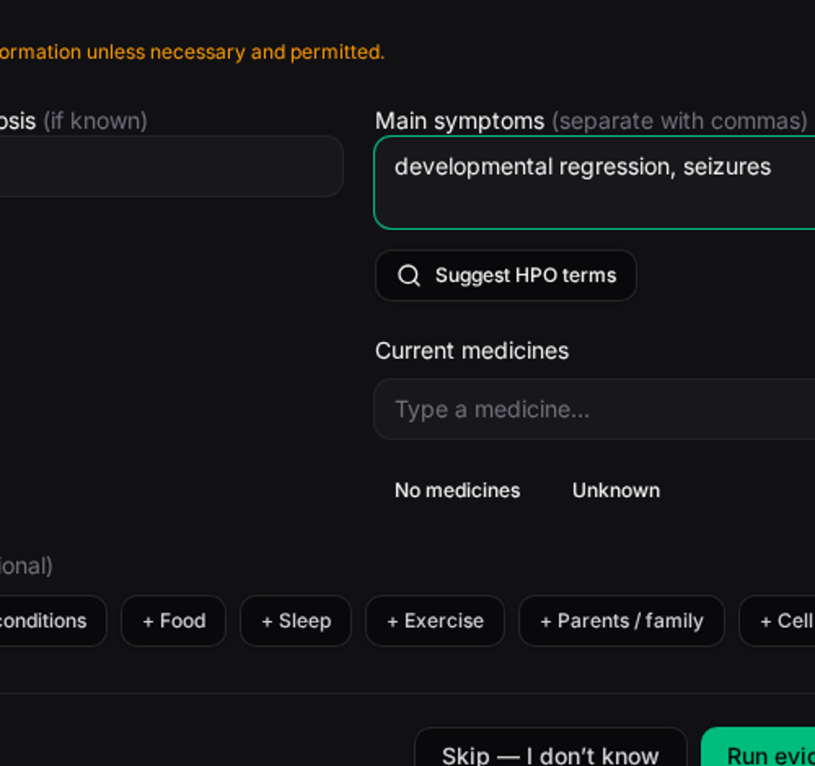
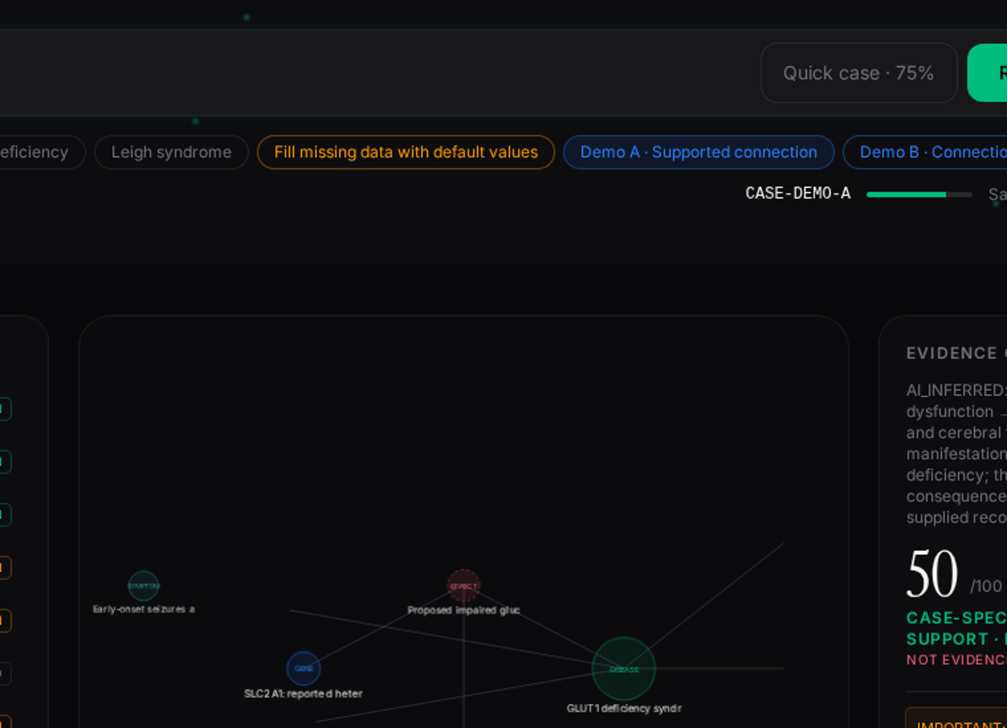
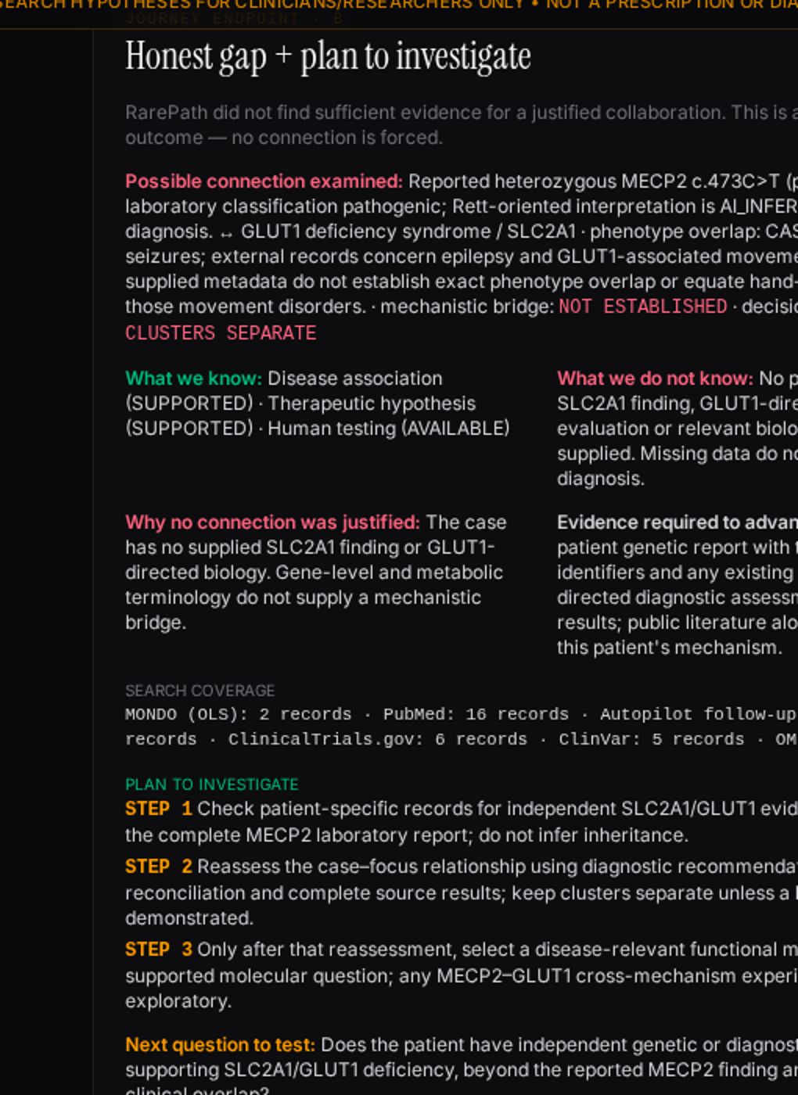
RAREPATH / EVIDENCE ATLAS
LIVE APP SNAPSHOTS
Actual RarePath screens
Captured from the running app · example cases, not patient data
1 / ENTER A CASE
2 / TRACE THE EVIDENCE
3 / REACH A DECISION
A suspected diagnosis and symptoms, before confirmation.
Case profile, graph, sources and separated confidence.
Rett / MECP2 versus GLUT1: keep clusters separate.
HACK NATION / HACKATHON 7
05 / 06

Slide 6
RAREPATH / EVIDENCE ATLAS
CLOSING
Thank you.
Questions?
Hossam Elshahaby / RarePath Evidence Atlas
Research hypotheses only · Not a diagnosis or prescription
HACK NATION / HACKATHON 7
06 / 06

