Slide 1
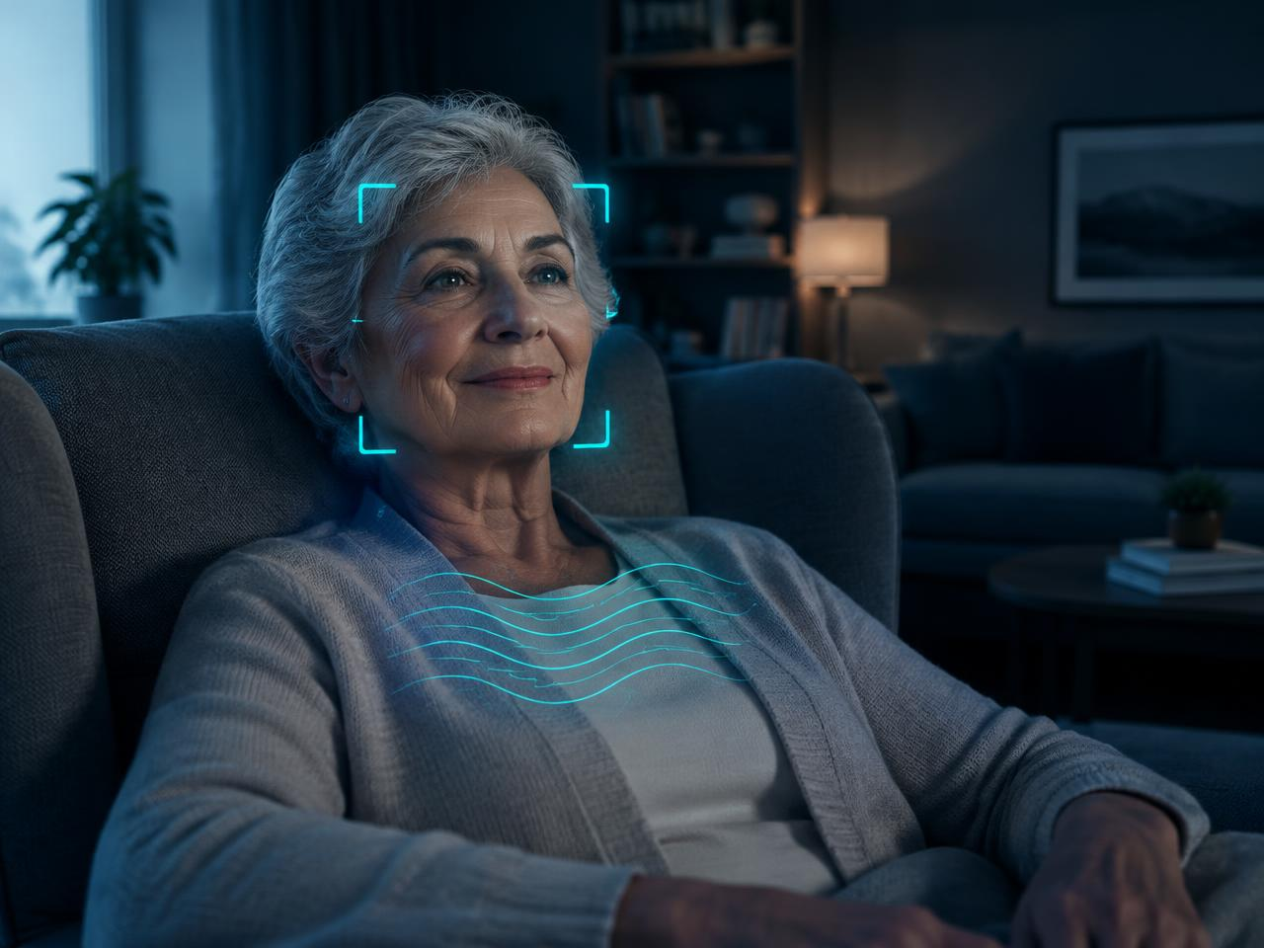
ROOMPULSE AI / BIOHACK 2026
RoomPulse AI
The Invisible Health Guardian · Vitals, No Wearable
Contactless vital-sign intelligence
from an ordinary camera.
Hossam Elshahaby
Browser-local processing. Transparent abstention.
EXPERIMENTAL RESEARCH PROTOTYPE • NOT A MEDICAL DEVICE
01 / 05

Slide 2
ROOMPULSE AI / BIOHACK 2026
The problem: wearable dependency
Charging, fit, access, and adherence can interrupt monitoring.
01
02
03
Independent living
Long periods at rest
Trust matters
Older adults may not consistently wear or charge sensors.
People in beds or chairs need low-burden research tools.
Missing or noisy signals must not become invented numbers.
EXPERIMENTAL RESEARCH PROTOTYPE • NOT A MEDICAL DEVICE
02 / 05

Slide 3
ROOMPULSE AI / BIOHACK 2026
The solution: contactless intelligence
Estimate only when the observed signal supports a reading.
01 Track face and skin regions
02 Extract RGB and upper-body motion
03 Analyze POS, CHROM, or Green rPPG
04 Link every reading to its quality
GREEN Reliable signal conditions
AMBER Interpret with caution
RED No vital-sign number
Respiration remains experimental.
EXPERIMENTAL RESEARCH PROTOTYPE • NOT A MEDICAL DEVICE
03 / 05

Slide 4
ROOMPULSE AI / BIOHACK 2026
Architecture and scientific validation
One analysis pipeline for live monitoring and dataset evaluation.
Camera → MediaPipe → skin RGB
Resample → detrend → POS / CHROM
Bandpass → Welch PSD → TrustScore
Local history → CSV / JSON / PDF
40 automated tests passed
Synthetic signals + integration checks
UBFC and CSV reference adapters
MAE, RMSE, bias, availability, Bland–Altman
No real-person accuracy or dataset benchmark results are claimed.
EXPERIMENTAL RESEARCH PROTOTYPE • NOT A MEDICAL DEVICE
04 / 05

Slide 5
ROOMPULSE AI / BIOHACK 2026
Demonstration, impact, and next steps
A trustworthy sensing prototype—not a diagnostic promise.
Demo: camera tracking and honest rejection
Potential: home and bedside research
Privacy: no video upload or identity recognition
Next: synchronized reference validation
Broader skin-tone and lighting evaluation
Respiratory ground-truth studies
Motion robustness experiments
Thank you · Hossam Elshahaby
EXPERIMENTAL RESEARCH PROTOTYPE • NOT A MEDICAL DEVICE
05 / 05

