Slide 1
NEBIUS TOKEN FACTORY
OPEN MODELS
RouteIQ
Every workload deserves the right model.
Evidence-driven inference routing across open models: preserve required quality while reducing unnecessary cost and latency.
AUTO ROUTER
Hossam Elshahaby – Team AcceliQ
Demo
FAST
BALANCED
DEEP
Accel Amsterdam Hackathon • 2026
Notes:
This is Hossam Elshahaby, and I'm presenting RouteIQ: an evidence-driven inference control plane for open models. Every workload deserves the right model. RouteIQ uses Nebius Token Factory for inference and chooses the capability needed for each request instead of defaulting to the biggest model.

Slide 2
PROBLEM
AI teams are over-provisioning inference.
One premium model is often used for every workload - even when a smaller model is sufficient.
WASTED CAPABILITY
HIDDEN ECONOMICS
NO FEEDBACK LOOP
Simple ≠ Deep
Cost is fragmented
Routing stays static
Classification, extraction and short support tasks often do not need the most capable model.
Different open models have different hosted inference prices, token behavior and latency.
Teams rarely measure whether another model could meet quality targets faster or cheaper.
The missing layer is not another model. It is an inference control plane.
Notes:
The problem is over-provisioning. AI teams often send classification, extraction, support, coding, and complex reasoning through the same expensive model. Open weights do not mean free hosted inference. Each request still consumes infrastructure, tokens, and time. Without comparable evidence, teams cannot see where they are paying for capability they do not need.

Slide 3
SOLUTION
RouteIQ selects the least expensive model that meets the required quality.
Capability gate → workload fit → complexity → evidence → cost → latency.
REQUEST
→
ROUTEIQ
→
MODEL
→
NEBIUS
→
EVIDENCE
AUTO ROUTING
LIVE ECONOMICS
TRADE-OFFS
Fast / Balanced / Deep + exact model
Requesty Nebius pricing reference + runtime tokens
Quality × cost, quality × latency, token efficiency
CHALLENGE AUTO
ADAPTIVE EVIDENCE
FRESHNESS GATE
Force another eligible model and compare
Learn workload-specific routing preferences
Use Tavily only when current external evidence is needed
Notes:
RouteIQ adds that missing control layer. It first gates by capability, then evaluates task family, complexity, benchmark evidence, cost, latency, and prior routing outcomes. It selects Fast, Balanced, or Deep and then an exact eligible Nebius model. It tracks live economics, visualizes trade-offs, uses Tavily only for genuinely fresh external information, and lets the user challenge the automatic choice with another model.

Slide 4
IMPACT
Turn model choice into measurable inference economics.
RouteIQ makes quality, cost, latency and escalation decisions observable.
QUALITY RETAINED
COST AVOIDED
LATENCY
DEEP CALLS
Measured
Measured
Measured
Avoided
Ground-truth benchmarks separate real accuracy from estimated suitability.
Compare selected route with a Deep-only control when pricing is verified.
Expose routing, retrieval, inference and end-to-end latency.
Count cheaper routes only when benchmark correctness is preserved.
Real customer pattern
Mixed customer-support, research and operations workloads. RouteIQ prevents simple requests from automatically consuming Deep inference while still escalating complex reasoning when evidence justifies it.
FinAssist AI
Fast when sufficient. Deep when necessary.
Notes:
The impact is measurable rather than theoretical. RouteIQ tracks quality retained, cost avoided, latency, and Deep calls avoided. Ground-truth benchmarks such as BANKING77 and GSM8K provide stronger evidence than subjective confidence. For a mixed-workload customer such as FinAssist AI, simple support requests can stay on efficient models while difficult reasoning is escalated only when necessary.

Slide 5
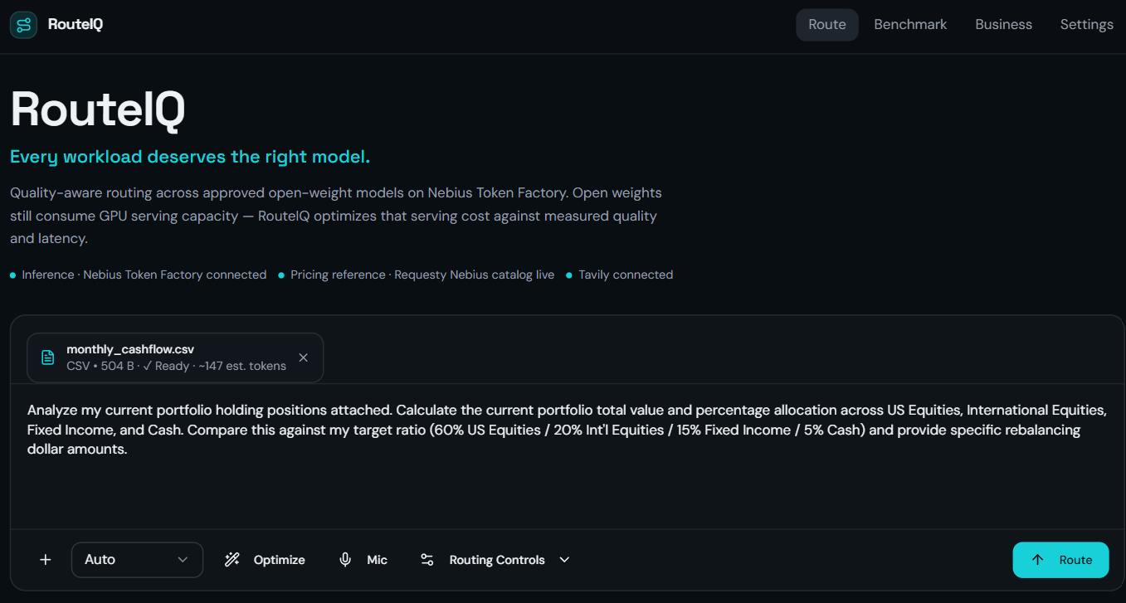
DEMO
Watch RouteIQ make - and defend - the routing decision.
Live app walkthrough: Route → model challenge → Benchmark → trade-offs → Business impact.
See the video: RouteIQ: Cost Efficient Model Selection
Notes:
Now the live demo. On Route, I enter a request and Auto recommends both a routing profile and an exact model. The metric strip immediately shows latency, tokens, cost when verified pricing is available, and measured quality evidence. I can open the trade-off view to compare quality against cost or latency. I can force another eligible model, run the same task, and compare the two responses. If the alternative is better, RouteIQ records workload-specific adaptive evidence. In Benchmark, fixed Fast and Deep controls are compared against RouteIQ Auto, and the quality-cost frontier shows whether expensive inference was actually necessary. Business then turns those measured routes into inference economics.

Slide 6
RouteIQ
Measure every route. Learn from evidence. Escalate only when necessary.
Thank you
Questions?
Hossam Elshahaby
www.github.com/helshahaby/RouteIQ
Notes:
RouteIQ is designed around one simple principle: fast when sufficient, deep when necessary. It measures every routing decision and learns from evidence instead of assuming that one model is best for everything. Thank you, and I'm happy to answer your questions.

