Slide 1
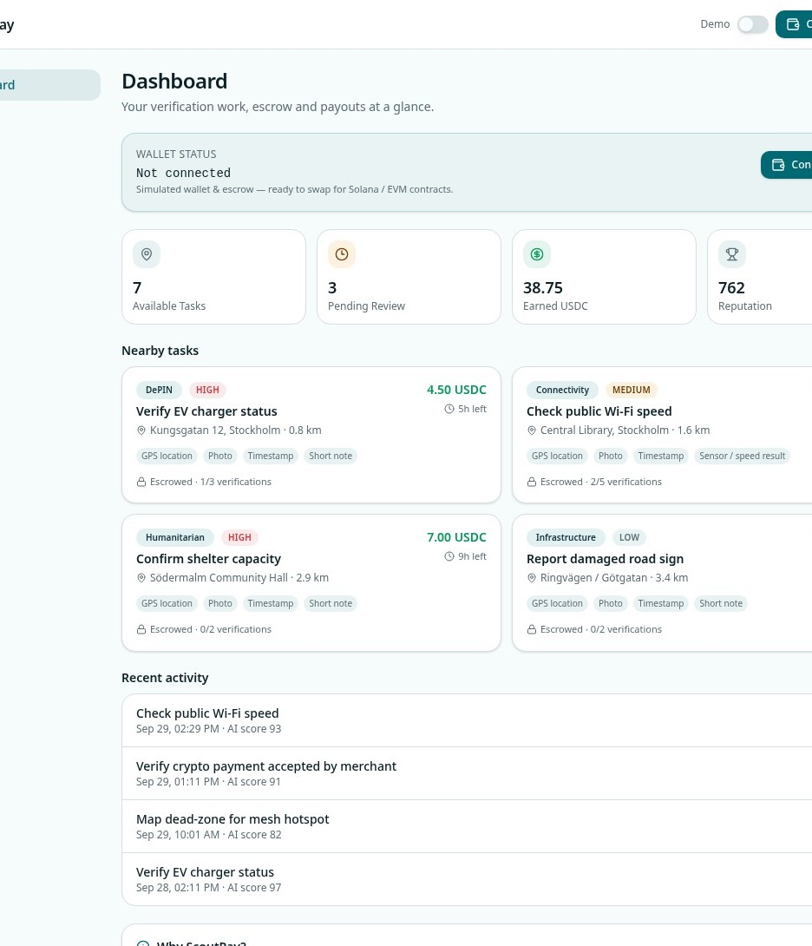
SCOUTPAY
Verified work.
Trusted proof.
Stablecoin rewards.
A crypto-native marketplace for real-world verification.
COLOSSEUM HACKATHON MVP

Slide 2
01 · PROBLEM
Field verification is still slow, fragmented and hard to trust
01
Operational drag
02
Weak evidence
Calls, spreadsheets and contractors make small field checks expensive.
A photo alone does not prove location, time, uniqueness or context.
03
Payment friction
04
Limited participation
Cross-border micro-rewards are delayed, costly and hard to audit.
Local contributors lack a transparent way to access verified work.
ScoutPay
02

Slide 3
02 · SOLUTION
One accountable loop from question to payout
ScoutPay combines structured proof, AI assistance, reviewer judgment and transparent reward release.
1
2
3
4
5
Sponsor
→
Worker
→
AI
→
Reviewer
→
Network
Posts task + escrows USDC
Captures field evidence
Scores proof quality
Approves or rejects
Pays + updates trust
Proof bundle
GPS location · photo · timestamp · short note · optional sensor result
ScoutPay
03

Slide 4
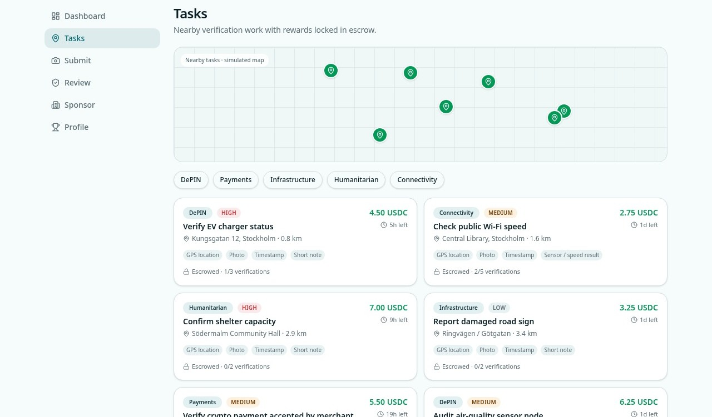
03 · PRODUCT
A marketplace for verified field work
Seven realistic tasks across five categories, with rewards locked in escrow.
Discover locally
Map and list views surface nearby work.
Understand the ask
Reward, deadline, urgency and proof rules are explicit.
Choose by expertise
DePIN, payments, infrastructure, humanitarian and connectivity.
ScoutPay
04

Slide 5
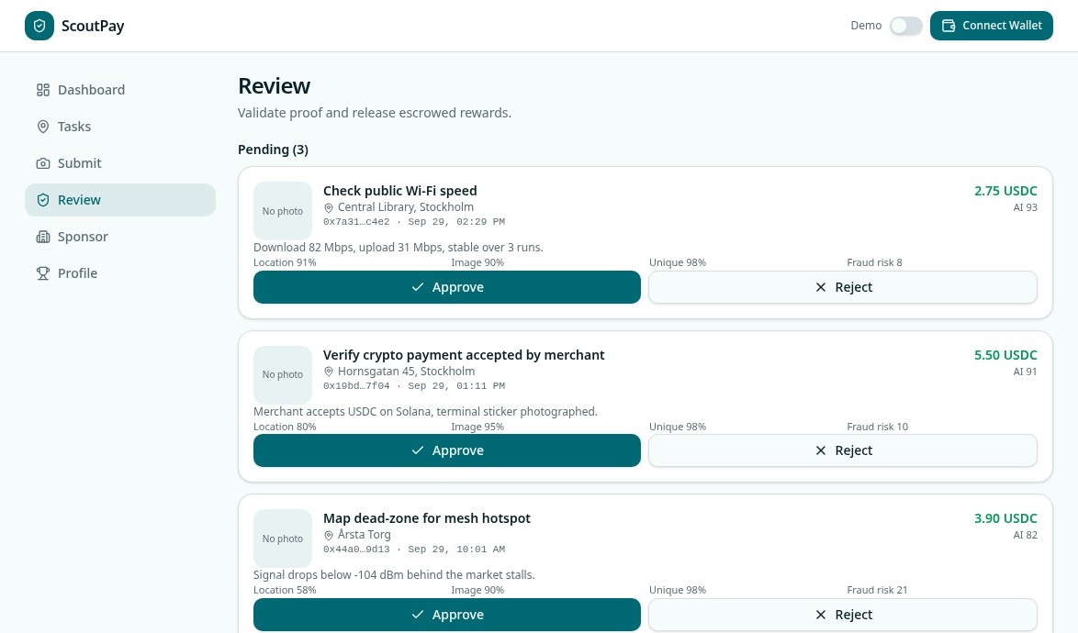
04 · TRUST LAYER
AI assists. Humans decide.
Reviewers see evidence quality and fraud indicators before releasing funds.
Multi-signal scoring
Location, image, uniqueness and risk.
Fast decisions
Approve or reject from one review queue.
Auditable outcome
Proof and payout references remain visible.
ScoutPay
05

Slide 6
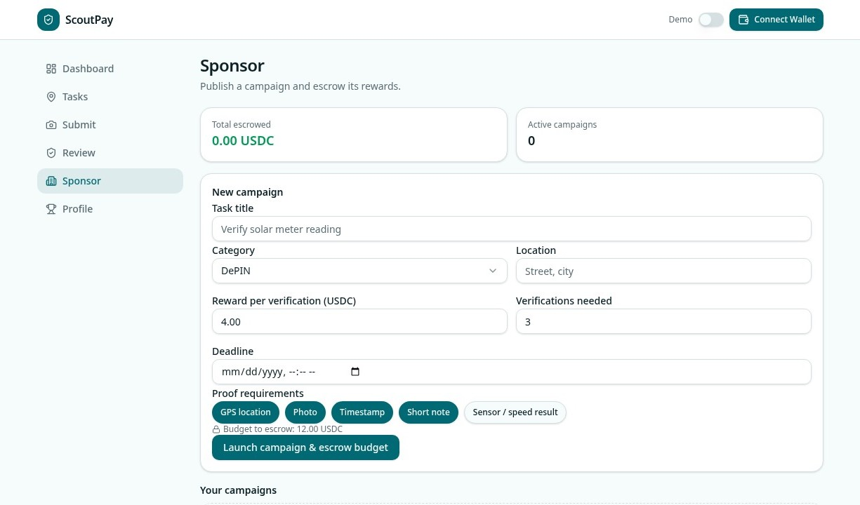
05 · SPONSOR EXPERIENCE
Launch campaigns without operational overhead
Set the location, reward, verification count, deadline and required evidence.
Budget clarity
Preview total USDC before launch.
Flexible proof rules
Match evidence requirements to the task.
Instant distribution
New work appears in the contributor feed.
ScoutPay
06

Slide 7
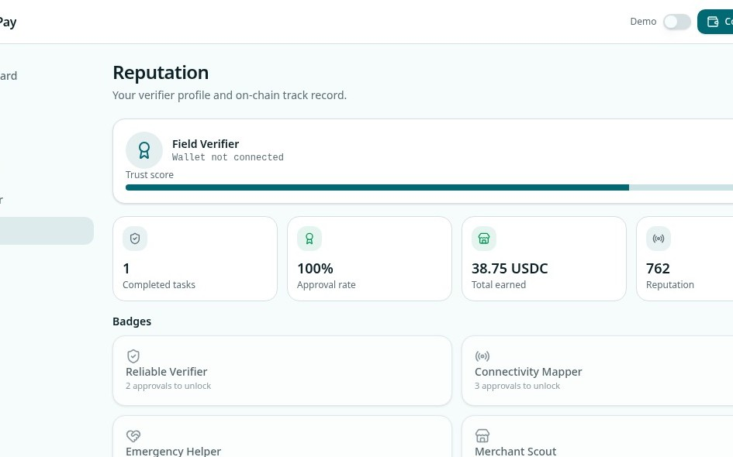
06 · NETWORK EFFECTS
Every approved task compounds trust
Reputation turns repeated field work into a portable verifier identity.
76/100
Trust score
100%
Approval rate
38.75
USDC earned
4
Badge tracks
Better reputation → higher confidence → more valuable work
ScoutPay
07

Slide 8
07 · MVP ARCHITECTURE
Built to demo now—and swap in production rails later
01
Mobile-first product
02
Persistent demo state
Responsive task, proof, review, sponsor and reputation experiences.
The full journey survives refresh without accounts or setup.
03
Deterministic validation
04
Replaceable crypto layer
Repeatable AI-style scores keep judging consistent.
Mock wallet, escrow and hashes can move to Solana or EVM contracts.
ScoutPay
08

Slide 9
08 · WHY SCOUTPAY
More than a task board. More practical than pure automation.
01
Proof-native workflow
02
Human + machine review
Evidence requirements are structured before work begins.
AI accelerates decisions without hiding reviewer accountability.
03
Transparent incentives
04
Portable reputation
Rewards are visible before acceptance and released on approval.
Approved work grows a reusable trust profile and badges.
ScoutPay
09

Slide 10
NEXT
From simulation to a live verification network
01
Accounts & persistent campaigns
What we’re looking for
02
Real wallet connection
• A launch partner with repeat field-verification needs
• Feedback from DePIN and stablecoin builders
• Support taking escrow and proof integrity on-chain
03
Smart-contract escrow
04
Secure proof storage
05
Vertical pilot
ScoutPay
Make real-world truth payable.

