Slide 1
01 / SIGNALWEAVE
SignalWeave
Industrial evidence for proactive decisions
Hossam Elshahaby
Junction X Vaasa 2026
ABB challenge: From weak signals to proactive decisions
snap-and-see-pro.lovable.app
Notes:
Presenter: Hossam Elshahaby. Independent hackathon prototype for the ABB challenge, not an ABB production deployment. Content based on project discussion and user-provided app screenshots.

Slide 2
02 / SIGNALWEAVE
Problem
Weak signals arrive in separate places
Small changes in motor current and temperature can escape routine checks.
Operator notes and alarms lack a shared context.
Video adds evidence, but teams still need a clear reason to act.
snap-and-see-pro.lovable.app
Notes:
Presenter: Hossam Elshahaby. Independent hackathon prototype for the ABB challenge, not an ABB production deployment. Content based on project discussion and user-provided app screenshots.

Slide 3
03 / SIGNALWEAVE
Solution and app features
A shared investigation workspace
Import measurements, maintenance notes and alarms from CSV.
Review video with matching object annotations.
Investigate signals and propose actions for human review.
Benchmark detection separately from event warning timing.
snap-and-see-pro.lovable.app
Notes:
Presenter: Hossam Elshahaby. Independent hackathon prototype for the ABB challenge, not an ABB production deployment. Content based on project discussion and user-provided app screenshots.

Slide 4
04 / SIGNALWEAVE
Impact
Earlier investigation, with evidence
Maintenance: connect rising measurements with operator observations.
Warehouse safety: review worker and forklift interactions in video.
Operations: record the reason for an action and review its outcome.
Expected benefits require validation in a real industrial pilot.
snap-and-see-pro.lovable.app
Notes:
Presenter: Hossam Elshahaby. Independent hackathon prototype for the ABB challenge, not an ABB production deployment. Content based on project discussion and user-provided app screenshots. Benefits are proposed, with no measured reduction in downtime or incidents.

Slide 5
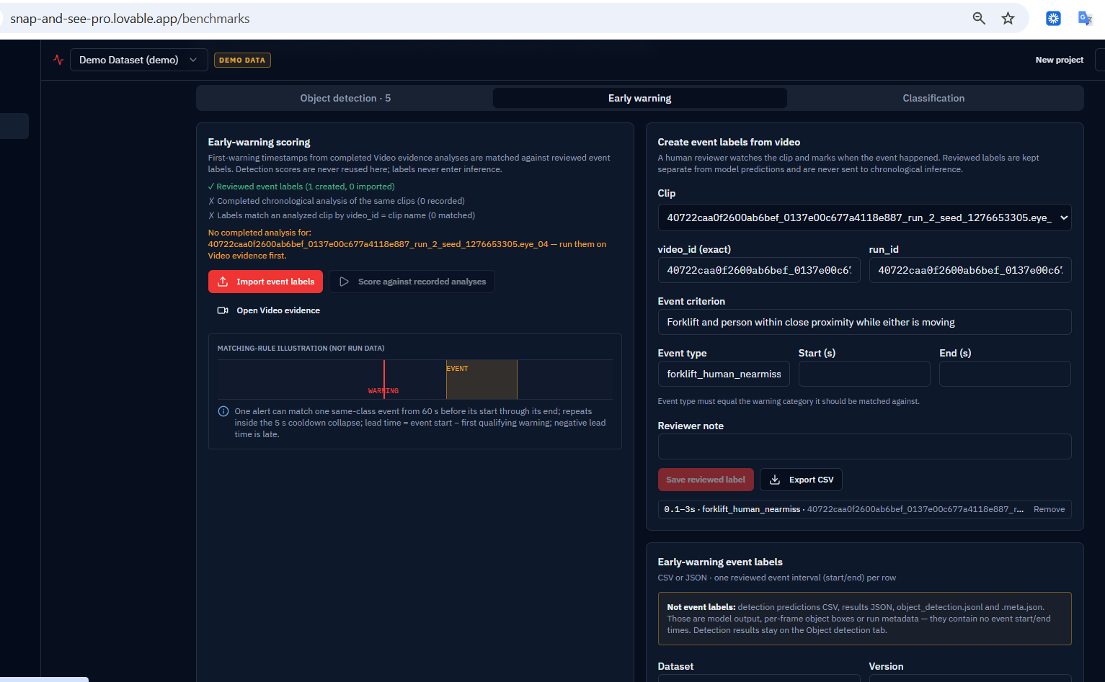
05 / SIGNALWEAVE
Demo
Evidence and honest evaluation
01 Load a clip and its matching object_detection.jsonl.
02 Reveal ground truth and run detection scoring.
03 Create a reviewed event label.
04 Complete chronological analysis, then score warning timing.
Screenshot: event label saved; chronological analysis pending
snap-and-see-pro.lovable.app
Notes:
Open https://snap-and-see-pro.lovable.app for the live demo. Use the exact same clip ID for predictions and labels. Ground truth stays separate from inference. The screenshot is user-provided on 4 October 2026. Detection metrics do not establish early-warning performance. If chronological analysis is unavailable, show that prerequisite honestly.

Slide 6
06 / SIGNALWEAVE
Thank you
Questions?
Hossam Elshahaby
SignalWeave
Industrial decisions backed by traceable evidence
snap-and-see-pro.lovable.app
Notes:
Presenter: Hossam Elshahaby. Independent hackathon prototype for the ABB challenge, not an ABB production deployment. Content based on project discussion and user-provided app screenshots.

