Slide 1
CURVESYS HACKATHON PROJECT
SWARMOPS
Autonomous AI
Engineering Team
One objective. Six agents. One engineered solution.
LIVE APPLICATION
https://agents-swarm-ops.lovable.app/
DEMO VIDEO • https://youtu.be/iNc_CAn4aFs
GitHub: [ADD GITHUB REPOSITORY URL]
Hossam Elshahaby

Slide 2
01 / THE CHALLENGE
Engineering work is fragmented
A single prompt can produce code — but a dependable delivery needs a coordinated engineering process.
01
02
03
Disconnected expertise
Opaque handoffs
Validation gap
Research, architecture, development, QA and security often happen in separate workflows.
It is hard to see who did what, what evidence supports a decision, and what remains open.
Generated code can look convincing without being executed, tested, or security-reviewed.
The gap: turning an idea into an accountable, reviewable engineering handoff.
SWARMOPS • AUTONOMOUS AI ENGINEERING TEAM
2

Slide 3
02 / THE SOLUTION
Six specialist agents. One orchestrated workflow.
SwarmOps decomposes a natural-language objective into role-specific work and visible handoffs.
RESEARCH
ARCHITECT
DEVELOPER
TESTER
SECURITY
DELIVERY
›
›
›
›
›
Investigate
Design
Build
Validate
Review
Package
ORCHESTRATOR + SHARED PROJECT CONTEXT
Task dependencies • Agent messages • Review feedback • Bounded retries
Failed checks can trigger a Developer revision and a focused re-review.
SWARMOPS • AUTONOMOUS AI ENGINEERING TEAM
3

Slide 4
03 / EXPECTED IMPACT
Make engineering work visible, traceable and reviewable
Designed to improve coordination and confidence — not to replace human engineering accountability.
Clear ownership
Traceable decisions
Every specialist role has a defined responsibility and output.
Agent messages, task events and artifacts preserve the work history.
Earlier feedback
Better handoff
Testing and security findings can flow back into implementation.
A consolidated report makes outcomes, limitations and next steps explicit.
Trust principle: generated ≠ reviewed ≠ executed ≠ verified.
SWARMOPS • AUTONOMOUS AI ENGINEERING TEAM
4

Slide 5
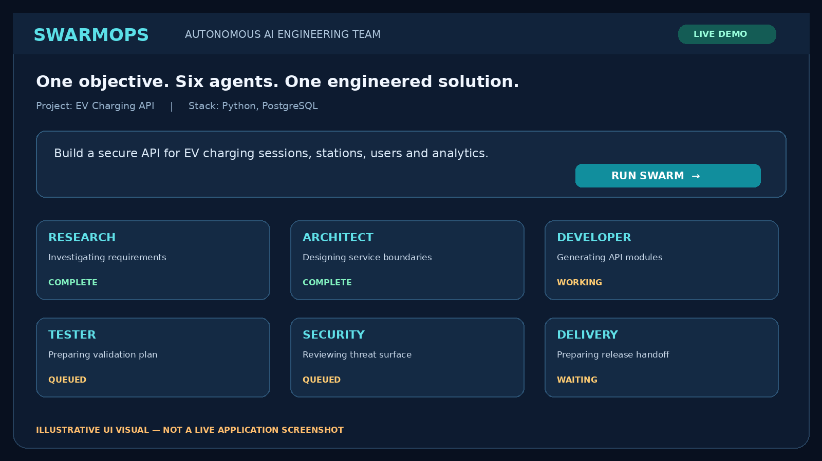
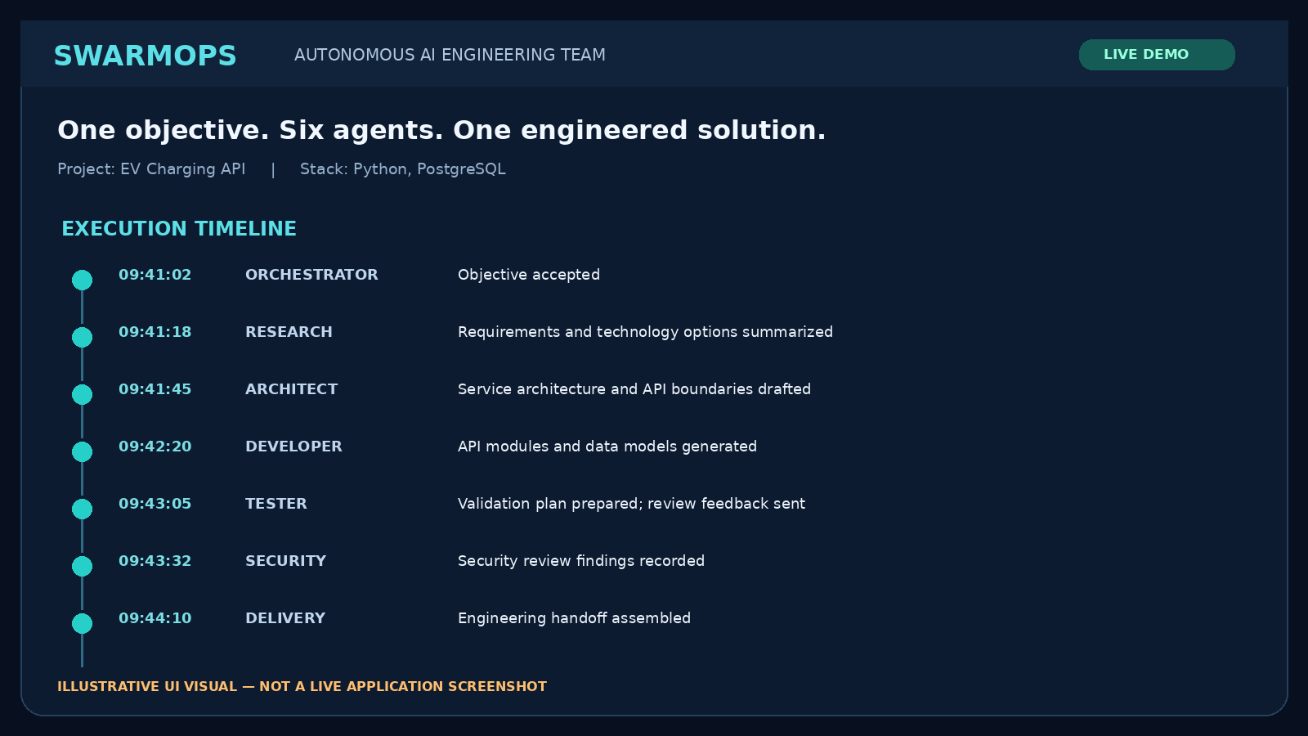
04 / PRODUCT WALKTHROUGH
See the swarm in action
Live app: objective entry, agent activity, execution timeline and engineering handoff.
COMMAND CENTER • OBJECTIVE + SIX AGENTS
EXECUTION TIMELINE • VISIBLE HANDOFFS
These are illustrative UI visuals, not captured screenshots of the live site.
https://agents-swarm-ops.lovable.app/ | Walkthrough: https://youtu.be/iNc_CAn4aFs
SWARMOPS • AUTONOMOUS AI ENGINEERING TEAM
5

Slide 6
SWARMOPS • AUTONOMOUS AI ENGINEERING TEAM
THANK YOU
One objective. Six agents. One engineered solution.
TRY THE LIVE APPLICATION
https://agents-swarm-ops.lovable.app/
Demo video: https://youtu.be/iNc_CAn4aFs
Hossam Elshahaby

