Slide 1
BUILDERS & BREWS / NEBIUS + TAVILY
ClaimRadar
CR
Voice-first opportunity radar
Hossam Elshahaby
Find opportunities, verify fit, and prepare the next action.
Voice agent with live web context
ClaimRadar 1/6

Slide 2
PROBLEM
Opportunity discovery is scattered
Relevant programs live across event pages, job boards, PDFs, newsletters, and social posts.
Manual search
Users lose time checking deadlines, eligibility, cost, location, and required documents.
Many tabs, repeated checks, no clear next step.
High-fit opportunities often disappear before the user prepares an application.
Missed timing
People without strong networks need a practical way to find and act on opportunities.
Good matches are found after the deadline or too late to apply.
Weak follow-through
Discovery rarely becomes a finished email or application.
ClaimRadar 2/6

Slide 3
SOLUTION AND FEATURES
A voice agent for verified opportunities
Tavily searches the live web and extracts source details.
Secure setup
Keys stay in backend secrets.
Nebius ranks results by fit, urgency, impact, effort, and confidence.
ElevenLabs gives the product a professional voice interface.
Voice controls
Mic, mute, captions, transcript, and call history.
ClaimRadar saves transcripts, opportunity briefs, and next actions.
Action output
Ranked cards, source links, and next step.
Design modes
Executive, Nordic, and startup UI options.
ClaimRadar 3/6

Slide 4
IMPACT
ClaimRadar turns access into action
94
Students and job seekers
88
Researchers and builders
91
Career centers
Find internships, free certifications, scholarships, and programs before deadlines close.
Track hackathons, fellowships, grants, datasets, and calls for proposals.
Offer verified opportunity intelligence instead of static newsletters.
Less time spent searching across disconnected sources.
More trust because each recommendation includes a reason and source.
Better follow-through because the agent prepares the first action.
ClaimRadar 4/6

Slide 5
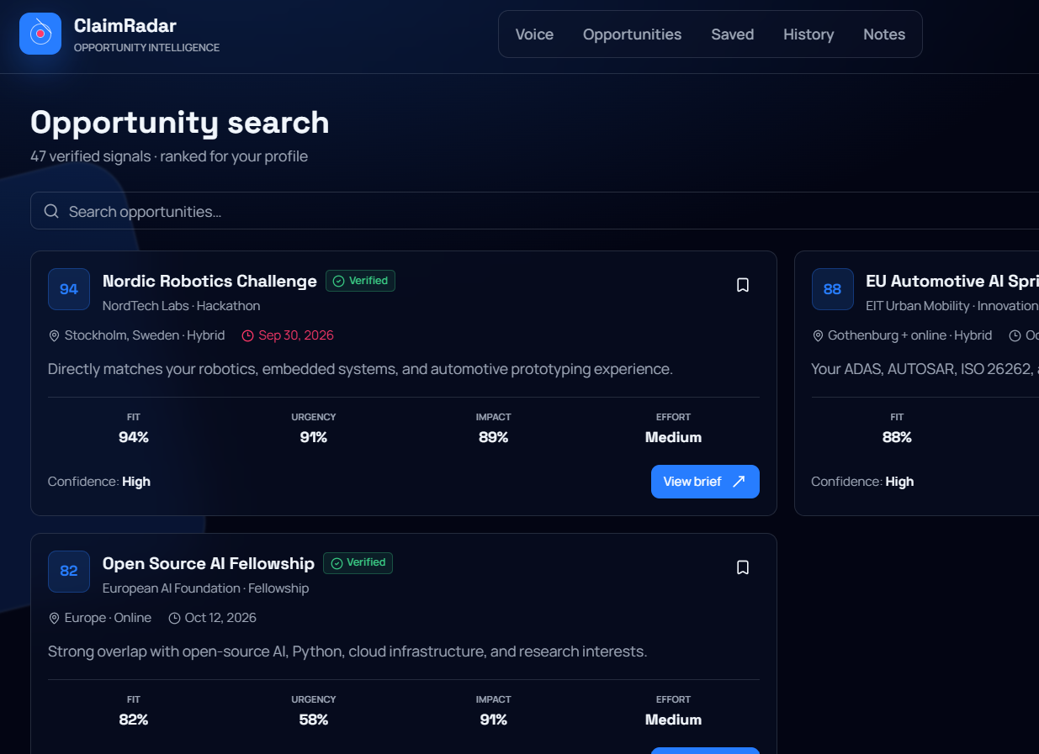
DEMO
Live app walkthrough
Open the app and choose the voice-agent experience.
Search opportunities by voice or text.
Review ranked opportunity cards with verified signals.
Save the transcript and prepare the next application step.
Real ClaimRadar app screen from the Lovable prototype
ClaimRadar 5/6

Slide 6
THANK YOU
Questions
Prototype
https://ai-palette-chooser.lovable.app
ClaimRadar helps people act on opportunities before deadlines disappear.
Demo video
Hossam Elshahaby
https://youtu.be/wzWk1DUPPvc
Gothenburg, Sweden
Next milestone
Connect production APIs and test with real applicants.
ClaimRadar 6/6

