Slide 1
Scala-Helsinki
Meetup
29/09/2016

Slide 2
Hands-on session on Option, Future and use of those with Actors

Slide 3
So what is an Option?
Represents a value that can be missing
It's a parametric type (i.e. Option[T])
Main subtypes: Some and None
Rich API for manipulating and combining Options (e.g. map, flatMap)
Resemblance with type Try[T]
API docs: http://www.scala-lang.org/api/current/#scala.Option

Slide 4



What does it look like?
Option[Int]
None
Some(42)

Slide 5
So what is a Future?
Represents a value that will be available at a later time (or more accurately, a "computation")
It's a parametric type (i.e. Future[T])
Since the computation may fail, the contained value is a Try[T] (i.e. Success or Failure)
Rich API for manipulating and combining Futures
API docs: http://www.scala-lang.org/api/current/#scala.concurrent.Future

Slide 6


What does it look like?
Do
something
else meanwhile...
Future[T]
Try[T]
Time

Slide 7
And what is an Actor?
a model for concurrent computation
the basic unit of computation in this model
strong analogy with real-life processes
easy to reason about (most of the time :))
share nothing - the only way to mutate state is by sending immutable messages between actors
Docs: http://akka.io/docs/

Slide 8
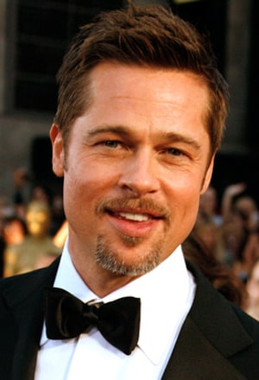
What does it look like?

Slide 9
Common operations
isEmpty (Option), isCompleted (Future)
map: transforms the "contained" value
flatMap: transforms the "contained" value and wraps it into another box
filter: discards the "contained" value if the given predicate is false

Slide 10



How map works?
Int => Char
Option[Int]
Option[Char]

Slide 11
How flatMap works?
Char => Option[Int]
Option[Char]
Option[Int]

Slide 12
Hands on!
https://github.com/ale64bit/meetup

Slide 13

Example #1: Future+Option with for-comprehension
powerful abstractions for representing and combining computations
simple enough to reason about
not isolated; can interact with each other
for-comprehension can be decomposed in a sequence of map+flatMap operations
along with most other components in Scala build-in library (notably, collections), they present monadic characteristics...

Slide 14
Example #2: Guess the types after getOrElse
getOrElse is practical, although dangerous
Scala is full of unexpected effects
the type system is powerful, but good knowledge is required to not run into those unwanted effects
there are millions of ways of doing the same thing: Scala can be horrible for team-working

Slide 15
Example #3: Futures as workers
Futures can be leveraged as workers to accomplish several concurrent computations
the ExecutionContext nature is key for a performant system (don't use the default one!)
blocking pattern can be useful as well to mark blocking computations
BONUS QUESTION: why worker numbers are always odd?

Slide 16
Example #4: Futures and Actors
ask and pipe patterns allow interaction with Futures
care should be taken when using the Actor's dispatcher as ExecutionContext
ask should be used with care as well; beware of timeout hell and the temporary Actor who actually "asks"
actors are low-level primitives
as before, many different ways to accomplish the same things

Slide 17
Thanks!
Questions?

