Slide 1
Audio Receiving TIVA
This is just an empty power point used for video please check YouTube link https://youtu.be/Pyc1sTJoJ3k
By: Hussein(Shawn) el-souri and Y’esha Lester

Slide 2
Initializations, Testing and Plan of action
Setting up microphone
Testing output on each pin
Showing microphone functionality via Arduino
Making proper connections to TIVA board
Replicating Arduino functionality on TIVA

Slide 3

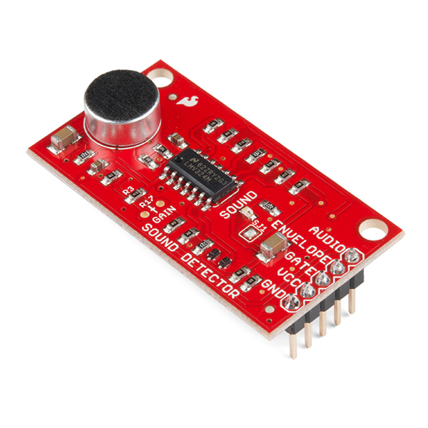

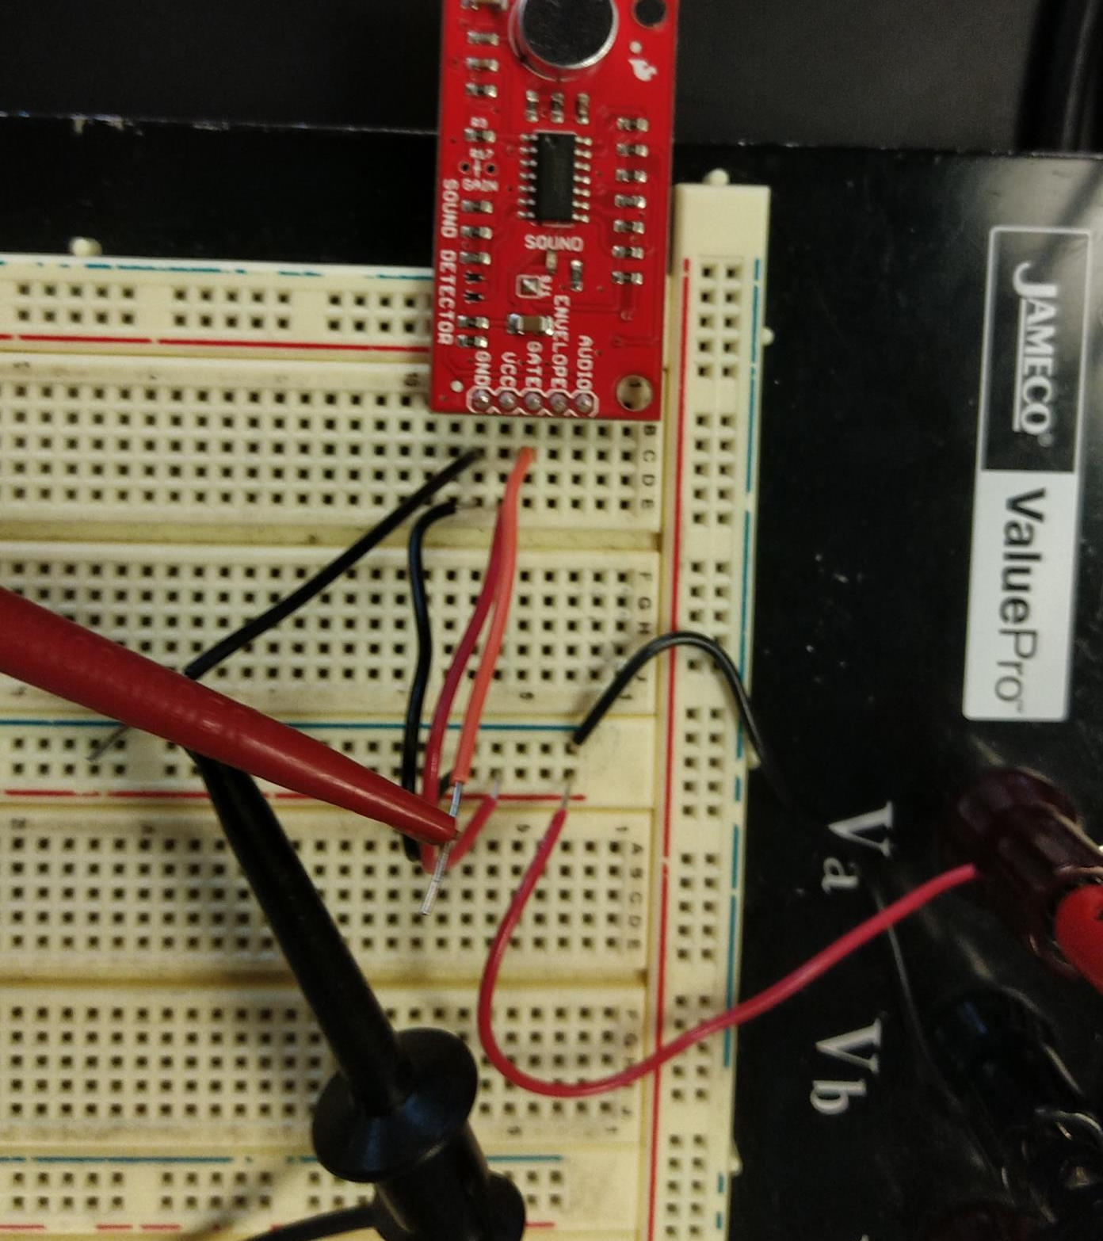
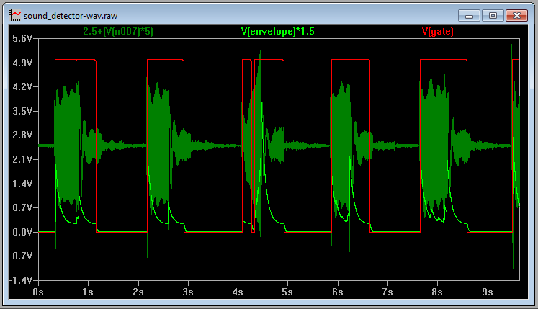


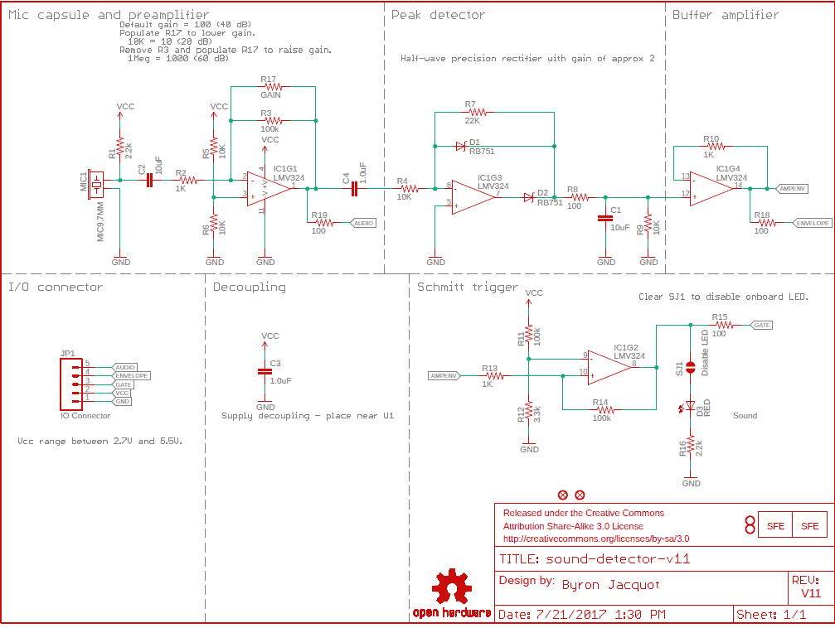

Microphone connections

Slide 4
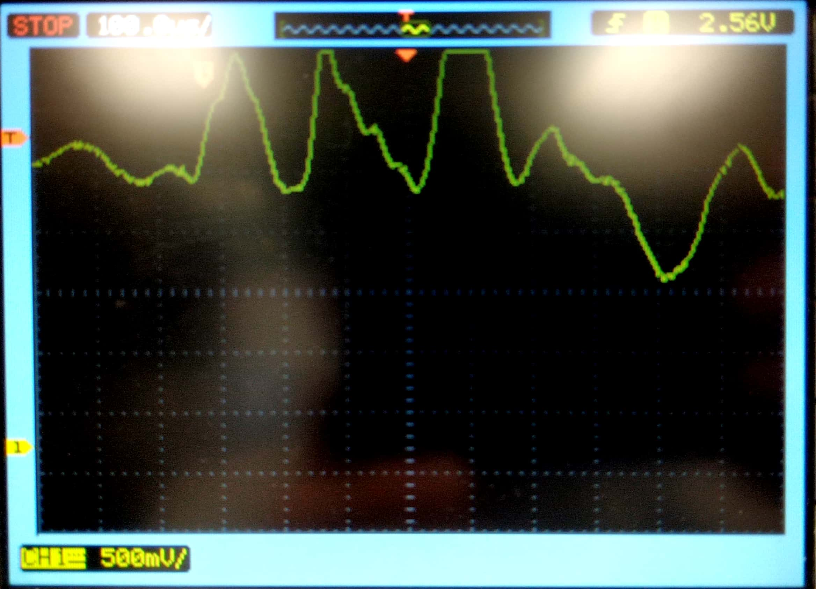
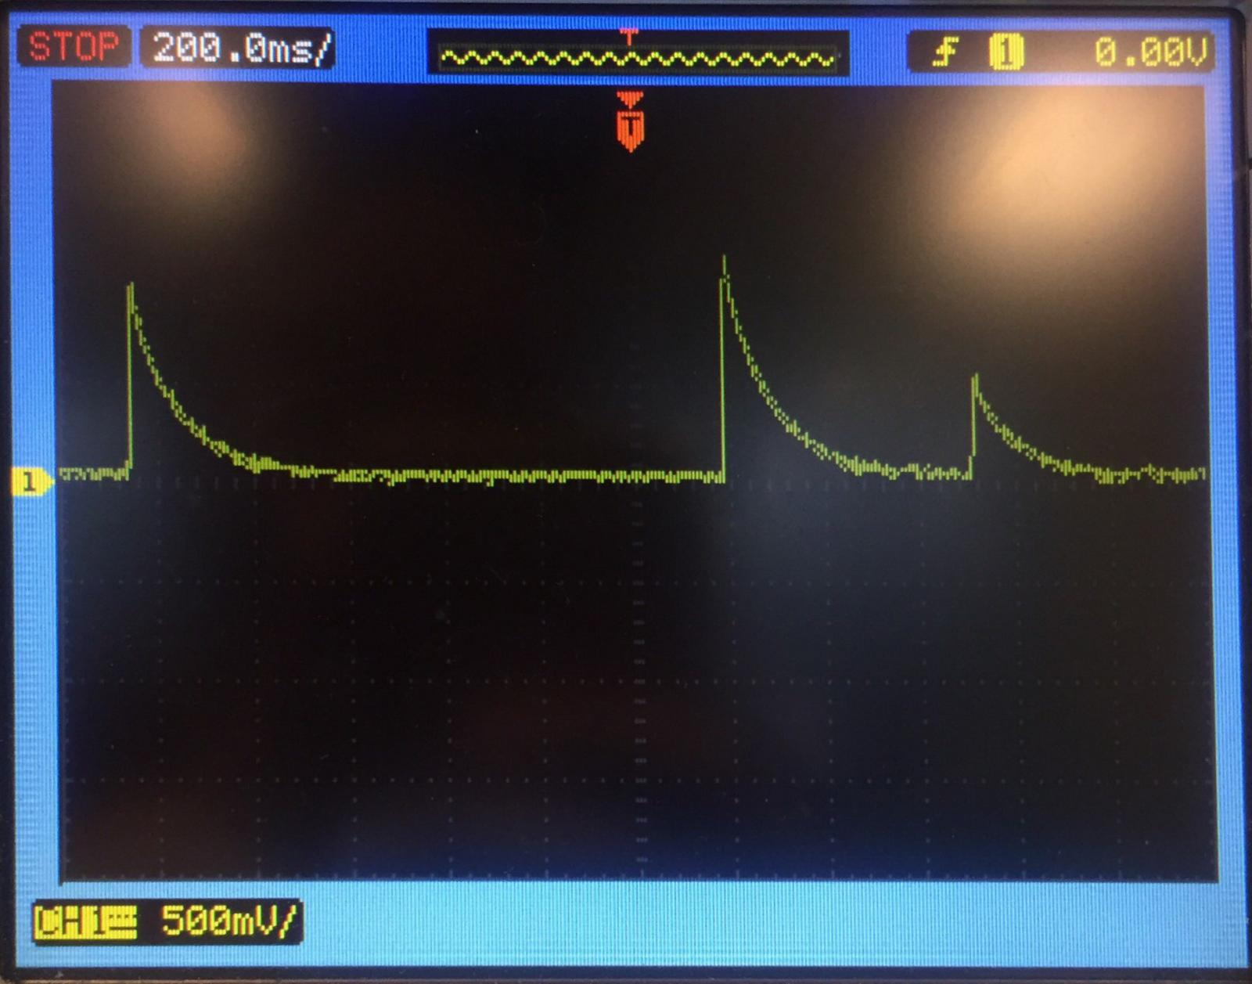
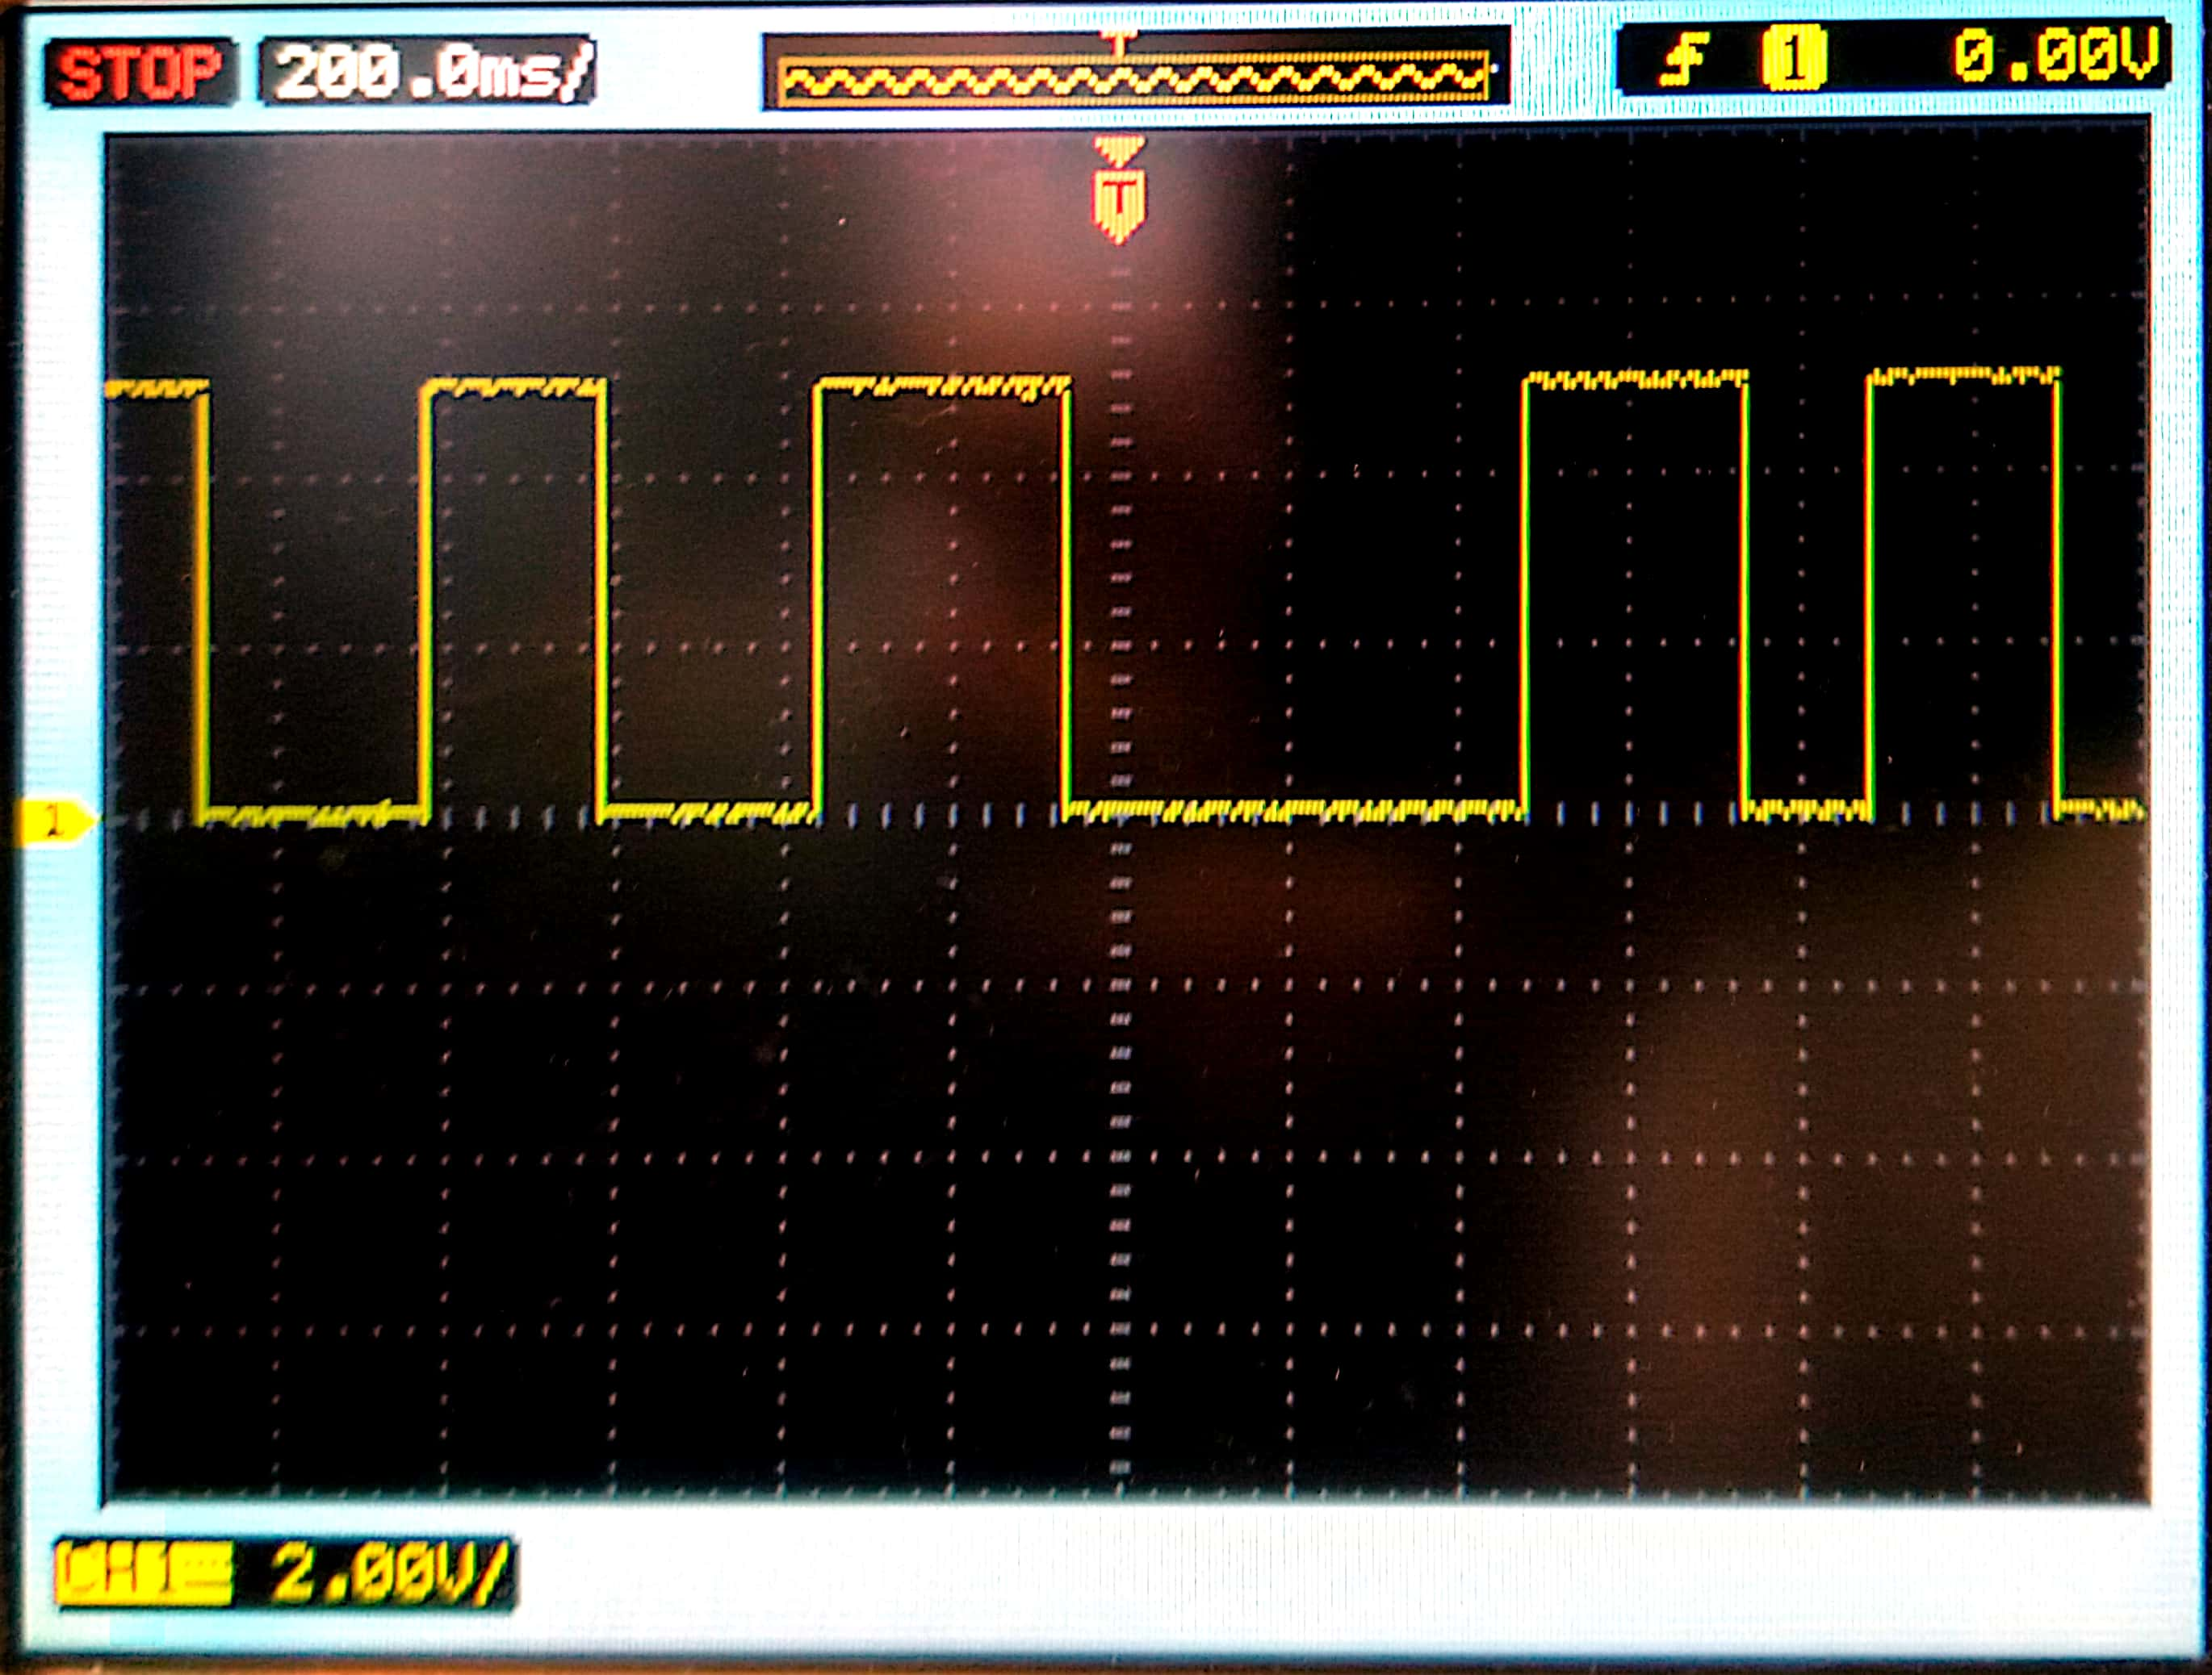
Pin outputs
Audio Pin Output
Envelope Pin Output
Gate Pin Output

Slide 5
Arduino Functionality

Slide 6
Code and TIVA Replication

Slide 7
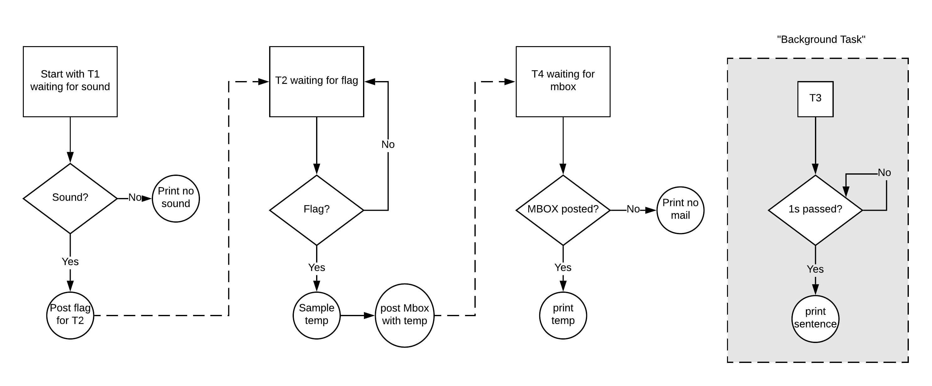
Flow Chart

Slide 8
References
SparkFun Sound Detector (with Headers)
https://www.sparkfun.com/products/14262

