Slide 1
Woofy.com Software Architecture

Slide 2



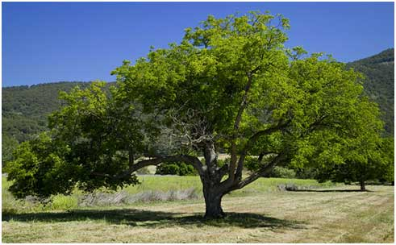
Current Woofie.com Architecture
browser
web pages + images
Internet
Apache
web server
PHP
App Logic
Local file system
Data Cache
Database
Web Server
Database Server

Slide 3
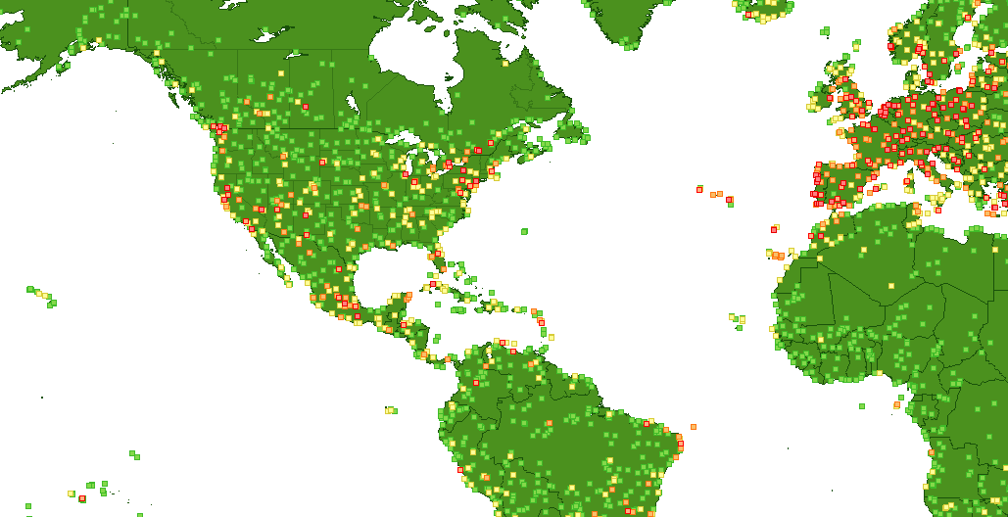
browser
PHP Code Architecture
Flash “map”
web pages +
images
Internet
Web Server
Database
Server
Apache web server
www/html/8fce4f21d/…
Admin.php (router); /include has tons of php files
All db access, html gen, etc!!! MUSHED TOGETHER
www/html/index.php &
www/includes/services.php
www/flashservices
Everything:
Db access, “tag libs”
Echo “xml”, HTML header(bla)
URL “router”
Data Cache
www/classes
www/includes
Php “classes”:
Db access
“tag libs”
Echo “html”
HTML header(bla)
Local file system
Logic “controllers”
Mish mash of shtuff
Some “framework” support
Some output of headers, html
www/forum (miniBB)
Everything:
Db access
“tag libs”
Echo “html”
HTML header(bla)
PHP

Slide 4
Views/HTML/JavaScript Architecture
www/html/swf
www/html/js
Map_home.swf
Map_sidebar.swf
Video.swf
Blog.js
BlogArchive.js
… (20+ files)
Each is one or more “objects”
Lots of embedded generation of HTML using DOM API!
“library.js” – homebrew stuff similar to some of jQuery
www/html/css
Normal css stuff
www/html/flv
Some .flv files
www/html/docs
www/html/8fce4721d/admin.php
www/html/8fce4721d/includes/…
Some .pdf articles with images and text
The admin tool
This contains all: database access, UI templates,
Generation of HTML/JavaScript, etc.
www/error
All the error pages (404, etc.) in all languages
www/templates
These look like “smarty” templates. Maybe not
Anyhow, instead of representing entire pages, they are just “snippets” of generated HTML. The BULK!!! Of html is generated “inline” from within the controllers in the www/includes/… folder.

Slide 5
Flash Services Back-End Architecture
www/flashservices
Contains all AMF-PHP magic that allows Flash client to invoke server-side objects as if they were Flash objects.
www/flashservices/browser/*
Client-side .swfs and such you load into the browser to permit AMF-PHP communications
Cities.php ACTIONS:
getCities ()
getCitiesCache ()
getCitiesByArea ()
getZoomLevel ()
getCitiesByTravelBlogId ()
getInfo ()
www/flashservices/core/*
Open-source, magic AMF PHP plumbing / framework
www/flashservices/xml-rpc.php (or is it gateway.php?)
“Front controller” (aka router aka dispatcher)
Info.php ACTIONS:
getStatus ()
www/flashservices/services/Cities.php
www/flashservices/services/Info.php
www/flashservices/services/Photos.php
www/flashservices/services/Users.php
Photos.php ACTIONS:
getPhotos ()
Hand-coded “domain/logic” classes for woophy
These contain all the database access and such.
Users.php ACTIONS:
getInfo ()

Slide 6
browser
Flash “map” (bunch of Flash objects)
Flash “map” Architecture
SearchService
TravelBlog
LinkBar
Map
SearchResult
???
Cities.getCitiesByTravelBlogId ()
Info.getStatus ()
Info.getStatus ()
Cities.getCitiesCache ()
Cities.getCities ()
Cities.getCitiesByArea ()
Users.getInfo ()
Cities.getInfo ()
RemoteServlet
Internet
Web Server
Database
Server
Apache web server
www/flashservices/*
gateway.php (router)
Cities.php
Info.php
Gateway.php (router)
Photos.php
Users.php
PHP

Slide 7
Data Model
abuse_reports
cities
messages
status
advertising_ads
cityoftheday
photo_tags
tellafriend_posts
ambassadors
contest_entries
photo_tag2photo
travelblogs
awards
contest_votes
photo_comments
tipoftheday
blog_newsletters
ecard_posts
photos
users_deleted
blog_user2category
editors_picks
photo2category
users
blog_comments
favorite_photos
photo_folders
blog_posts
favorite_users
photos_trash
blog_photos
language_name
rating

Slide 8
Data Model: “Photos” Subject Area
photo_tags
contest_entries
photo_tag2photo
contest_votes
photo_folders
editors_picks
photos
photo_comments
users
favorite_photos
rating
blog_photos
photos_trash
photo2category
blog_posts

Slide 9
Data Model: “Users” Subject Area
contest_entries
blog_comments
blog_posts
contest_votes
messages
tellafriend_posts
ambassadors
favorite_photos
awards
users
photo_comments
photos
editors_picks
abuse_reports
users_deleted
favorite_users

Slide 10
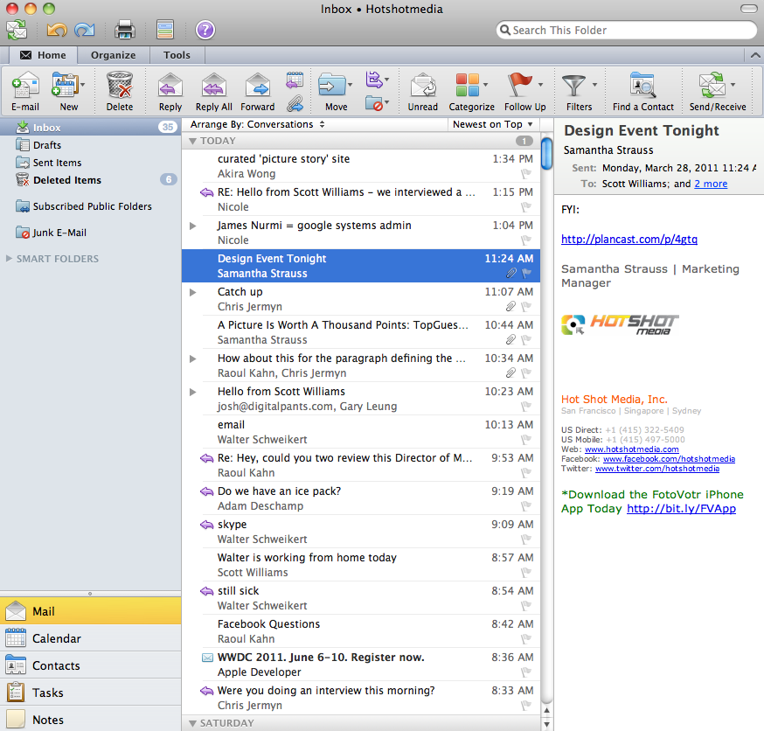

New Woophy Network Architecture
user’s “inbox”
browser
images
email
notifications
web pages
Woophy Images
CDN
Woophy Web Server
RDS (database)

Slide 11
New Woophy Images CDN (content delivery network)
browsers
images
http://cdn.hotshotmedia.com
This is a world-wide
Amazon-hosted
CDN (this ensures fast
access of all HSM images
from anywhere!)
CloudFront server
CloudFront server
CloudFront server
CloudFront
S3 Images Store

