Slide 1
Predicting TPG Ridership
Can we predict ridership ?
Patrick Romand — September 2025

Slide 2
Introduction
Goal: Predict daily ridership on Geneva's TPG network
Approach: global model comparison (total network ridership), followed by a local stop-level case study.

Slide 3
Data Sources
TPG Open Data (stops, ridership)
Weather data (Open-Meteo)
Calendar: public holidays
Volume: ~4.8 million rows (2021–2025)

Slide 4
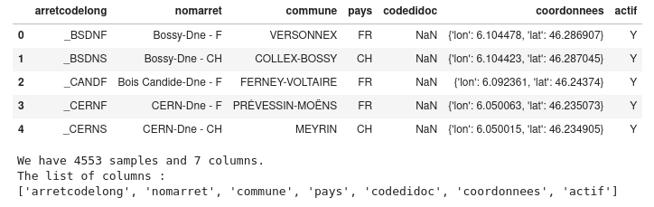
The network
The stops dataset was mainly used for exploration and visualization with Folium, as a first step to get familiar with the TPG network.

Slide 5
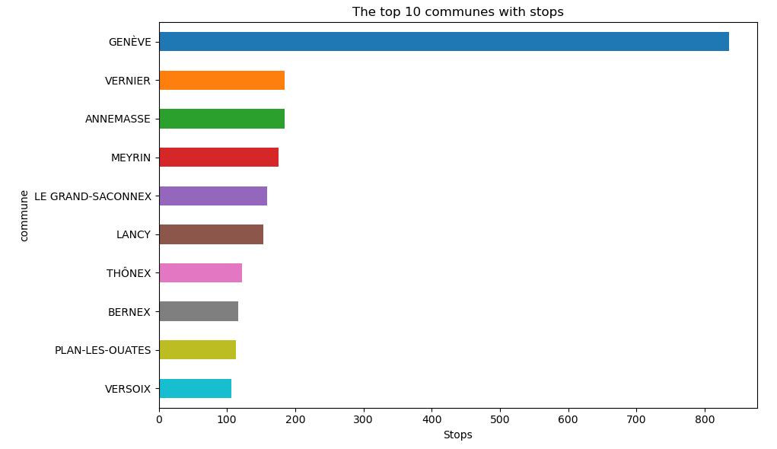
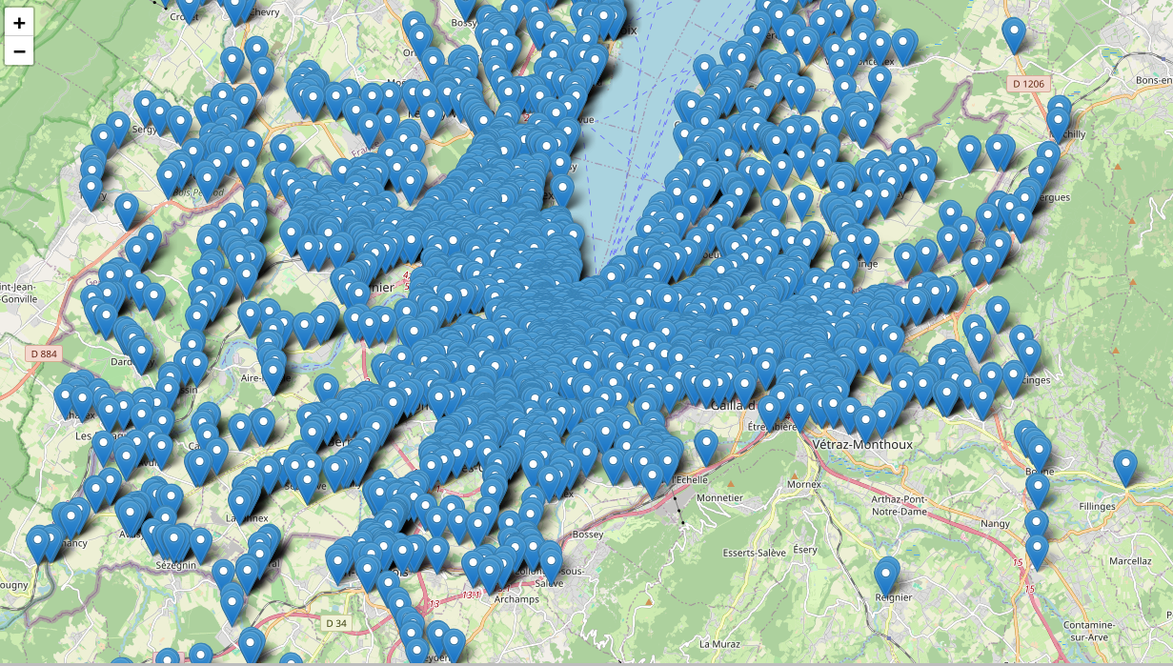
Where are TPG stops distributed?
Geneva has significantly more stops than the other municipalities.
Geneva has significantly more stops than the other municipalities.
The stops are concentrated in the canton of Geneva, with a few located far outside the canton.

Slide 6
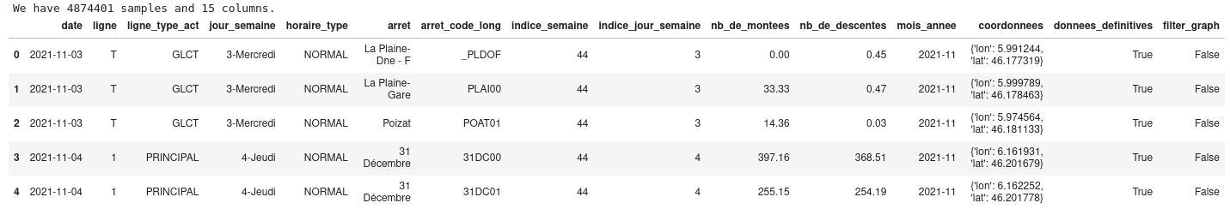
The ridership
I will use the datasets "montees-par-arret-par-ligne" (boardings per stop per line)."
The data covers the date range from 2021-08-01 00:00:00 to 2025-06-22 00:00:00

Slide 7
Exploratory Data Analysis
The time data needs to be converted to Datetime.
Data validation (features)
Merging sources : ridership, weather, calendar
Handle missing values and duplicate
Feature creation : type of vehicle

Slide 8
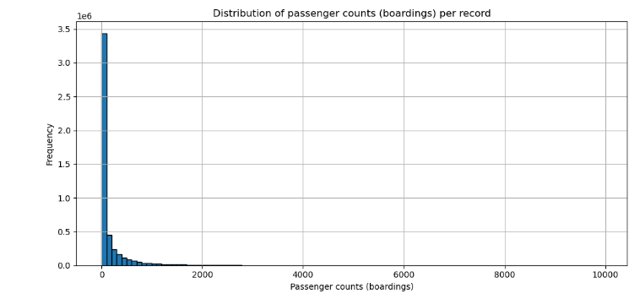
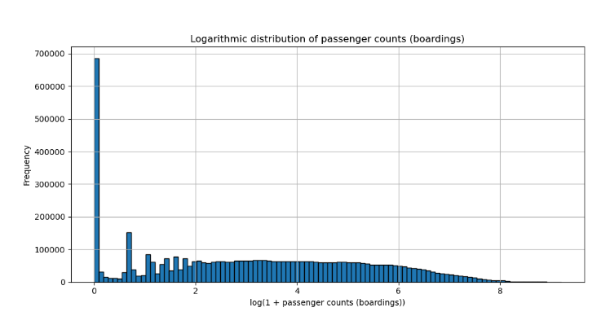
How the boarding are distributed?
Huge concentration of values between 0 and 200 passenger counts (boardings) per record.
A very long tail (skewed distribution): few cases go beyond 1,000, and even fewer beyond 5,000.
There are more than 3 million points between 0 and ~200 — showing an over-density of stops with
low passenger counts (boardings) or off-peak periods.
After log transformation, the long tail is reduced and passenger counts are more evenly distributed, improving model performance.

Slide 9
EDA : conclusion
I have a clean initial dataset: no duplicates and very few missing values.
I observed that some features are not useful (for example: ‘filter_graph’) or redundant (‘jour_semaine’), so I removed them.
I also noticed that the distribution of passenger counts (boardings) and passenger counts (alight-ings) is highly skewed. A logarithmic transformation can help the models by reducing this skewness.
Based on this, I created new variables: the sum of passenger counts (boardings) and passenger counts (alightings) to represent the total ridership, and the difference between them to provide insights into passenger flows.

Slide 10
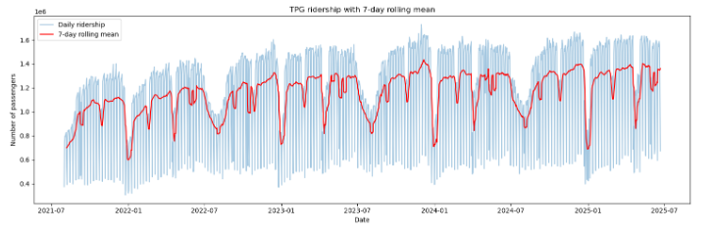
Analyze the ridership data to identify temporal patterns
Temporal Patterns
The 7-day rolling mean smooths daily variations, clearly showing weekly seasonality, recurring drops during holidays, and the overall upward trend from 2021 to 2025.

Slide 11
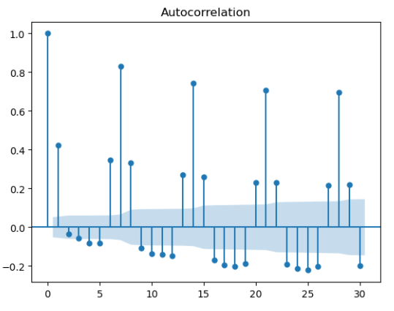
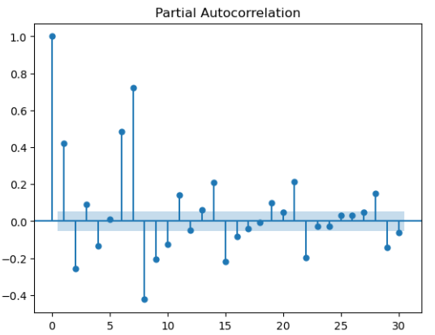
Autocorrelation of the data
The long-term graph shows repetitive effects.
Do these effects also appear on a smaller scale?
The ACF plot shows the global correlations between daily passenger counts and their lagged values.
• Significant peaks at lags 7, 14, 21, and 28 indicate a clear weekly periodicity.
• This means that passenger counts on a given day are strongly correlated with the same weekday in previous weeks.
• This is typical of human mobility patterns: commuting during weekdays and lower activity on weekends.
There are strong weekly temporal dependencies, which supports: the use of lag features such as frequentation_lag_7, frequentation_lag_14.
Notes:
📝 Notes du présentateur – Slide Lag features (lag_1, lag_7)
Contexte : On cherche à améliorer la prédiction de la fréquentation journalière.
Idée clé : La fréquentation d’un jour dépend fortement des jours précédents.
À expliquer oralement :
lag_1 → correspond à la fréquentation de la veille.
lag_7 → correspond à la fréquentation du même jour la semaine précédente.
Le graphe temporel montre que les valeurs suivent des tendances similaires d’un jour à l’autre et d’une semaine sur l’autre.
Les corrélogrammes (ACF et PACF) confirment statistiquement ces dépendances :
ACF : corrélation forte aux lags multiples de 7 (périodicité hebdomadaire).
PACF : seuls lag 1 et lag 7 ressortent vraiment comme déterminants → ce sont les plus utiles pour le modèle.
Conclusion à dire :
👉 “Ces observations justifient la création des variables lag_1 et lag_7, qui deviennent des prédicteurs essentiels pour nos modèles de Machine Learning.”

Slide 12
Final Dataset
At the end of the EDA, two datasets were obtained: TPG_meteo_all_df and global_daily_df.
global_daily_df is designed to address global and daily-level problems.
TPG_meteo_all_df allows for a more detailed analysis of passenger counts.

Slide 13
To ensure consistency between the two datasets, they will be enriched with cross-features:
- global_daily_df: add daily weather, temporal variables, and logarithmic transformations.
- TPG_meteo_all_df: add lagged variables.

Slide 14
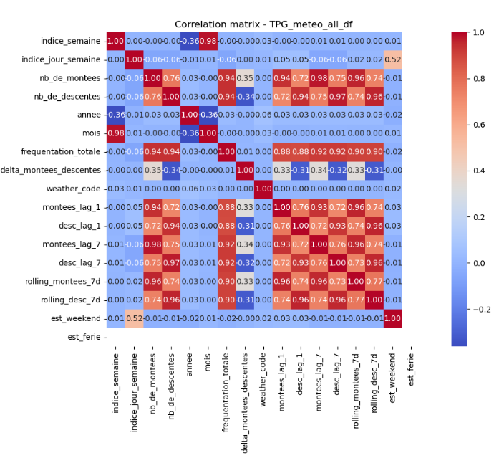
Weather impact analysis
Is there a correlation between ridership and weather?
The weather_code variable remains very weakly correlated with the others (<0.1).
The potential impact of weather on the models will be examined in the next chapter...

Slide 15
Modeling Daily Passenger Counts with Machine Learning
The goal is to model and compare different Machine Learning approaches using the global_daily_df dataset.
This dataset aggregates daily passenger counts (boardings and alightings) across the entire TPG Network.
The objectives are:
- to evaluate the ability of different models to capture temporal and contextual patterns in the data,
- to compare their performance using standard metrics (MAE, RMSE, R²).
This work will provide insights into the strengths and limitations of several Machine Learning models when applied to public transport demand forecasting.
We will implement and compare several Machine Learning models, using a consistent pipeline for preprocessing and evaluation.
The analysis is limited to daily aggregated data.
Stop-level details are addressed in the next notebook.

Slide 16
Machine Learning Methodology
Time-based split (train/valid/test)
Sectect the features
Models: Baseline, Ridge, Decision Tree, Random Forest, k-NN, Neural Networks
Metrics: MAE, RMSE, R² (log & real scale)

Slide 17
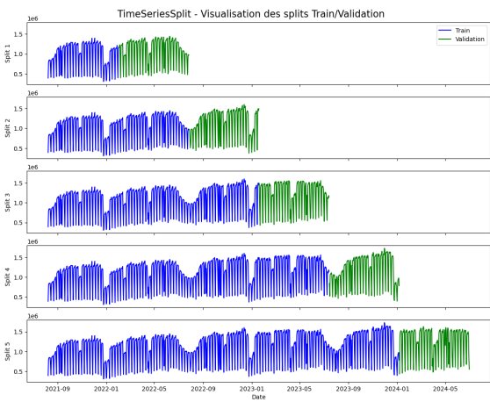
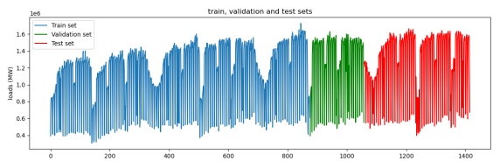
Splitting the data
For a time series, the chronological order must be preserved — we do not shuffle the rows.
The dataset should be split sequentially into
train → validation → test.
Fixed split by defining explicit temporal boundaries.
TimeSeriesSplit for cross-validation, which allows splitting the training set into several
train/validation folds while preserving temporal order.

Slide 18
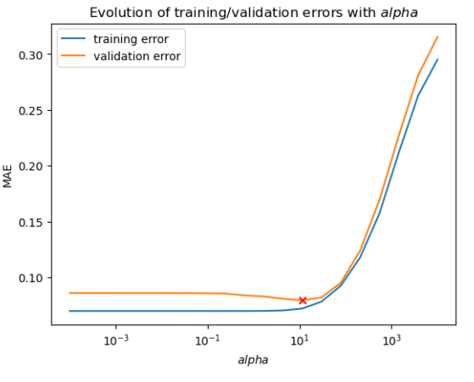
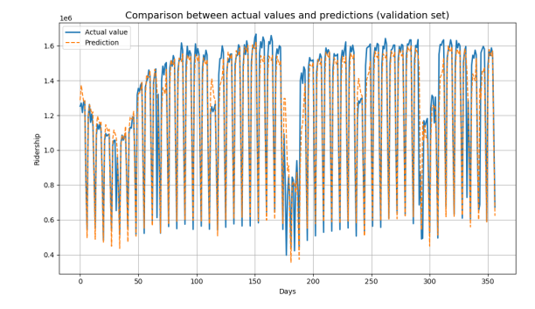
Focus on the Ridge model
The model captures the general dynamics of daily ridership well, including seasonal variations and
weekly patterns.
However, discrepancies remain during some peaks and troughs, where the predictions tend to
underestimate or overestimate the actual values.
I used GridSearchCV to tune the alpha parameter.
The MAE remains stable for small values of alpha and starts to increase significantly when alpha becomes too large.
The optimal performance is reached around alpha = 10, where the validation error is minimized.

Slide 19
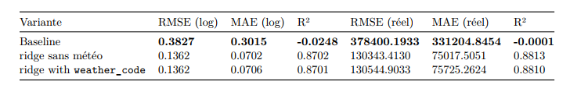
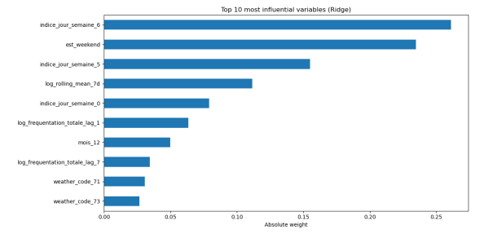
Which features are the most influential?
Analyzing the influence of weather
The most influential variables are linked to the day of the week (indice_jour_semaine_6, indice_jour_semaine_5, indice_jour_semaine_0) and the weekend indicator (est_weekend).
• Temporal features such as the 7-day rolling mean and lagged passenger counts (log_frequentation_totale_lag_1, log_frequentation_totale_lag_7) also play an important role.
• Weather variables (weather_code_71, weather_code_73) appear in the Top 10 but with relatively low influence.
Weekly seasonality and past ridership values are the dominant drivers in the Ridge model, while the impact of weather remains marginal

Slide 20
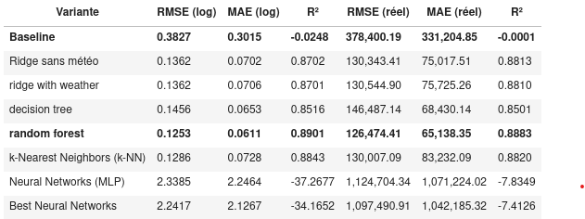
Results
Random Forest provides the best compromise between accuracy and robustness, followed closely by Ridge regression (simpler and more interpretable).
Weather variables have limited additional value, while temporal and calendar features remain the dominant drivers.

Slide 21
Practical case study
The objective is to answer a concrete question such as:
“How many boardings at stop XXX on line YYY on date ZZZ?”
However, I was not able to implement a simple function that correctly recomputes the lag variables for the future period.
Therefore, I chose another approach: truncate the dataset up to June 19, 2025, estimate the number of boardings for June 20, 2025, and then compare this prediction with the actual value contained in the original dataset.

Slide 22
methodology
Truncate the dataset TPG_daily_df at June 19, 2025 in order to exclude the day of June 20.
Actual vs Predicted Comparison
Load dataset TPG_daily_df
Store the June 20, 2025 into a separate dataset to compare the final result
Split dataset
Train the model
Predict the June 20 with the model

Slide 23
Results
Question: boardings at RIVE00 (L12) on 20/06/2025?
Model : Ridge with GridSearCV
Model prediction : 3,353.95
Actual value : 3,320.14
Absolute error : 33.81 (1.02 %)
This corresponds to a 1% difference.

Slide 24
Conclusion
• ML models can predict ridership with high accuracy
• Temporal and calendar effects dominate
• Random Forest = best performance, Ridge chosen for case study (robust & efficient)
Future work: integrate real-time data, detect exceptional events
Notes:
This project also gave me the opportunity to experiment with different models, face concrete
computational constraints, and confirm the importance of a pragmatic approach to modeling. I
also realized that there are always further opportunities for improvement or optimization, but at
some point it is necessary to conclude the work.

