Slide 1
MTH 3105: Discrete Mathematics
Propositional Logic
Rosen 1.1 – 1.3
Lecture 2: Sept 4

Slide 2
Logic
Crucial for mathematical reasoning
Used for designing electronic circuitry
Logic is a system based on propositions.
A proposition is a statement that is either true or false (but not both).
We say that the truth value of a proposition is either true (T) or false (F).
Corresponds to 1 and 0 in digital circuits

Slide 3
Common connectives
¬ or ~ Negation (not)
∧, &, · Conjunction (and)
∨ Disjunction (or)
⊕ Exclusive or (xor)
→, ⇒, or ⊃ Implication (if…then)
↔, ≡, or = Bi-conditional (if and only if)
Bi-implication (iff)

Slide 4
Truth Tables
Negation (NOT)
Unary Operator, Symbol: ¬
P | ¬P
True | False
False | True

Slide 5
Conjunction (AND)
Binary Operator, Symbol: ∧
P | Q | P∧Q
T | T | T
T | F | F
F | T | F
F | F | F

Slide 6
Disjunction (OR)
Binary Operator, Symbol: ∨
P | Q | P∨Q
T | T | T
T | F | T
F | T | T
F | F | F

Slide 7
Exclusive Or (XOR)
Binary Operator, Symbol: ⊕
P | Q | P⊕Q
T | T | F
T | F | T
F | T | T
F | F | F

Slide 8

Conditional Statement
If p then q
p is called the hypothesis; q is called the conclusion
The department says:
“If your GPA is 4.0, then you don’t need to pay tuition fee.”
When is the above sentence false?
It is false when your GPA is 4.0 but you still have to pay tuition fee.
But it is not false if your GPA is below 4.0.
Another example: “If there is typhoon T8 today, then there is no class.”
When is the above sentence false?

Slide 9
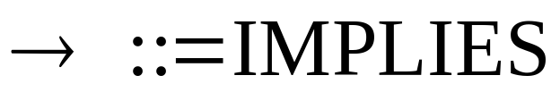

Logic Operator
P
Q
P Q
T
T
T
T
F
F
F
T
T
F
F
T
Convention: if we don’t say anything wrong, then it is not false, and thus true.

Slide 10
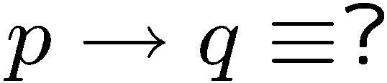
If-Then as Or
Idea 1: Look at the truth rows,
and take the “and”.
P
Q
P Q
T
T
T
(P ∧ Q) ∨ (¬P ∧ Q) ∨ (¬P ∧ ¬Q)
T
F
F
≡ (P ∧ Q) ∨ [¬P ∧ (Q ∨ ¬Q)]
F
T
T
≡ (P ∧ Q) ∨ [¬P ∧ T]
F
F
T
≡ (P ∧ Q) ∨ ¬P
≡ (P ∨ ¬P ) ∧ (Q ∨ ¬P)
≡ T ∧ (Q ∨ ¬P)
≡ Q ∨ ¬P

Slide 11


If-Then as Or
P
Q
P Q
Idea 2: Look at the false rows,
negate and take the “and”.
T
T
T
T
F
F
F
T
T
F
F
T
If you don’t give me all your money, then I will kill you.
Either you give me all your money or I will kill you (or both).
If you talk to her, then you can never talk to me.
Either you don’t talk to her or you can never talk to me (or both).

Slide 12
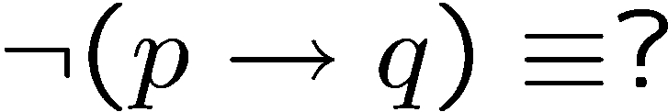




Negation of If-Then
If your GPA is 4.0, then you don’t need to pay tuition fee.
Your term GPA is 4.0 and you still need to pay tuition fee.
If my computer is not working, then I cannot finish my homework.
My computer is not working but I can finish my homework.
previous slide
DeMorgan

Slide 13
Precedence of Logic Operators
Operator
Precedence
¬
1
∧
2
∨
3
→
4
↔
5

Slide 14
Converse, contrapositive and inverse
For conditional statement p → q
  Converse: q → p
  Contrapositive: ¬q → ¬p
  Inverse: ¬p → ¬q
Contrapositive and conditional statements are equivalent

Slide 15
Contrapositive
The contrapositive of “if p then q” is “if ~q then ~p”.
Statement: If you are a CS year 2 student,
then you are taking MTH 3105.
Contrapositive: If you are not taking MTH 3105,
then you are not a CS year 2 student.
Statement: If x² is an even number,
then x is an even number.
Contrapositive: If x is an odd number,
then x² is an odd number.
Fact: A conditional statement is logically equivalent to its contrapositive.

Slide 16










Proofs
Statement: If P, then Q
Contrapositive: If Q, then P.
T | T | T
T | F | F
F | T | T
F | F | T
F | F | T
T | F | F
F | T | T
T | T | T

Slide 17
If, Only-If
You will succeed if you work hard.
You will succeed only if you work hard.
r if s means “if s then r”
We also say s is a sufficient condition for r.
r only if s means “if r then s”
We also say s is a necessary condition for r.
You will succeed if and only if you work hard.
p if and only if (iff) q means p and q are logically equivalent.

Slide 18





Math vs English
Parent: if you don’t clean your room, then you can’t watch a DVD.
C
D
This sentence says
So
In real life it also means
Mathematician: if a number x greater than 2 is not an odd number,
then x is not a prime number.
This sentence says
But of course it doesn’t mean

Slide 19
Necessary, Sufficient Condition
Mathematician: if a number x greater than 2 is not an odd number,
then x is not a prime number.
This sentence says
But of course it doesn’t mean
Being an odd number > 2 is a necessary condition for this number to be prime.
Being a prime number > 2 is a sufficient condition for this number to be odd.

Slide 20
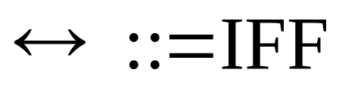




Necessary AND Sufficient Condition
P
Q
P Q
T
T
T
T
F
F
F
T
F
F
F
T
Note: P Q is equivalent to (P Q) (Q P)
Note: P Q is equivalent to (P Q) ( P Q)
Is the statement “x is an even number if and only if x² is an even number” true?

Slide 21

Argument
An argument is a sequence of statements.
All statements but the final one are called assumptions or hypothesis.
The final statement is called the conclusion.
An argument is valid if:
whenever all the assumptions are true, then the conclusion is true.
If today is Wednesday, then yesterday is Tuesday.
Today is Wednesday.
Yesterday is Tuesday.

Slide 22
Modus Ponens
If p then q.
p
q
If typhoon, then class cancelled.
Typhoon.
Class cancelled.
assumptions
conclusion
p | q | p→q | p | q
T | T | T | T | T
T | F | F | T | F
F | T | T | F | T
F | F | T | F | F
Modus ponens is Latin meaning “method of affirming”.

Slide 23
Modus Tollens
If p then q.
~q
~p
If typhoon, then class cancelled.
Class not cancelled.
No typhoon.
assumptions
conclusion
p | q | p→q | ~q | ~p
T | T | T | F | F
T | F | F | T | F
F | T | T | F | T
F | F | T | T | T
Modus tollens is Latin meaning “method of denying”.

Slide 24
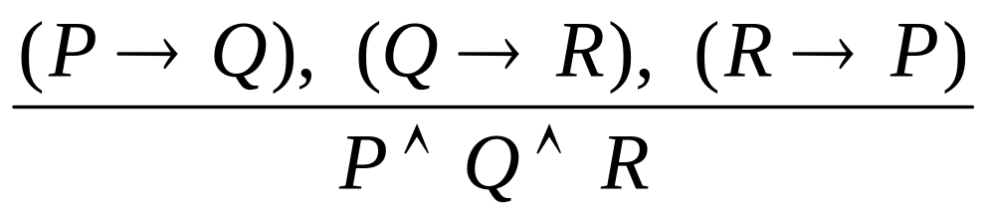
Equivalence
A student is trying to prove that propositions P, Q, and R are all true.
She proceeds as follows.
First, she proves three facts:
  P implies Q
  Q implies R
  R implies P.
Then she concludes,
``Thus P, Q, and R are all true.''
Proposed argument:
assumption
Is it valid?
conclusion

Slide 25




Valid Argument?
Is it valid?
assumptions
conclusion
P | Q | R
T | T | T
T | T | F
T | F | T
T | F | F
F | T | T
F | T | F
F | F | T
F | F | F
T | T | T
T | F | T
F | T | T
F | T | T
T | T | F
T | F | T
T | T | F
T | T | T
 | OK?
T | yes
F | yes
F | yes
F | yes
F | yes
F | yes
F | yes
F | no
To prove an argument is not valid, we just need to find a counterexample.

Slide 26
Valid Arguments?
assumptions
conclusion
p | q | p→q | q | p
T | T | T | T | T
T | F | F | F | T
F | T | T | T | F
F | F | T | F | F
If p then q.
q
p
Assumptions are true, but not the conclusion.
If you are a fish, then you drink water.
You drink water.
You are a fish.

Slide 27
Valid Arguments?
assumptions
conclusion
p | q | p→q | ~p | ~q
T | T | T | F | F
T | F | F | F | T
F | T | T | T | F
F | F | T | T | T
If p then q.
~p
~q
If you are a fish, then you drink water.
You are not a fish.
You do not drink water.

Slide 28


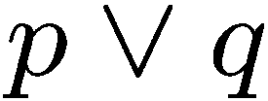
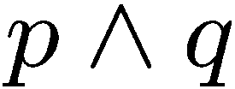



Exercises

Slide 29




More Exercises
Valid argument True conclusion
True conclusion Valid argument

Slide 30
Tautologies and Contradictions
A tautology is a statement that is always true.
Examples:
  R∨(¬R)
  ¬(P∧Q)↔(¬P)∨(¬Q)
If S→T is a tautology, we write S⇒T.
If S↔T is a tautology, we write S⇔T.

Slide 31
Tautologies and Contradictions
A contradiction is a statement that is always false.
Examples:
  R∧(¬R)
  ¬(¬(P∧Q)↔(¬P)∨(¬Q))
The negation of any tautology is a contradiction, and the negation of any contradiction is a tautology.

Slide 32

Contradiction
If you can show that the assumption that the statement
p is false leads logically to a contradiction,
then you can conclude that p is true.
You are working as a clerk.
If you have won Mark 6, then you would not work as a clerk.
You have not won Mark 6.

Slide 33
Logical Equivalences (1)
1. ¬¬p ⟺ p
double negation
2a. (p ∨ q) ⟺ (q ∨ p)
commutative laws
b. (p ∧ q) ⟺ (q ∧ p)
c. (p ⟷ q) ⟺ (q ⟷ p)
3a. [(p ∨ q) ∨ r] ⟺ [p ∨ (q ∨ r)]
associative laws
b.[(p ∧ q) ∧ r] ⟺ [p ∧ (q ∧ r)]
4a. [p ∨ (q ∧ r)] ⟺ [(p ∨ q) ∧ (p ∨ r)]
distributive laws
b.[p ∧ (q ∨ r)] ⟺ [(p ∧ q) ∨ (p ∧ r)]
5a. (p ∨ p) ⟺ p
idempotent laws
b.(p ∧ p) ⟺ p
6a. (p ∨ 0) ⟺ p
identity laws (1-tautology, 0-contradiction)
b.(p ∨ 1) ⟺ 1
c.(p ∧ 0) ⟺ 0
d.(p ∧ 1) ⟺ p
7a. (p ∨ ¬p) ⟺ 1
b.(p ∧ ¬p) ⟺ 0

Slide 34
Logical Equivalences (2)
8a. ¬(p ∨ q) ⟺ (¬p ∧ ¬q)
DeMorgan laws
b.¬(p ∧ q) ⟺ (¬p ∨ ¬q)
c.(p ∨ q) ⟺ ¬ (¬p ∧ ¬q)
d.(p ∧ q) ⟺ ¬ (¬p ∨ ¬q)
9. (p ⟶ q) ⟺ (¬q ⟶ ¬p)
contrapositive
10a. (p ⟶ q) ⟺ (¬p ∨ q)
implication
b. (p ⟶ q) ⟺ ¬(p ∧ ¬q)
11a. (p ∨ q) ⟺ (¬p ⟶ q)
b. (p ∧ q) ⟺ ¬(p ⟶ ¬q)
12a. [(p ⟶ r) ∧ (q ⟶ r)] ⟺ [(p ∨ q) ⟶ r]
b. [(p ⟶ q) ∧ (p ⟶ r)] ⟺ [p ⟶ (q ∧ r)]
13. (p ⟷ q) ⟺ (p ⟶ q) ∧ (q ⟶ p)
equivalence
14. [(p ∧ q) ⟶ r] ⟺ [p ⟶ (q ⟶ r)]
exportation law
15. (p ⟶ q) ⟺ [(p ∧ ¬q) ⟶ 0)]
reductio ad absurdum

Slide 35
Knights and Knaves
Knights always tell the truth.
Knaves always lie.
A says: B is a knight.
B says: A and I are of opposite type.
Suppose A is a knight.
Then B is a knight (because what A says is true).
Then A is a knave (because what B says is true)
A contradiction.
So A must be a knave.
So B must be a knave (because what A says is false).

Slide 36

Which is true?
Which is false?
“The sentence below is false.”
“The sentence above is true.”

